Slide 1

Criw Iaith

Slide 2

Year 2
We Need You!

Slide 3

What we do in Criw Iaith?
We ask Welsh questions to the children and teachers on the yard with the iPad.

Slide 4

Every year we create videos to show the parents how to use reading eggs.
We give out the Seren Cymraeg certificates every Friday in our assembly

Slide 5
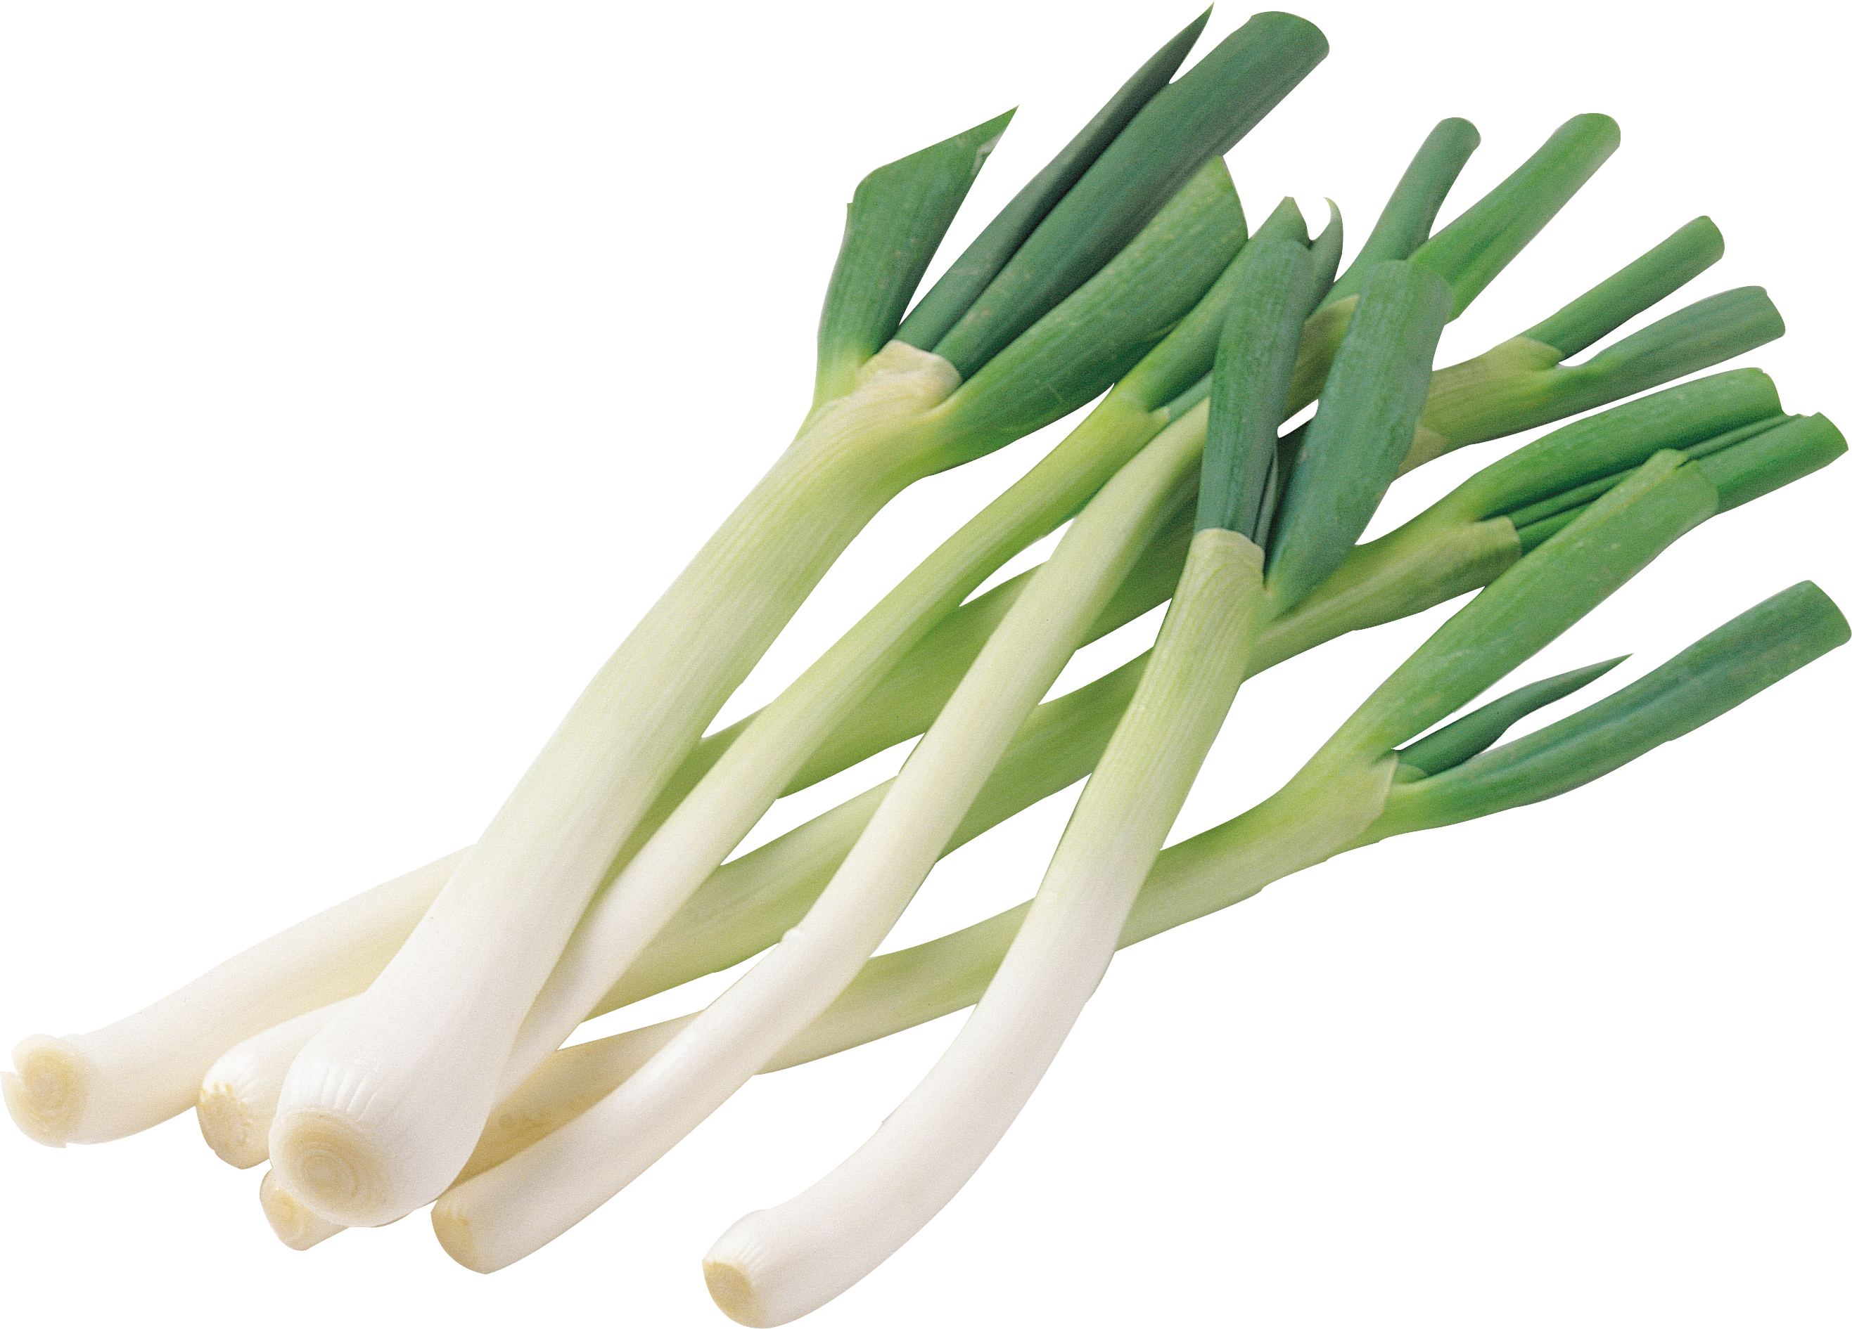
You need to be able to ask and answer Welsh questions.

Slide 6
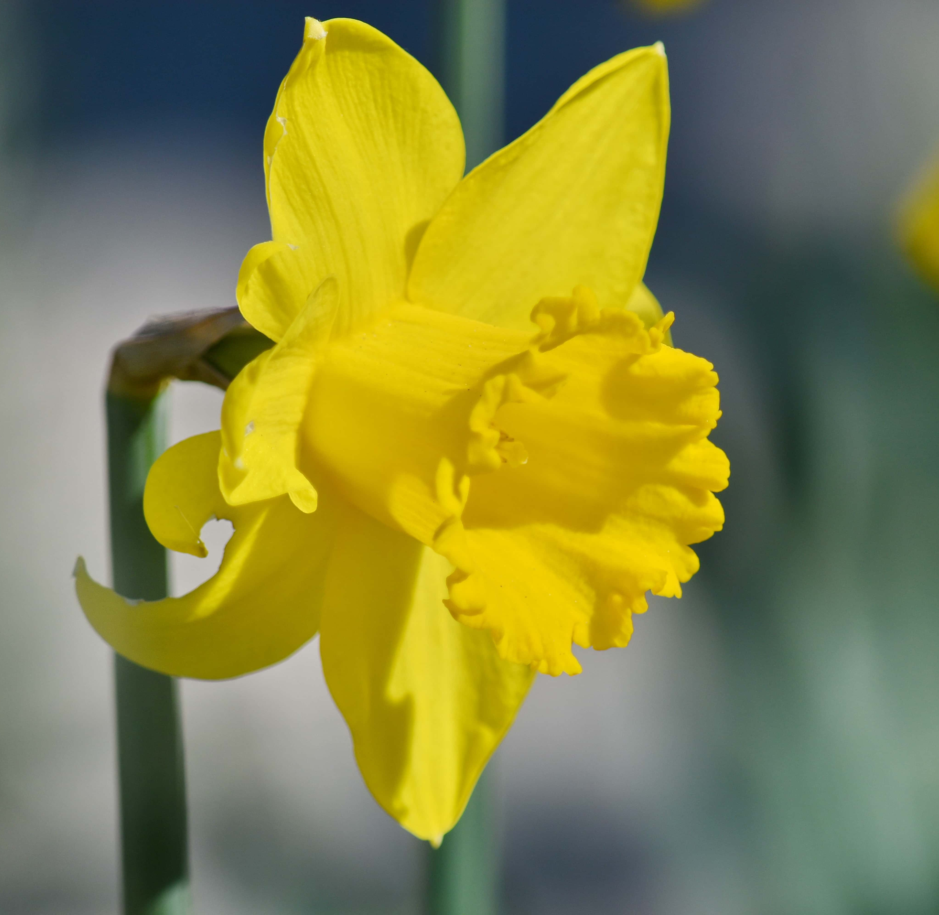
We play Welsh games at playtime and also create them.

Slide 7

How do you join Criw Iaith?
Let Miss Nicholas know if you want to join Criw Iaith.

