Slide 1
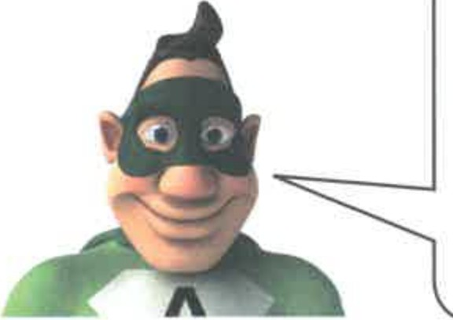
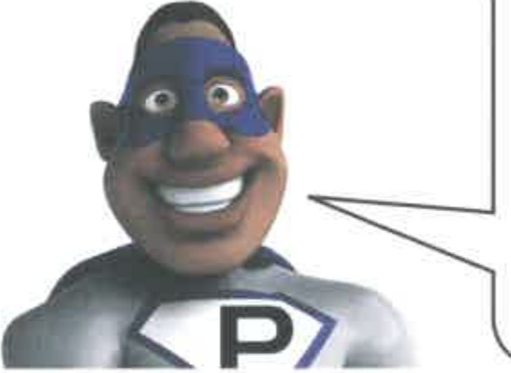



Aled and Pete plan their outfits.
My outfit needs 12 metres of silk.
J of that will be pink,
the rest will be red.
My outfit needs 12 metres of silk.
J of that will be purple,
the rest will be red.
Altogether, how many metres of red silk should they buy?
metres I
0
3m

Slide 2
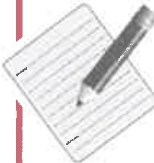
To make one outfit it takes:
1 hour and 15 minutes to cut
3 hours and 30 minutes to sew
15 minutes to iron.
Aled makes both outfits.
He must be finished by 6pm.
What is the latest time Aled can start making the first outfit?
I Start at
0
3m
0
TOTAL

Slide 3
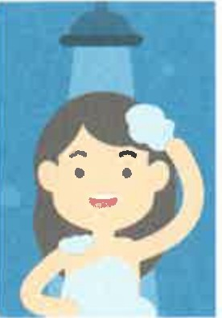
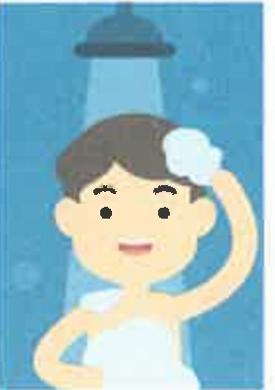

2 Power showers use more water than ordinary showers.
Ann's ordinary shower uses
9 litres of water in 1 minute.
Tom's power shower uses
18 litres of water in 1 minute.
Ann showers for 3 minutes. She uses ₋₋₋₋ litres of water. Tom showers for 3 minutes. He uses ₋₋₋₋litres of water.
0
1m
On another day, Ann showers for 10 minutes.
Tom uses the same amount of water as Ann. How long does Tom shower for?
minutes I
0
2m

Slide 4
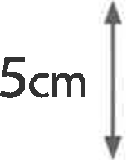


Draw more lines to divide the red square into
exactly two parts that are the same shape.
0
lm
G) Small cubes are 2cm high. Big cubes are 5cm high.
Mari stacks cubes on top of each other.
Show different ways she can make a stack 26cm high.
3 small cubes with bicgubes
or
small cubes with big cubes
or
0
small cubes with big cubes
3m
0
TOTAL

Slide 5
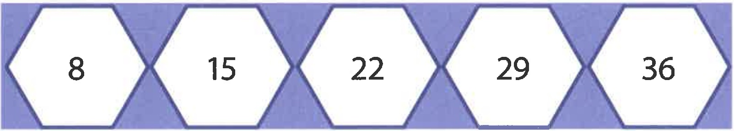
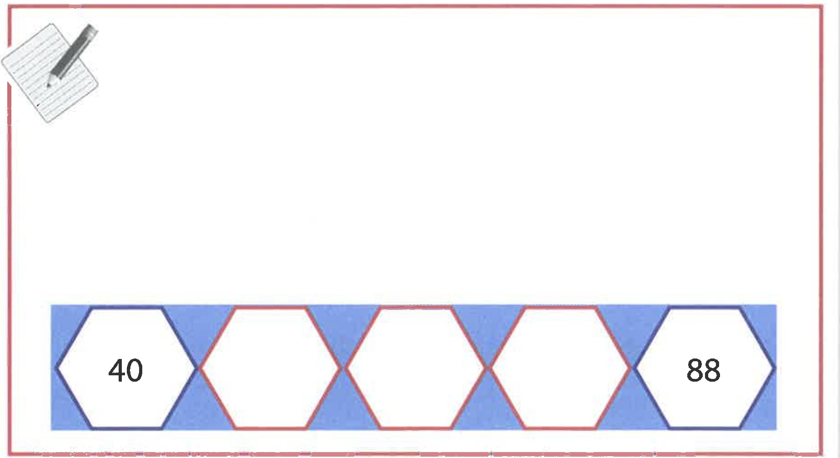





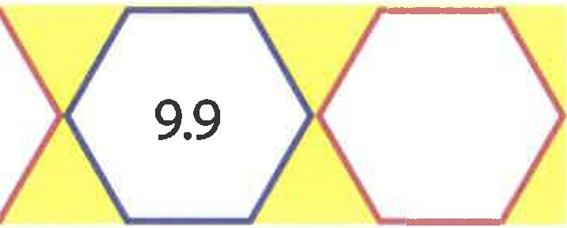
The numbers in these three sequences go up in equal steps.
Example:
Work out the missing numbers.
8.7
0
3m

Slide 6
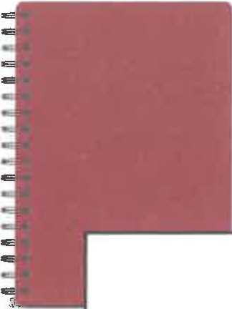



1 notepad
£1.15
1 pencil
95p
Lili has £10
She wants four notepads and as many pencils as possible.
How many pencils can she buy, and how much will be left over?
pencils I and
left over I
0
4m
0
TOTAL

Slide 7
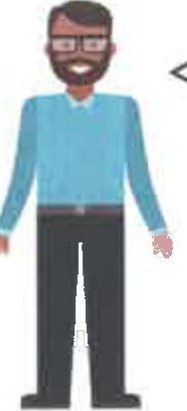
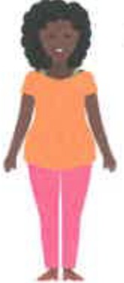
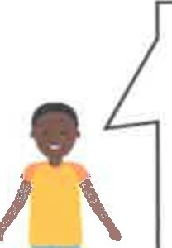
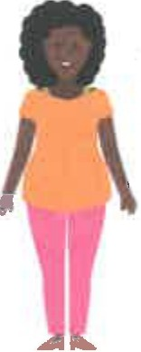
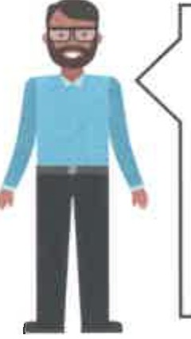
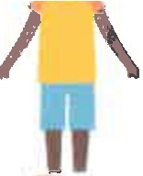
I get up first.
I get up
20 minutes after Dad.
I get up
25 minutes after Mum.
Dad
Mum
Rhys
[
6 : 40am J
Dad gets up at
so Rhys gets up at(
.•
0
lm
am]
They eat cereal.
I eat double the amount Rhys eats.
I eat
10 more grams than Mum.
� I choose.
Rhys
Mum
Dad
When Rhys eats 50 grams, Dad eats I
grams. I
0
lm
0
1m
When Dad eats 80 grams, Rhys eats I
grams. I

Slide 8
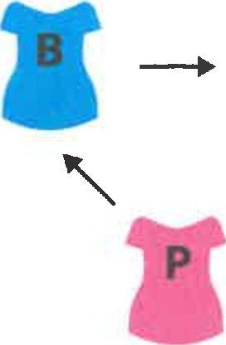





Order for T-shirts:
blue, orange, yellow, red, pink
Order for trousers:
pink, blue, orange
n
✓
---+
0
On 5th April Mum wears her blue T-shirt with pink trousers.
Write the next two dates when she wears her blue T-shirt.
0
S_th_A_pr_il_
...l.. _I
.....II .
lm
s_th_A_pri_l _I_I II _
Write the next two dates when she wears her pink trousers.
0
lm
Write the next two dates when she wears her blue T-shirt with pink trousers.
There are 30 days in April.
s_t_hA_p_ri_l I _I I _I .
0
2m
0
TOTAL

Slide 9
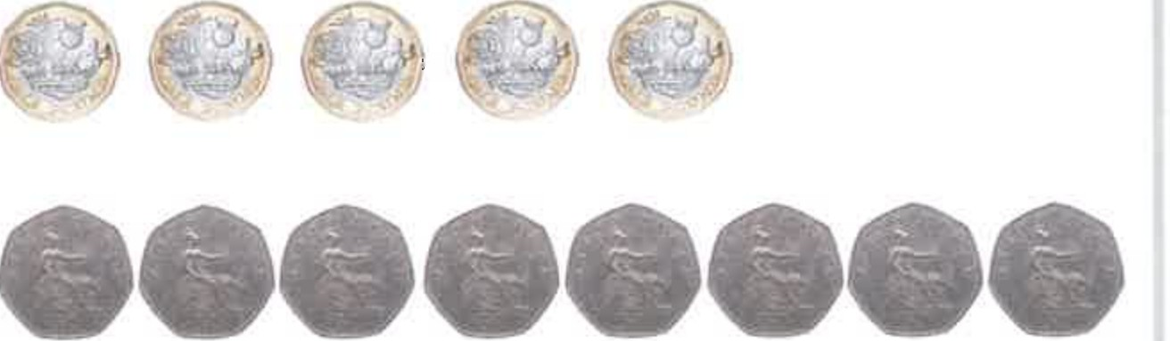
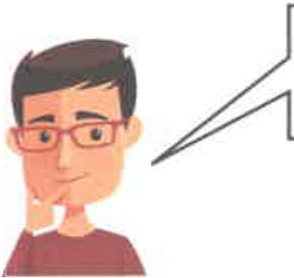

Tam has
five £1 coins and
eight SOp coins
Show different ways she can use her coins to pay exactly £3.50
Number of£ 1 coins | Number of 50p coins
0 | 7
1
0
2m
Seven years ago I was 28 years old.
How old will he be in seven years' time?
years old
0
2m

Slide 10
A robot moves on a grid.
The black lines -- show its path.
Complete the directions to show the robot's path.
'
Start
Start at ►,forward 1
turn | right | gQ⁰, forward | 2
turn | left | gQ⁰, forward
turn gQ⁰, forward
0
2m
turn gQ⁰, forward
The robot moves on a bigger grid.
Complete the directions to show the robot's path is a rectangle.
Start, forward 20
turn rightgQ⁰, forward 30
turn rightgQ⁰, forward _
0
turn rightgQ⁰, forward
---
1m
0
TOTAL

Slide 11
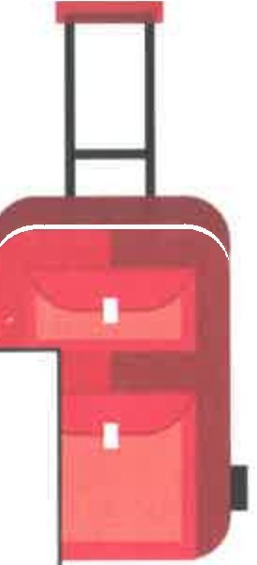
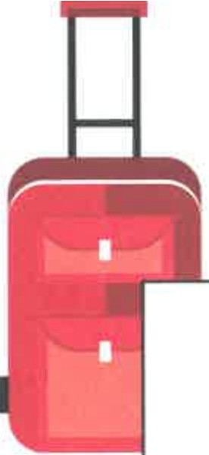
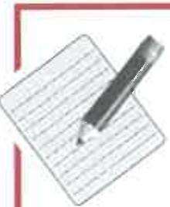
Mr and Mrs Hasan are going on holiday.
They pack two bags then weigh them.
Bag A
22kg
Bag B
17kg
They want the bags to weigh the same.
How many kilograms should they move from bag A to bag 8?
kilograms I
0
3m

Slide 12
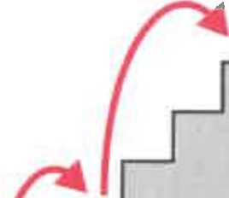
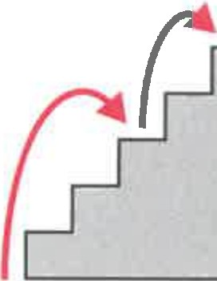
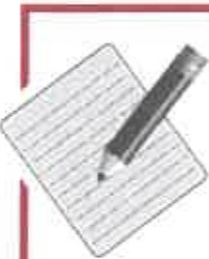
Beth always climbs steps 2 at a time or 3 at a time.
There are two different ways she can climb 5 steps.
and
2 steps, then 3
3 steps, then 2
There are more than two different ways she can climb 9 steps.
How many different ways are there? Show how you work it out.
9 steps,
2 at a time or 3 at a time
different ways I
0
3m
0
TOTAL

Slide 13
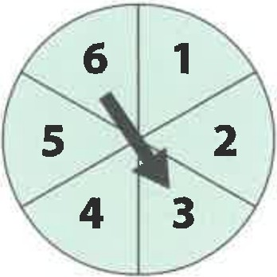
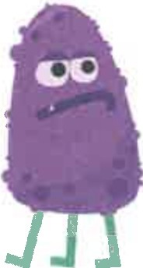

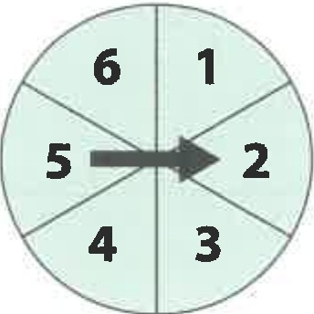
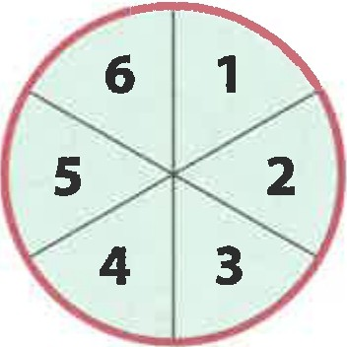
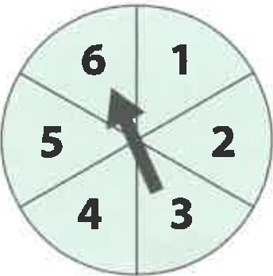
1
The dice shows the number of blobimals.
The spinner shows the number of legs for each blobimal.
Example:
• 6 legs altogether
Write the missing number.
•••
0
• •
---
legs altogether
lm
Show the missing arrow on the spinner.
••
0
•
9 legs altogether
lm
Show the missing number on the dice.
□
0
lm
30 legs altogether

Slide 14

It is not possible to get 14legs altogether.
Explain why not.
0
lm
Is it possible to get these totals for number of legs?
Write yes or no. If the answer is yes, give an example.
Total number of legs | yes orno | Example if yes
14 | no
15 | yes | throw 3 and spin 5
16
17
18
19
20
0
0
3m
TOTAL

Slide 15
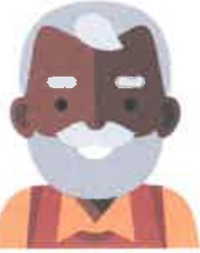
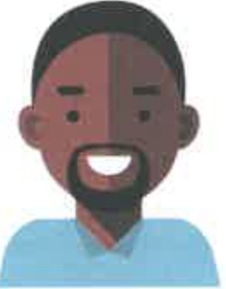


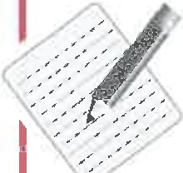
Grandad
Dad
Beca
Olwen
Grandad is 80 years old.
Dad is half Grandad's age.
Beca is three-quarters of Dad's age.
Grandad's, Dad's, Beca's and Olwen's ages add up to 159 years. How old is Olwen?
years old
0
3m

Slide 16
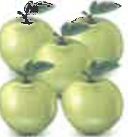
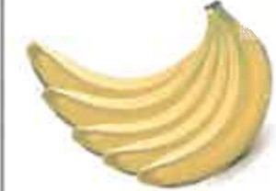
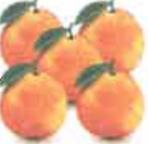
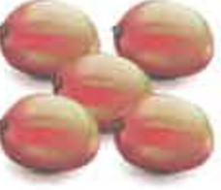
G) A shop sells these fruits.
Apples
20p
each
Bananas
30p
each
Oranges
SOp
each
Mangos
70p
each
Marc bought four fruits. He paid exactly £2
Which four fruits could Marc have bought?
I.I I.I
I._I_
or
_I._I_I.I I._I_I
or
_I._I _I._I _I.I_
0
3m
0
TOTAL

Slide 17
_20 J
Joe thinks of a number,
�-x_+
What is Joe's number?
0
Meg thinks of a different number, ■
� ■x■-■=20 J
lm
What is Meg's number?
■=
0
lm
Alun thinks of another different number,
Alun's number could be 0
What else could Alun's number be?
0
lm

Slide 18
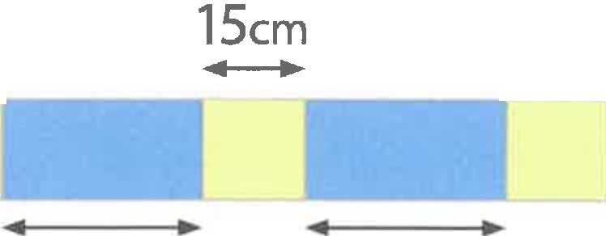
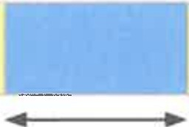
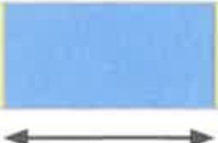

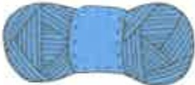


· G) Elen wants to knit this scarf.
¹..⁵.^{c}_^{m}.
¹.,.⁵..^{cm}..
15cm
15cm
�
�
30cm
30cm
30cm
30cm
Elen can knit 40cm with 1 ball of wool.
How many balls of blue wool should she buy? Show how you work it out.
knits 40cm
balls of blue wool
0
2m
How many balls of yellow wool should she buy?
Show how you work it out.
knits40cm
balls of yellow wool
0
2m
0
TOTAL

Slide 19


Arwel has 2 cooks.
Each cook has 3 helpers. Each helper has 4 pans.
Altogether, how many pans are there?
pansI
0
2m
Arwel leaves at 8am.
Each hour he travels 5 miles.
Gwen's palace is 30 miles away.
Without the raven's help, at what time would he arrive at Gwen's palace?
He would arrive at
0
2m

Slide 20

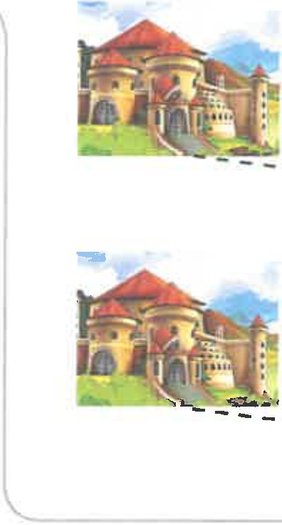
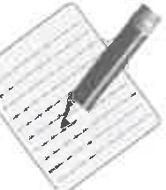
Arwel leaves at 8am.
Each hour he travels 5 miles.
Gwen's palace is 30 miles away.
The raven helps!
When you call me I will double the distance you 1
have already travelled.
(
------►
...
Arwel wants to arrive as quickly as possible.
At what time should he call the raven?
He should call at
0
2m
0
TOTAL

Slide 21
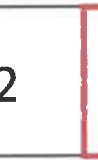
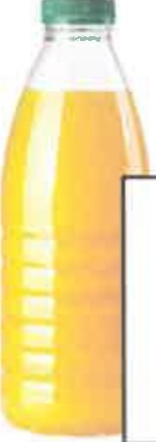


Write the missing digits.
+
2
4
0
0
lm
-
0
3
3
6
0
lm
A shop sells orange juice.
Small bottle
95p for i Iitre
Large bottle
£1.50 for 1 litre
Brad buys 1 litre in small bottles.
Ryan buys 1 litre in one large bottle.
How much more does Brad pay than Ryan?
p more I
0
2m

Slide 22


Star patterns use 2 red rods with each blue rod.
Examples:
/\
/\
,-,"
"-\✓/
4 blue rods
8 red rods
v-\1
I₋\₋₋I₋\
\/
6 blue rods
12 red rods
Poppy makes a star pattern.
She uses 20 red rods.
How many blue rods does she use?
blue rodsI
0
1m
Jamal makes a star pattern.
He uses 120 rods altogether.
How many blue rods and red rods does he use?
blue rodsI red rodsI
I
I
0
2m
0
TOTAL

Slide 23
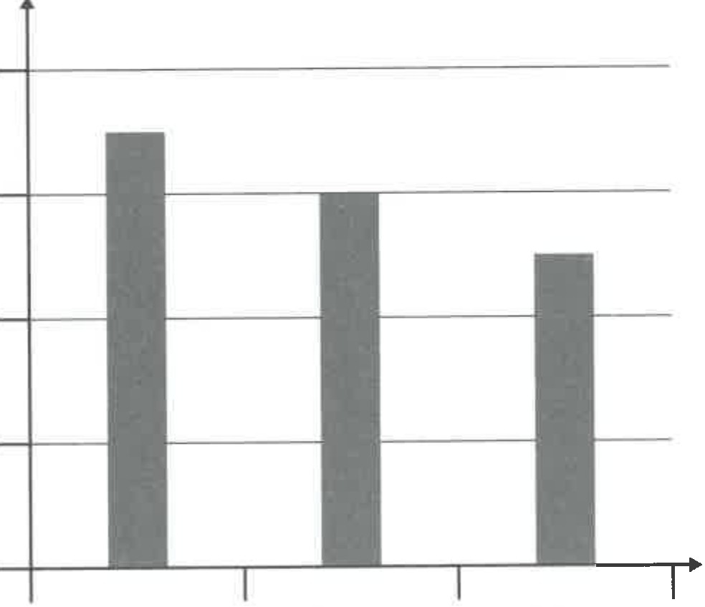
 | Scores in a singing competition
 | Tom | Elain | Mia
Judge A | 4 | 3 | 2 | 9
Judge B | 2 | 2 | 1 | 5
In the table, 4 shows ITom's score from judge A.
0
In the table,1 show_s I
In the table,9 showsI
lm
0
lm
The chart below shows the total scores from judges A, B and also C.
8
6
Total scores from judges A, Band C
4
2
0
Tom
Elain
Mia
Work out judge C's scores.
Tom
Elain
Mia
0
Judge C
2m

Slide 24
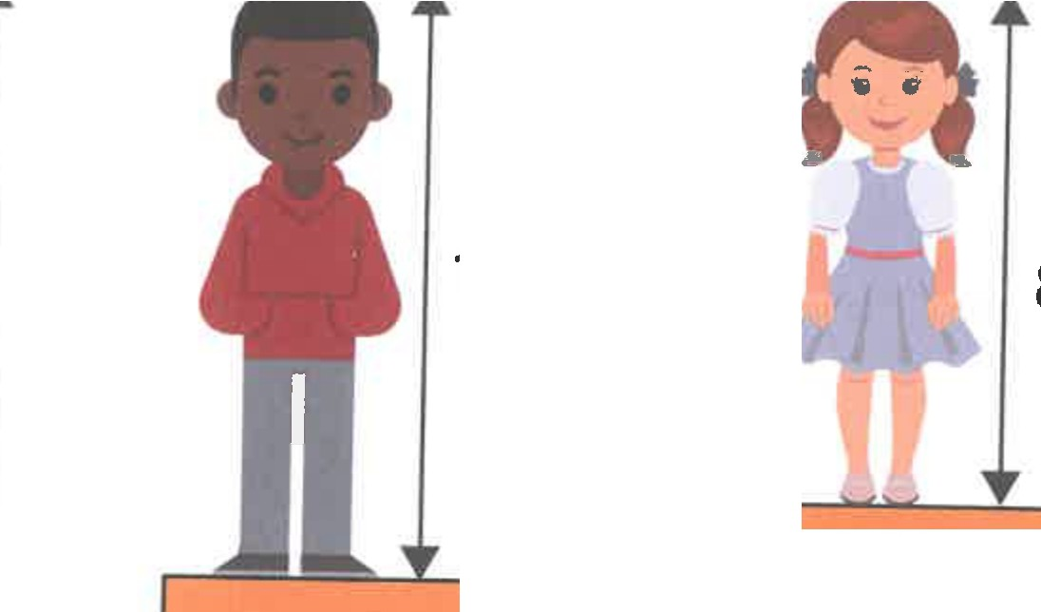
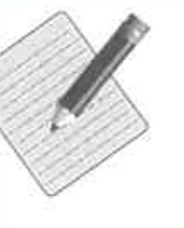
Sam and Meg have lots of blocks that are all the same height.
They stand on some of the blocks. Now they are both 140cm high.
140cm
100cm
85cm
8 blocks
? blocks
�------'-----
----
Not drawn to scale
Sam stands on 8 blocks.
How many blocks does Meg stand on? Show how you work it out.
blocksI
0
3m
0
TOTAL

