Slide 1
Numeracy Practice Questions

Slide 2
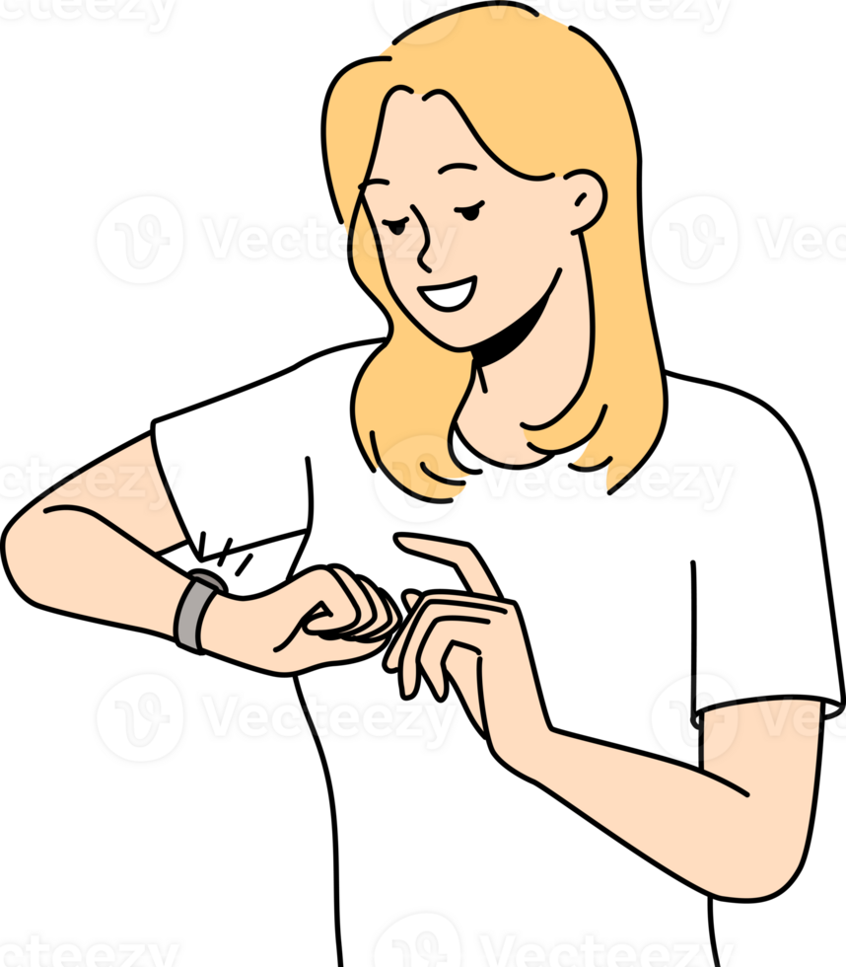
1. Time
Sophie has football practice at 5:15 p.m.
It takes her 25 minutes to get ready and 15 minutes to travel to the sports centre.
She also wants to spend 20 minutes doing her homework before she starts getting ready.
What is the latest time Sophie can start her homework?
Answer: ____________

Slide 3

2. Sharing Sweets
24 sweets are shared equally between 6 children.
How many sweets does each child get?
Answer: ______ sweets

Slide 4
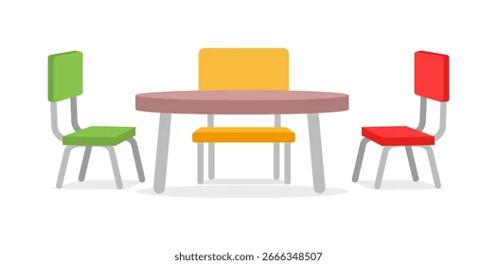
3. Seating Arrangement
There are 8 tables with 5 chairs at each table.
How many chairs are there altogether?
Answer: ______ chairs

Slide 5
4. Number Sentences
Fill in the missing numbers:
□ + 17 = 45
90 − □ = 34
6 × □ = 48
□ ÷ 4 = 7

Slide 6
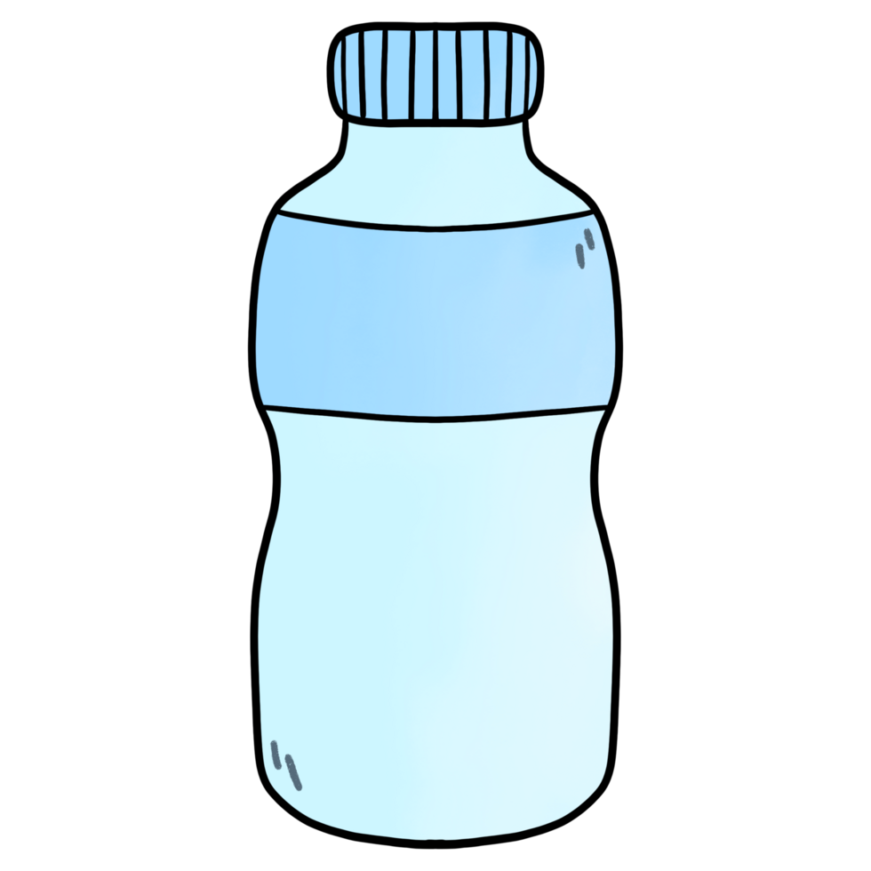
5. Drink Bottles
A bottle contains 1500 millilitres of juice.
Tom drinks 0.4 litres.
How much juice is left?
Answer: ______ litres

Slide 7
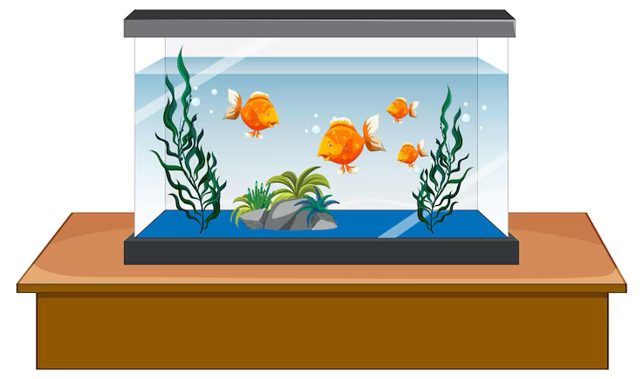
6. Shape Patterns
Mrs Jones buys a new fish tank for her classroom.
The tank is shaped like a cuboid and measures:
60 cm long
40 cm wide
50 cm high
What volume of water can be held in the tank?

Slide 8
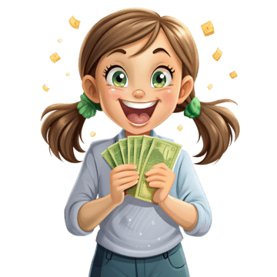
7. Pocket Money
Ava saves £3 each week.
How much money will she save in 8 weeks?
Answer: £______

Slide 9
8. Sports Day
If Caradog had 150 points in Sports Day, how many points did the other houses get?
How many points were collected altogether?

Slide 10
9. Favourite Fruit
a) Which fruit is the most popular?
b) How many more chose grapes than bananas?
c) How many pupils voted?

Slide 11
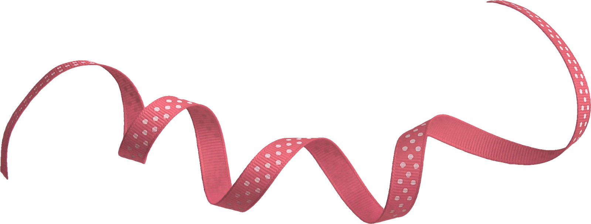
10. Ribbon Length
A ribbon is 2 metres long.
Emma cuts off 75 cm.
How much ribbon is left?
Give your answer in centimetres.

