Slide 1
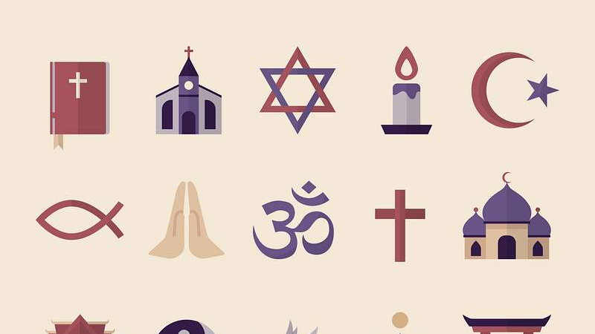
What Role Does Food Play in Religious Celebrations Here and Around the World ?
By Zaya

Slide 2
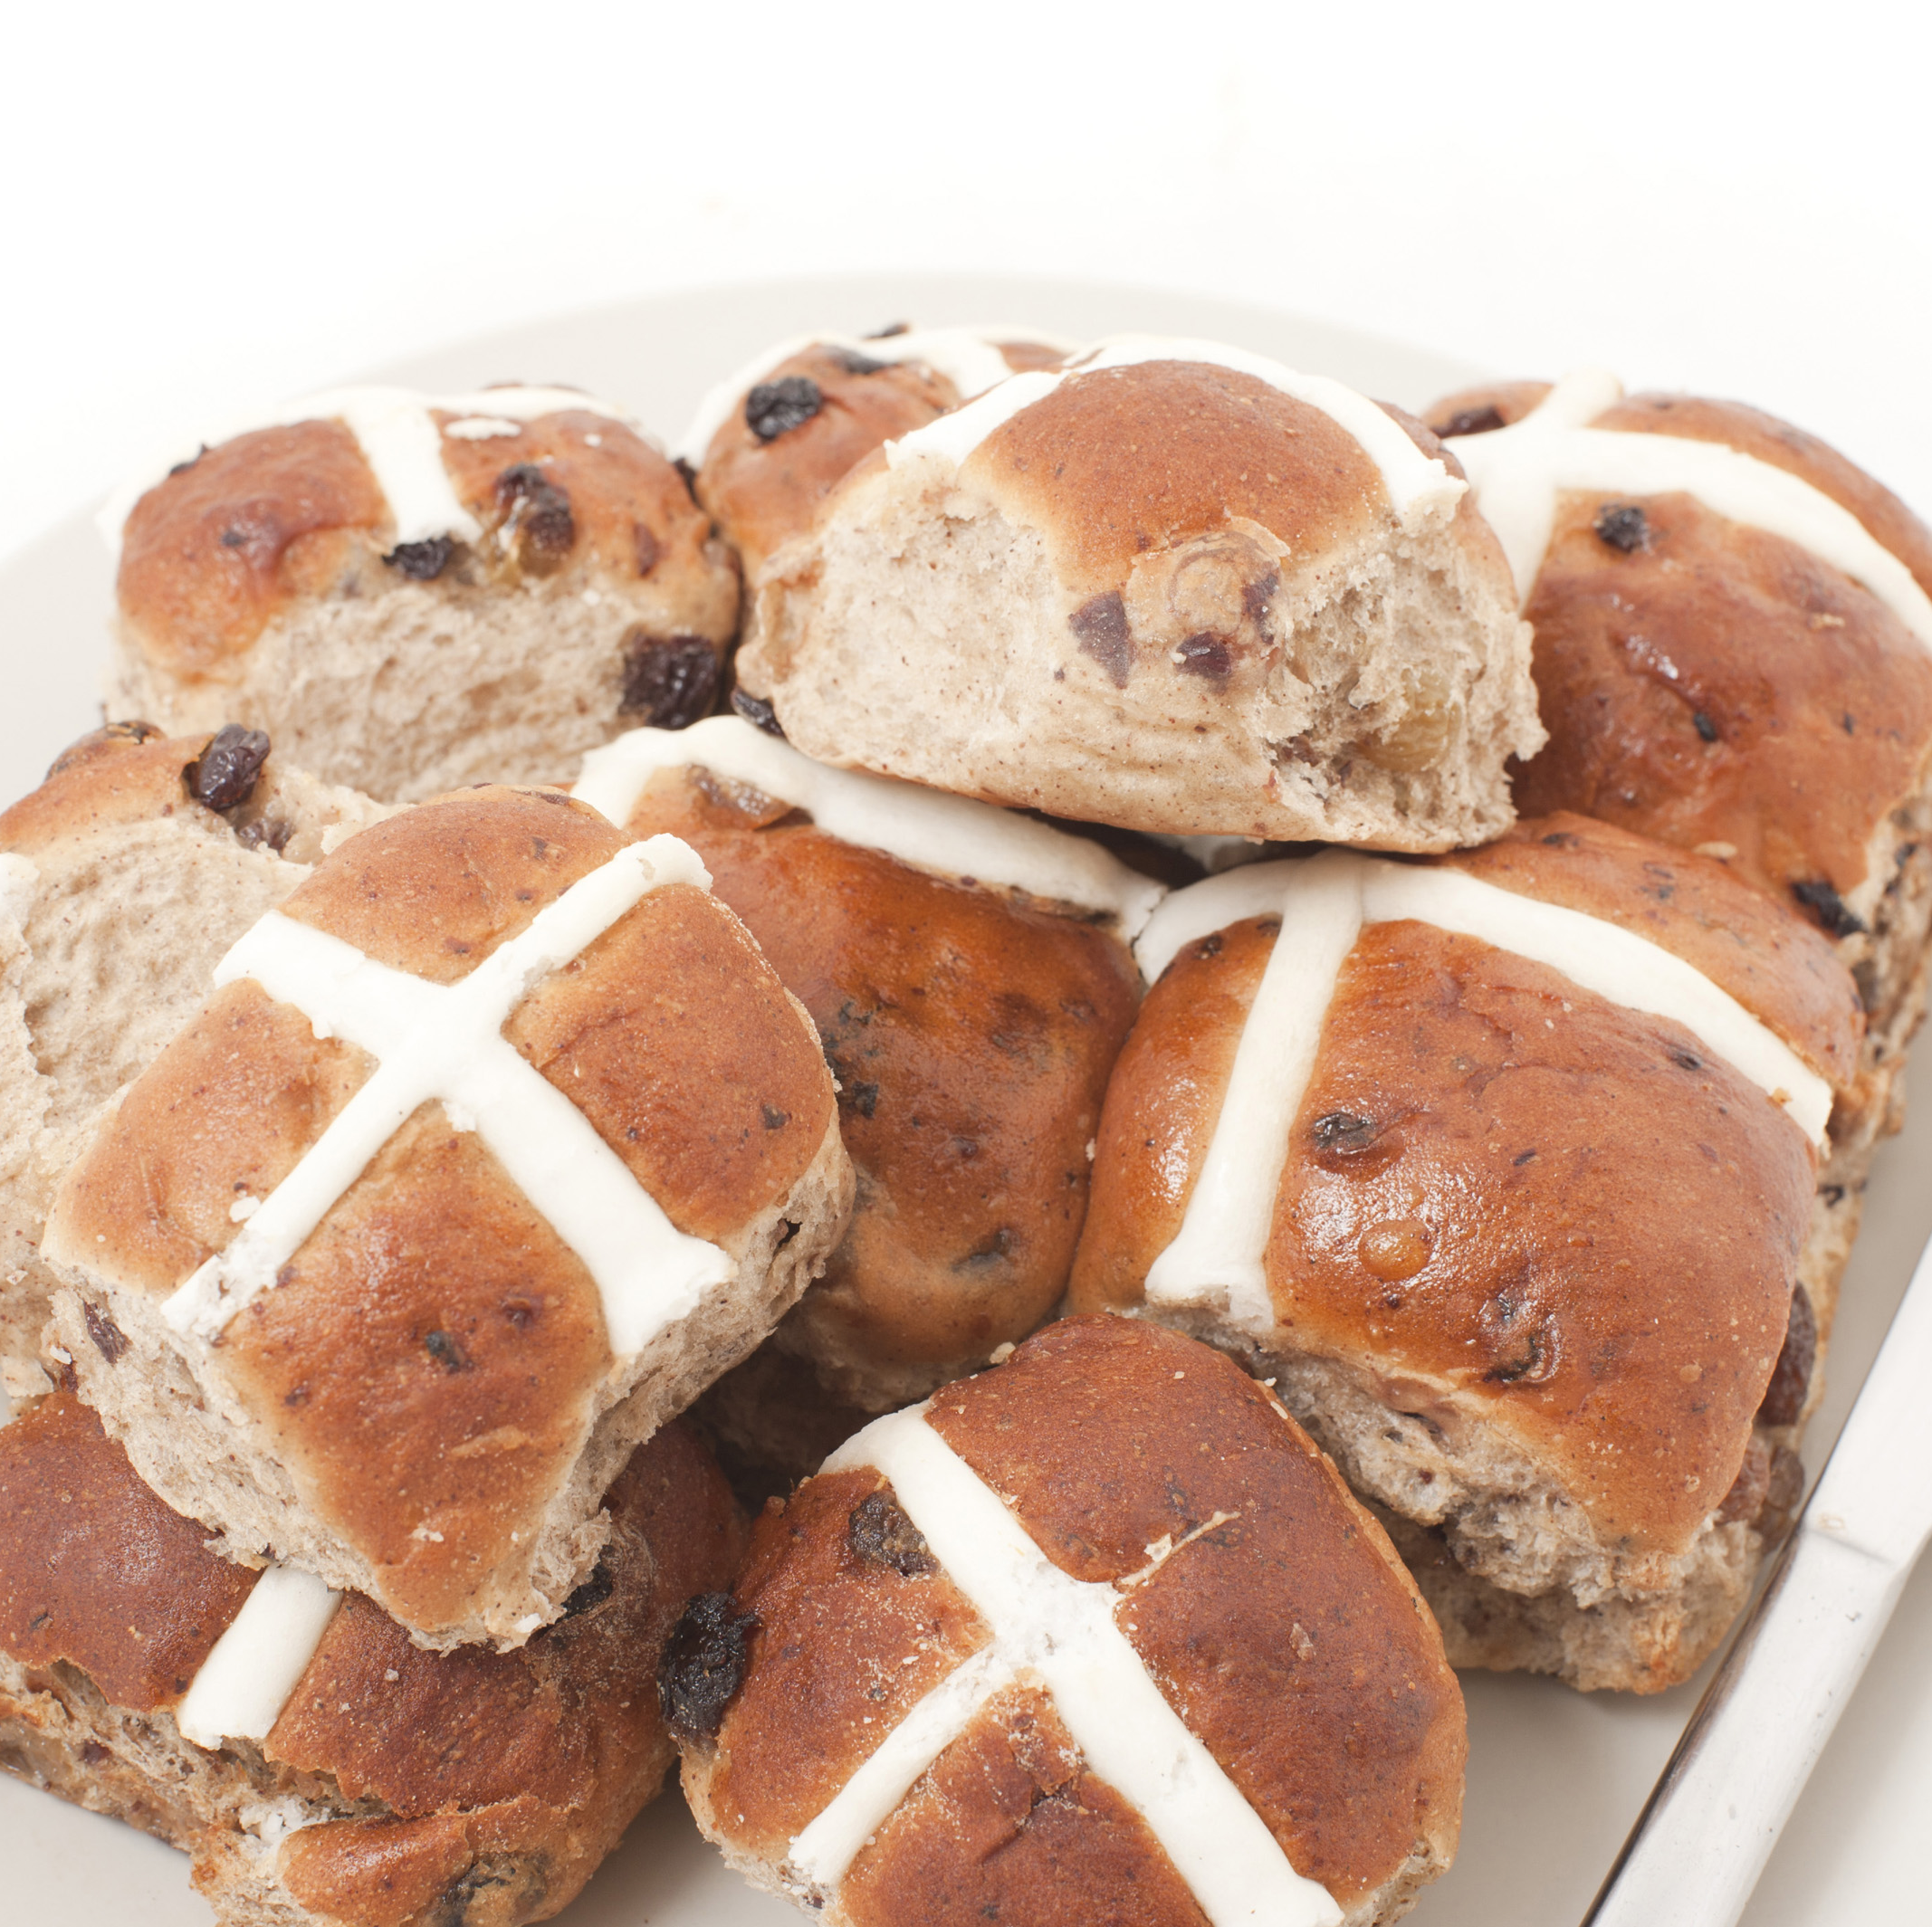
Christianity
Hot crossed buns are traditionally eaten on Good Friday to mark the end of Lent and to honour Jesus Christ who died on the cross.

Slide 3
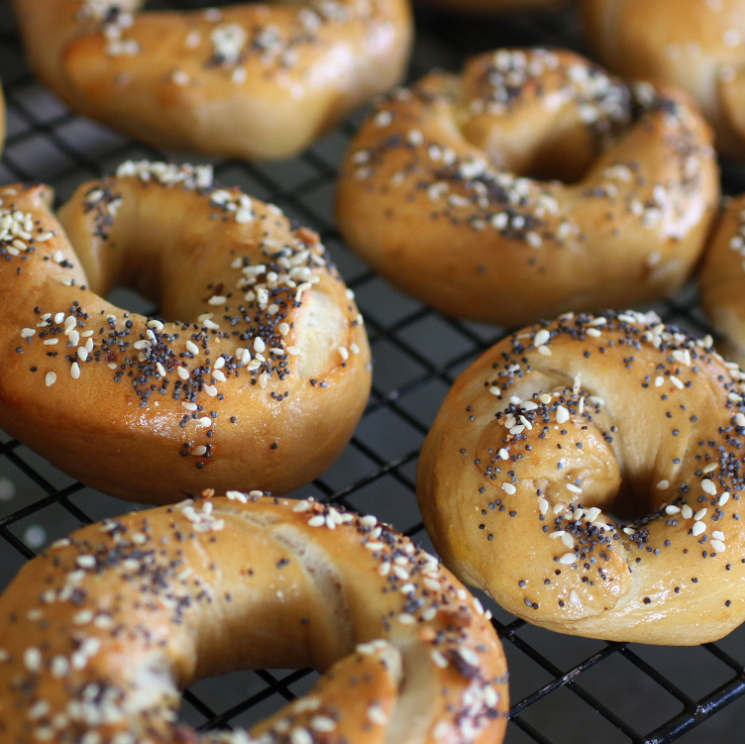
Judaism
Jews celebrate Shabbat and Passover. Jews celebrate through a combination of weekly rituals major holidays and eat bagels. At Passover, Jews eat the Seder meal.

Slide 4
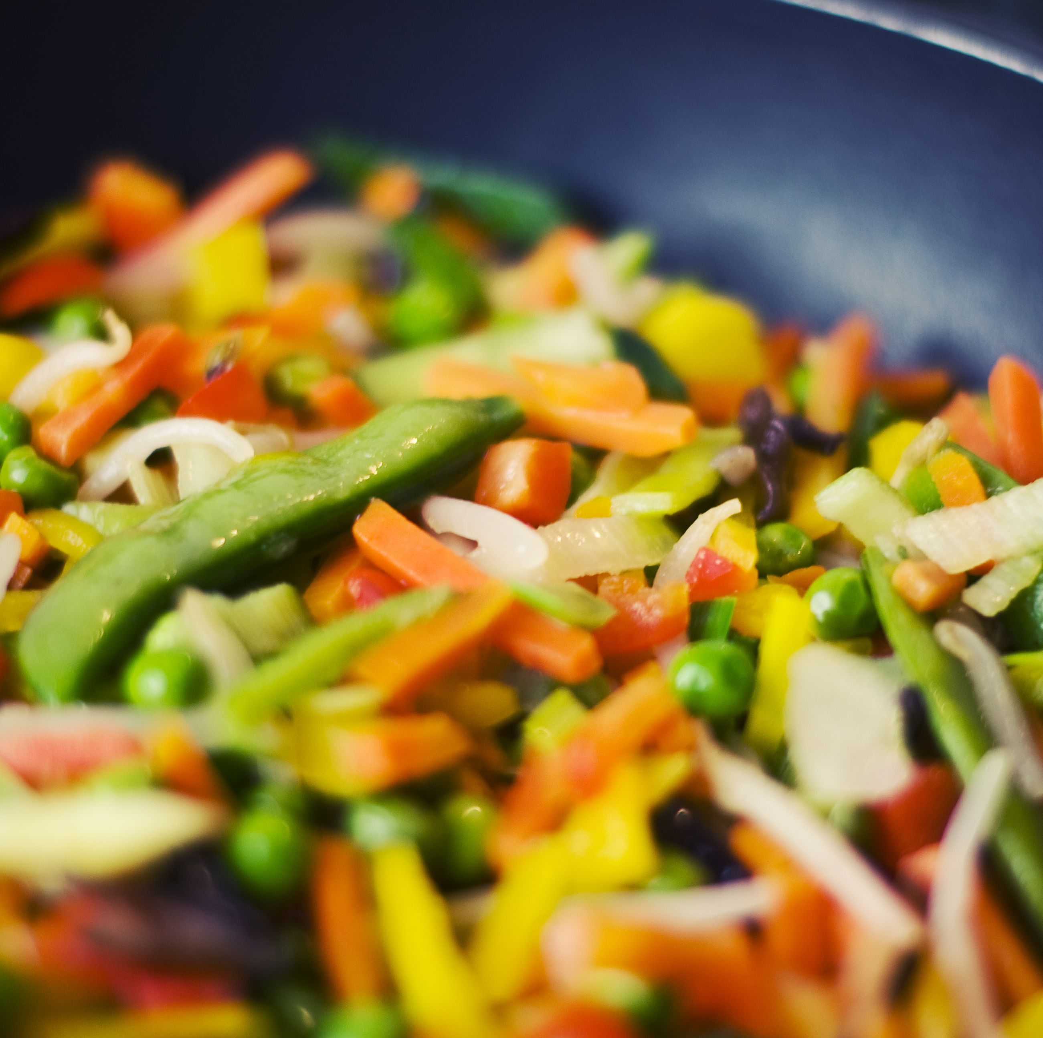
Buddhism
Buddhists celebrate Vesak. A Buddhist diet primarily consists of a plant based vegetarian approach. They do not eat meat.

Slide 5
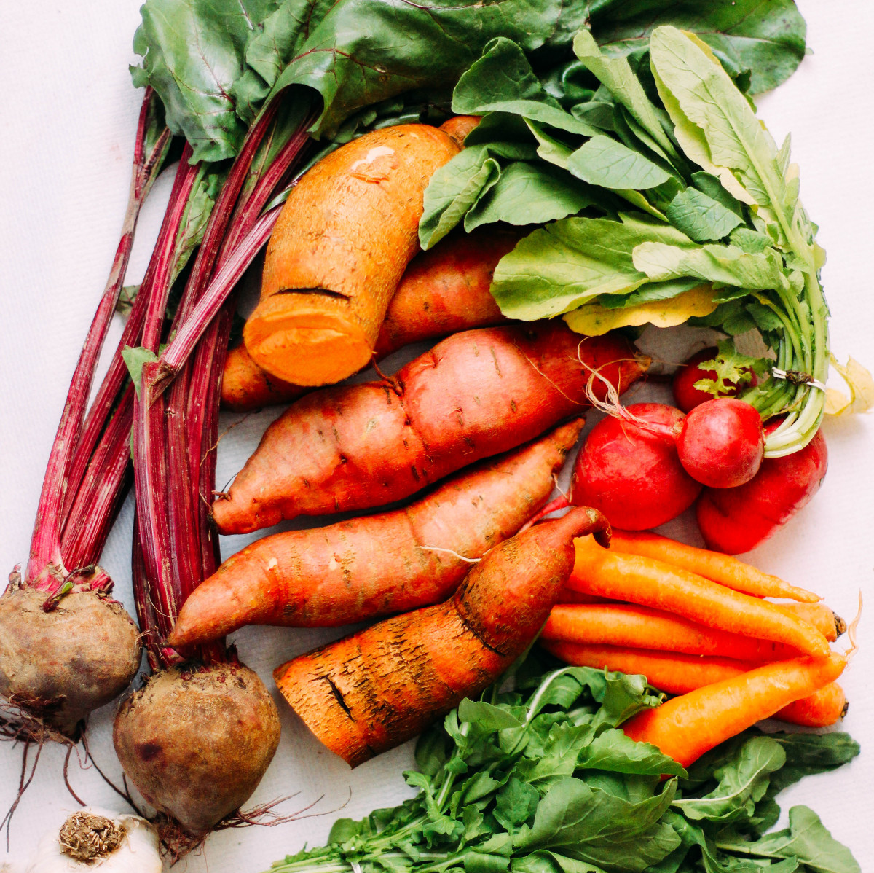
Sikhism
Sikhs celebrate Vaisakhi. Sikhs eat meals to celebrate Bandi Chhor Divas which is the Sikh Festival of Freedom. Sikhs make their own choice whether to eat meat or not.

Slide 6
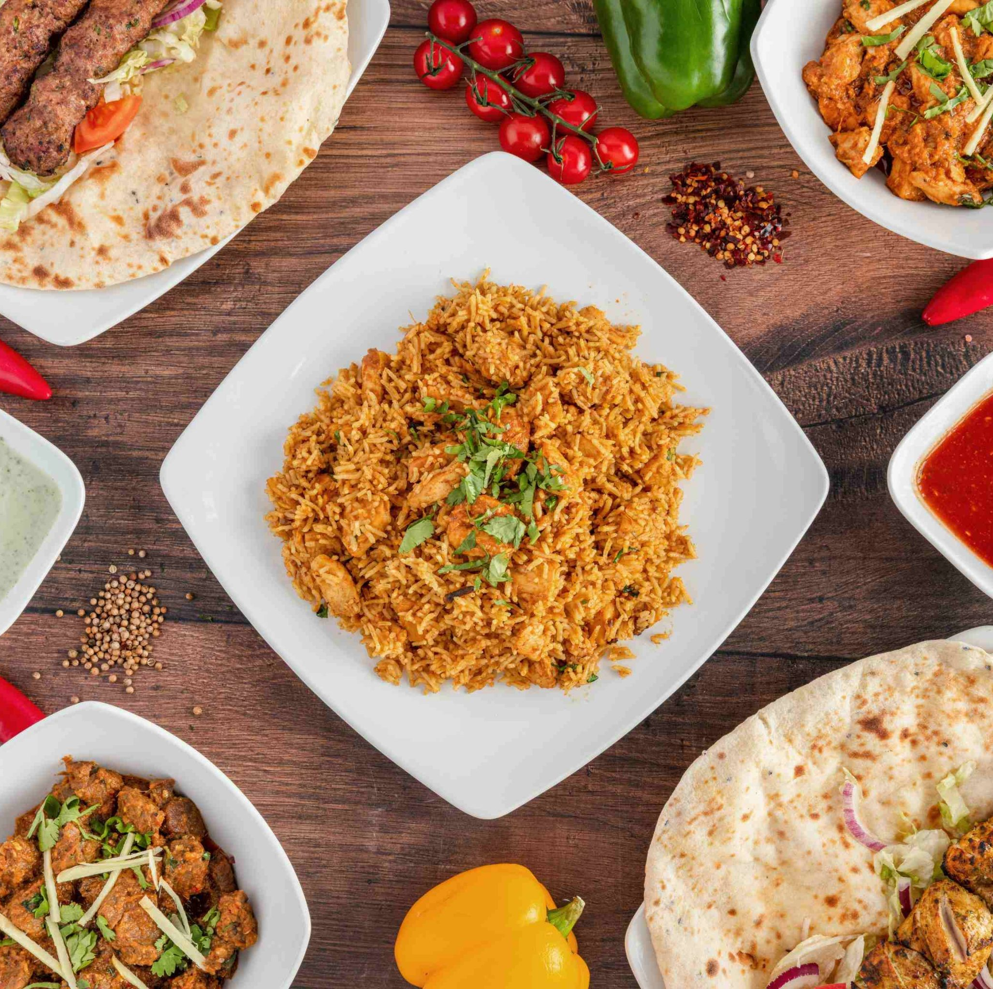
Islam
Islam celebrate major global festivals like Eid al-Fitr and for that they eat halal meats.

