Slide 1
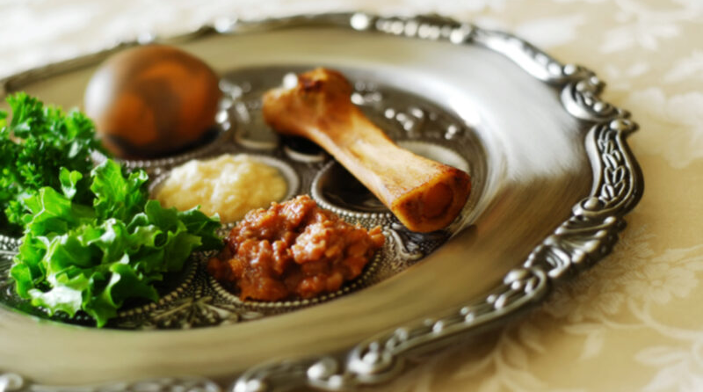
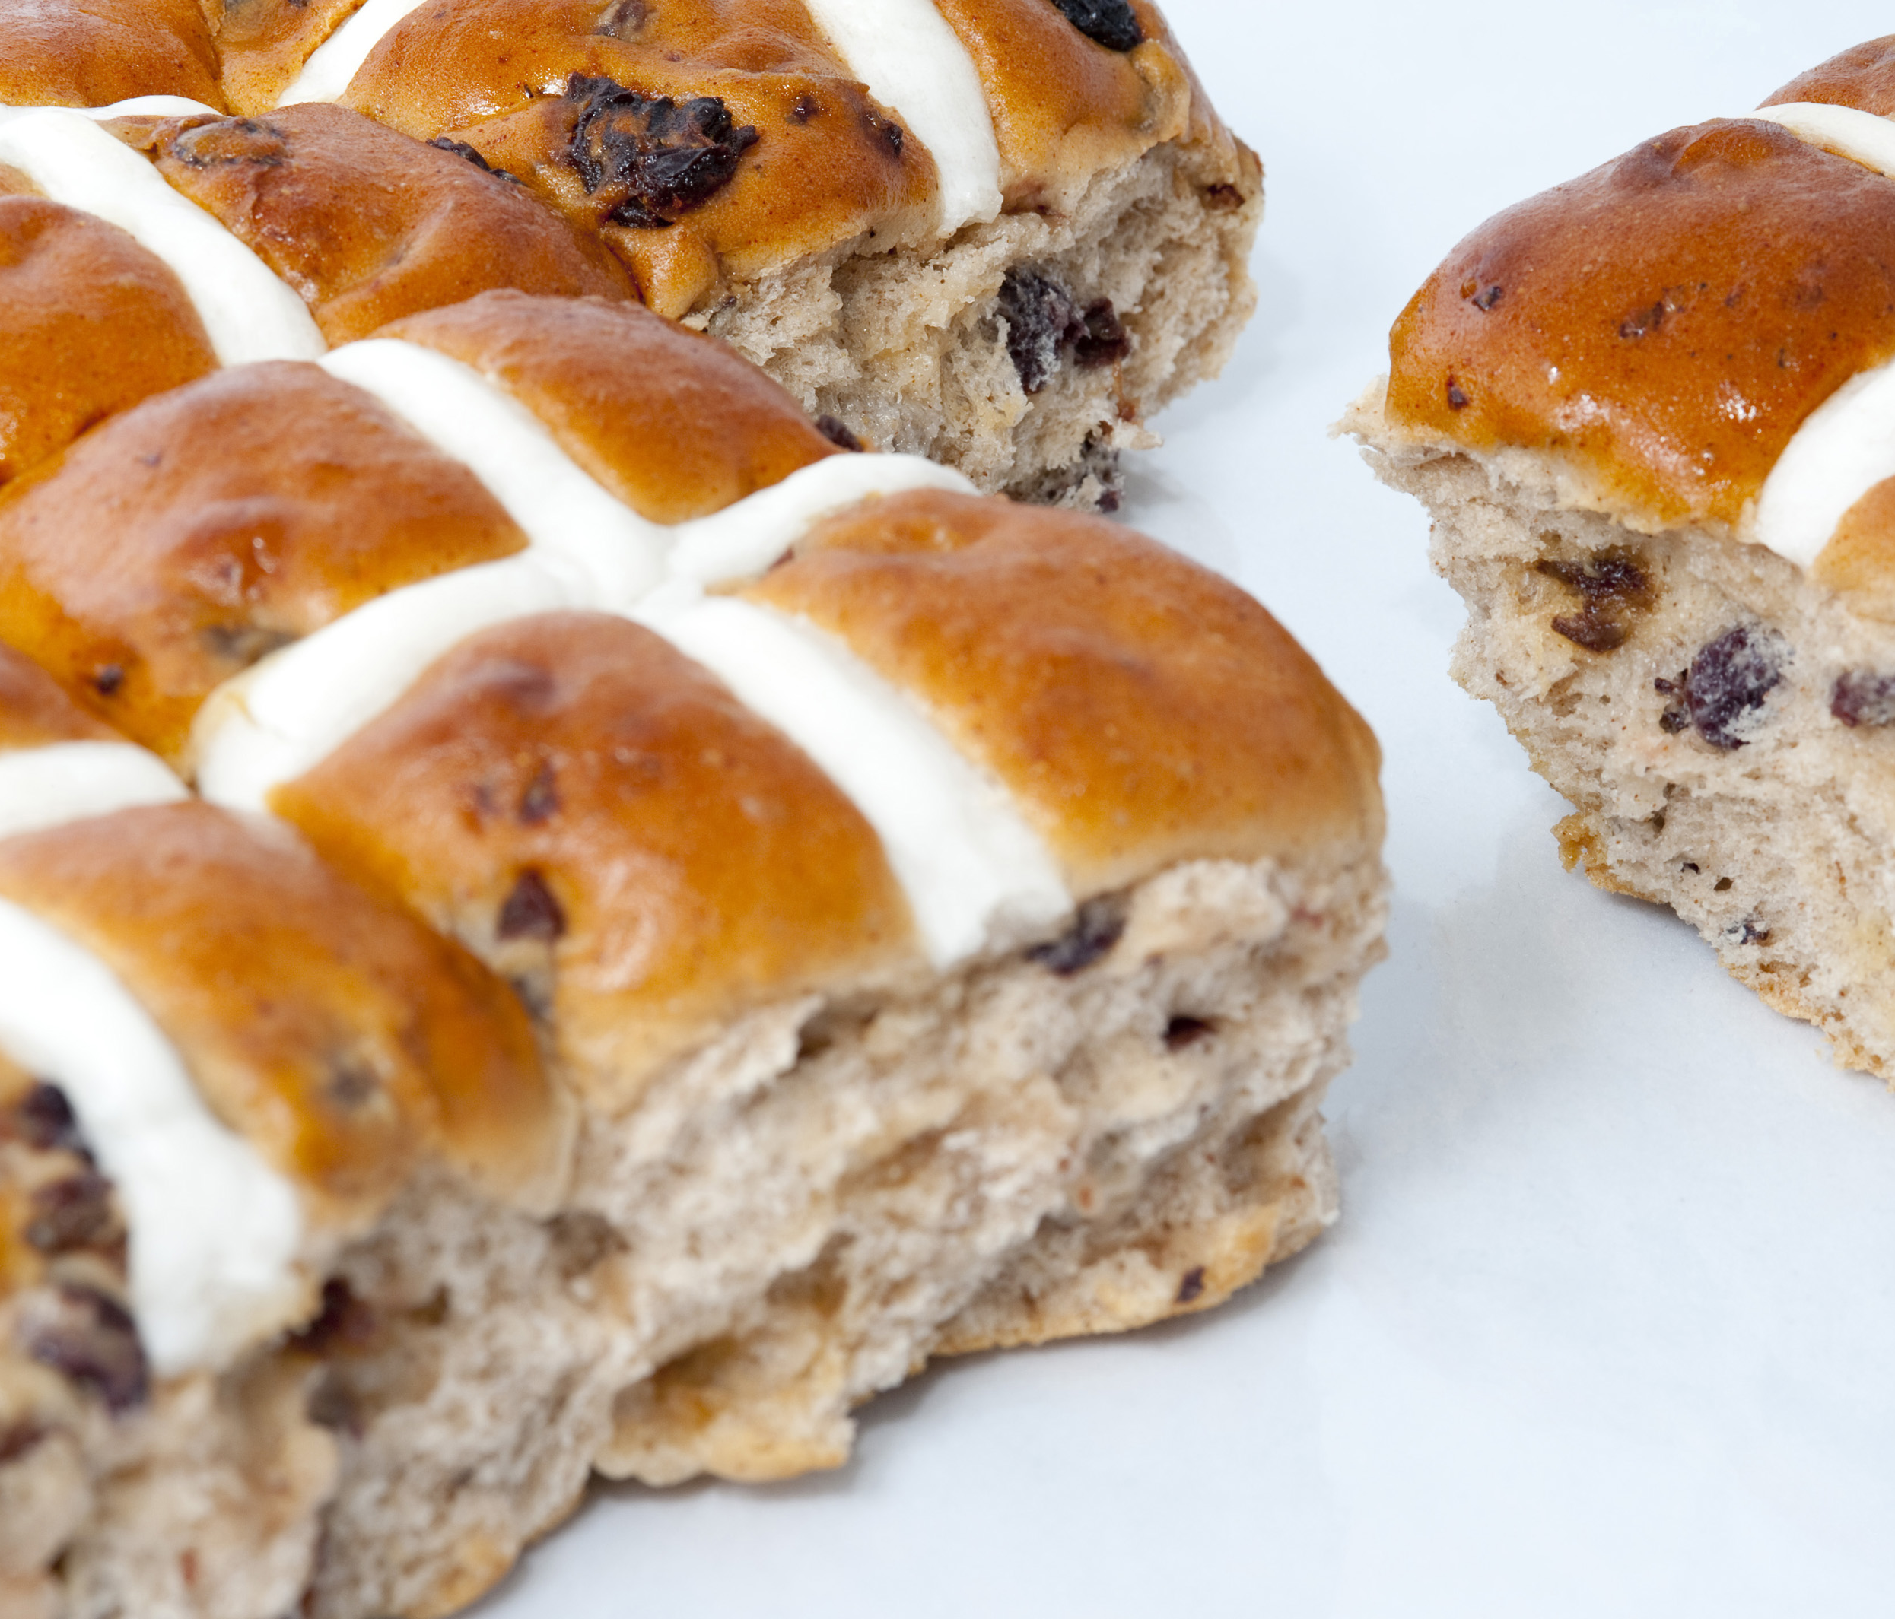
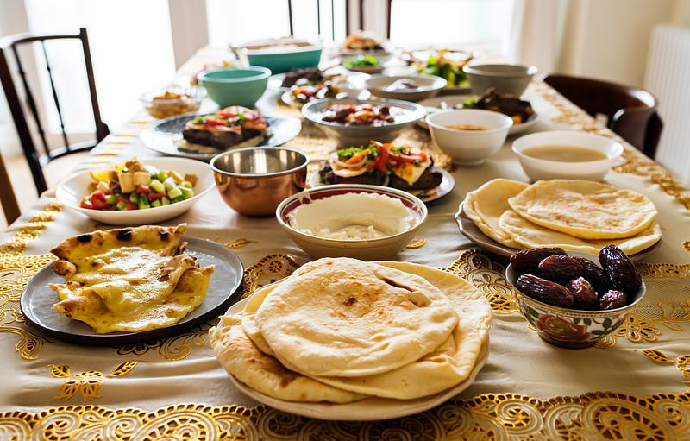
What Role Does Food Play in Religious Celebrations Around the World?
By Annabelle

Slide 2
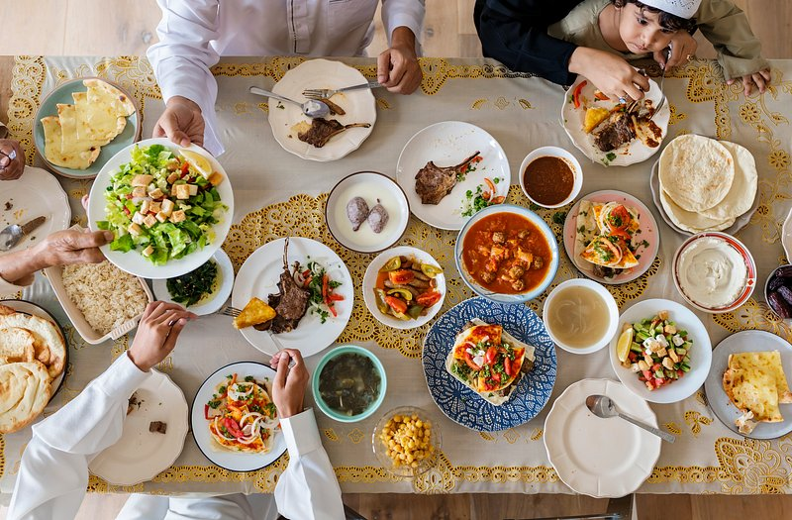
Islam
Muslims eat olives, grapes and honey at the celebration of Adha.

Slide 3


Christianity
Christians eat hot crossed buns at Easter as symbol of Jesus sacrificing himself on the cross to keep everyone safe.

Slide 4
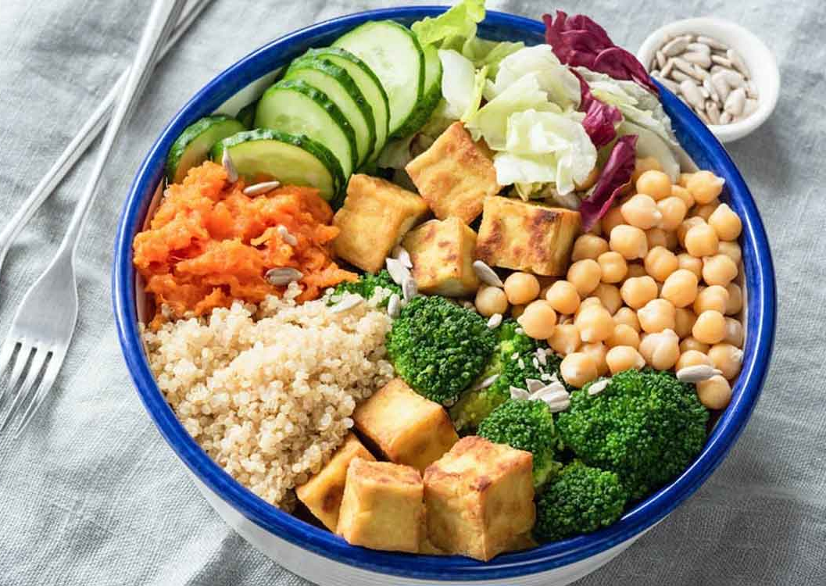
Buddhism
On Vesak, Buddhists eat vegetarian foods to honour the birth and passing of Buddha.

Slide 5
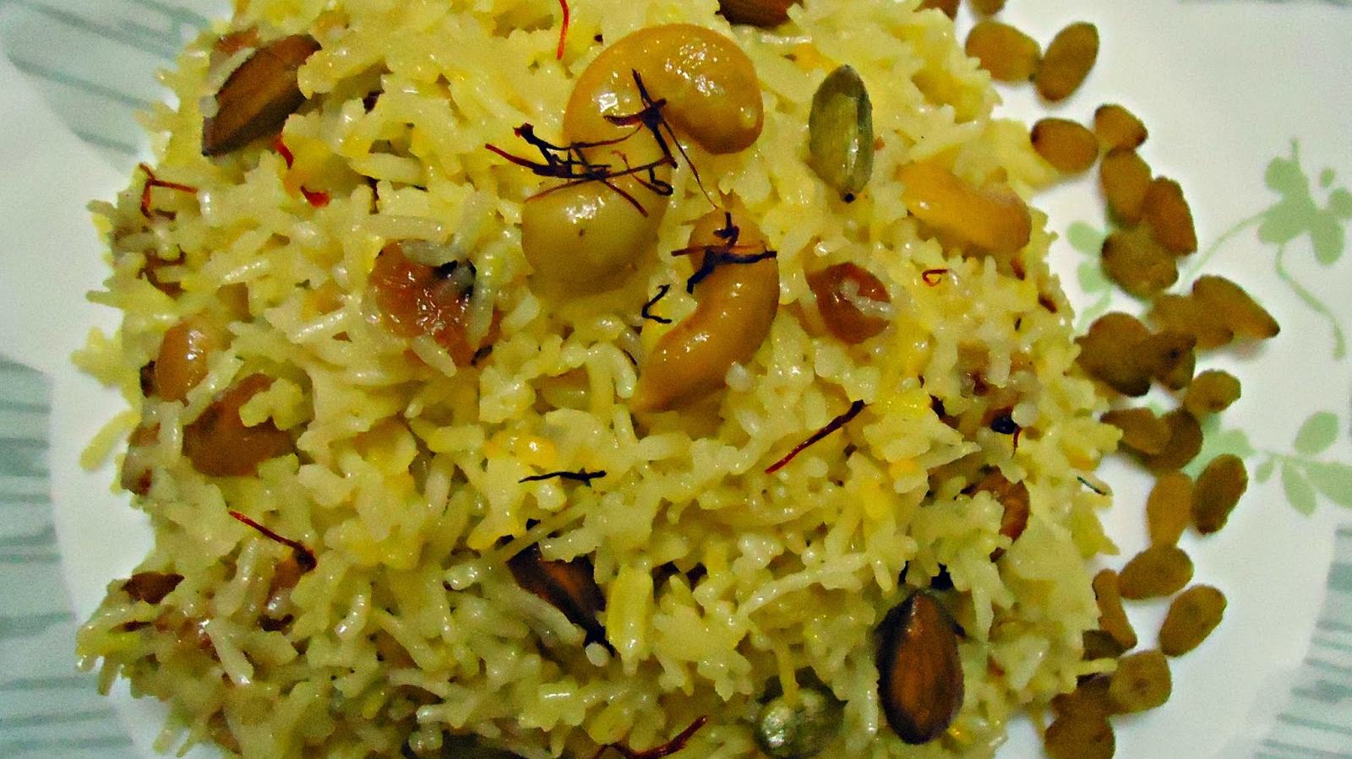
Sikhism
Sikhs eat sweet saffron rice to celebrate the arrival of Spring
ThePhoto by PhotoAuthor is licensed under CCYYSA.

