Slide 1
What Role Does Food Play in Religious Celebrations around the world?
By Isaac

Slide 2

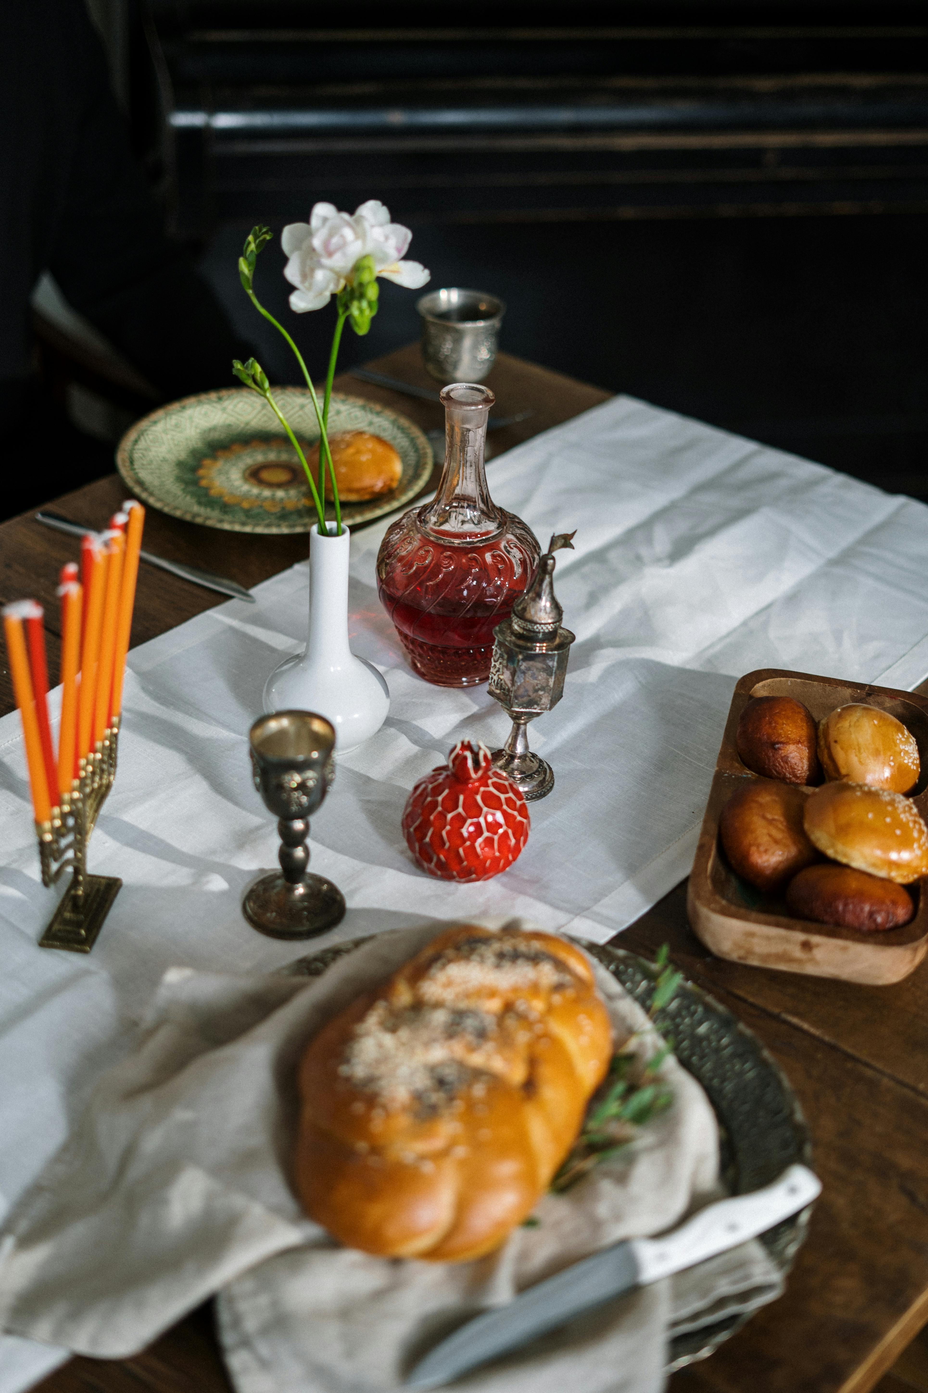
Judaism
Jews celebrate Passover. They eat soup, bread, bagels, lettuce and lamb shank.

Slide 3
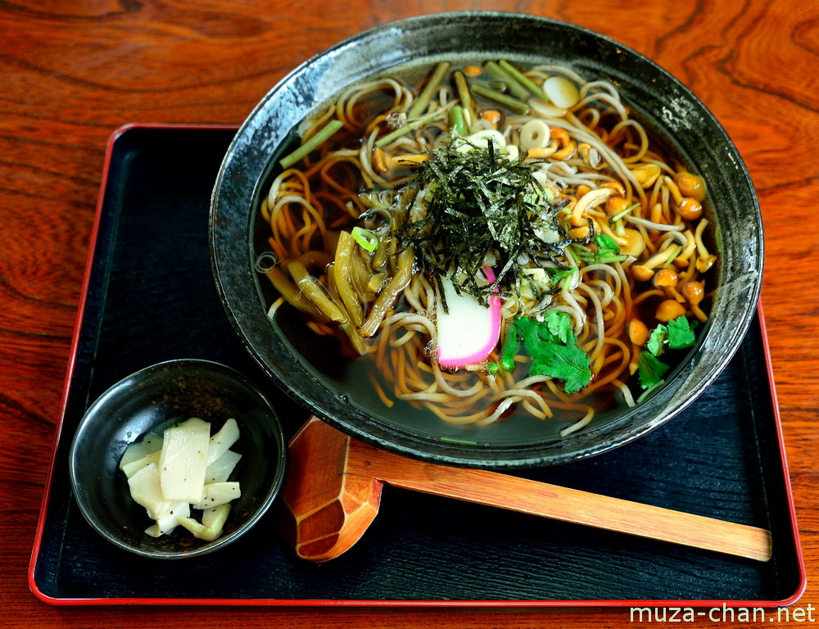

Buddhism
Buddhists celebrate Vesak. They eat fruit and vegetables.
ThePhoto by PhotoAuthor is licensed under CCYYSA.

Slide 4
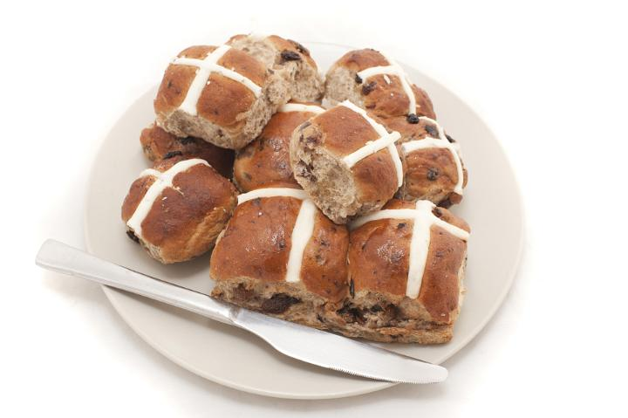
Christianity
Christianity is a religion. There are lots of Christians in the UK. They celebrate Easter and they eat hot crossed buns and chocolate eggs.
sed under CCYY

Slide 5
Sikhism
Sikhism is over 500 years old. Vaisakhi is what they celebrate. They eat yellow and orange foods.

