Slide 1
What Role Does Food Play in Religious Celebrations Here and Around the World?
By Alfie

Slide 2

Christianity
Christians celebrate Easter by eating hot cross buns and chocolate eggs.

Slide 3
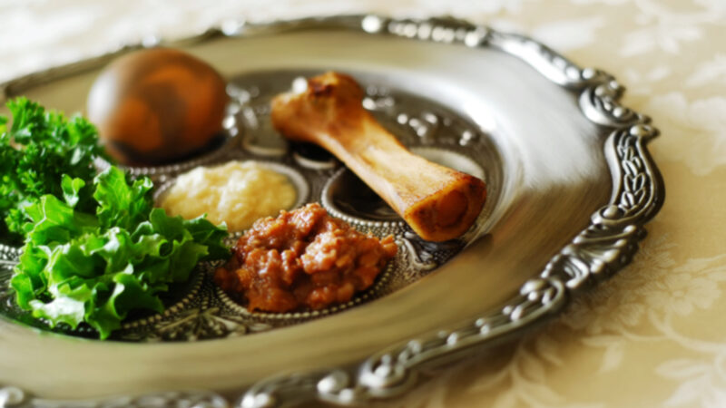
JUDAISM
Jewish people celebrate Passover and they eat chicken soup, challah bread and lamb shanks

Slide 4
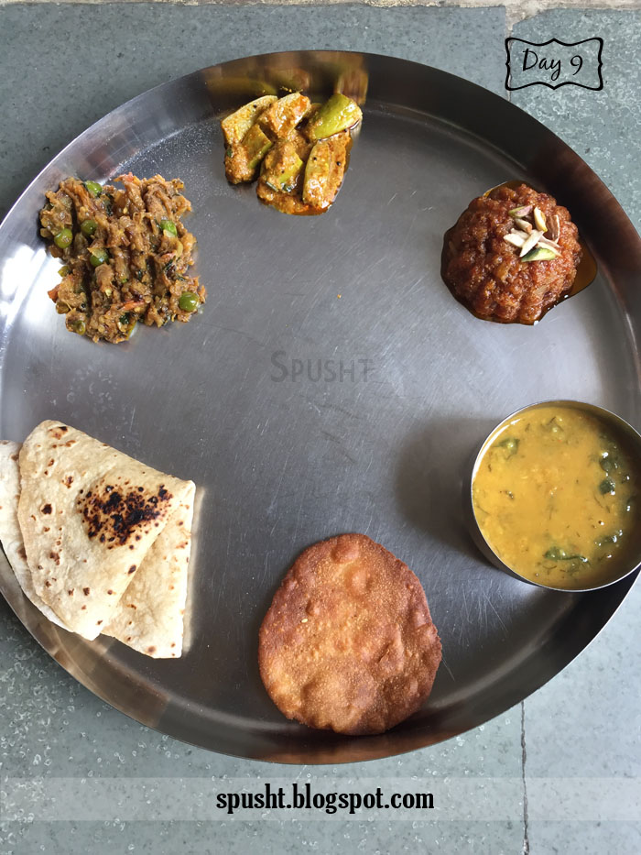
SIKHISM
Sikhs eat meat, eggs, fruit and vegetables as they celebrate Guru birthdays.

Slide 5
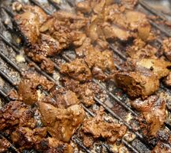

ISLAM
Muslims eat Halal meat and vegetables when they celebrate Eid al-Fitr.

Slide 6
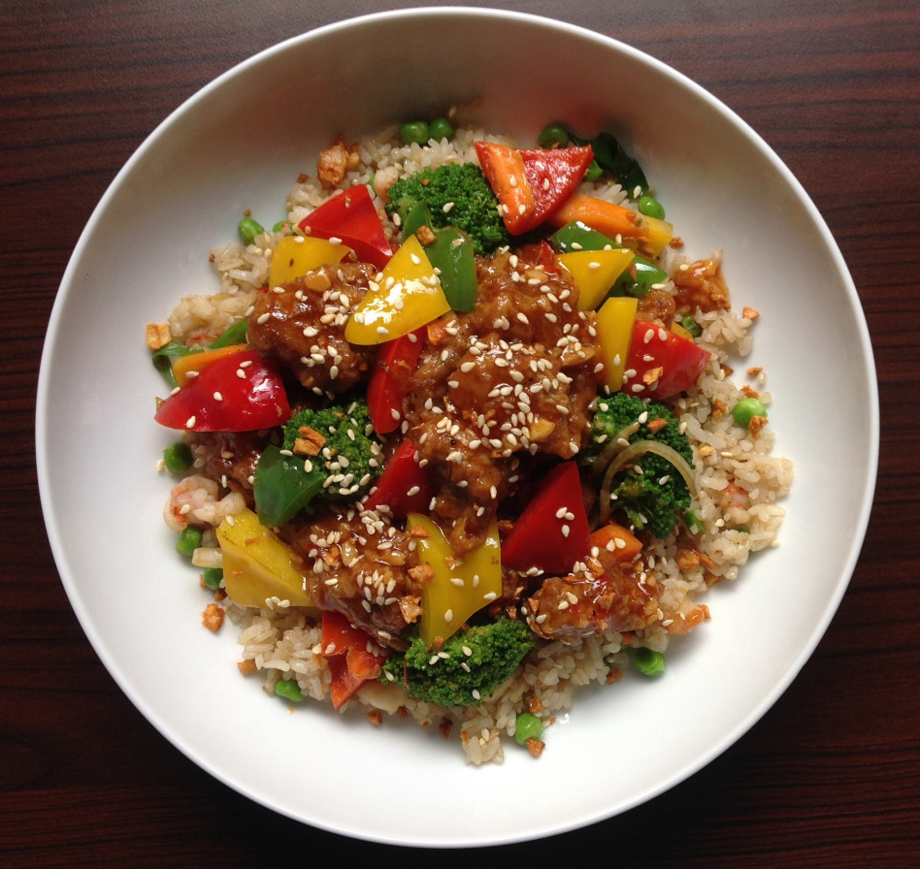
Buddhism
Buddhists eat rice, noodles, vegetables, legumes and tofu when they celebrate Buddha's birthday.

