Slide 1
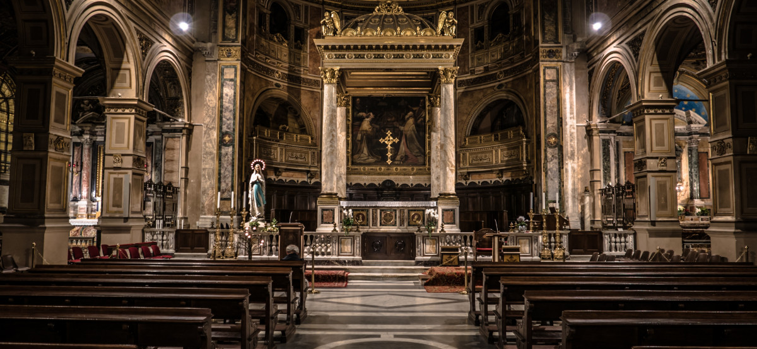
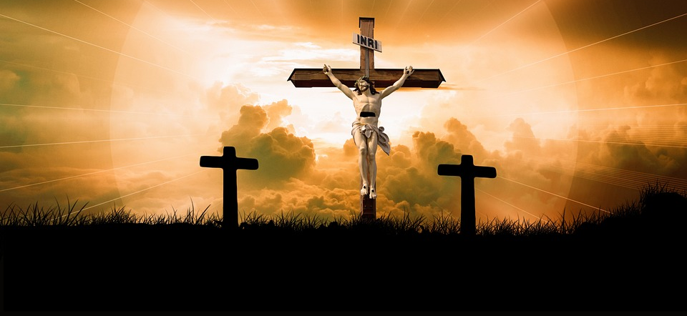
What Role Does Food Play in Religious Celebrations Here and Around the World?

Slide 2
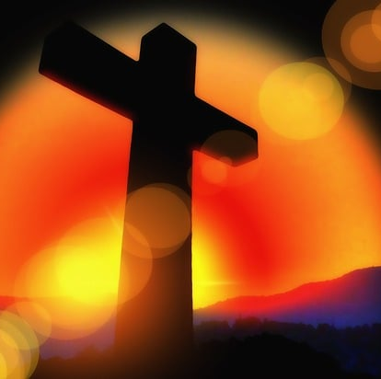
Christianity and Catholicism
Catholicism is a Christian Religion. Catholics celebrate Easter and Christmas. Christians eat chocolate Easter eggs at Easter time every year.

Slide 3
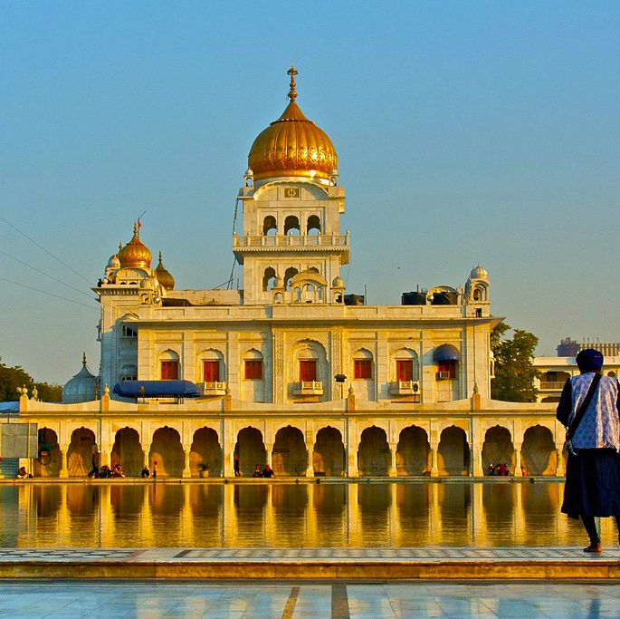
Sikhism and Vaisakhi
Sikhs celebrate Vaisakhi to commemorate the birth the Khalsa in 1699 by guru Golind Singh Ji. They eat a simple nutritious diet based on moderation compassion and spiritual mindfulness.

Slide 4
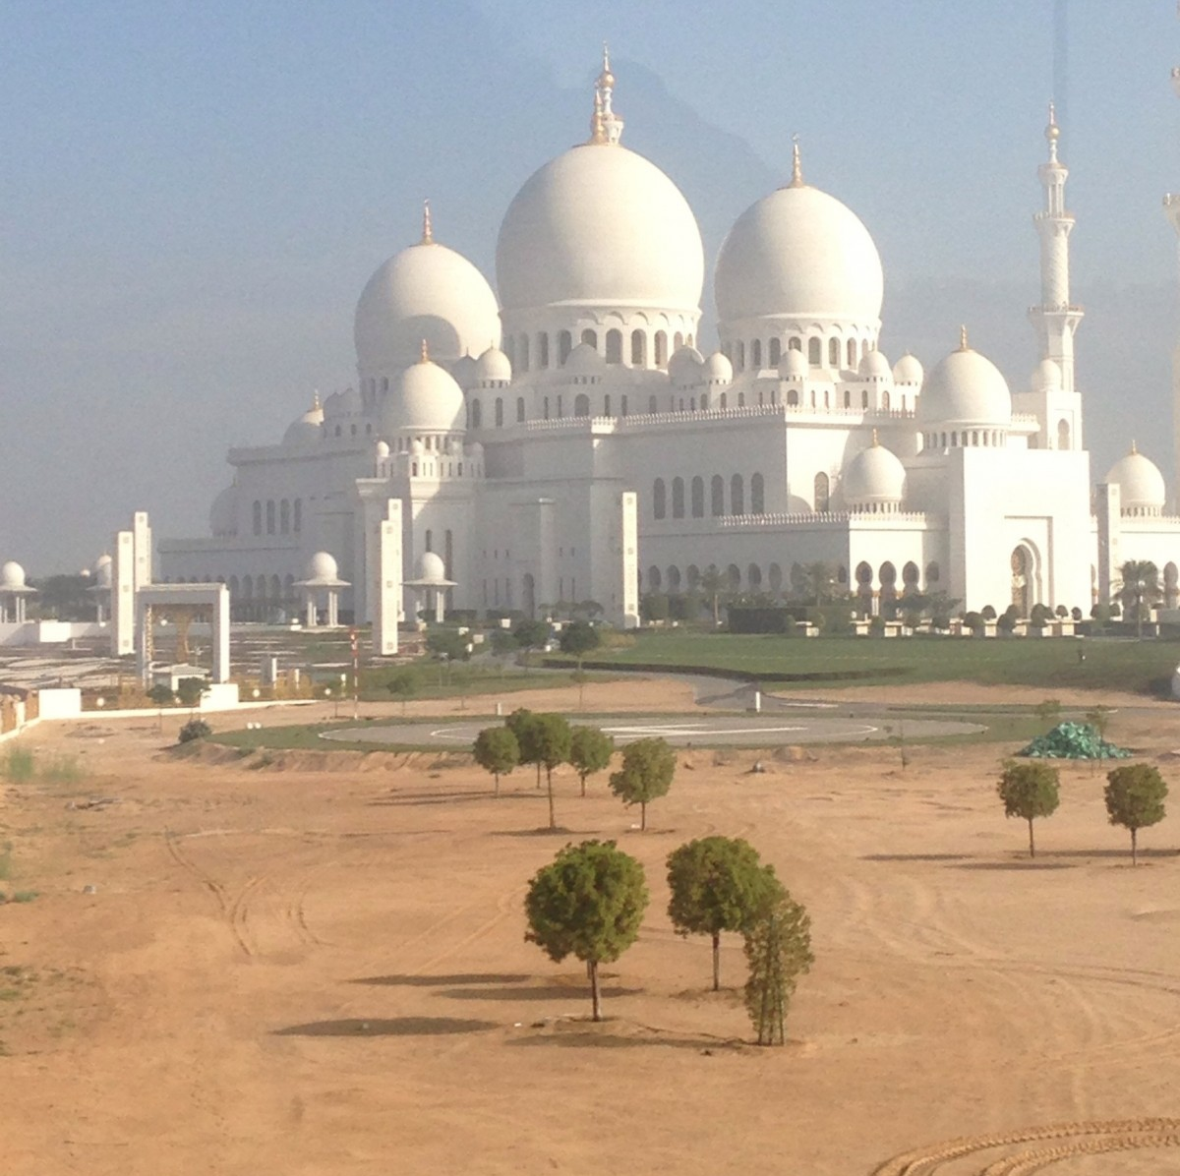
Buddhism and Dhamma
Dhamma is a Buddhist celebration where Buddhists celebrate Vesak. They celebrate Vesak to commemorate three key milestones in the life of Siddhortha Gathutama. They eat a plant-based diet of fruits, vegetables, legumes and grains.

Slide 5
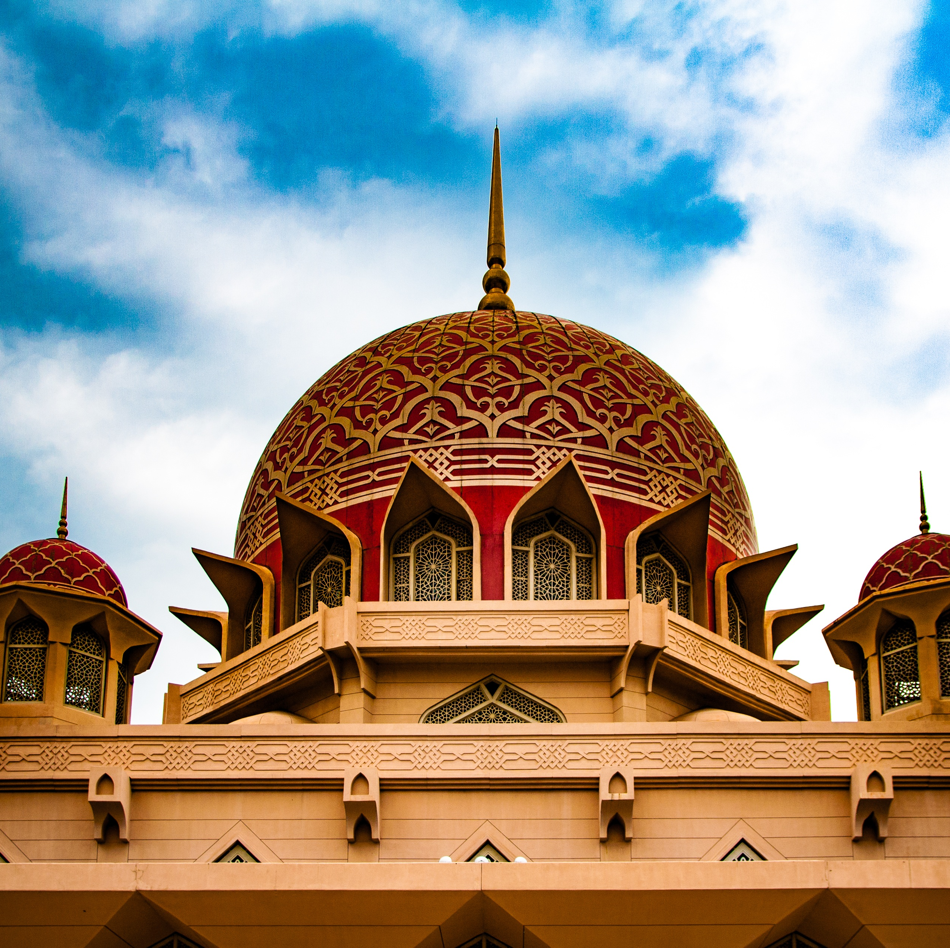
Islam and Eid al-Fitr
Eid al-Fitr is an Islam festival where Muslims celebrate Eid al-Fitr to mark the end of the month-long, dawn to sunset fasting of Ramadan. They eat Halal food which includes fruits, vegetables, grains, seafood and meat.

