Slide 1

Welcome to Pontarddulais Comprehensive School
Croeso i
Ysgol Gyfun Pontarddulais

Slide 2




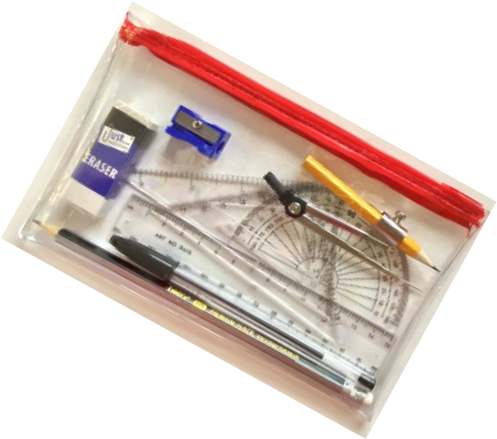


Pupils,
Welcome to Pontarddulais Comprehensive School. This booklet will provide you with some useful information about our school before you commence in September.
Your journey to comprehensive school is very exciting, but we also understand that it can be pretty nervous, but just remember that everyone is here to help you settle in quickly so that you can enjoy your time in school. If you are worried about anything, you only have to ask.
A note for your Parents/Carers,
Towards the end of the booklet is a consent form that we kindly ask you to complete.
Any queries, please contact us via phone at 01792 884556 or email us at info@pontcomp.co.uk. Additionally, stay updated with the latest news and updates on our website at https://pontcomp.co.uk, where you'll find sections dedicated to both
parents and pupils, packed with helpful information.

Slide 3

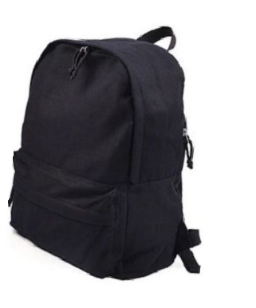

On the first day of term you will need to make sure you have the correct equipment. Make sure you are organised and pack the night before. Here are a few helpful tips as to what you will need.
Bag:
Make sure you have an appropriate bag or backpack to carry your equipment. This should be easy to carry, have plenty of storage space and will keep your equipment dry.
Pencil Case/ Cas Pensiliau:
Be prepared and make sure your pencil case has all the essentials. Look at this list below for ideas.
Pens - Black/Blue
Pencils - plain and coloured
Eraser, ruler and sharpener
Scissors and a glue stick
Remember/ Cofiwch!
We use a Cashless Catering System in our school. We will register you on your first day and show you how to use the system. Your account will need to have enough money for the week, it is around £3.50 for lunch and £1 for break time snacks. You could also bring a packed lunch.
P.E: Please pack a PE kit including shorts, T-shirt and trainers in case you have PE on the first day.
Mobile Phones/ Ffonau Symudol:
Mobile phones are not allowed in school. If you need to contact home you may go to the main office for help. Likewise, parents/carers can pass urgent messages onto their child by contacting the school office.

Slide 4



Route 328
Llangyfelach (opp. Plough & Harrow)
Swansea Road (Jnc. Maes Sant Teilo)
Jcn. Heol Pentre Felen/ Llangyfelach Road
Route 329
.00
8.05
Mynydd Bach
Route 330A
8.00
8.05
Llangyfelach Road, Penllergaer (opp. Primary School) Penllergaer Roundabout
Oaklands Road
Route 330B
7.50
Llangyfelach (opp. Plough & Harrow)
7.53
7.55
Swansea Road (Jnc. Maes Sant Teilo)
Jnc. Heol Pentre Felen / Llangyfelach Road
Route 331
Plas-Y-Coed, Felindre
Fforest Newydd
Bryn Bach Road, Ponttliw

Slide 5

Route 332 (Years 7, 9 & 10)
07:55 Gorseinon Road (Gelli Gynore)
07:58 Heol-y-Gelli
08:00 Llewellyn Road
08:04 Gorseinon Road (opp. Post Office)
08:90 Tircoed Forest Village (Community Centre)
Route 332A
07:57 Gorseinon Road (Gelli Gynore)
08:00 Heol-y-Gelli
08:02 Llewellyn Road
08:06 Gorseinon Road (opp. Post Office)
08:11 Tircoed Forest Village (Community Centre)
Route 333
07:54 Parc Penllergaer
08:00 Swansea Road (Jcn Druidstone Way)
08:02 Druidstone Way
08:05 Swansea Road (Old Inn)
Route 329
08.00 Penyrheol (Coalbrook Road)
08:05 Grovesend (High Street)

Slide 6
Route 334
07:55 Lle’r Fedwen & Ty Trawst, Cwmcerdinen
08:05 Lon-y-Felin, Garnswllt
Route 335
07:31 Little Haven, Blaen Cilau & Graig Cwm Celie, Rhos Fawr Farm, Salem
07:48 Bryntywod, Llangyfelach
0753 Mansion Gardens, Penllergare
0757 Efail Wen
08:02 Heol-yr-Eos, Penllergaer
08:15 Golwy-y-Llanw, Pontarddulais

Slide 7




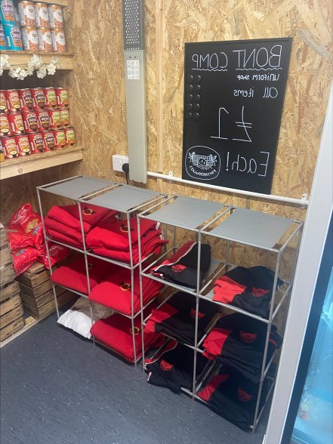
When you start in September, the correct uniform is extremely important. Don’t forget, you represent the school when you are in your uniform so you must look your best!
Click on the link below to view our School Uniform & Appearance Policy. https://pontcomp.co.uk/wp-content/uploads/2024/03/School-Uniform-policy-min.pdf
Our uniform suppliers are:
Bergoni, 8, Tower Court, Swansea Enterprise Park, St. David’s Rd, Llansamlet,
Swansea SA6 8RU. You can also order online: www.bergoni.co.uk.
J & S Products, 74 Tycoch Rd, Sketty, Swansea SA2 9EQ. You can also order online: www.js-products.co.uk
We also have a fantastic selection of pre-loved uniform available for purchase at our Big Bocs Bwyd shop. The shop is open every Tuesday and Thursday from 9:00 to 11:00 am.

Slide 8


Being on time is really important.
The times of the school day are below:
Session / Sesiwn | Time / Amser
Registration—Cofrestru | 8.30-8.45 am
Lesson 1 | 8.45-9.45 am
Transfer time | 5 minutes
Lesson 2 | 9.50-10.50 am
Break (20 mins) Egwyl | 10.50-11.10 am
Transfer time | Warning bell (11.05 am)
Lesson 3 | 11.10-12.10 pm
Transfer time | 5 minutes
Lesson 4 | 12.15-1.15 pm
Lunch (45 mins) Cinio | 1.15-2.00 pm
Transfer time | Warning bell (1.55 pm)
Lesson 5 | 2.00-3.00 pm

Slide 9


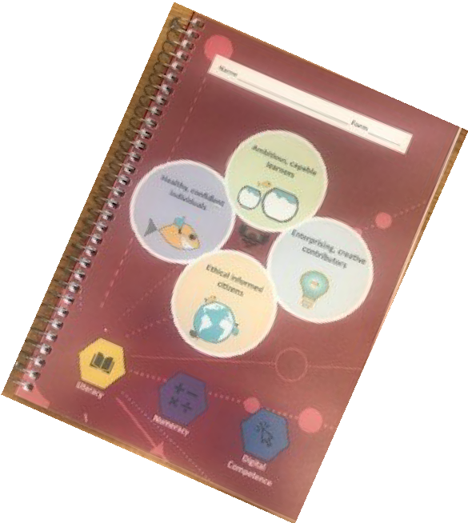
Tick Tock Tip
If you don’t have a watch, now might be a good time to get one! Packing in September will need some organisation.
Use your planner to check your homework and your timetable to see what lessons you have the following day
Pack your bag the night before
Put all the books, folders, homework, P.E. kit, cookery in your bag and take out
the equipment you don’t need.
The Planner
This is a very important part of school life. You must bring this in everyday to record information. You must show your planner to your parents everyday after school.
In your planner you will have:
your timetable
your homework
late/absence note sheets
learning agreement
school rules
notes from teachers
your parents can write notes to your teachers in your planner too

Slide 10



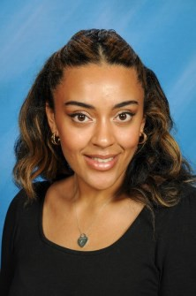
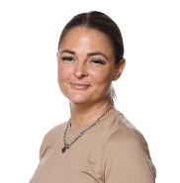
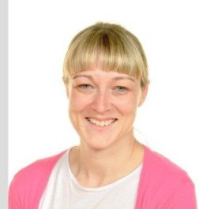
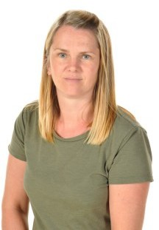
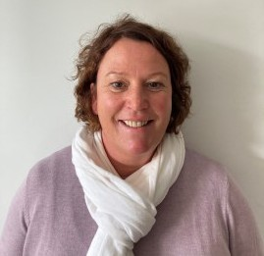
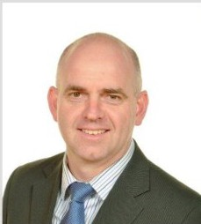
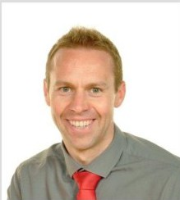
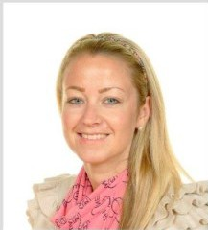
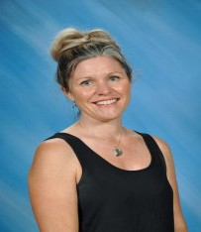
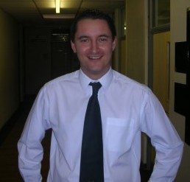
Miss L. Johnson
Year 7 Head of Year
TAC Team (Team around the Child)
Mrs. Morris
First Aider
Mrs. E. Jones
Mrs. R. Jones
Mrs. C. Parry
Headship Team
Mr. G. Rees Headteacher
Mr. A. Owens Deputy Headteacher
Mrs. R. Thomas Deputy Headteacher
Mrs. R. Holland Assistant Headteacher / ALNCo
Mr. M. Evans Resources Manager

Slide 11

Term | Term begins | Mid-term holiday begins | Mid-term holiday ends | Terms ends
Autumn 2026 | Tuesday 1 September 2026 | Monday 26 October 2026 | Friday 30 October 2026 | Friday 18 December 2026
Spring 2027 | Monday 4 January 2027 | Monday 8 February 2027 | Friday 12 February 2027 | Friday 19 March 2027
Summer 2027 | Monday 5 April 2027 | Monday 31 May 2027 | Friday 04 June 2027 | Tuesday 20 July 2027
INSET Days are yet to be confirmed

Slide 12
















For Parents/Carers
To finalise your child's admission, we kindly ask you to complete the
online consent forms provided below by clicking the links.
We understand it's lengthy, but it's crucial for ensuring a seamless transition and having all the necessary information.
Your cooperation is greatly appreciated.
2026/2027 Data Collection and Consent – Fill in form

