Slide 1


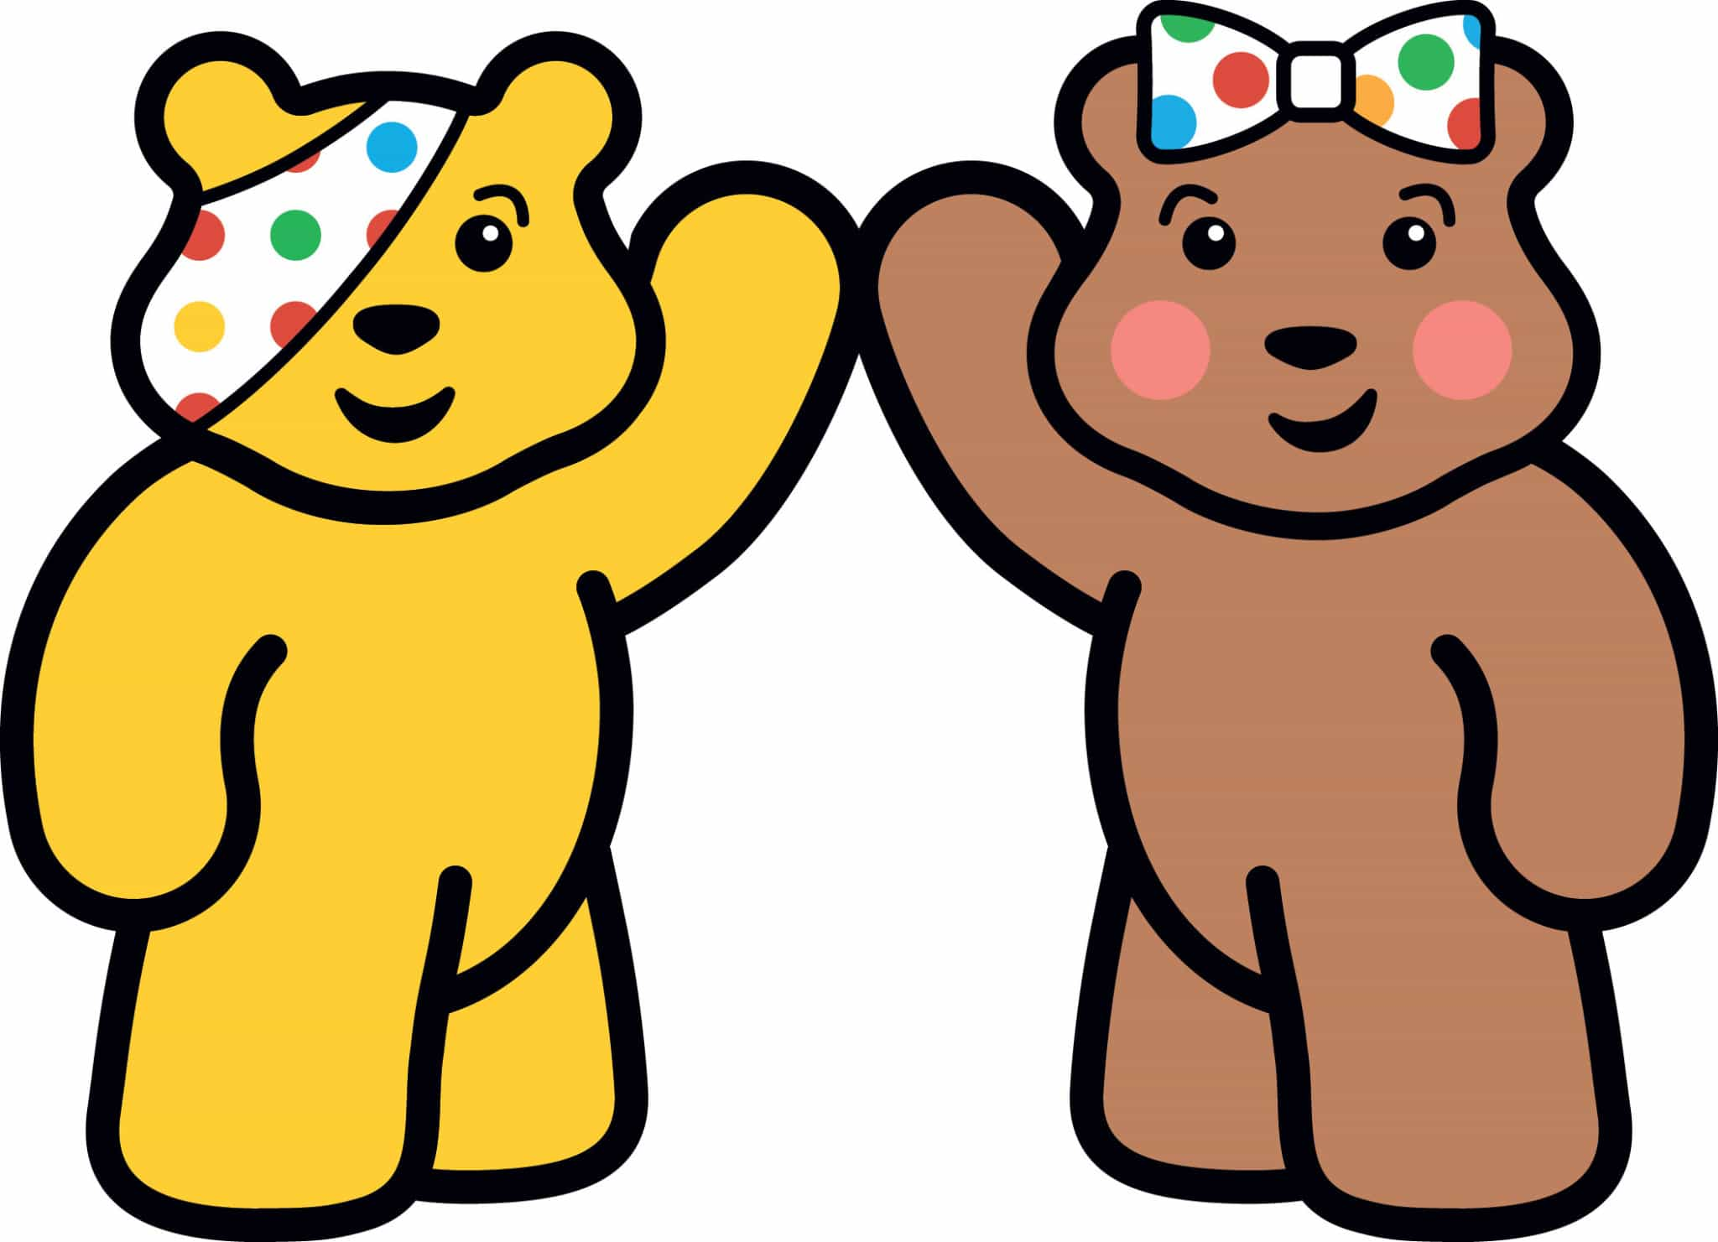
Five to Thrive
This power point is about connecting, take notice, exercise routine, being curious and giving.

Slide 2

Connect
Connecting means when you connect with people and you can trust them. You can also tell them your feelings and bond with them. Telling your feelings to friends, family or anyone you know you can tell and can trust will help on the good days and bad days.

Slide 3

Taking notice
Taking notice means when we take notice of people's feelings and not be rude to their lifestyle and how they live. Also taking notice means to take notice of people and listen to what they say.

Slide 4

Exercise Routine
Exercise routine means when you have a Routine to help you exercise. Just try to keep your body moving and try doing it every day it, doesn’t need to be for long, just to warm your body.

Slide 5

Being Curious
Being Curious means when you go out of your comfort zone and try new things you’ve never done before or want to do it to a harder level. For example, if you have never done golf before you could go out of your comfort zone and try it.

Slide 6
Give
Giving means when you do something to raise money for a charity. For example this seven-year-old boy is going to bike ride seven miles to help Children in Need.

Slide 7

Conclusion
I think that the Five to Thrive idea is good because they have activities to raise money for children in need .

