Slide 1
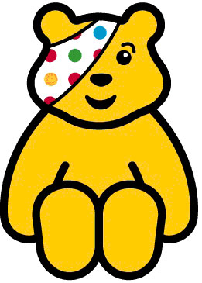
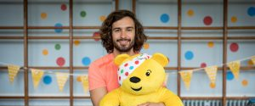
Five to Thrive
This Presentation is a recap of the Joe Wicks Five to Thrive Children In Need program

Slide 2
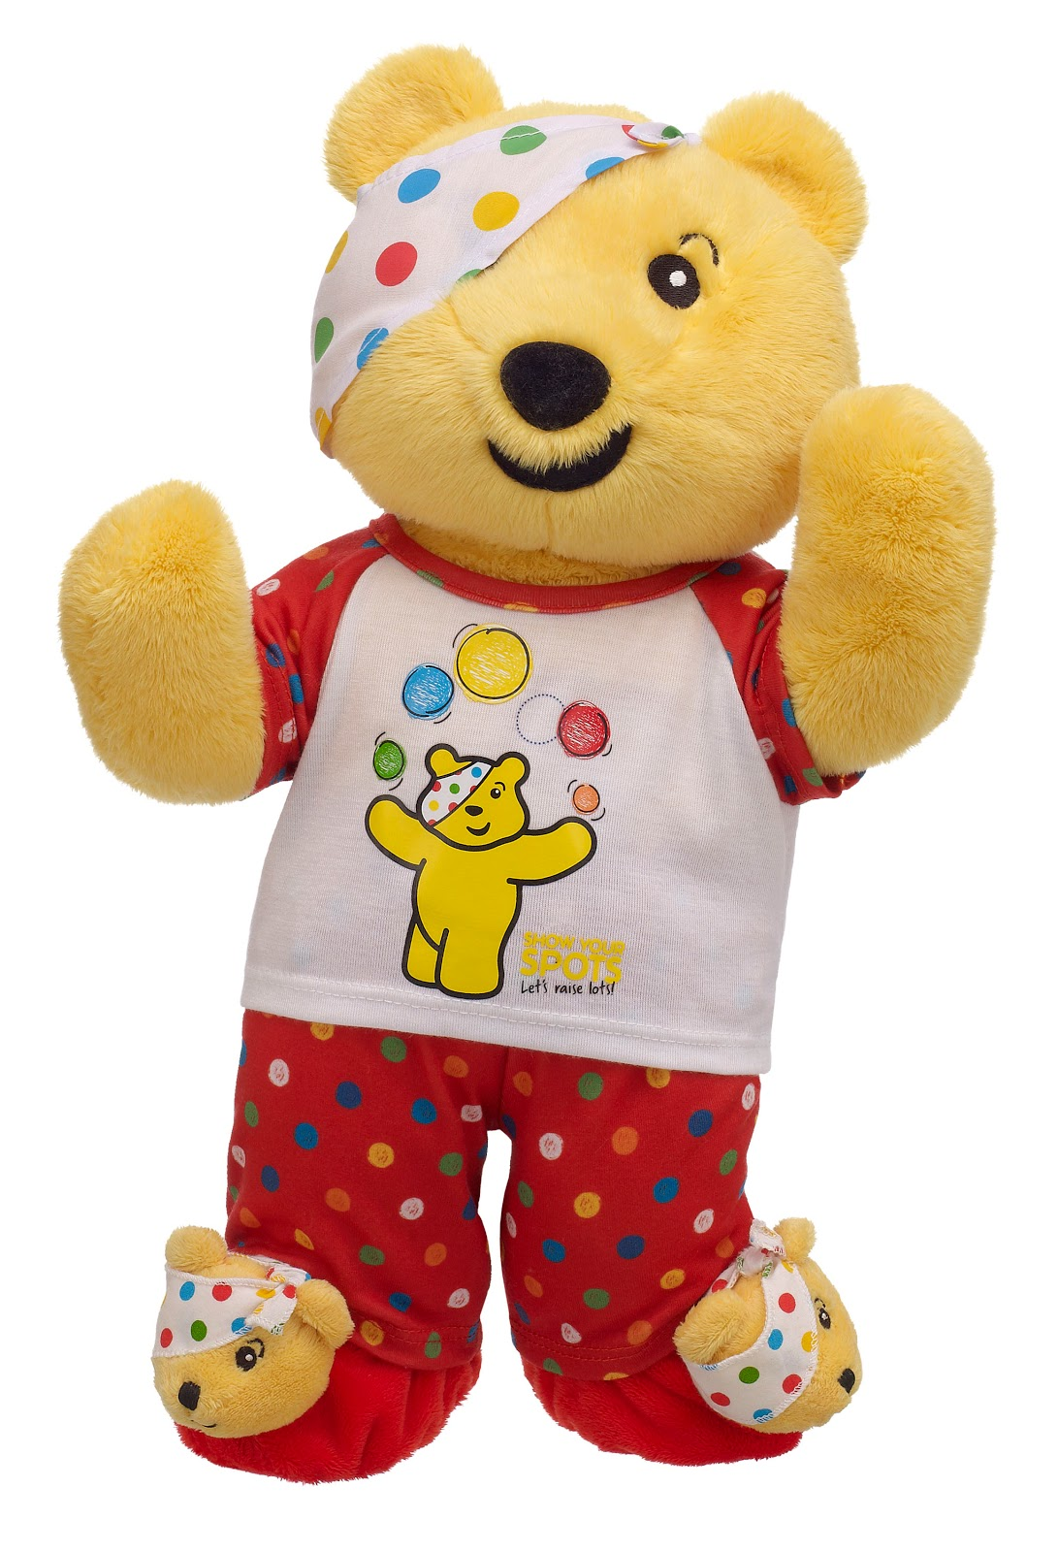
What Is BBC Children In Need?
BBC Children In Need is an event that raises money for children that need it. The event takes part all over the UK and has raised up to 55 million pounds!!! Normally children come to school dressed up on the day of Children in Need to raise money for all the ill and disadvantaged children across the UK. Since BBC's Children In Need first major appeal in 1980, we've raised over 1 billion pounds for children that need it. BBC Children in Need is currently supporting over 3000 local charities across the UK that are helping children and young people facing a range of disadvantages and have changed lives of over 600,000 children.
Please Visit The Children In Need Website Here

Slide 3
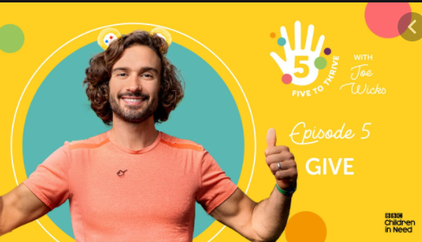
What Is Five to Thrive?
Five to Thrive is a program by BBC. The purpose of the program is to help children improve their physical and mental wellbeing. The Five to Thrive series took place on the week of Children in Need, 2020. On the show there were lots of special guests, such as, Dr Radha and Blue Peter. With the help of Joe Wicks, primary school children have improved their mental and physical health through Five to Thrive.

Slide 4
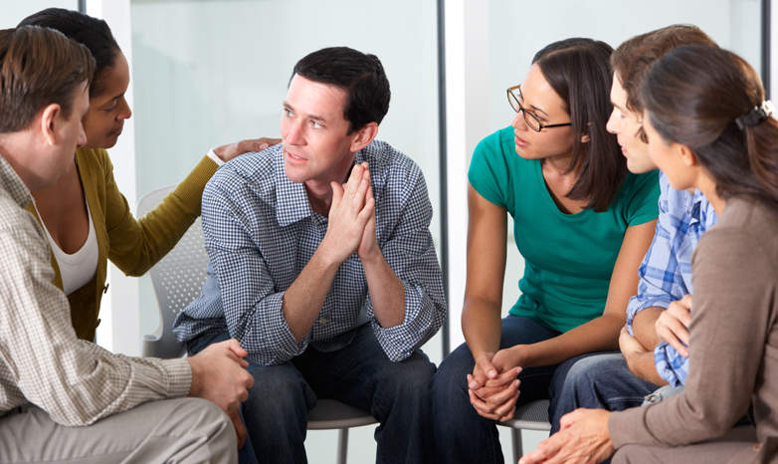
Day 1 of Five To Thrive
(Connect)
Day 1 of Five to Thrive was based on connecting. In this episode Joe Wicks was joined by GP and broadcaster Doctor Radha.
Connecting means talking to other people like friends and family about our feelings and what is going on around us that might make us upset. During the video Doctor Radha went deep into how connecting is great for our mental wellbeing. She also told us about how connecting with our family and friends helps us feel happier and more comfortable.
In this lesson about connecting we learnt:
Connect is about talking to people about feelings
It is good to be open and honest with each other
If we connect, we will feel less lonely and isolated
It is just as good to listen to your friends and family rather than just yourself
Even if the problem is small, still talk about it, because a good friend will always listen

Slide 5
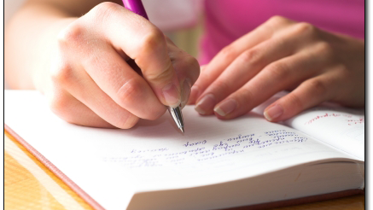
Day 2 of Five to Thrive (Take Notice)
The second day of Five to Thrive was about taking notice. In this episode Joe is talking about how taking notice of our lives really improves out mental wellbeing. Taking notice is about taking in what is happening around you, whether that is hearing, seeing or smelling. Taking notice helps you feel more present and lively in the moment.
A good idea of taking notice is writing down things that make you happy and what things make you worried. Then look at the things that make you worried and remind yourself that you don't need to worry about them. Then look at the things that make you happy and try to do those things. Doing this will help you feel better about yourself.

Slide 6

Day 3 of Five to Thrive (Get Active)
On the third day of Five to Thrive, Joe Wicks was talking about how getting active can boost both your physical and mental health. During the episode he did exercises and told us to join in. Getting active doesn't need to be hard, it can even be going for a walk. You can get active everywhere, you don't need special equipment or access to a gym. Getting active boosts your mental wellbeing as well as your physical wellbeing you normally feel a lot better after a workout. You can feel awake and ready for the day.
In this lesson about getting active, we learnt:
Getting active is about getting your body moving
It doesn't have to be an intense workout
It is physically and mentally good for us
It is good to get active regularly, maybe make it part of your day
It combines other ways of wellbeing, such as, taking notice and connecting

Slide 7
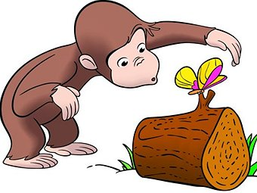
Day 4 of Five to Thrive (Be Curious)
On Thursday's video we learnt about being curious. On this episode Joe was with BBC's Blue Peter. There were two BP presenters speaking, they were Mwaksy and Adam. They showed a video of them with two other children (Abigail and Oliver). Adam and Mwaksy gave a great example of how being active boosts your physical and mental health by trying something new.
Overall they explained that being active:
It helps improve your well being
It boosts your self-esteem
It improves your mental health
It helps you communicate
You get a sense of achievement

Slide 8
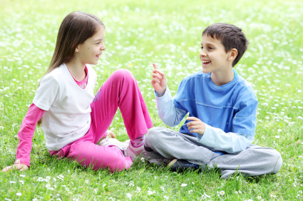

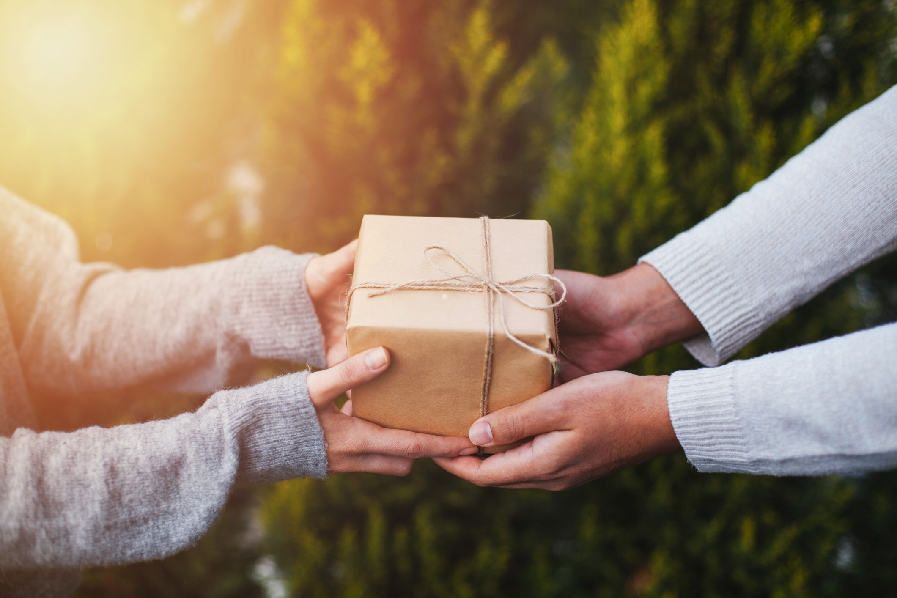
Day 5 of Five to Thrive (Give)
On the 5th day of Five To Thrive, Joe talked about how good it is to give. In this episode Joe is joined by a 7yr old boy who rode 7 miles for Children In Need, Seth. In this episode Joe and Seth explain that giving isn't just giving money or giving someone a present, but it is also giving someone your time. Giving doesn't just make someone else feel happy, but it can also make you feel happy and overwhelmed too.
In this lesson about giving, we learnt:
Giving is about doing something kind for other people
The more you give, the happier you'll become
Giving is a kind, positive action that makes them and us happy
Giving can boost your self-esteem
Giving helps us connect with people

Slide 9
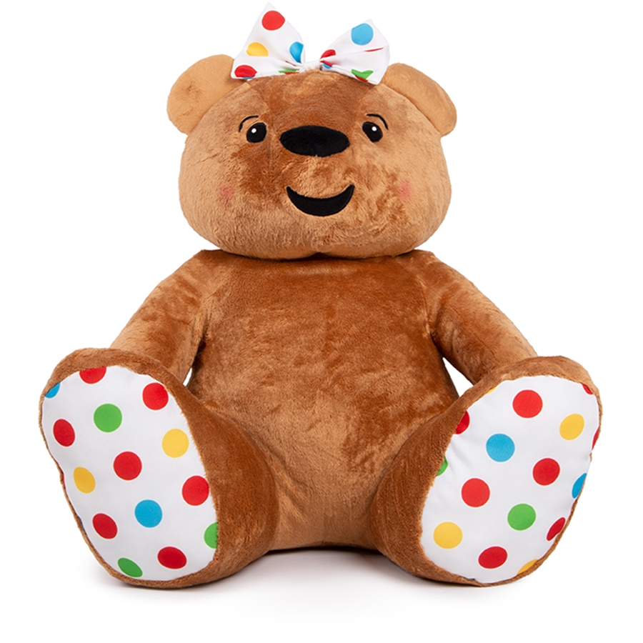
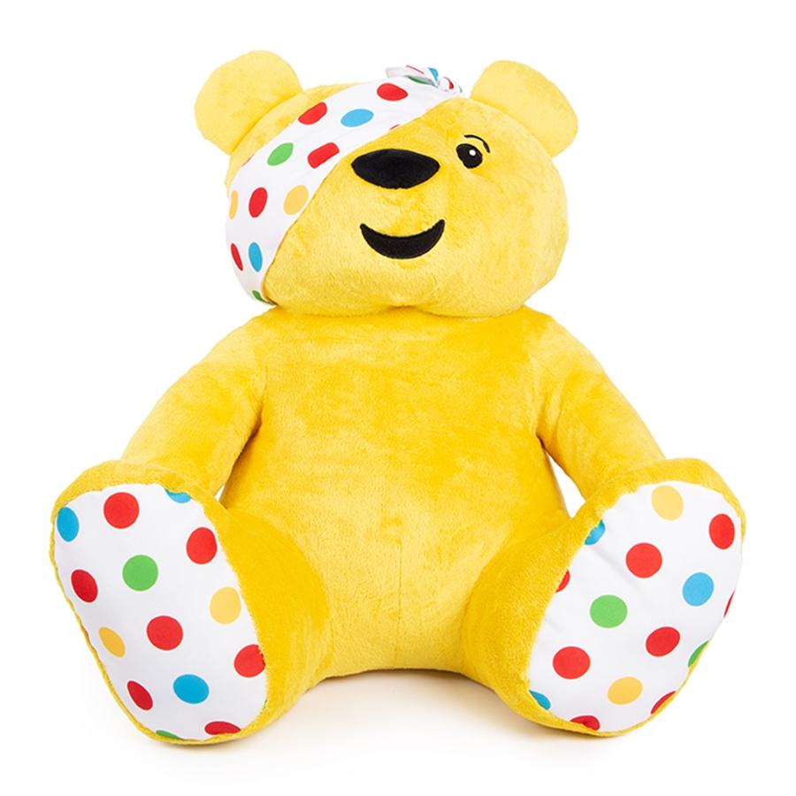
Usefull CIN (Children In Need) Websites
Visit the BBC children in need website here.
Any questions? Click here to see some answers to frequently asked questions.
Want to donate? Click here to do so.
Want to visit the Five To Thrive Hub? Click here to do so.
Want to buy something Pudsey? Click here to visit the CIN shop.

Slide 10

THANK YOU FOR GIVING YOUR TIME TO SEE THIS PRESENTATION!

