Slide 1


LPS News!
New Waste Bins on the Yard!
Created by: Carter Davies

Slide 2
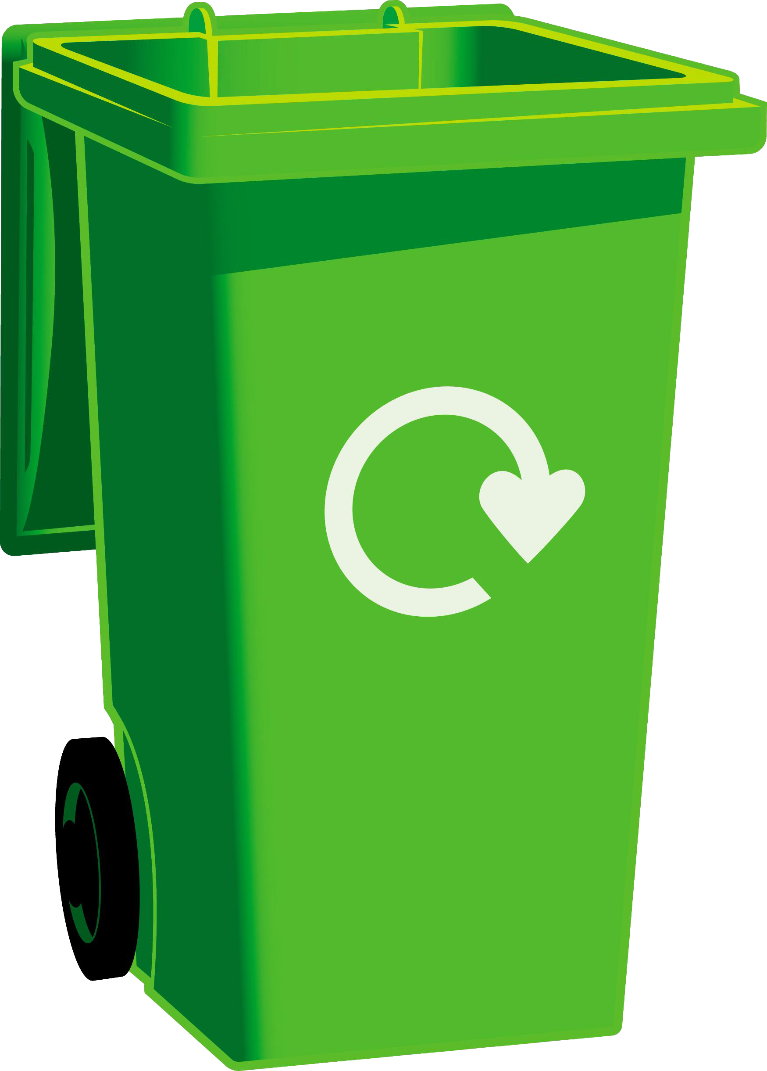
What's Going On...
We have got new waste bins on our yard! We have 1 for Food Waste and another for Plastic Waste! But don't worry, Because our Black bins for general waste are still around!
Food Waste and Plastic Waste bins will look a bit like this!
This Photo by Unknown author is licensed under CC BY-NC.

Slide 3
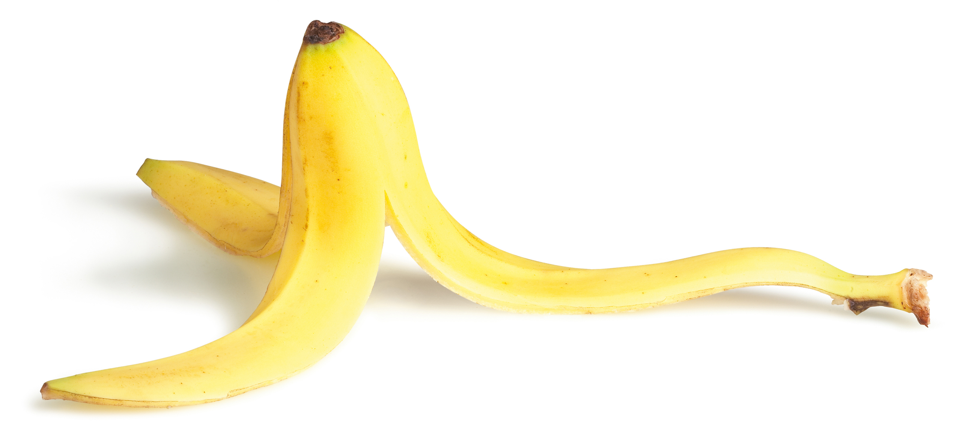
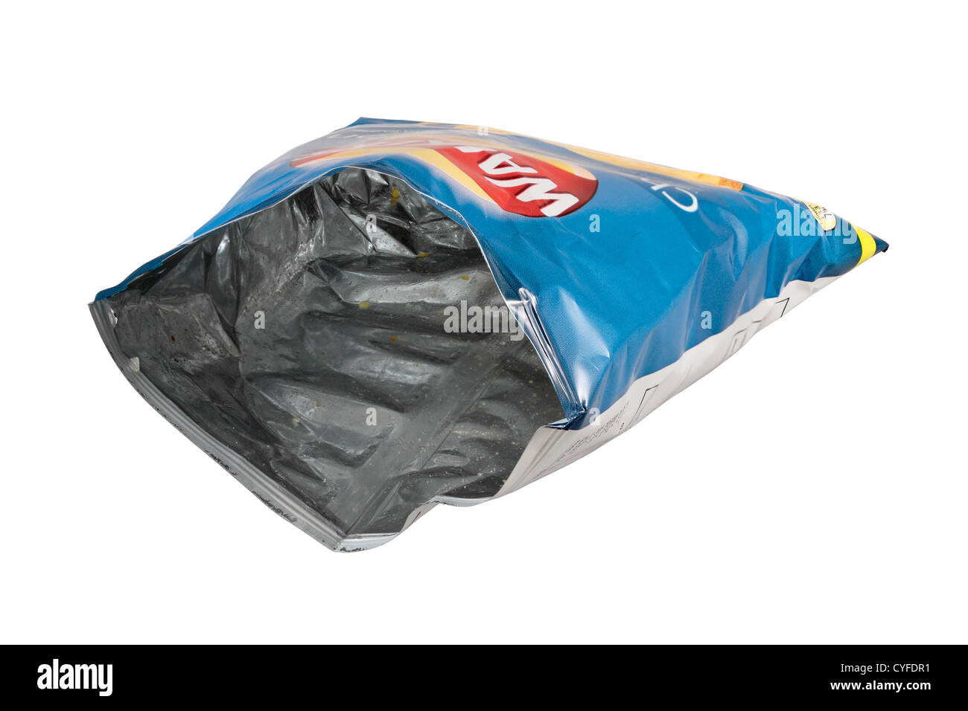
What Goes In Our Bins?
As their names suggest, leftover food (Banana Peels, Apple Cores, etc) goes in the Food Waste Bin while Plastic Waste (Plastic Bottles, Yoghurt pots, etc) go in the Plastic Waste Bin, and as you probably know stuff like crisp packets and breakfast bar wrappers go in the Black Bin!
PS: Mr Flowers and Triple H Members will check and monitor the bins regularly.

Slide 4
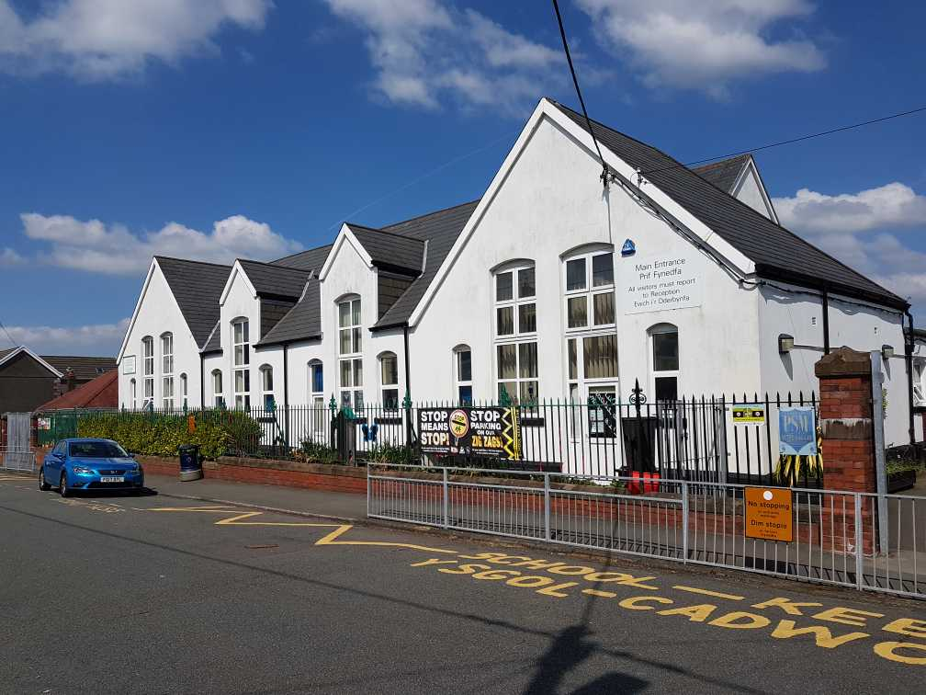
Where do you find our new Bins?
You can find our new bins on all 3 yards! This means Top Yard, Middle Yard, and Bottom Yard!

Slide 5
Why do we need the Bins?
If you think you know, put your hand up and we will answer!
Thinking Time!

Slide 6

We need your Help!
Your new homework is to help us make new posters for our bins! To do this, you need to make 2 posters, 1 for the Plastic Bins and another for the Food Bins, The Triple H will choose who has made the best posters, Who knows, maybe it could be you!
PS: Deadline next Monday!

Slide 7


Thank You for Listening, Bye!

