Slide 1
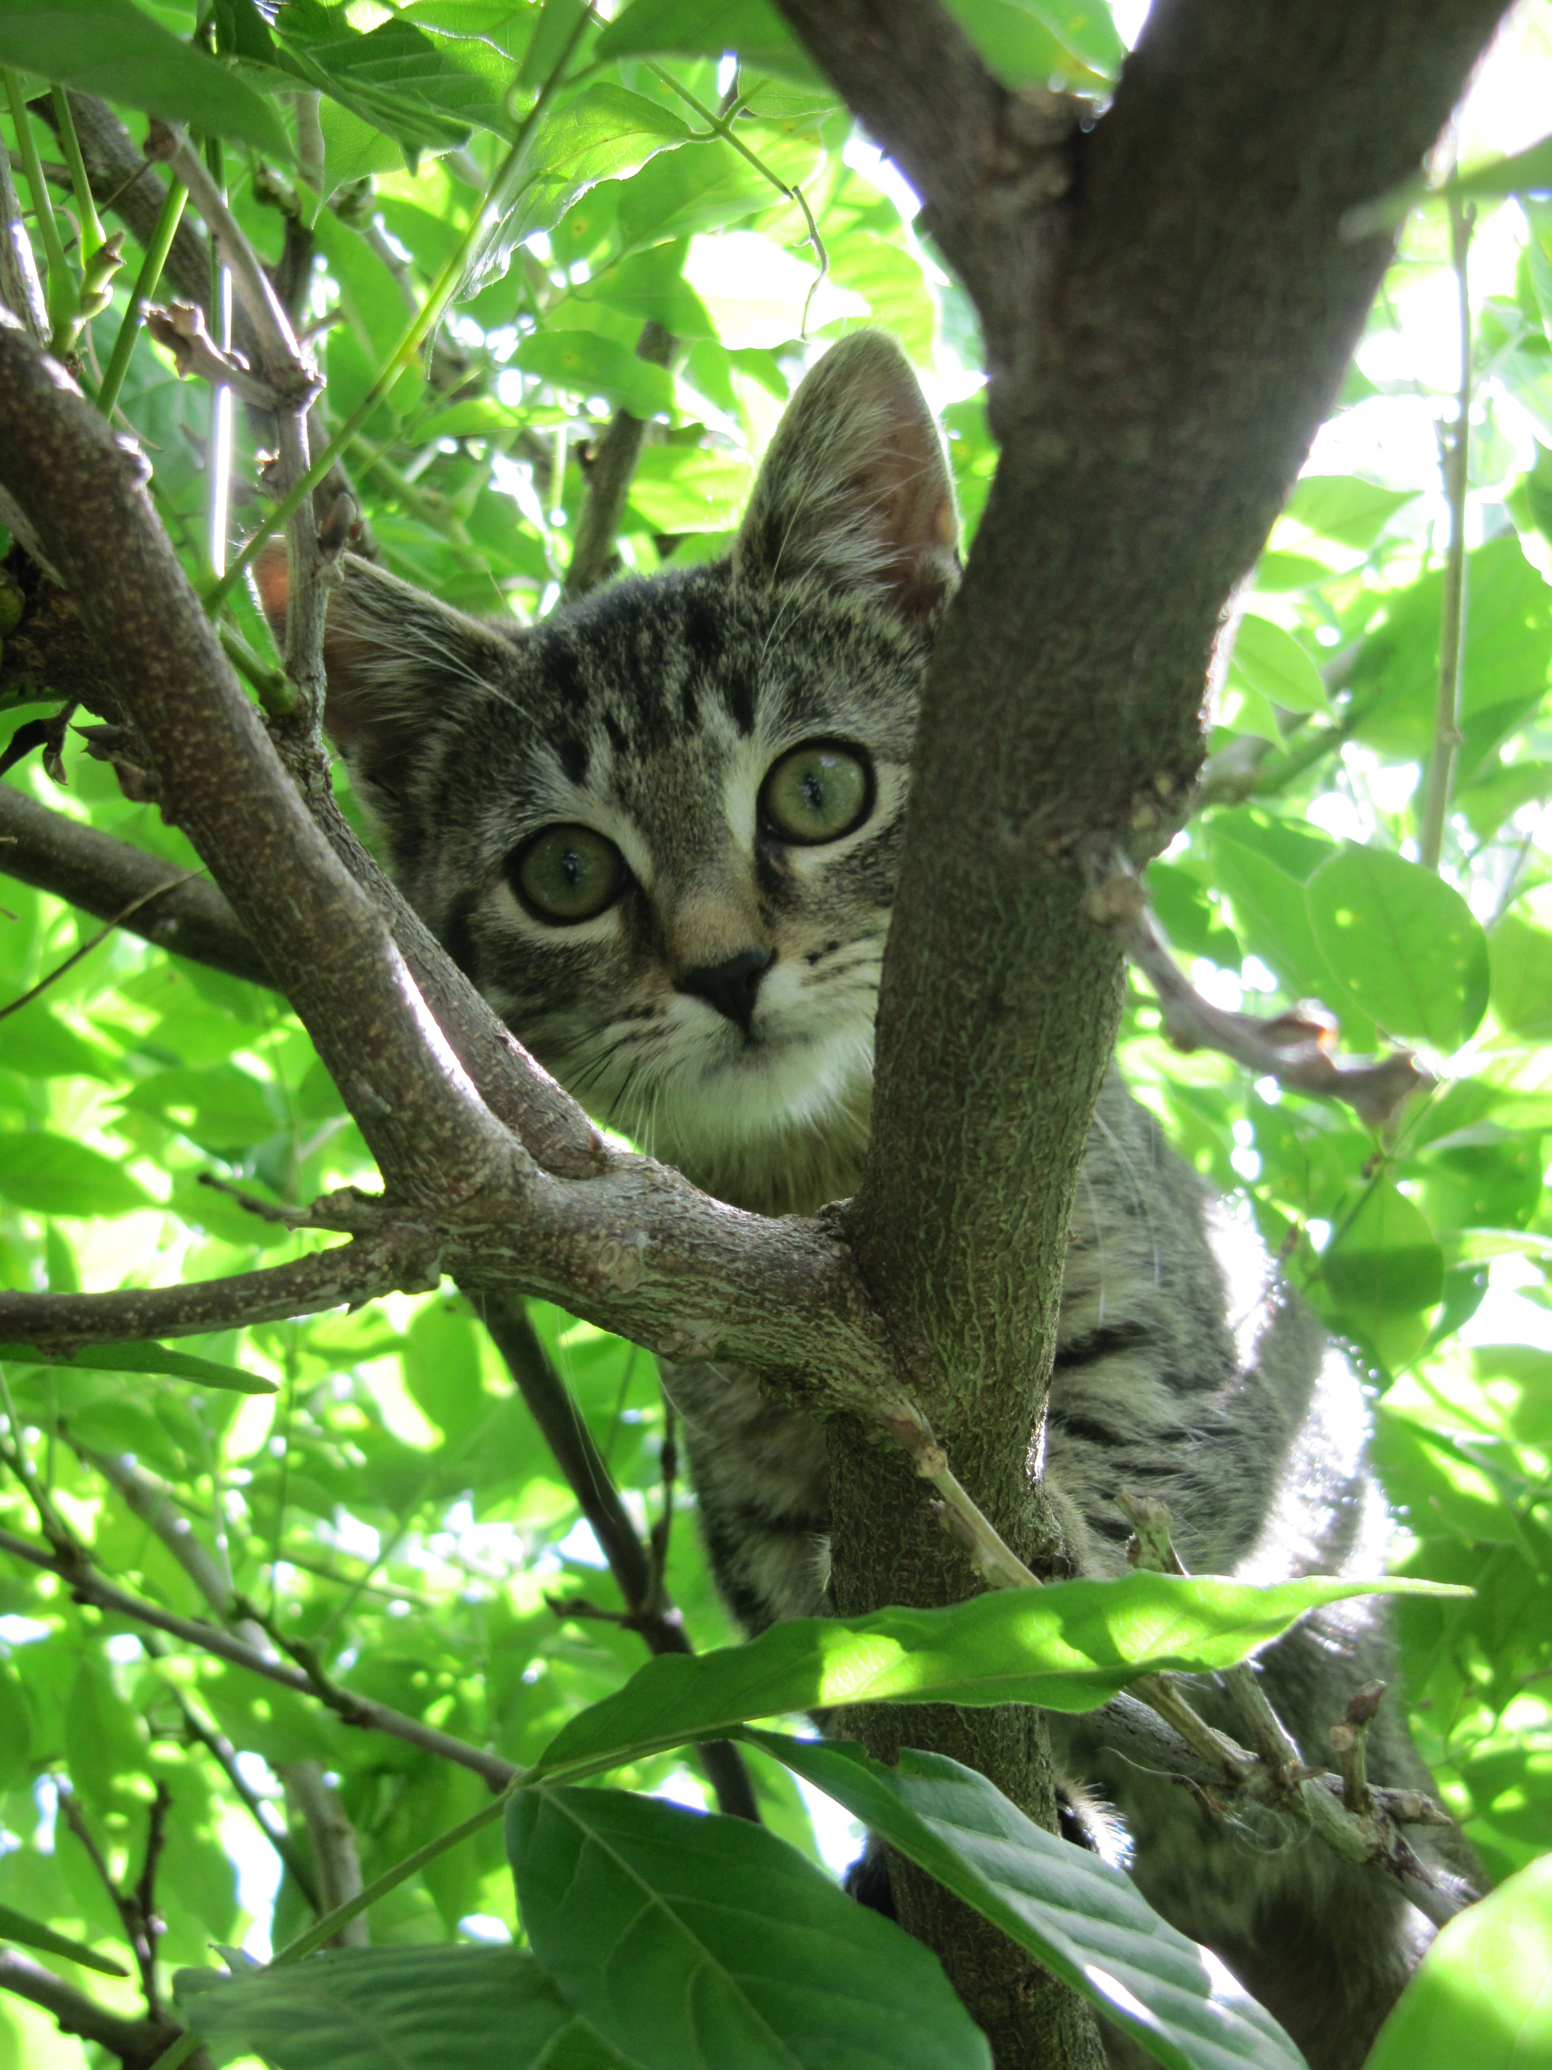
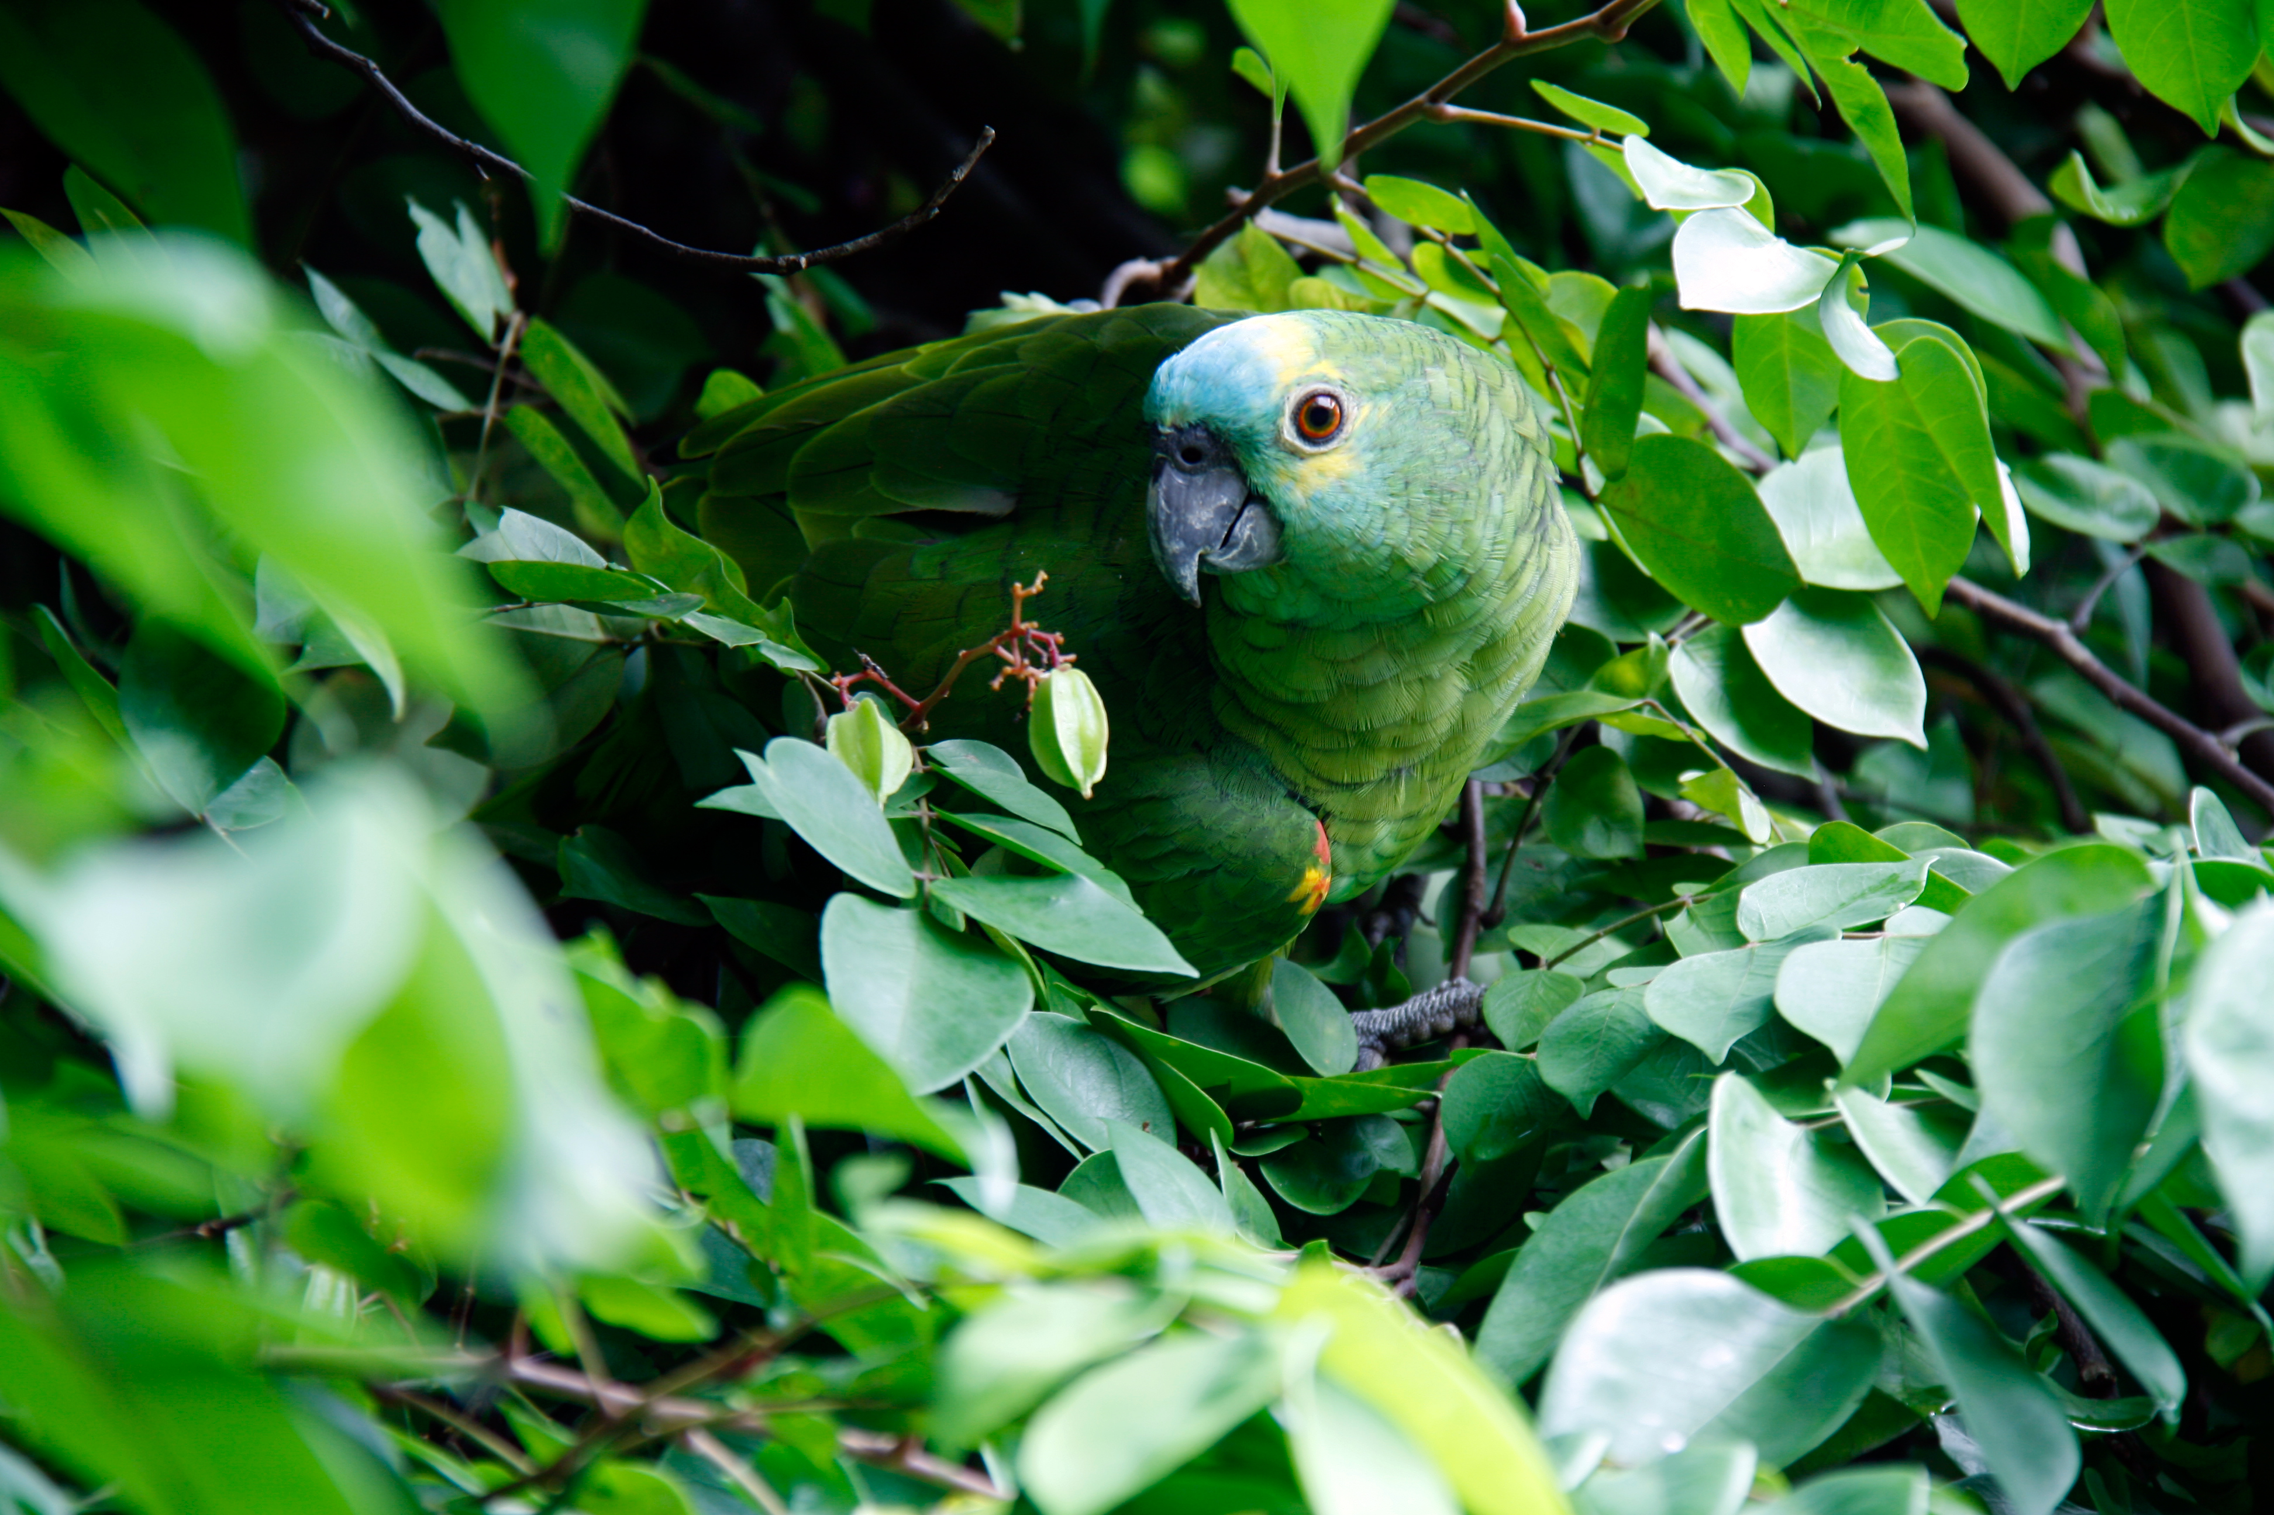
What Animals Live in the Rainforest?
By morgan coe

Slide 2
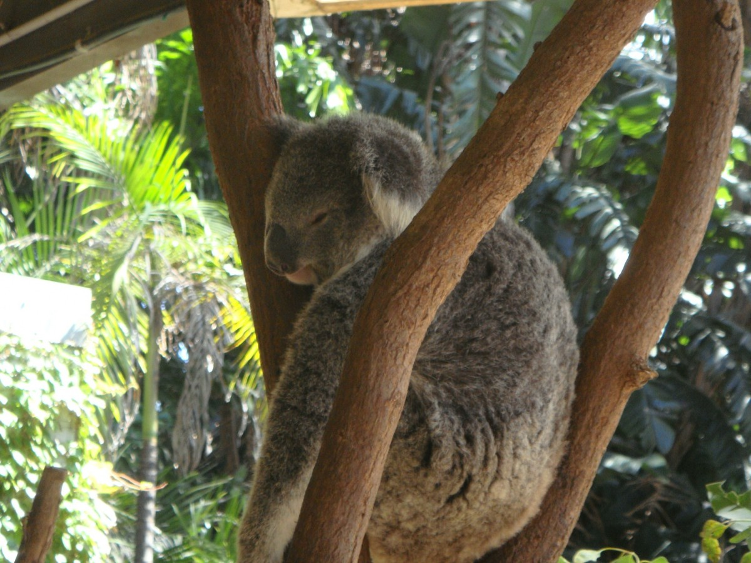
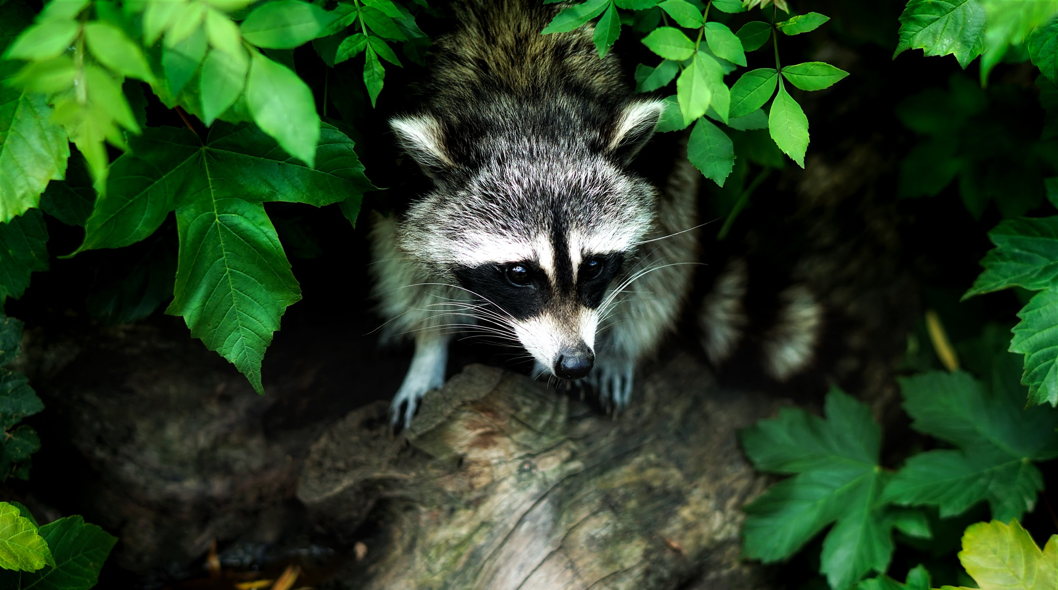
Rainforest Animals
A rainforest is a beautiful place full of plants and animals. Some animals and plants can be poisonous, and some are not. Fun fact - did you know that around 80% of rainforest animals such as toucans and orangutans live in the canopy layer of the rainforest?

Slide 3
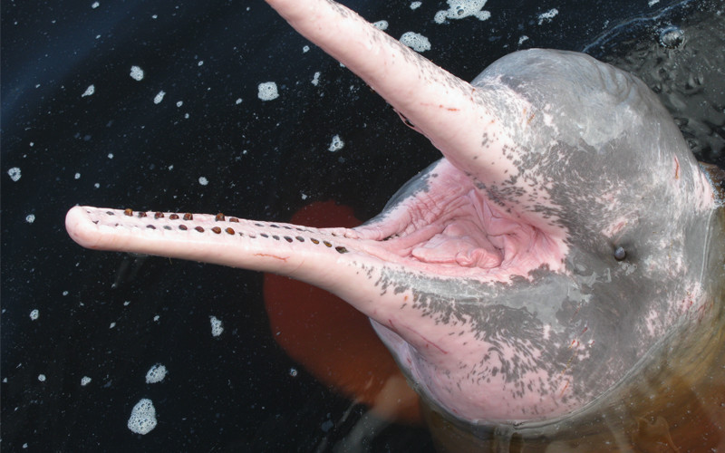
Amazon pink river dolphins
In the Amazon Rainforest there are rare creatures called Amazon pink river dolphins. They are very rare because they are endangered and they are only found in the Amazon river.

Slide 4
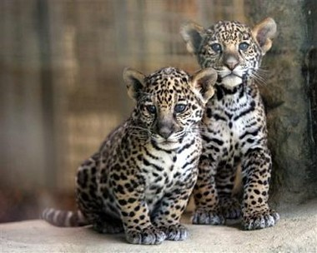
Jaguars, Ocelots and Leopards
Jaguars, ocelots, and leopards are all types of big cats that live in the rainforest. Leopards are very fast and ocelots are too. Overall, they are cool animals.

Slide 5
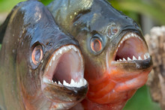
Piranhas
In the rainforest there are very deadly fish called piranhas. They are very deadly because they have sharp teeth and they can bite and kill, so they are dangerous.

Slide 6
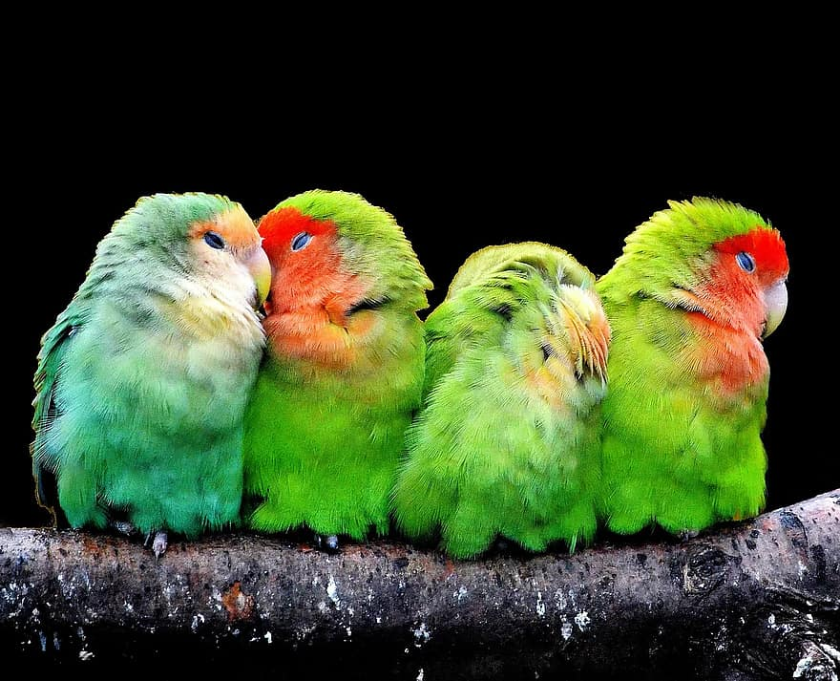
Parrots
In rainforests there are very cute animals called parrots. They have zygodactyl feet, two toes on the front and two on the back. Parrots are excellent problem solvers - sometimes using tools or working together to solve problems.

Slide 7
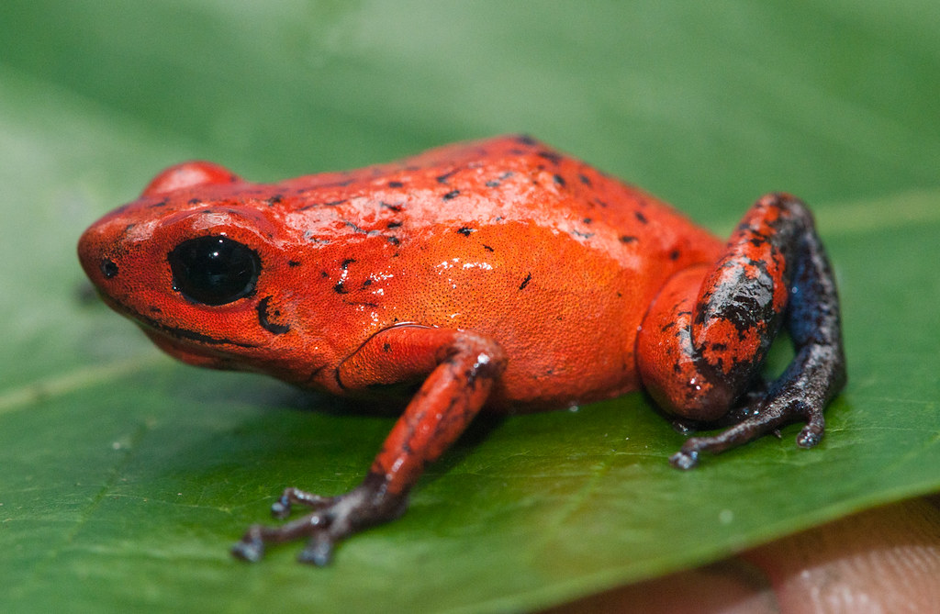
Poison dart frogs
In the rainforest there are poisonous creatures called poison dart frogs. Poison dart frogs are so poisonous that they can kill more than 100 people in their lifetime.

Slide 8
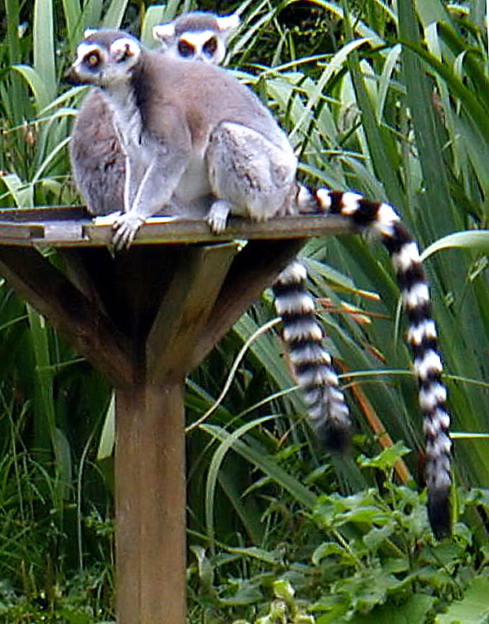
lemurs
Lemurs are animals that live in the rainforests. Fun fact - did you know that the word lemur comes from the Latin word for ghost.

Slide 9
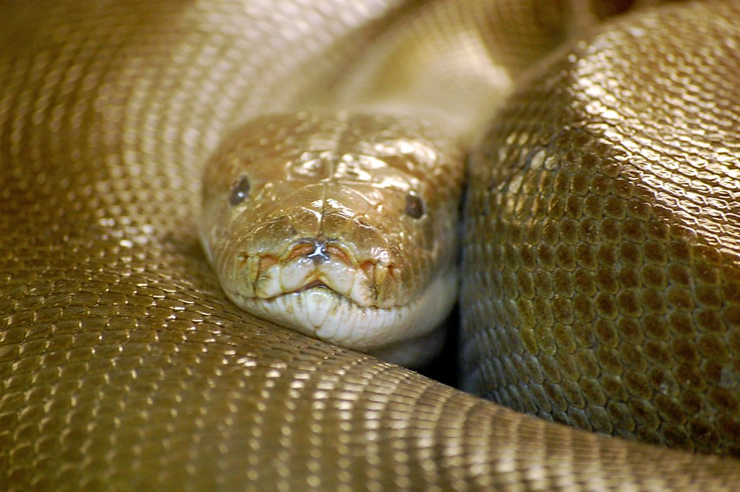
ANACONDA
Anacondas are a type of snake in the rainforests - they are very deadly. They are not poisonous though. They coil around prey, then apply pressure stopping the prey's heart completely or stopping its blood supply. Then it swallows the prey whole.

Slide 10
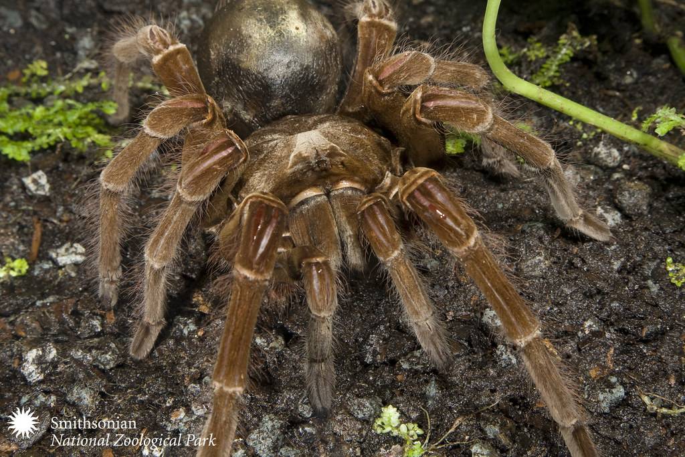
Goliath Bird Eating Spider
In the rainforest there are deadly spiders called goliath bird eating spiders, but they rarely eat birds. They mainly eat insects, worms, rodents, frogs and lizards.

Slide 11
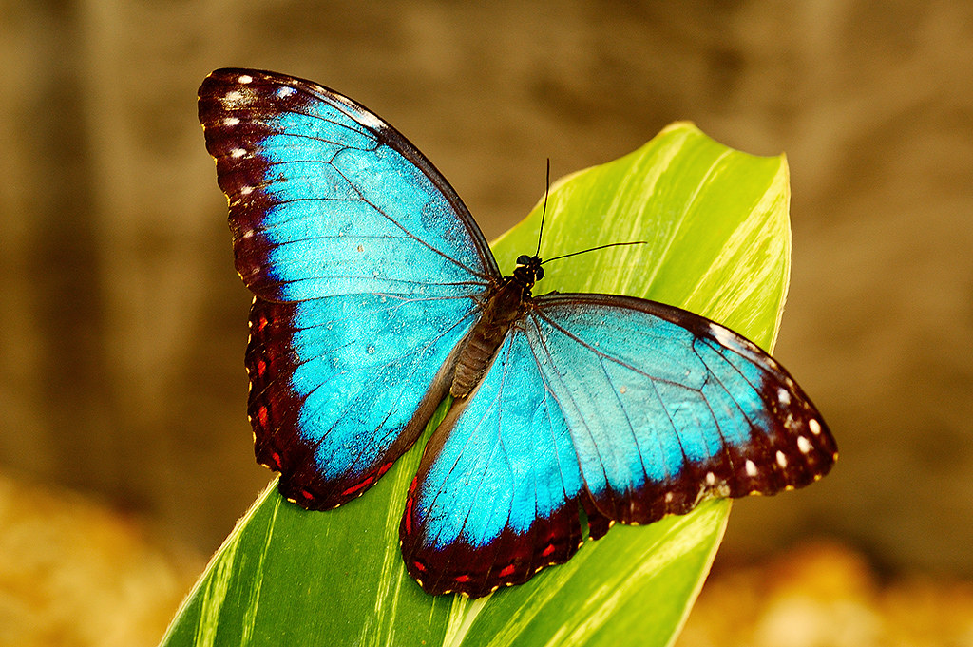
Blue Morpho Butterflies
In the rainforest there are beautiful butterflies called blue morpho butterflies. Blue morpho butterflies have blue wings which get their colour from light reflecting rather than pigments.

Slide 12
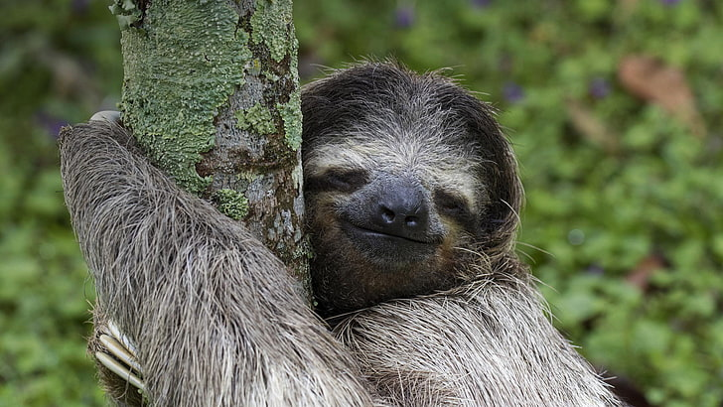
Sloths
In the tropical rainforests there are slow animals called sloths. They are so slow that they only move at 0.15mph making them the slowest animal. Three toed sloths have two extra neck vertebrae.

Slide 13
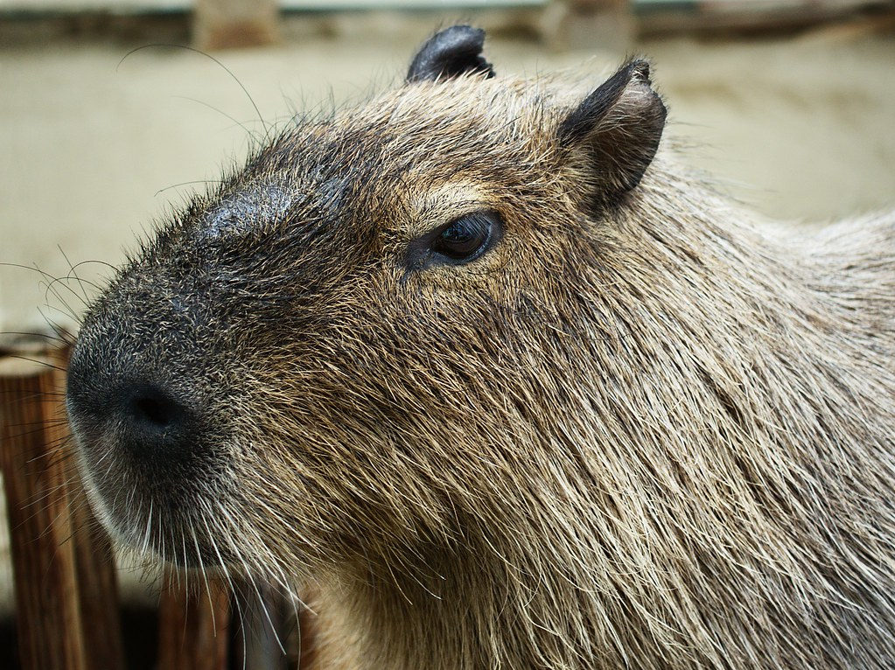
Capybaras
In the rainforest there are animals called capybaras. They aren't really dangerous, they are friendly.

Slide 14
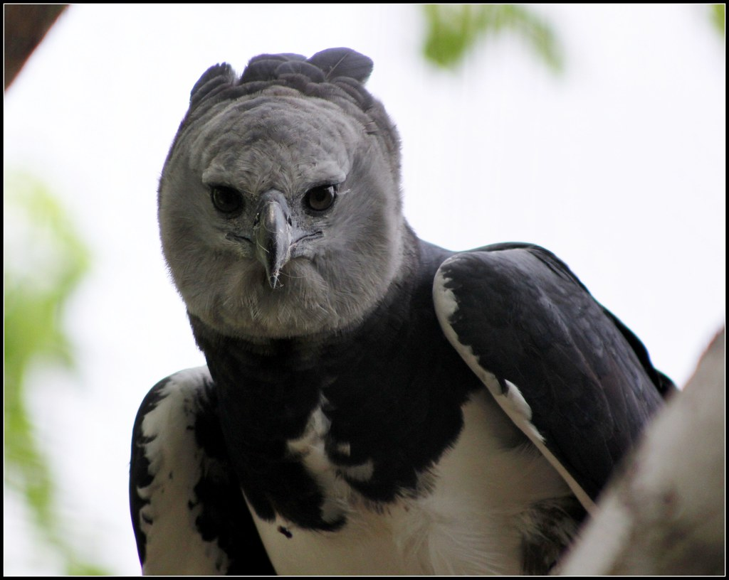
Harpy Eagle
Harpy Eagles are another animal that lives in the rainforest. Harpy Eagles are the largest and most powerful bird on earth. They hunt by waiting for prey to come and then snatch their prey from the ground.

Slide 15
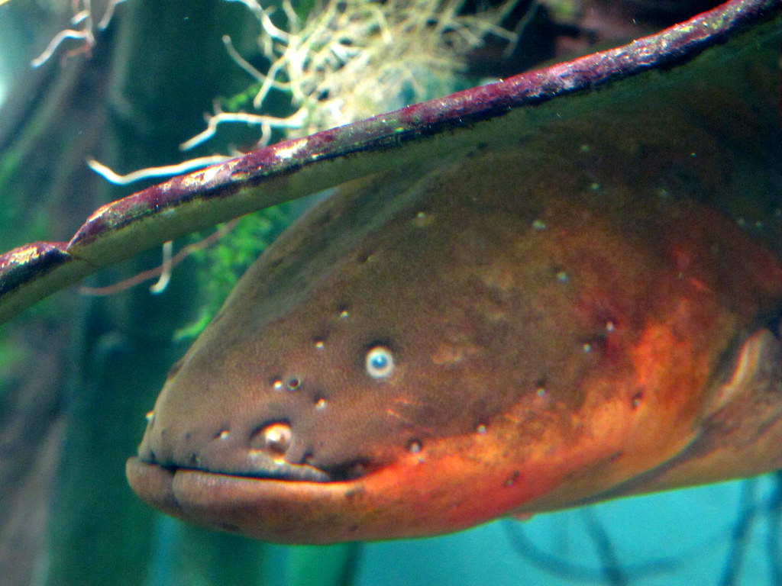
Electric Eel
In the rainforests there are
In the rainforests there are deadly animals called Electric eels. They are known for their ability to stun their prey by delivering shocks up to 860 volts.

