Slide 1
What Animals Live in the Rainforest?
By Callie

Slide 2
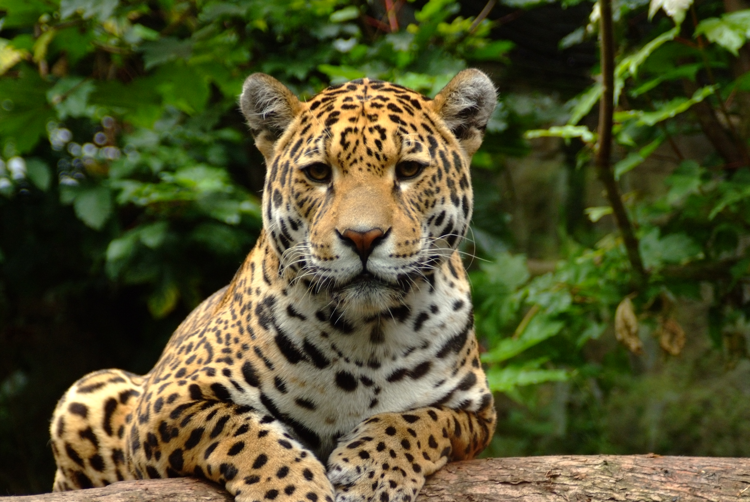
Jaguar
One of the rainforest animals is a Jaguar. Jaguars are fast and they live on the forest floor.

Slide 3
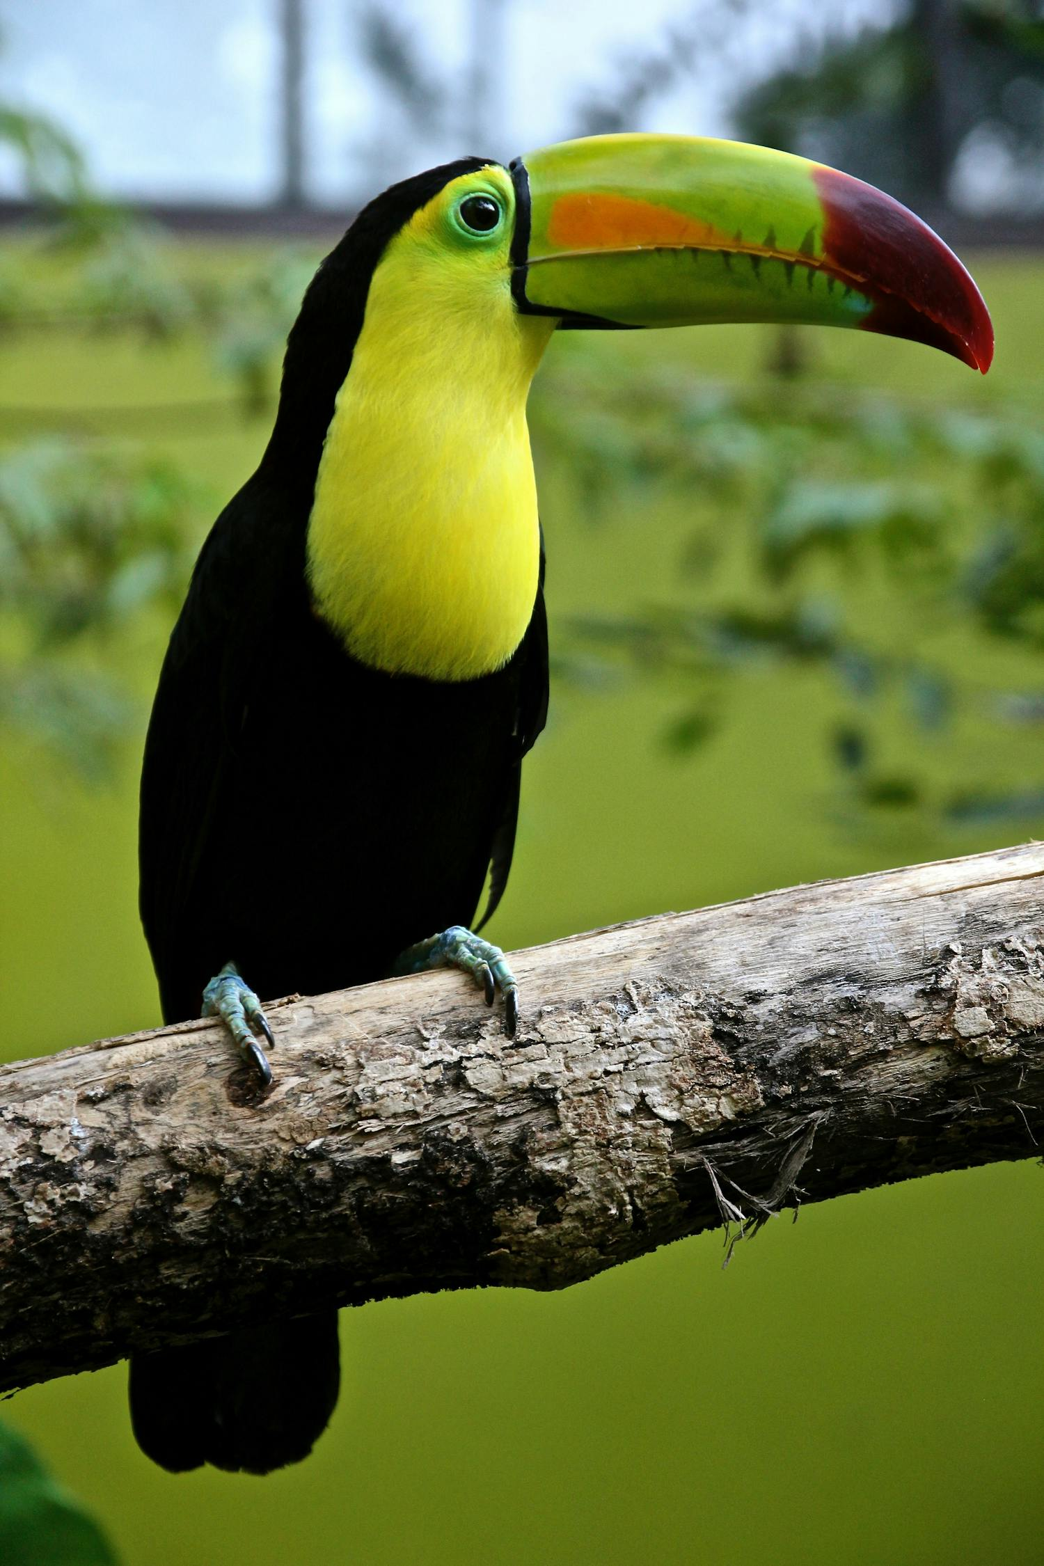
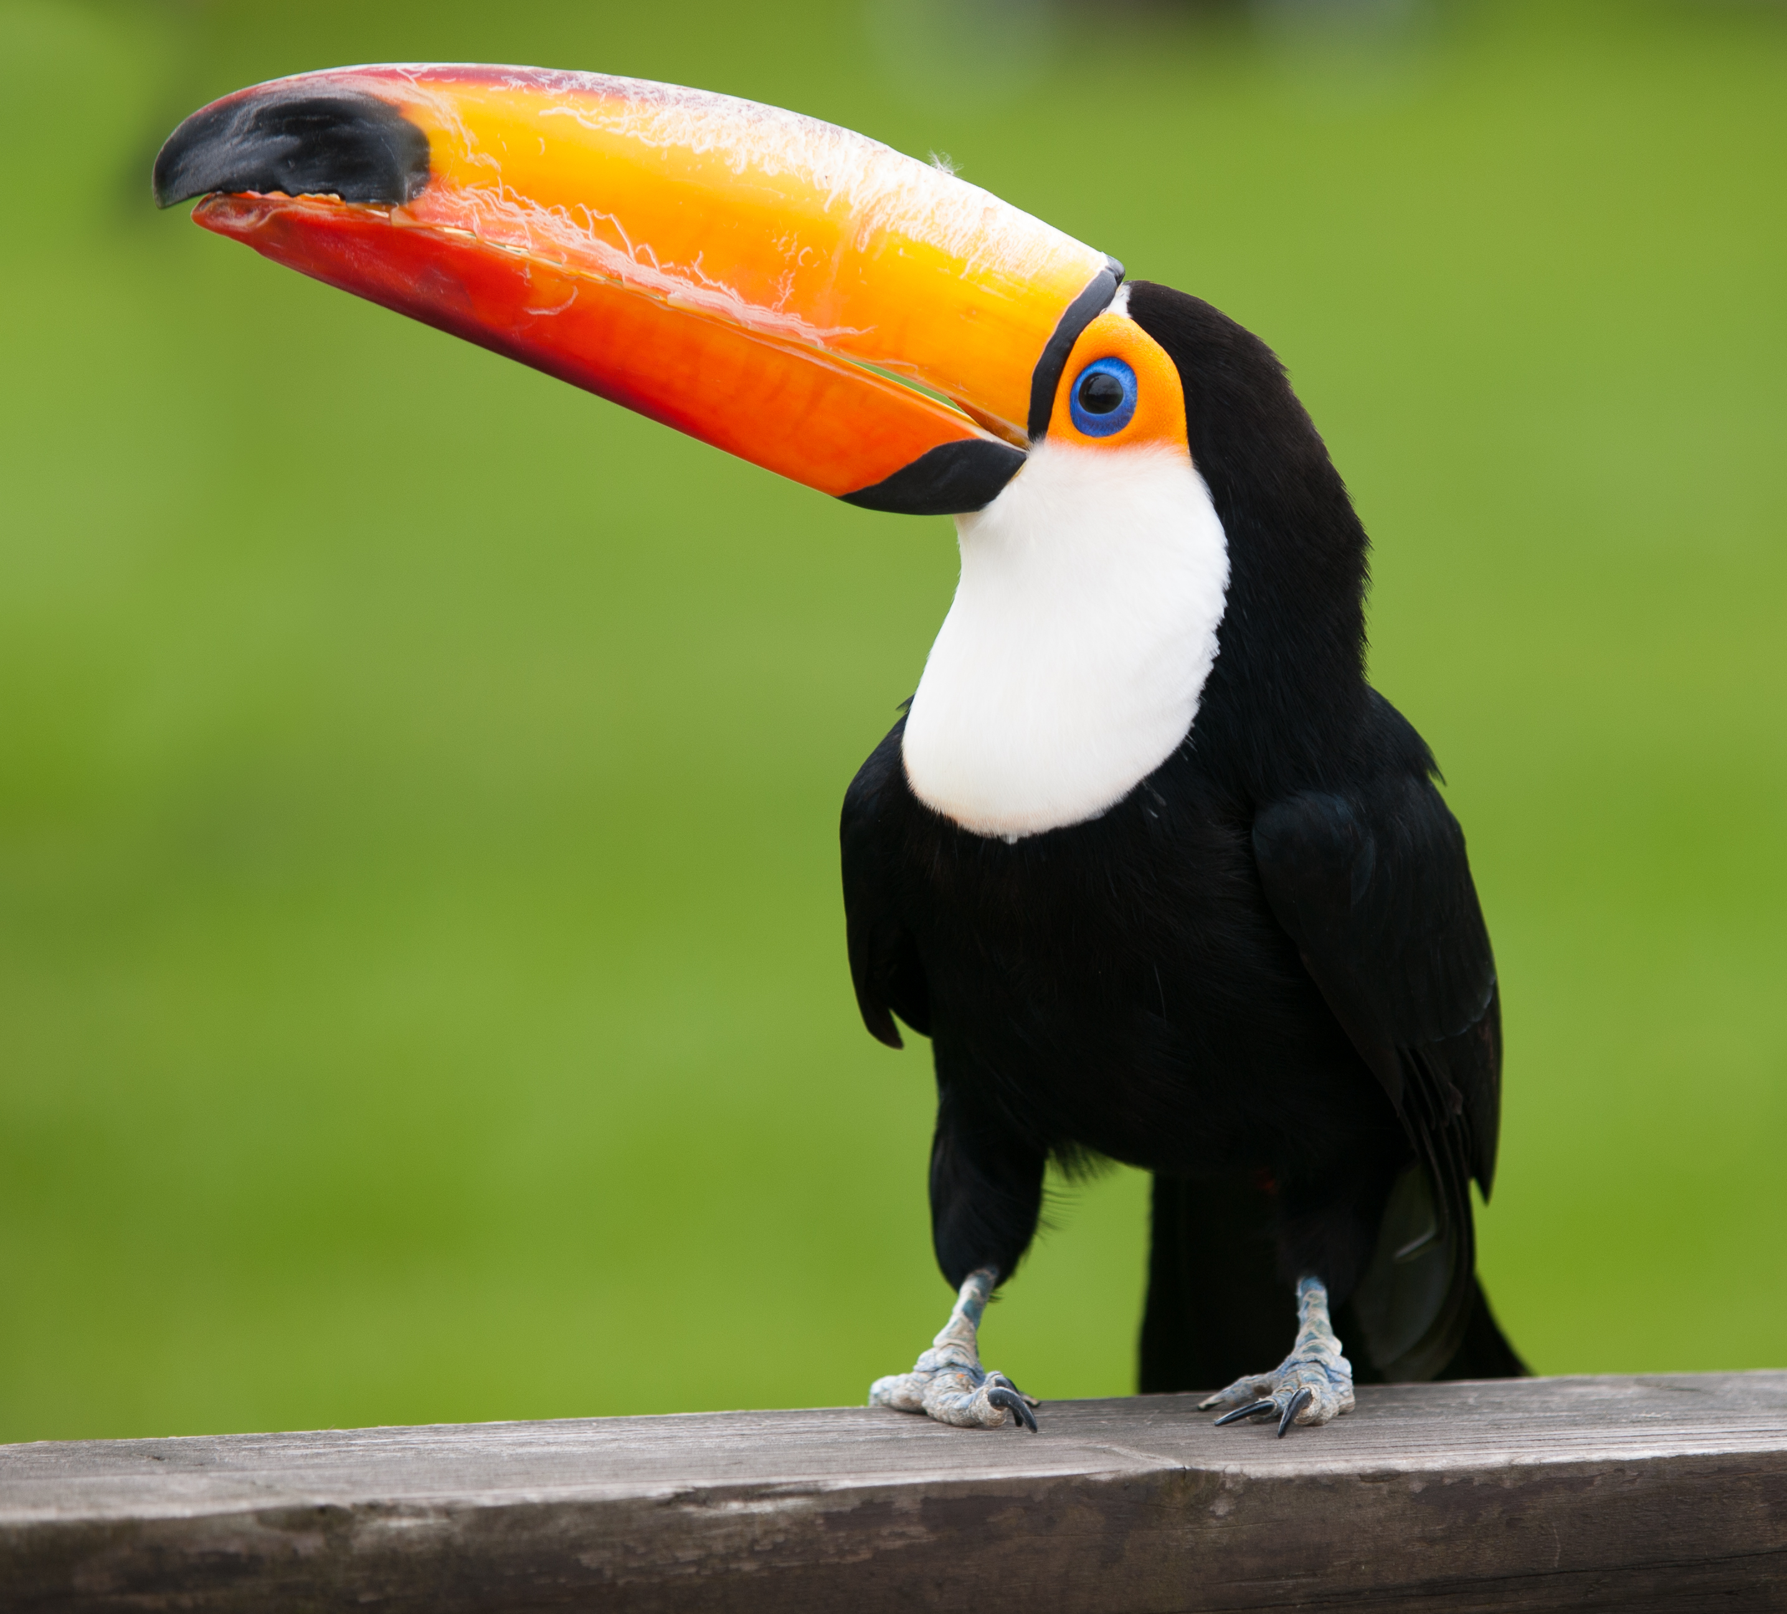
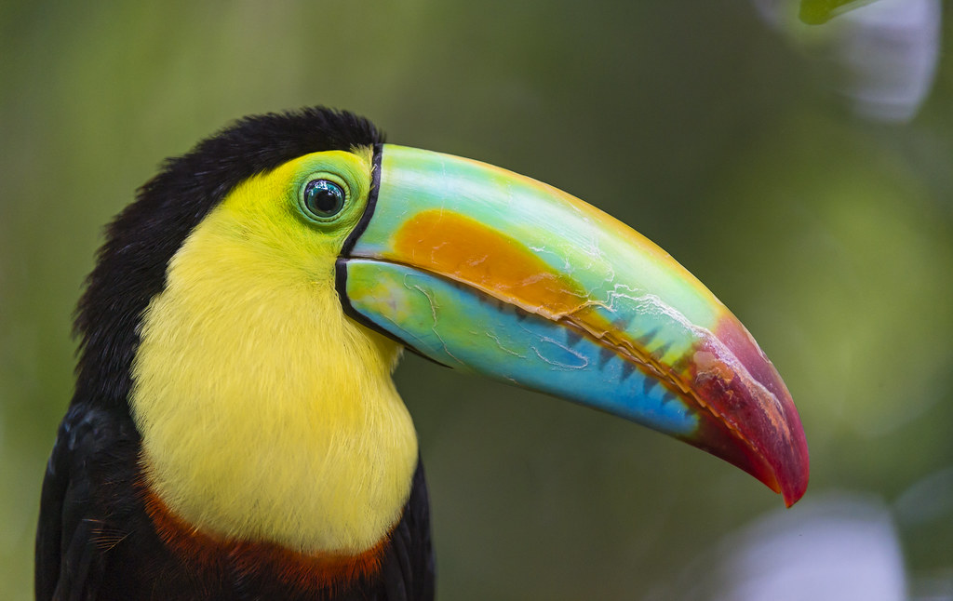
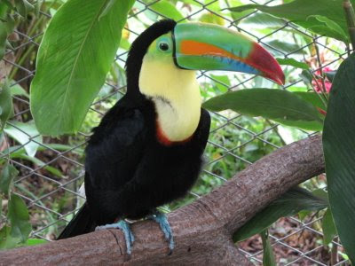
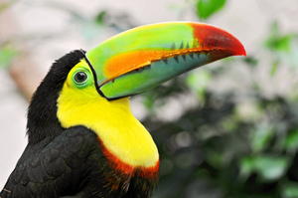
Toucans
Toucans live in the rainforests and their homes are in the canopy layer.
.
ThePhoto by PhotoAuthor is licensed under CCYYSA.
ThePhoto by PhotoAuthor is licensed under CCYYSA.
ThePhoto by PhotoAuthor is licensed under CCYYSA.

Slide 4
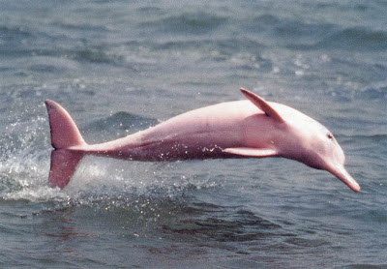
The Amazon Pink River Dolphin
Another rainforest animal is called the pink river dolphin. They are only found in the Amazon river.
.

Slide 5
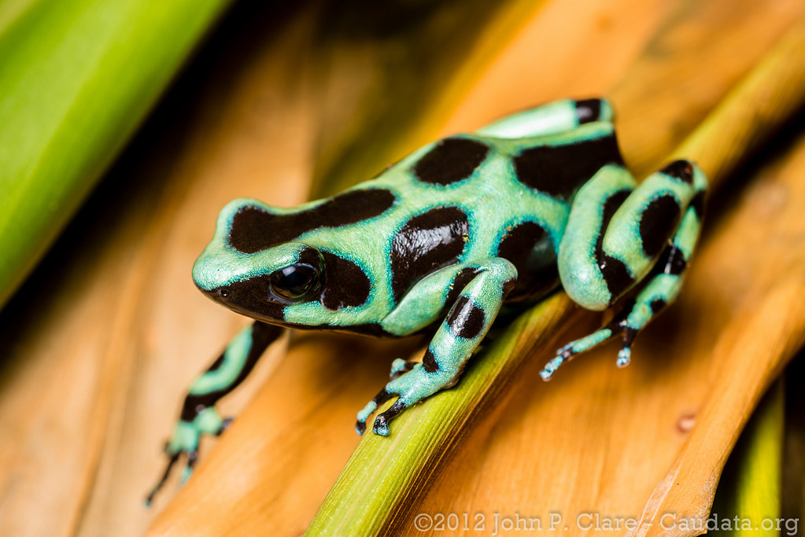
Poison Dart Frogs
Poison dart frogs can kill up to 100 people a year.
ThePhoto by PhotoAuthor is licensed under CCYYSA.

Slide 6
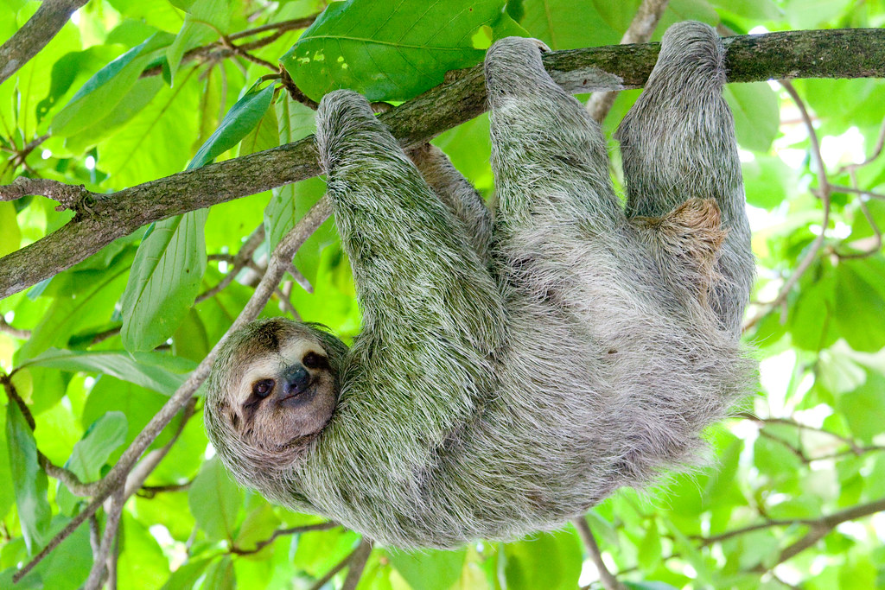
Sloth
Sloths are endangered because people are chopping down the rainforest trees. And also, people want them as pets.

Slide 7
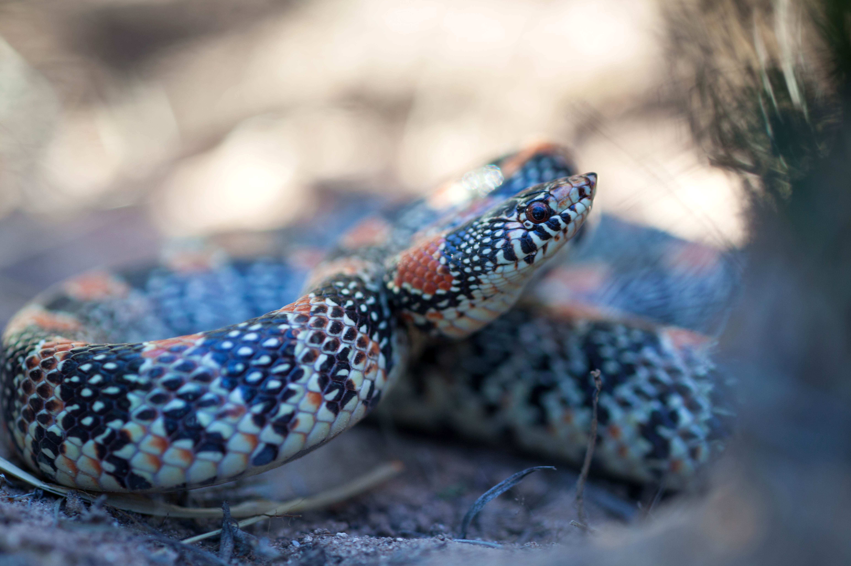
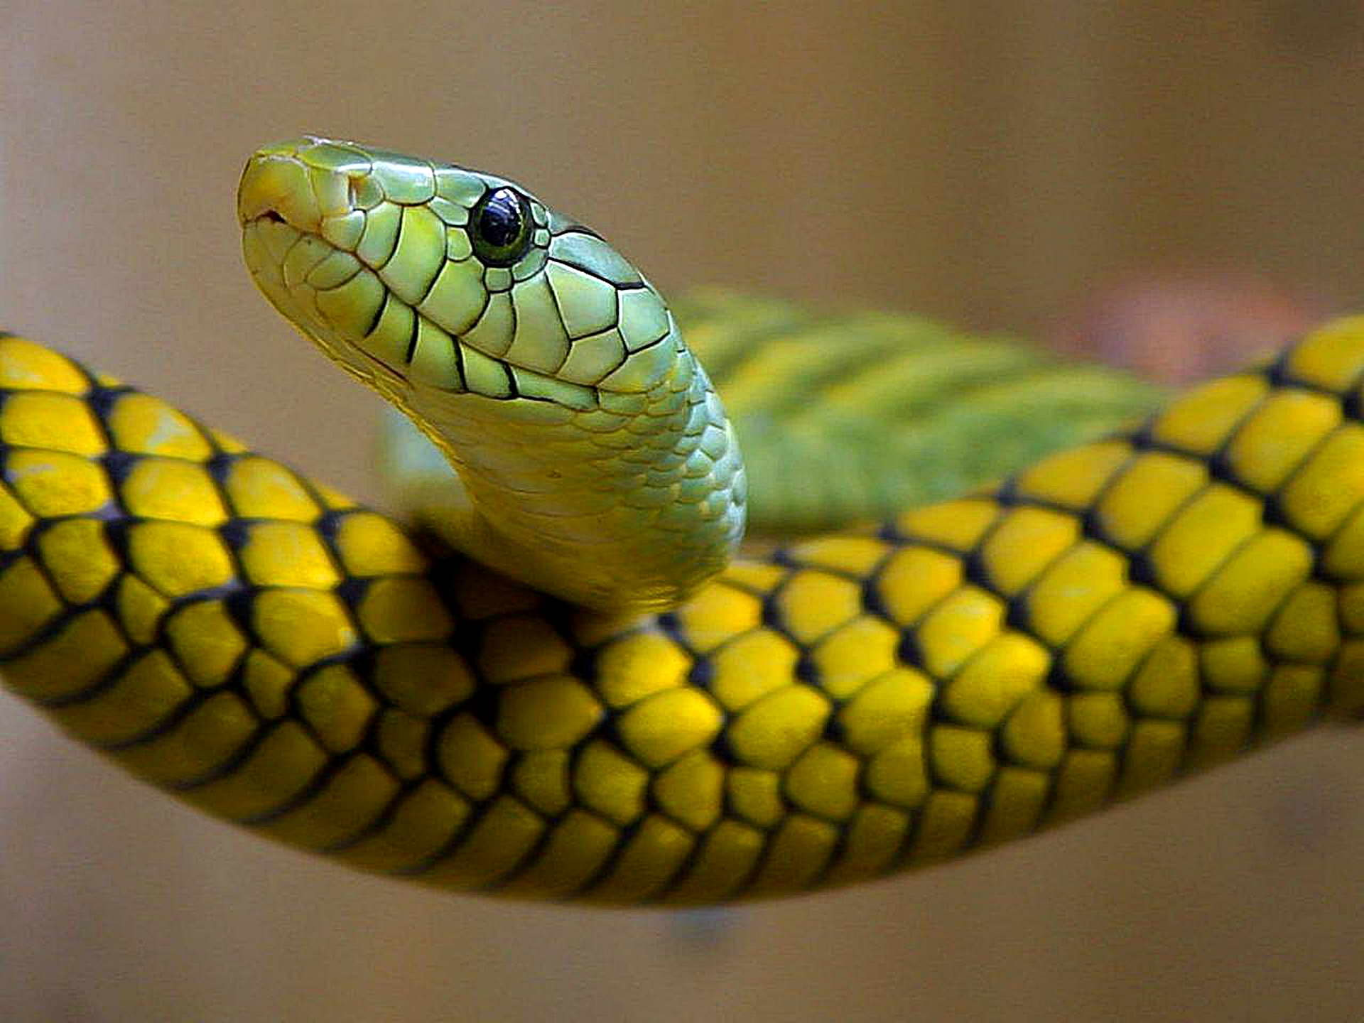
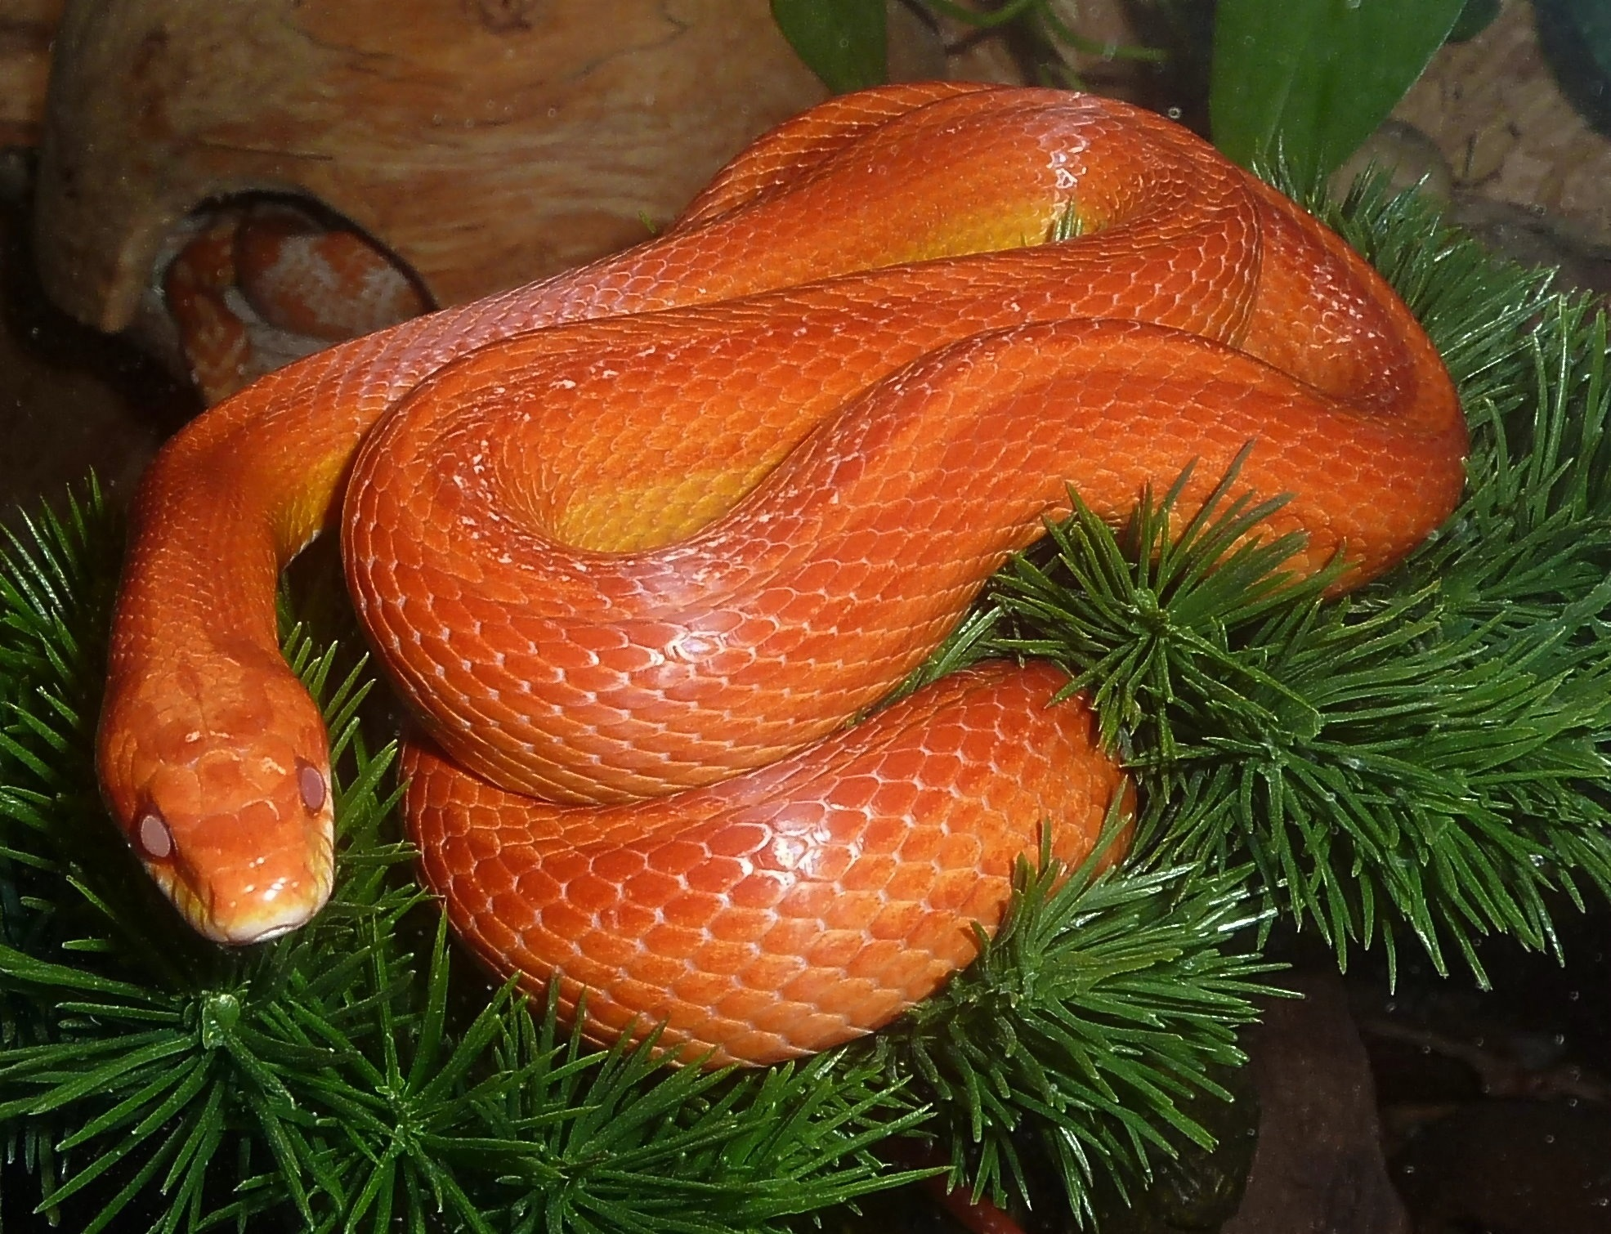
Snakes
Snakes like living on the forest floor and in canopy layer. They slither on the ground because they don’t have legs.

Slide 8
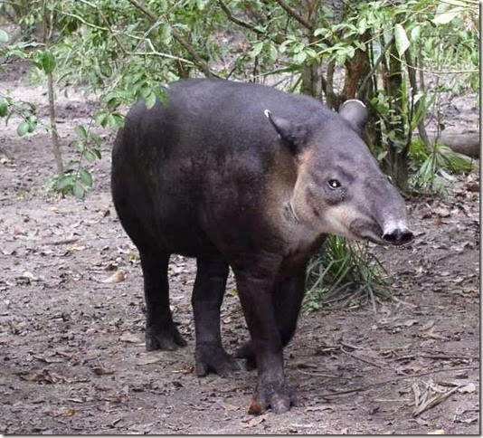
Tapirs
Tapirs live in the Amazon rainforest. They are often found near water and play a crucial role in the ecosystem by spreading seeds.
.

Slide 9
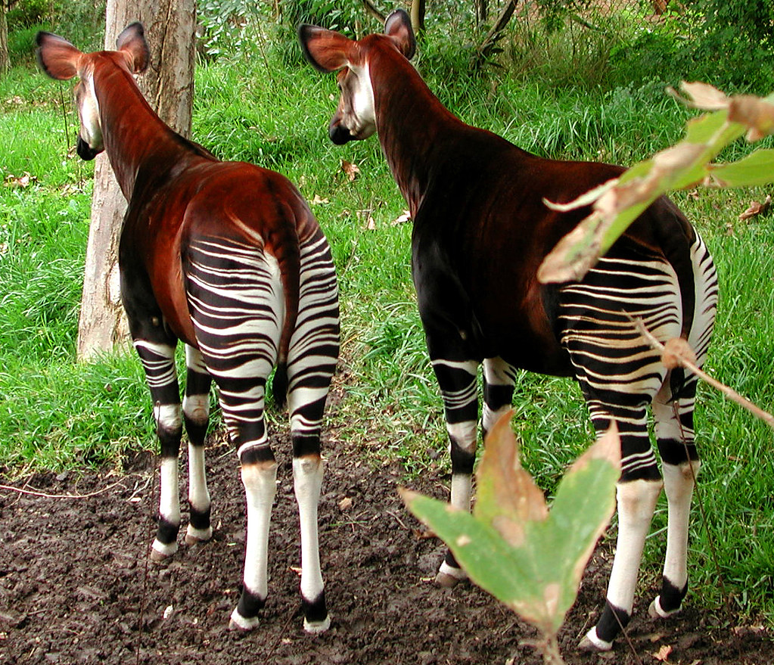
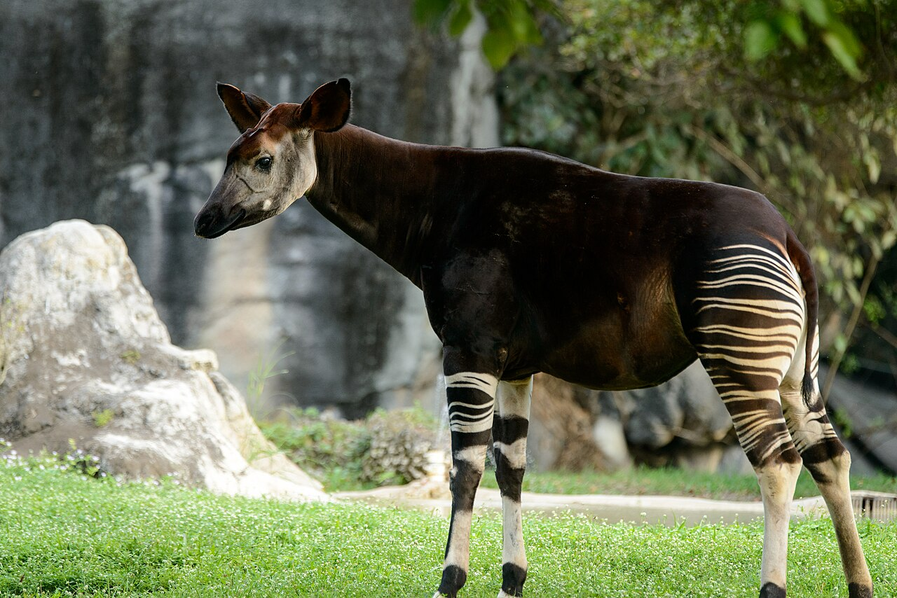
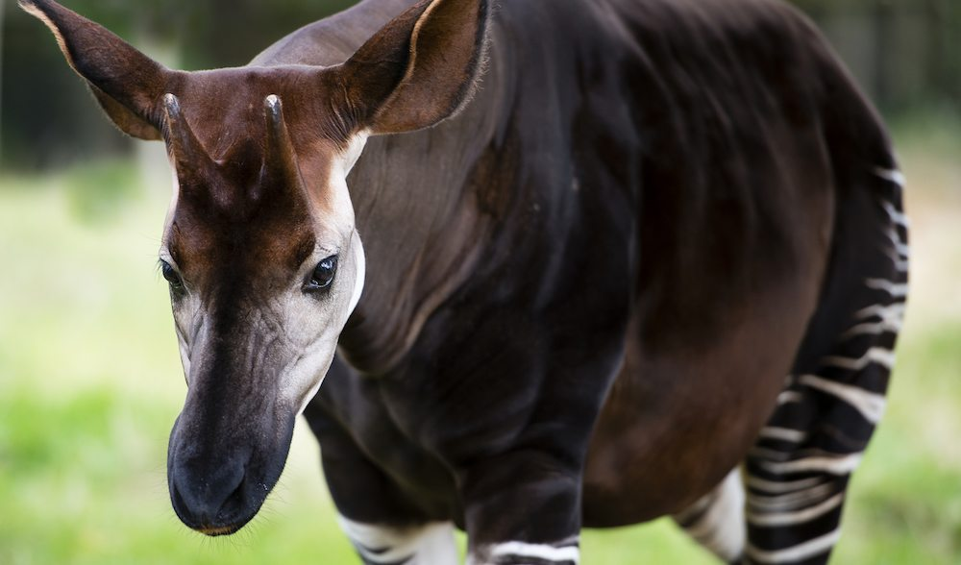
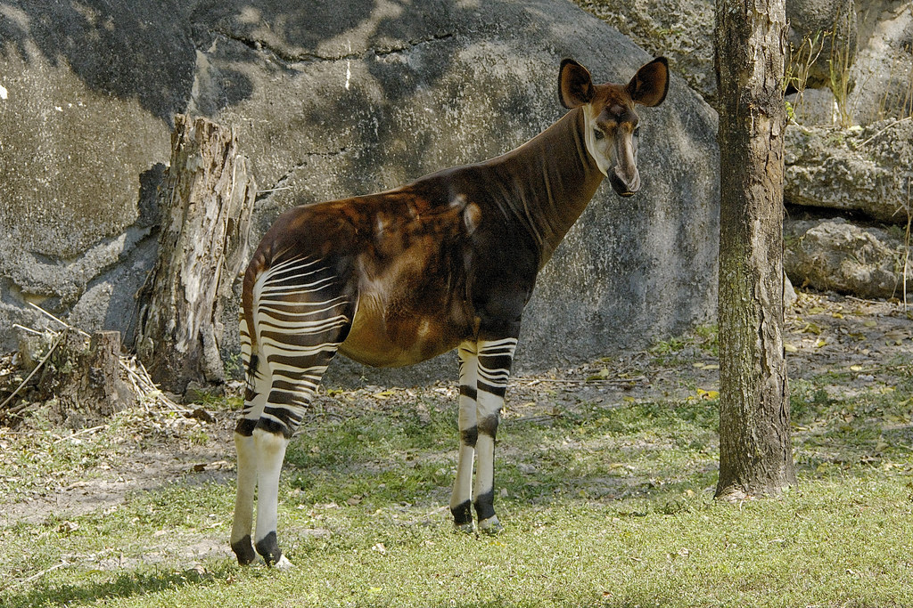
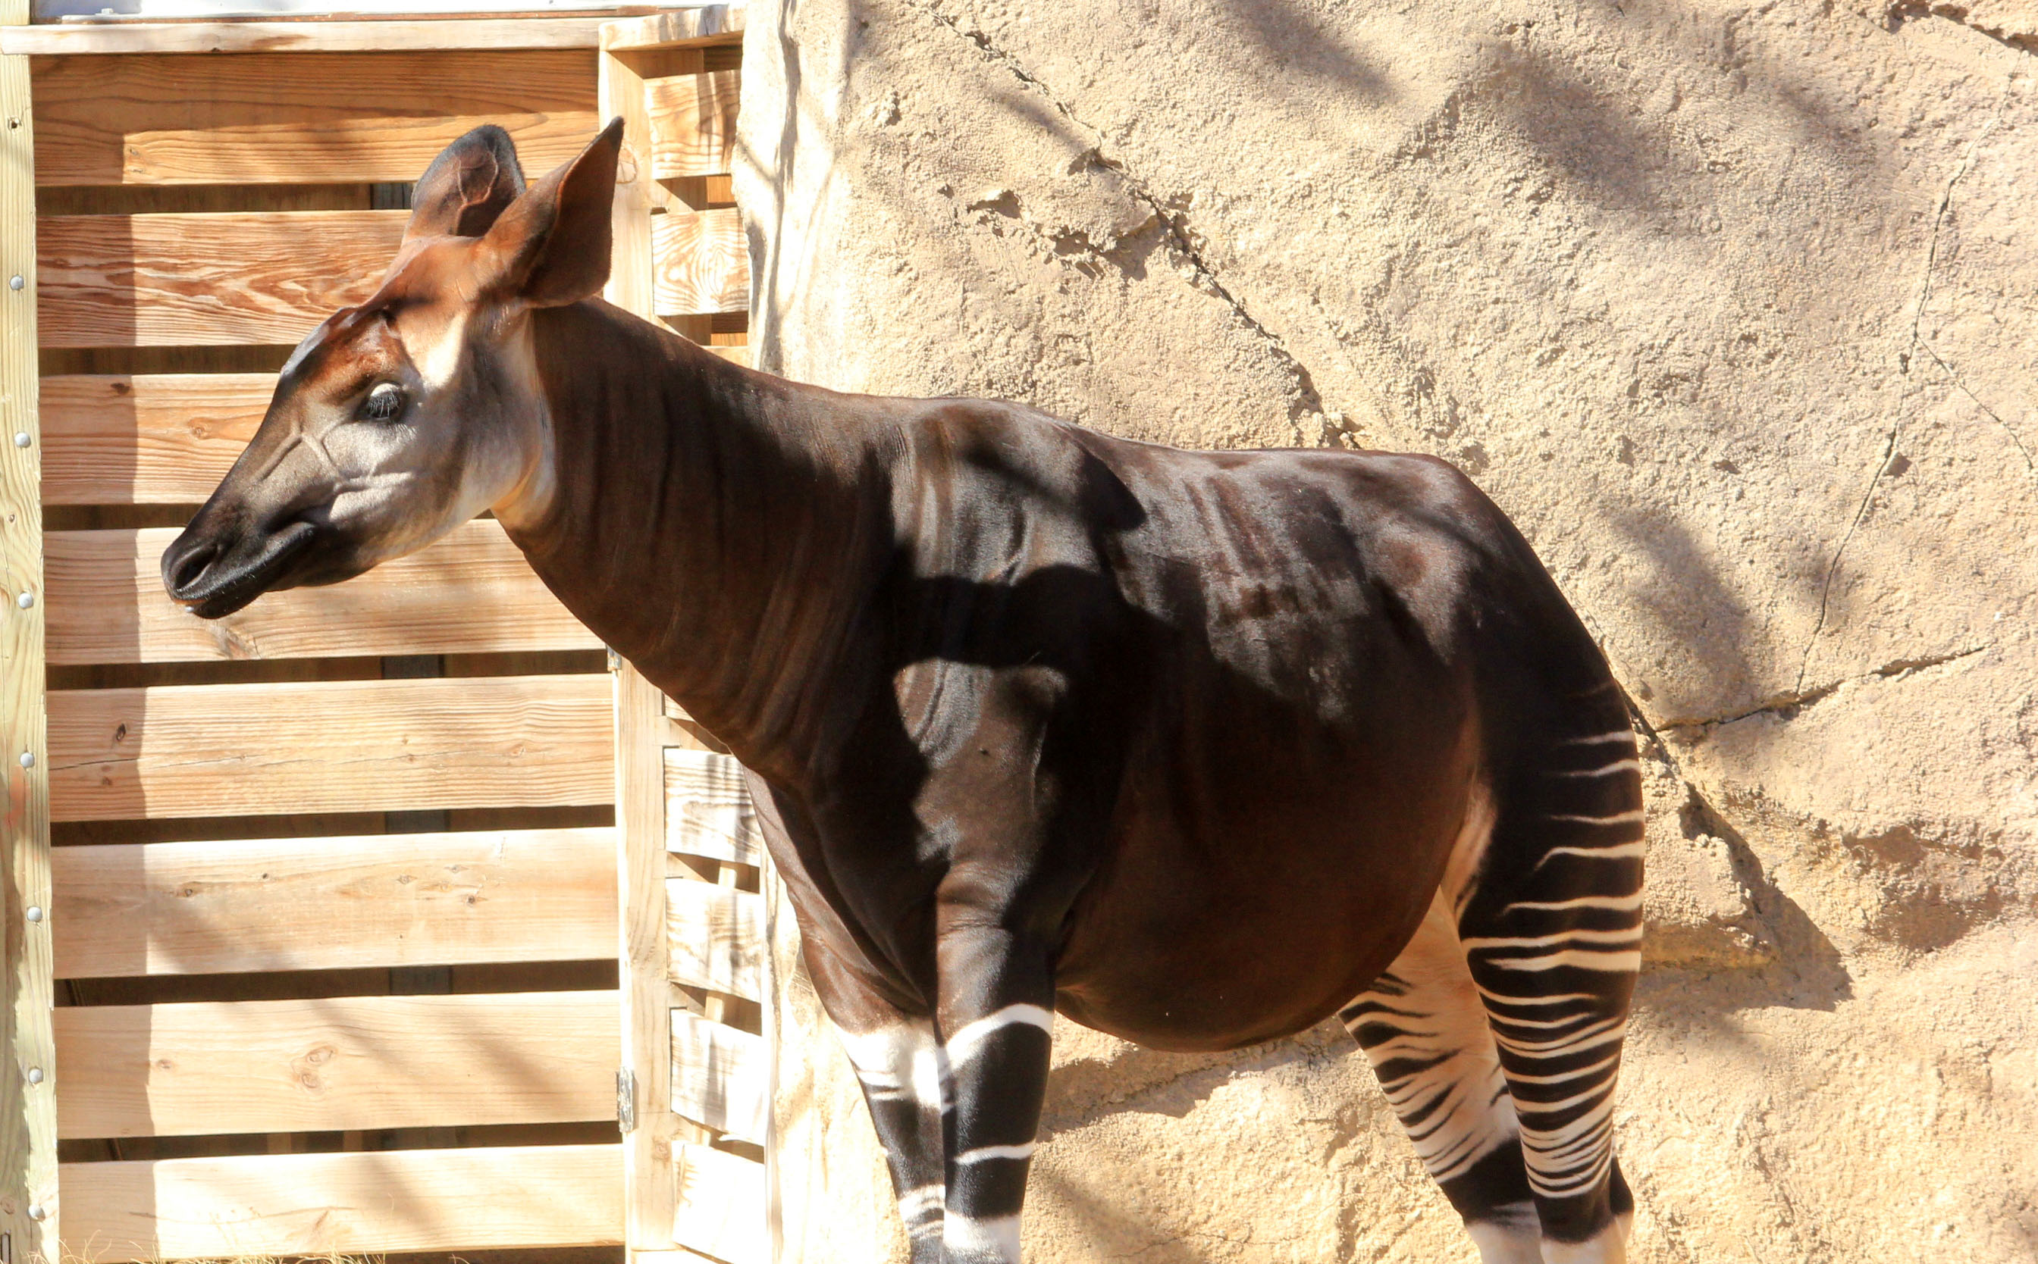
Okapi
Okapi are rainforest animals native to the Congo Rainforest in Africa.

Slide 10
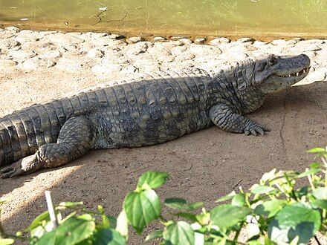
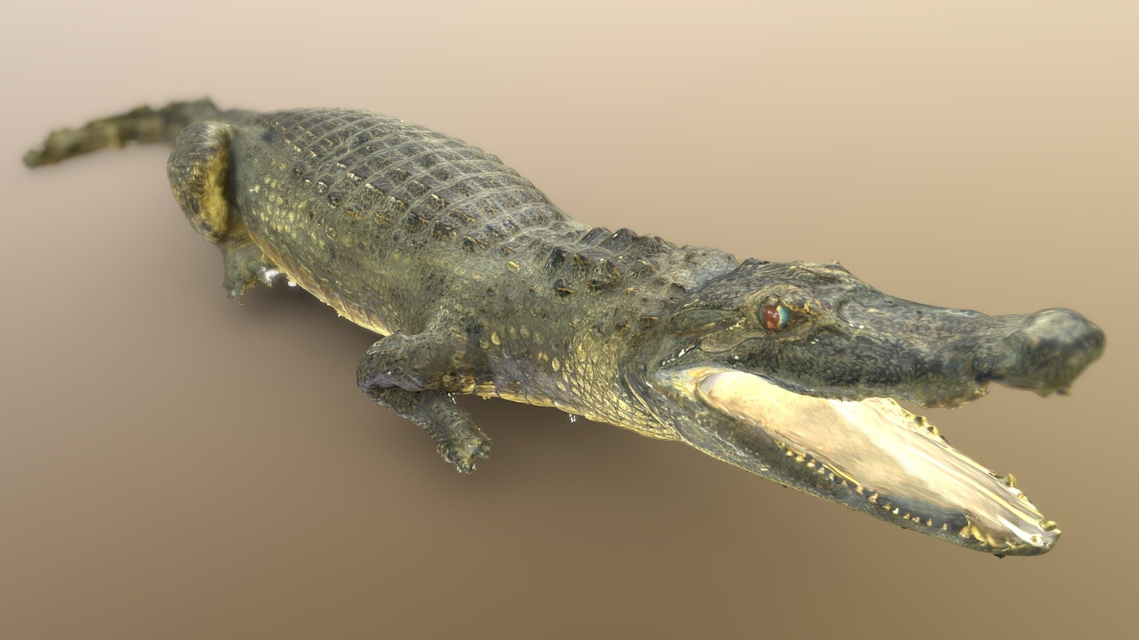
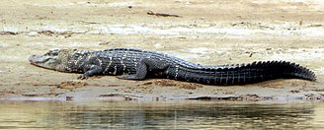
Black Caimans
Black caimans live in the rainforest, they are a type of crocodile.

