Slide 1
Where do Animals live in the Rainforest?
By
Annabelle

Slide 2
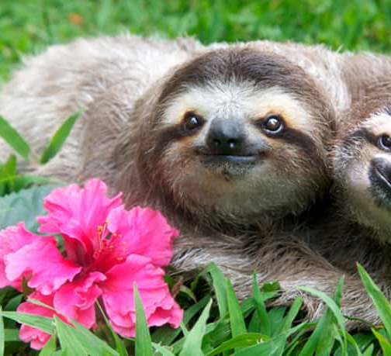
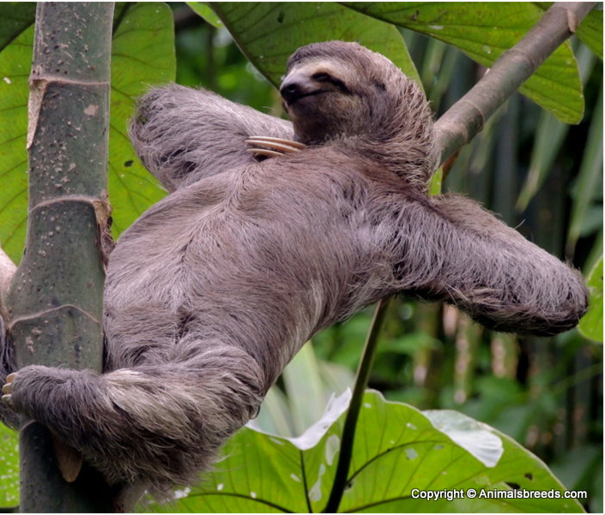
Sweet Sloths
Sloths live in the canopy layer. They eat leaves, branches and dirt.

Slide 3
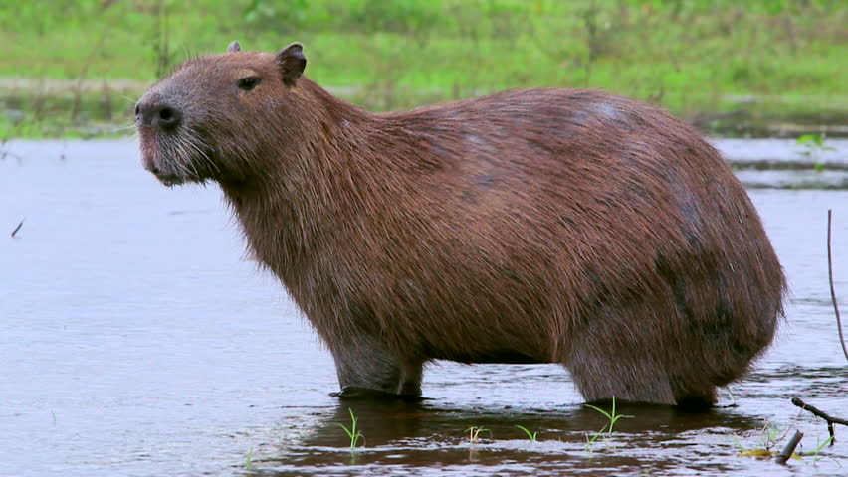
Capybaras
Capybaras live on the forest floor. They are very cute and they eat plants.

Slide 4
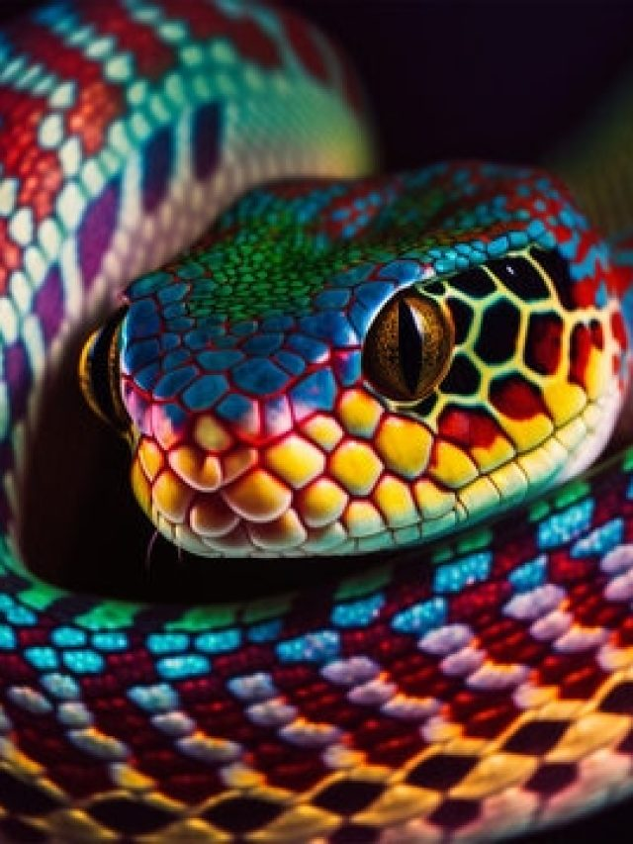
Snakes
Snakes live in the canopy layer and the understory. They can be all different colours.

Slide 5
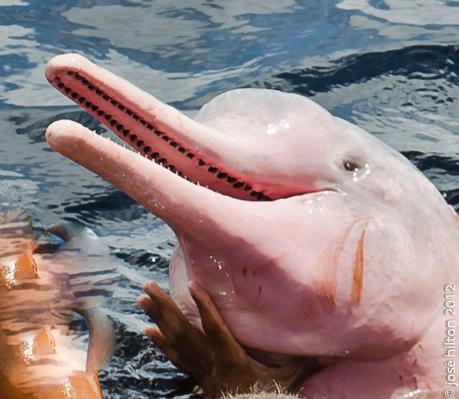
Amazon Pink River Dolphins
Amazon pink river dolphins live in the Amazon River. They are fast.
Amazon pink river dolphins are amazing swimers and hunters.
They are carnivores which means they eat meat and fish.

