Slide 1
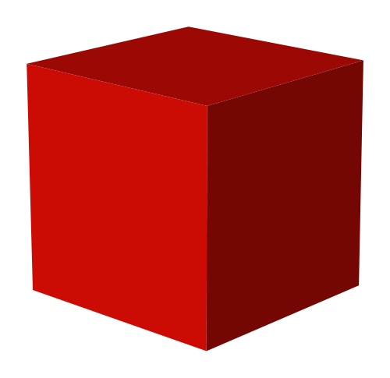
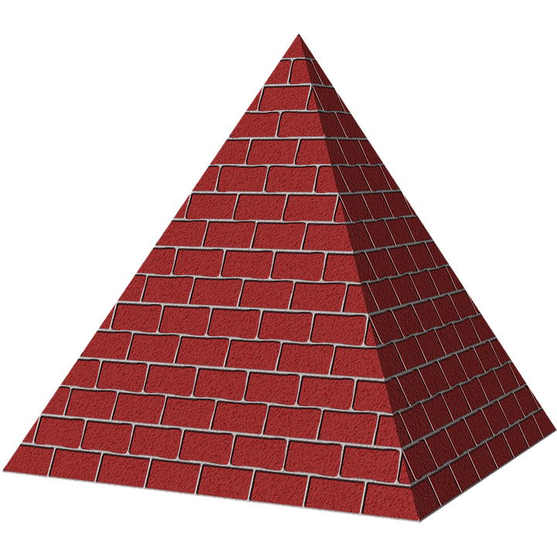
3D Shapes
This Photo by Unknown author is licensed under CC BY-NC.
William Fenn

Slide 2
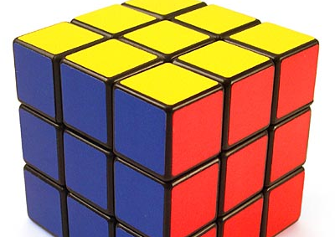
Cube
8 vertices
12 edges
6 sides
This Photo by Unknown author is licensed under CC BY-SA.

Slide 3
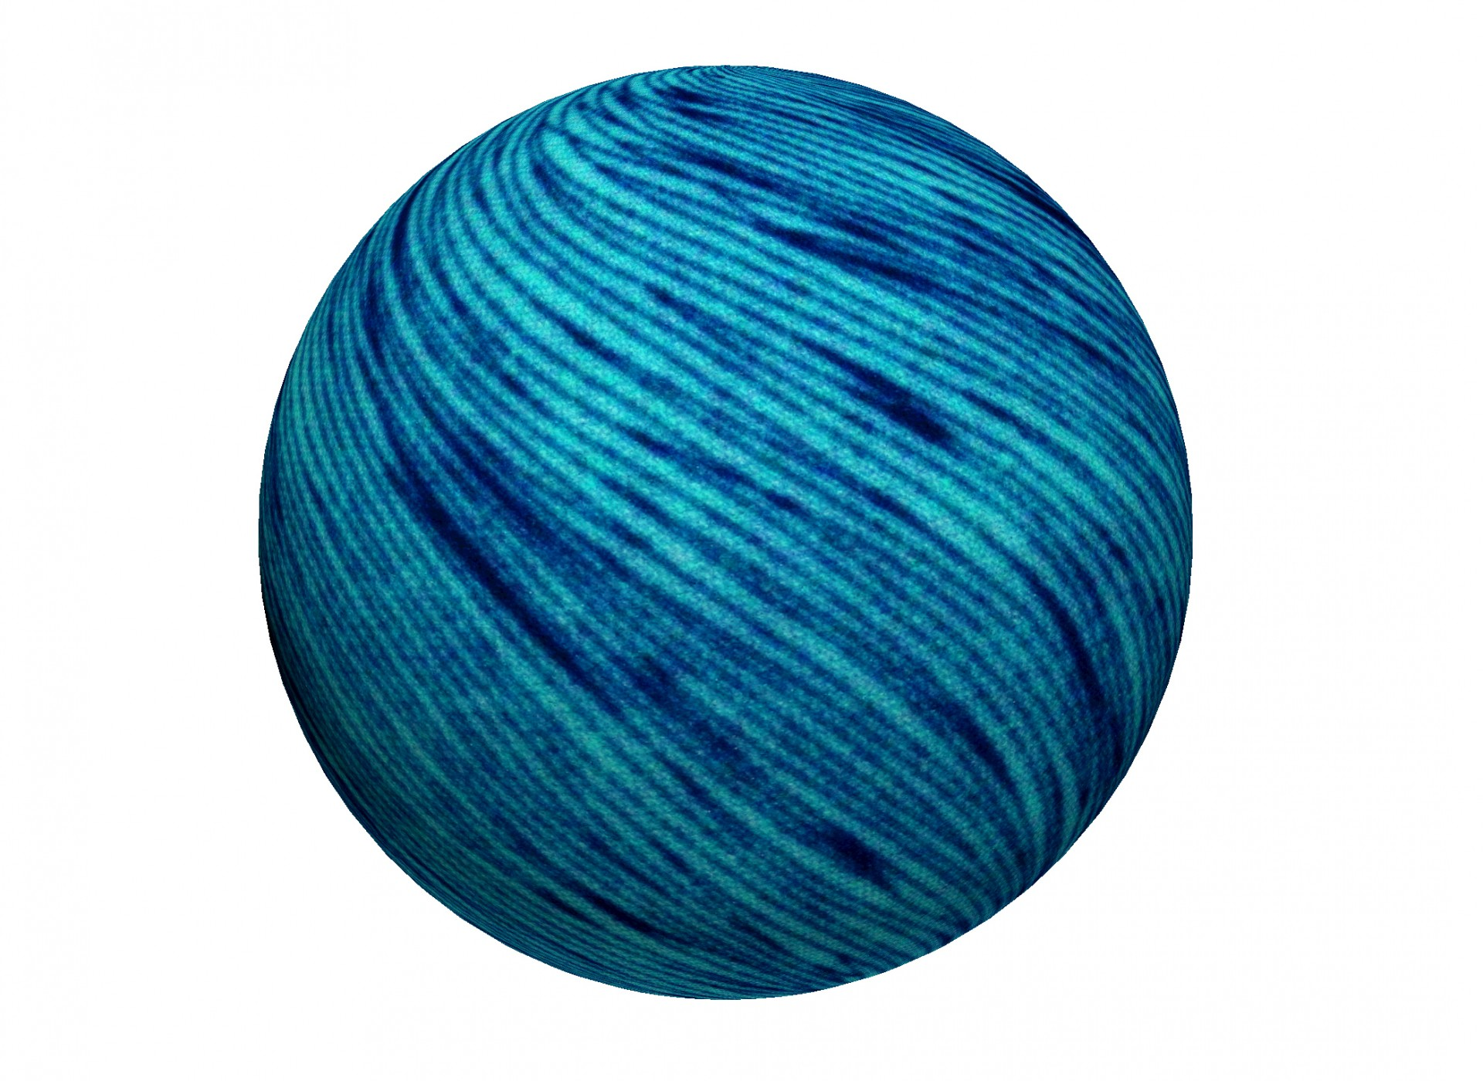
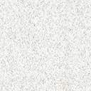
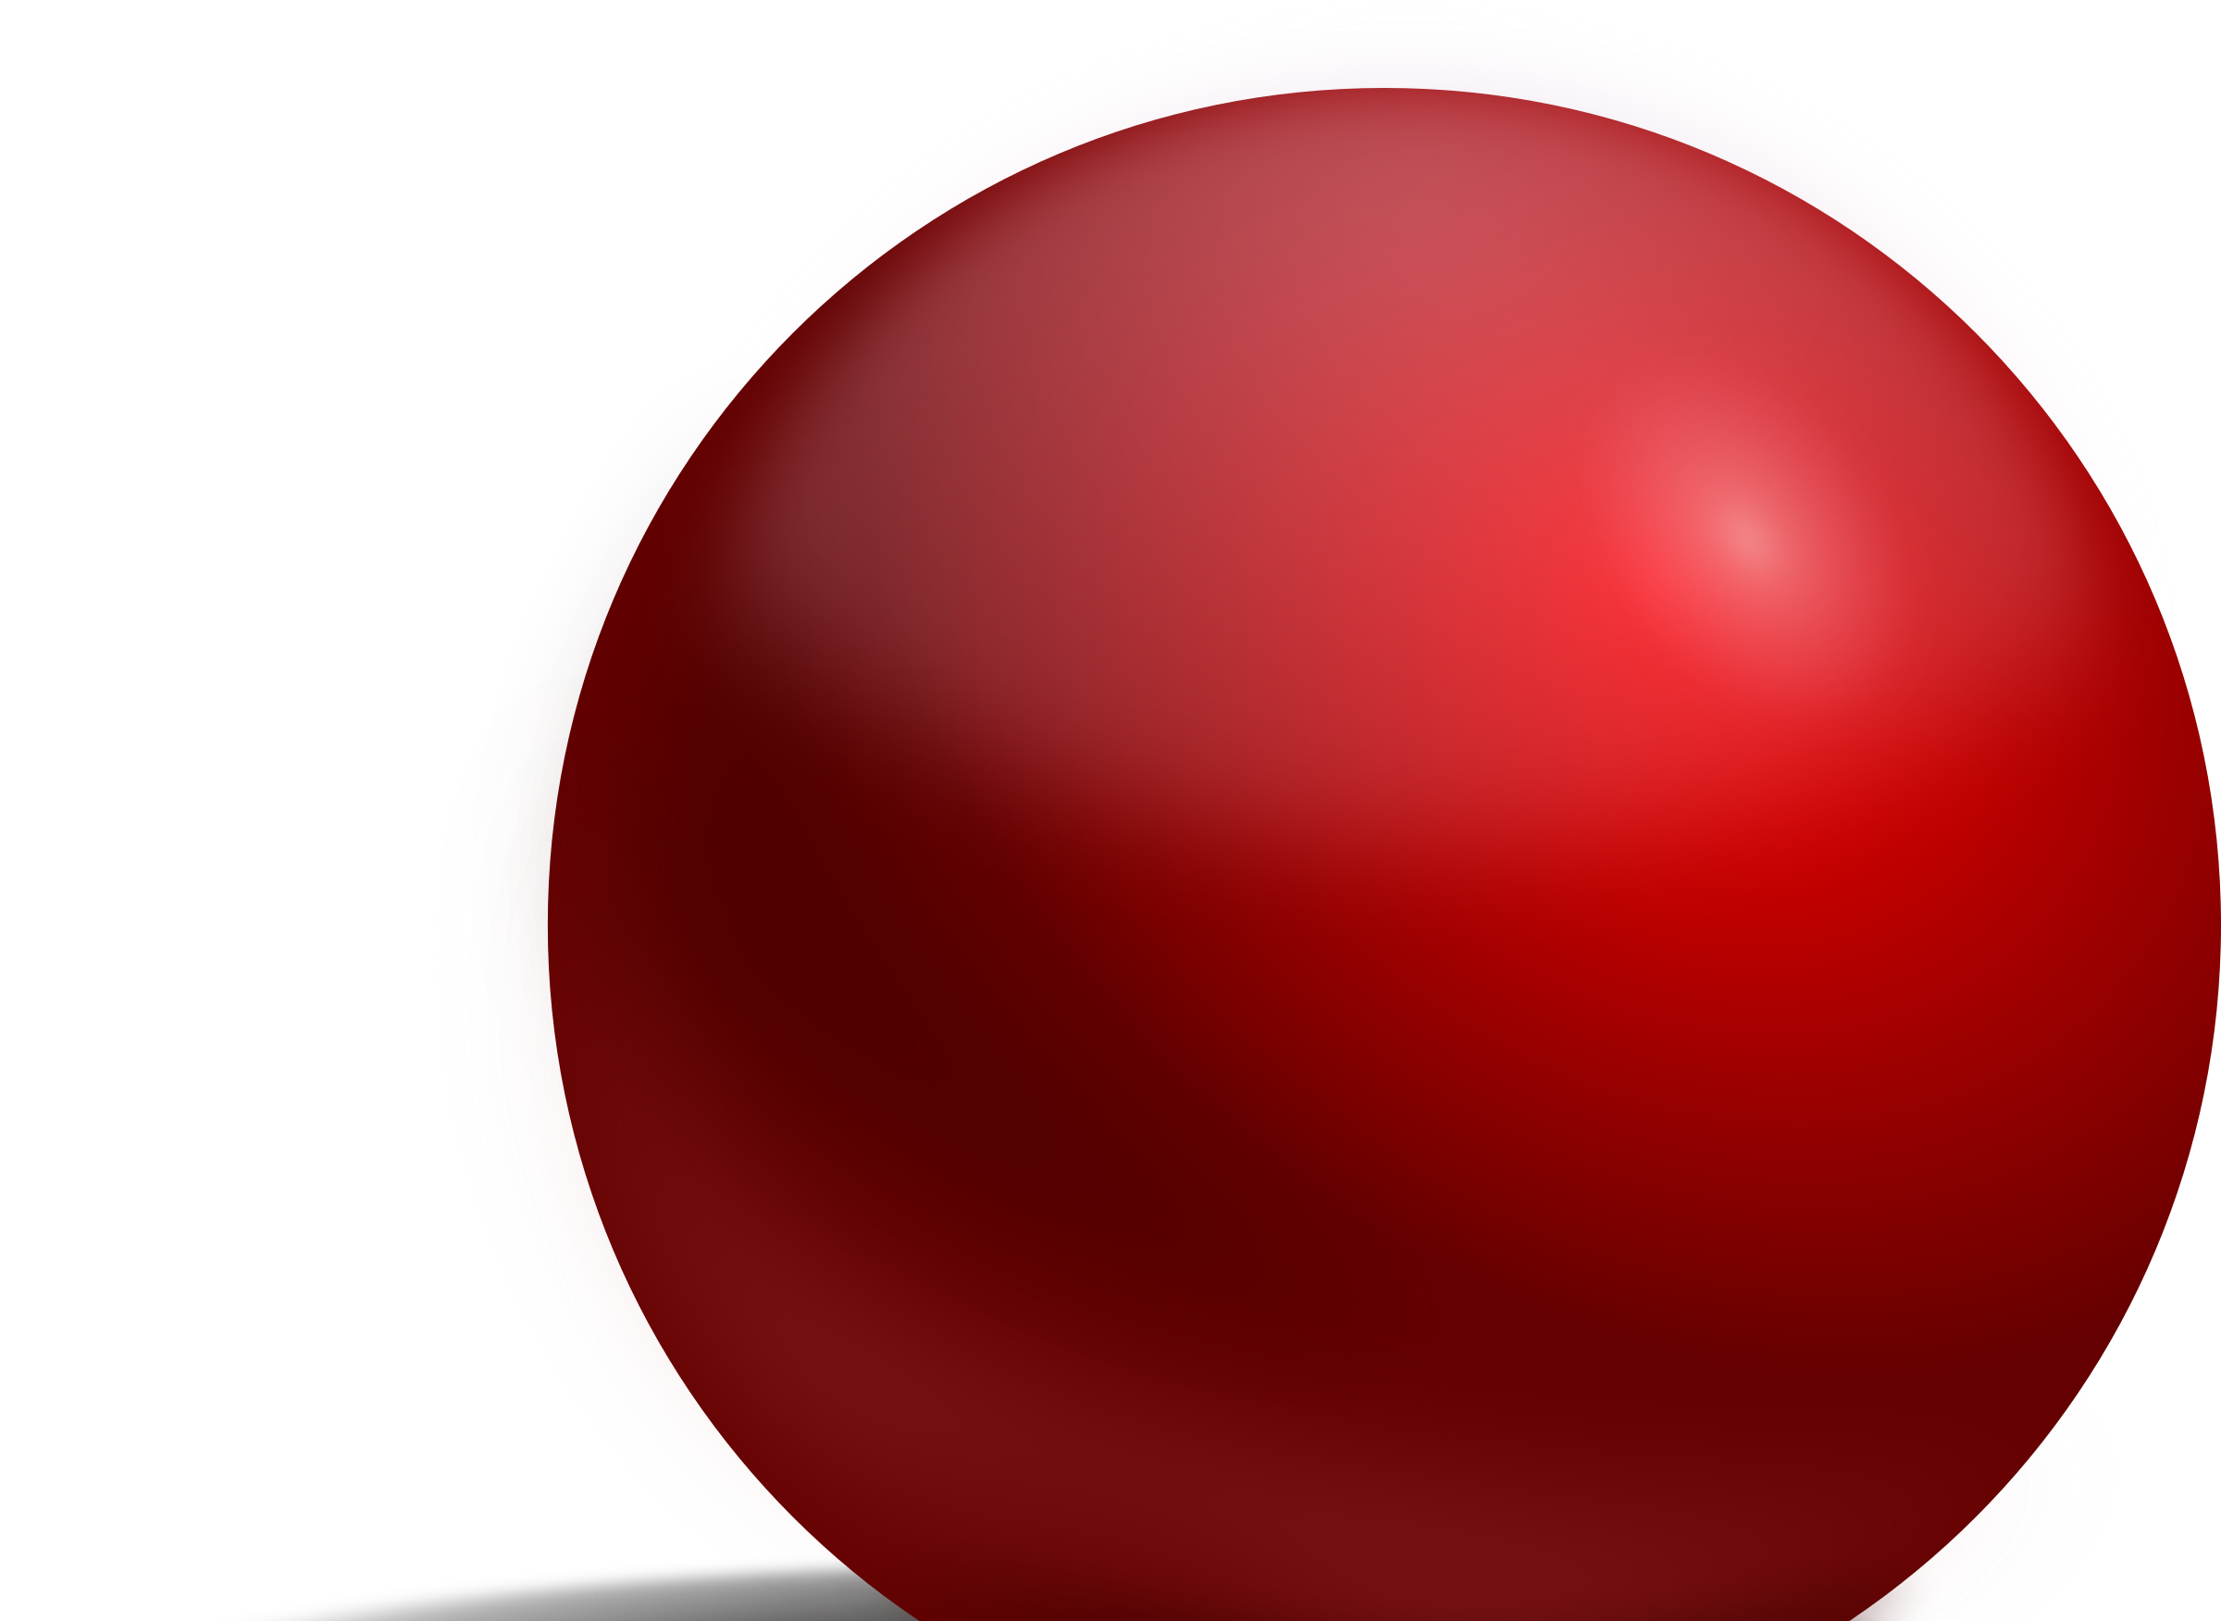
Sphere
0 vertices
1 side
1 curved surface
0 edges

Slide 4

Cylinder
3 faces
0 vertices
2 edges

Slide 5
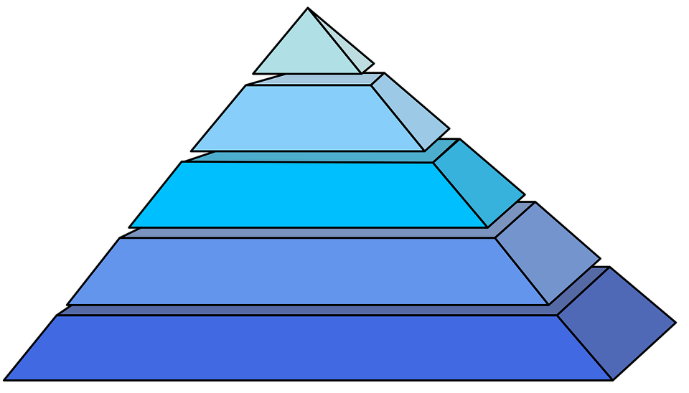
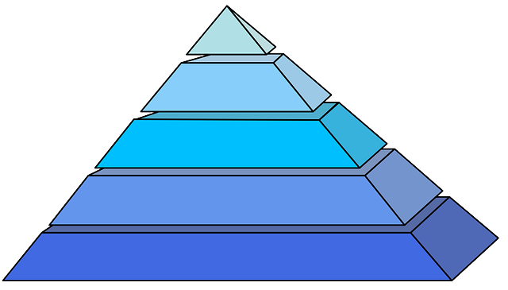
Pyramid
5 vertices
5 faces
0 curved faces
8 edges

Slide 6
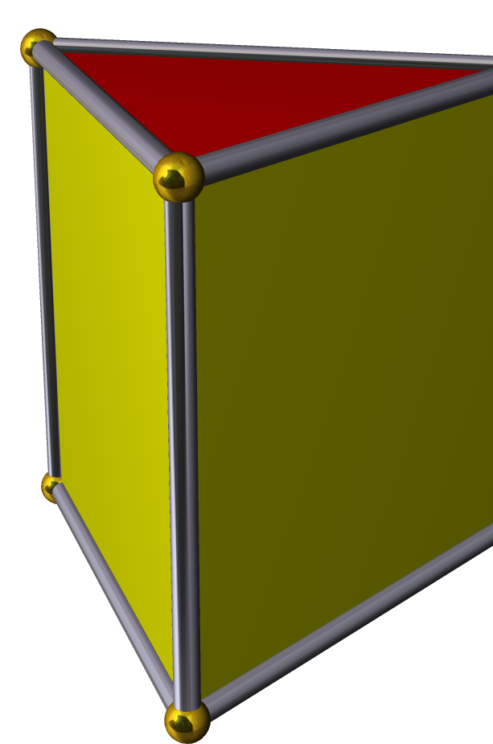
Triangular Prism
6 vertices
5 faces
9 edges
This Photo by Unknown author is licensed under CC BY-SA.

Slide 7
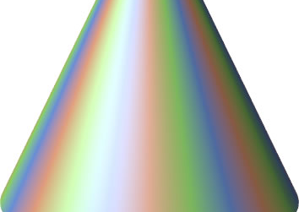
Cone
1 curved face
1 flat face
1 vertex
1 edge
This Photo by Unknown author is licensed under CC BY-SA.

Slide 8
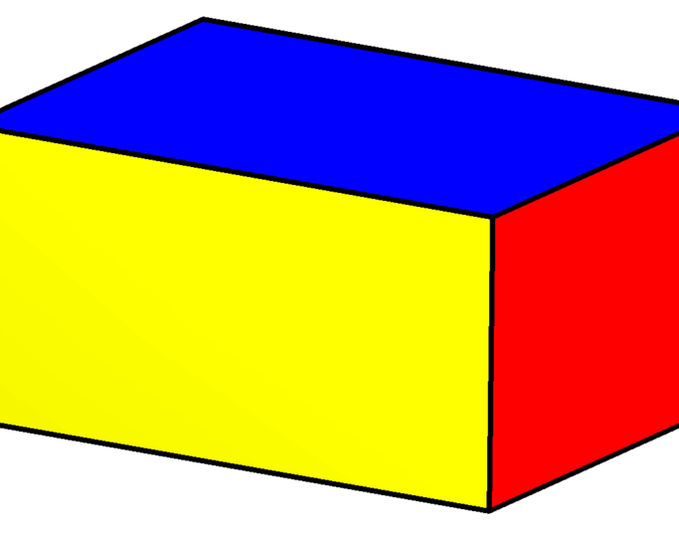
Cuboid
8 vertices
6 flat faces
12 edges
This Photo by Unknown author is licensed under CC BY-SA.

Slide 9
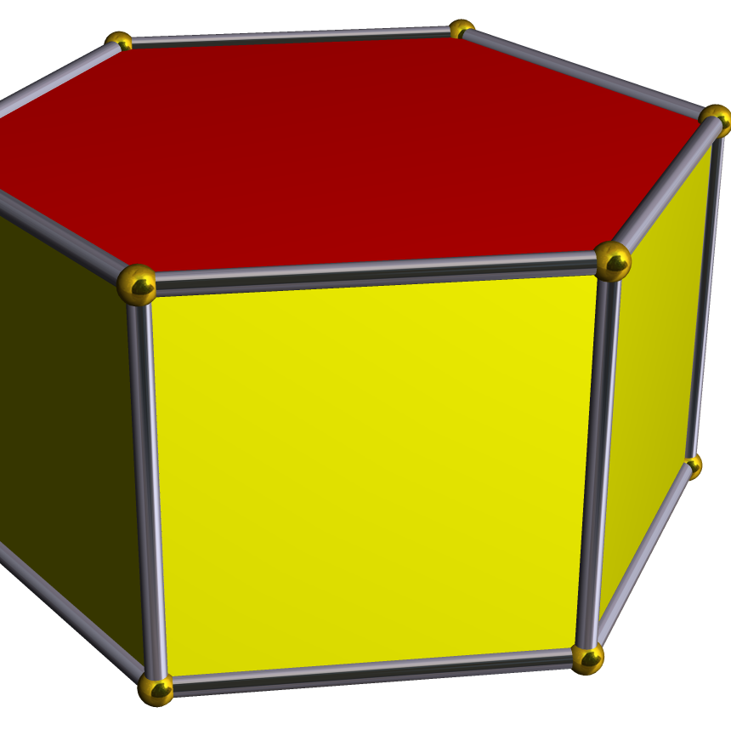
Hexagonal Prism
8 faces
12 vertices
18 edges
This Photo by Unknown author is licensed under CC BY-SA.

Slide 10
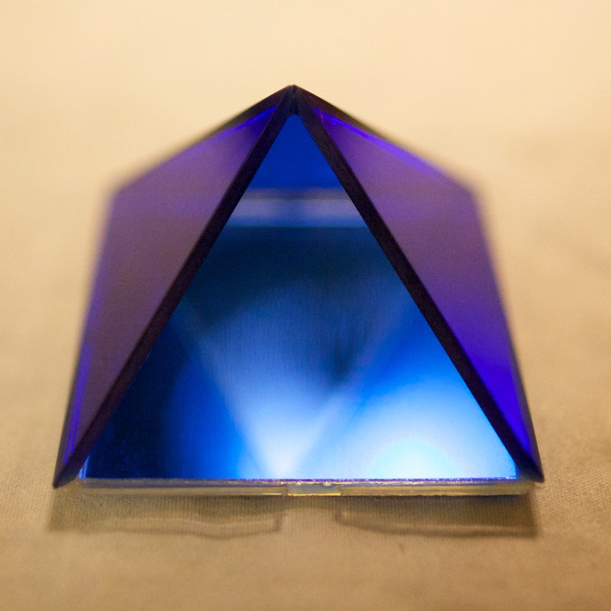
Square Based Pyramid
5 vertices
5 faces
0 curved faces
This Photo by Unknown author is licensed under CC BY-SA-NC.

Slide 11
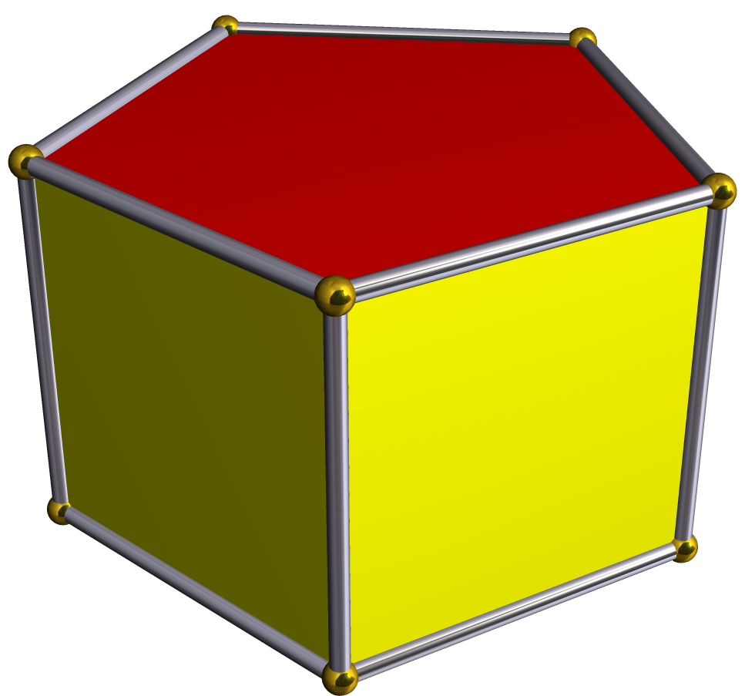
Pentagonal Prism
10 vertices
7 faces
15 edges
This Photo by Unknown author is licensed under CC BY-SA.

Slide 12
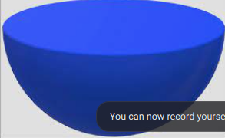
Hemisphere
1 curved face
1 flat face
0 vertices

Slide 13
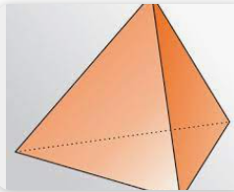
Tetrahedron
5 faces
4 vertices
6 edges

Slide 14
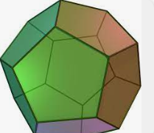
Dodecahedron
12 faces
30 edges
20 vertices

Slide 15
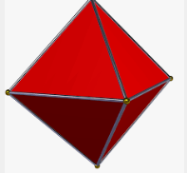
Octahedron
8 faces
6 vertices
12 edges

Slide 16


