Slide 1
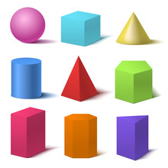
3D Shapes
By Bethan

Slide 2
Cylinder
3 faces
2 edges
0 vertices

Slide 3
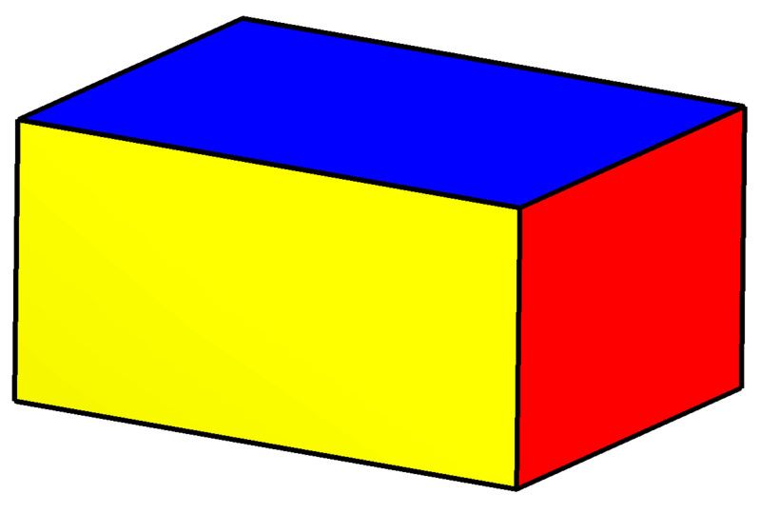
Cuboid
6 faces
12 edges
8 vertices
This Photo by Unknown author is licensed under CC BY-SA.
This Photo by Unknown author is licensed under CC BY-SA-NC.
This Photo by Unknown author is licensed under CC BY-SA-NC.
This Photo by Unknown author is licensed under CC BY-SA-NC.
This Photo by Unknown author is licensed under CC BY-SA-NC.
This Photo by Unknown author is licensed under CC BY-SA-NC.
This Photo by Unknown author is licensed under CC BY-SA-NC.

Slide 4
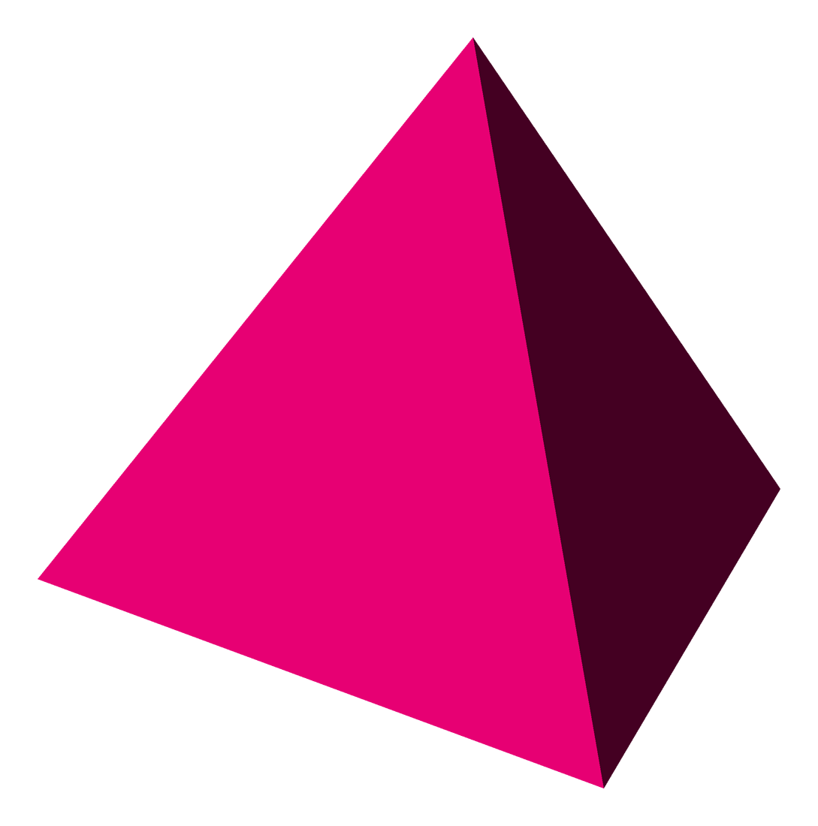
Square Based Pyramid
5 faces
8 edges
5 vertices
This Photo by Unknown author is licensed under CC BY-SA.
This Photo by Unknown author is licensed under CC BY-NC-ND.
This Photo by Unknown author is licensed under CC BY-NC-ND.

Slide 5
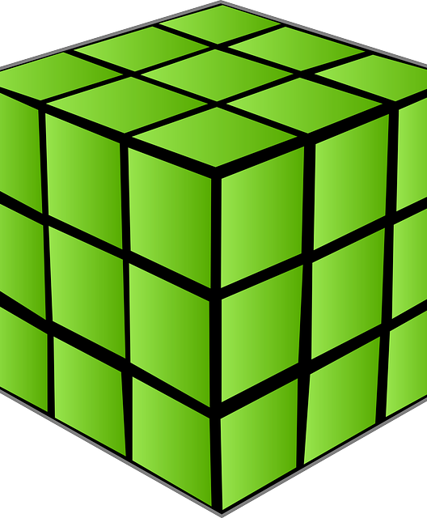
Cube
6 faces
12 edges
8 vertices

Slide 6
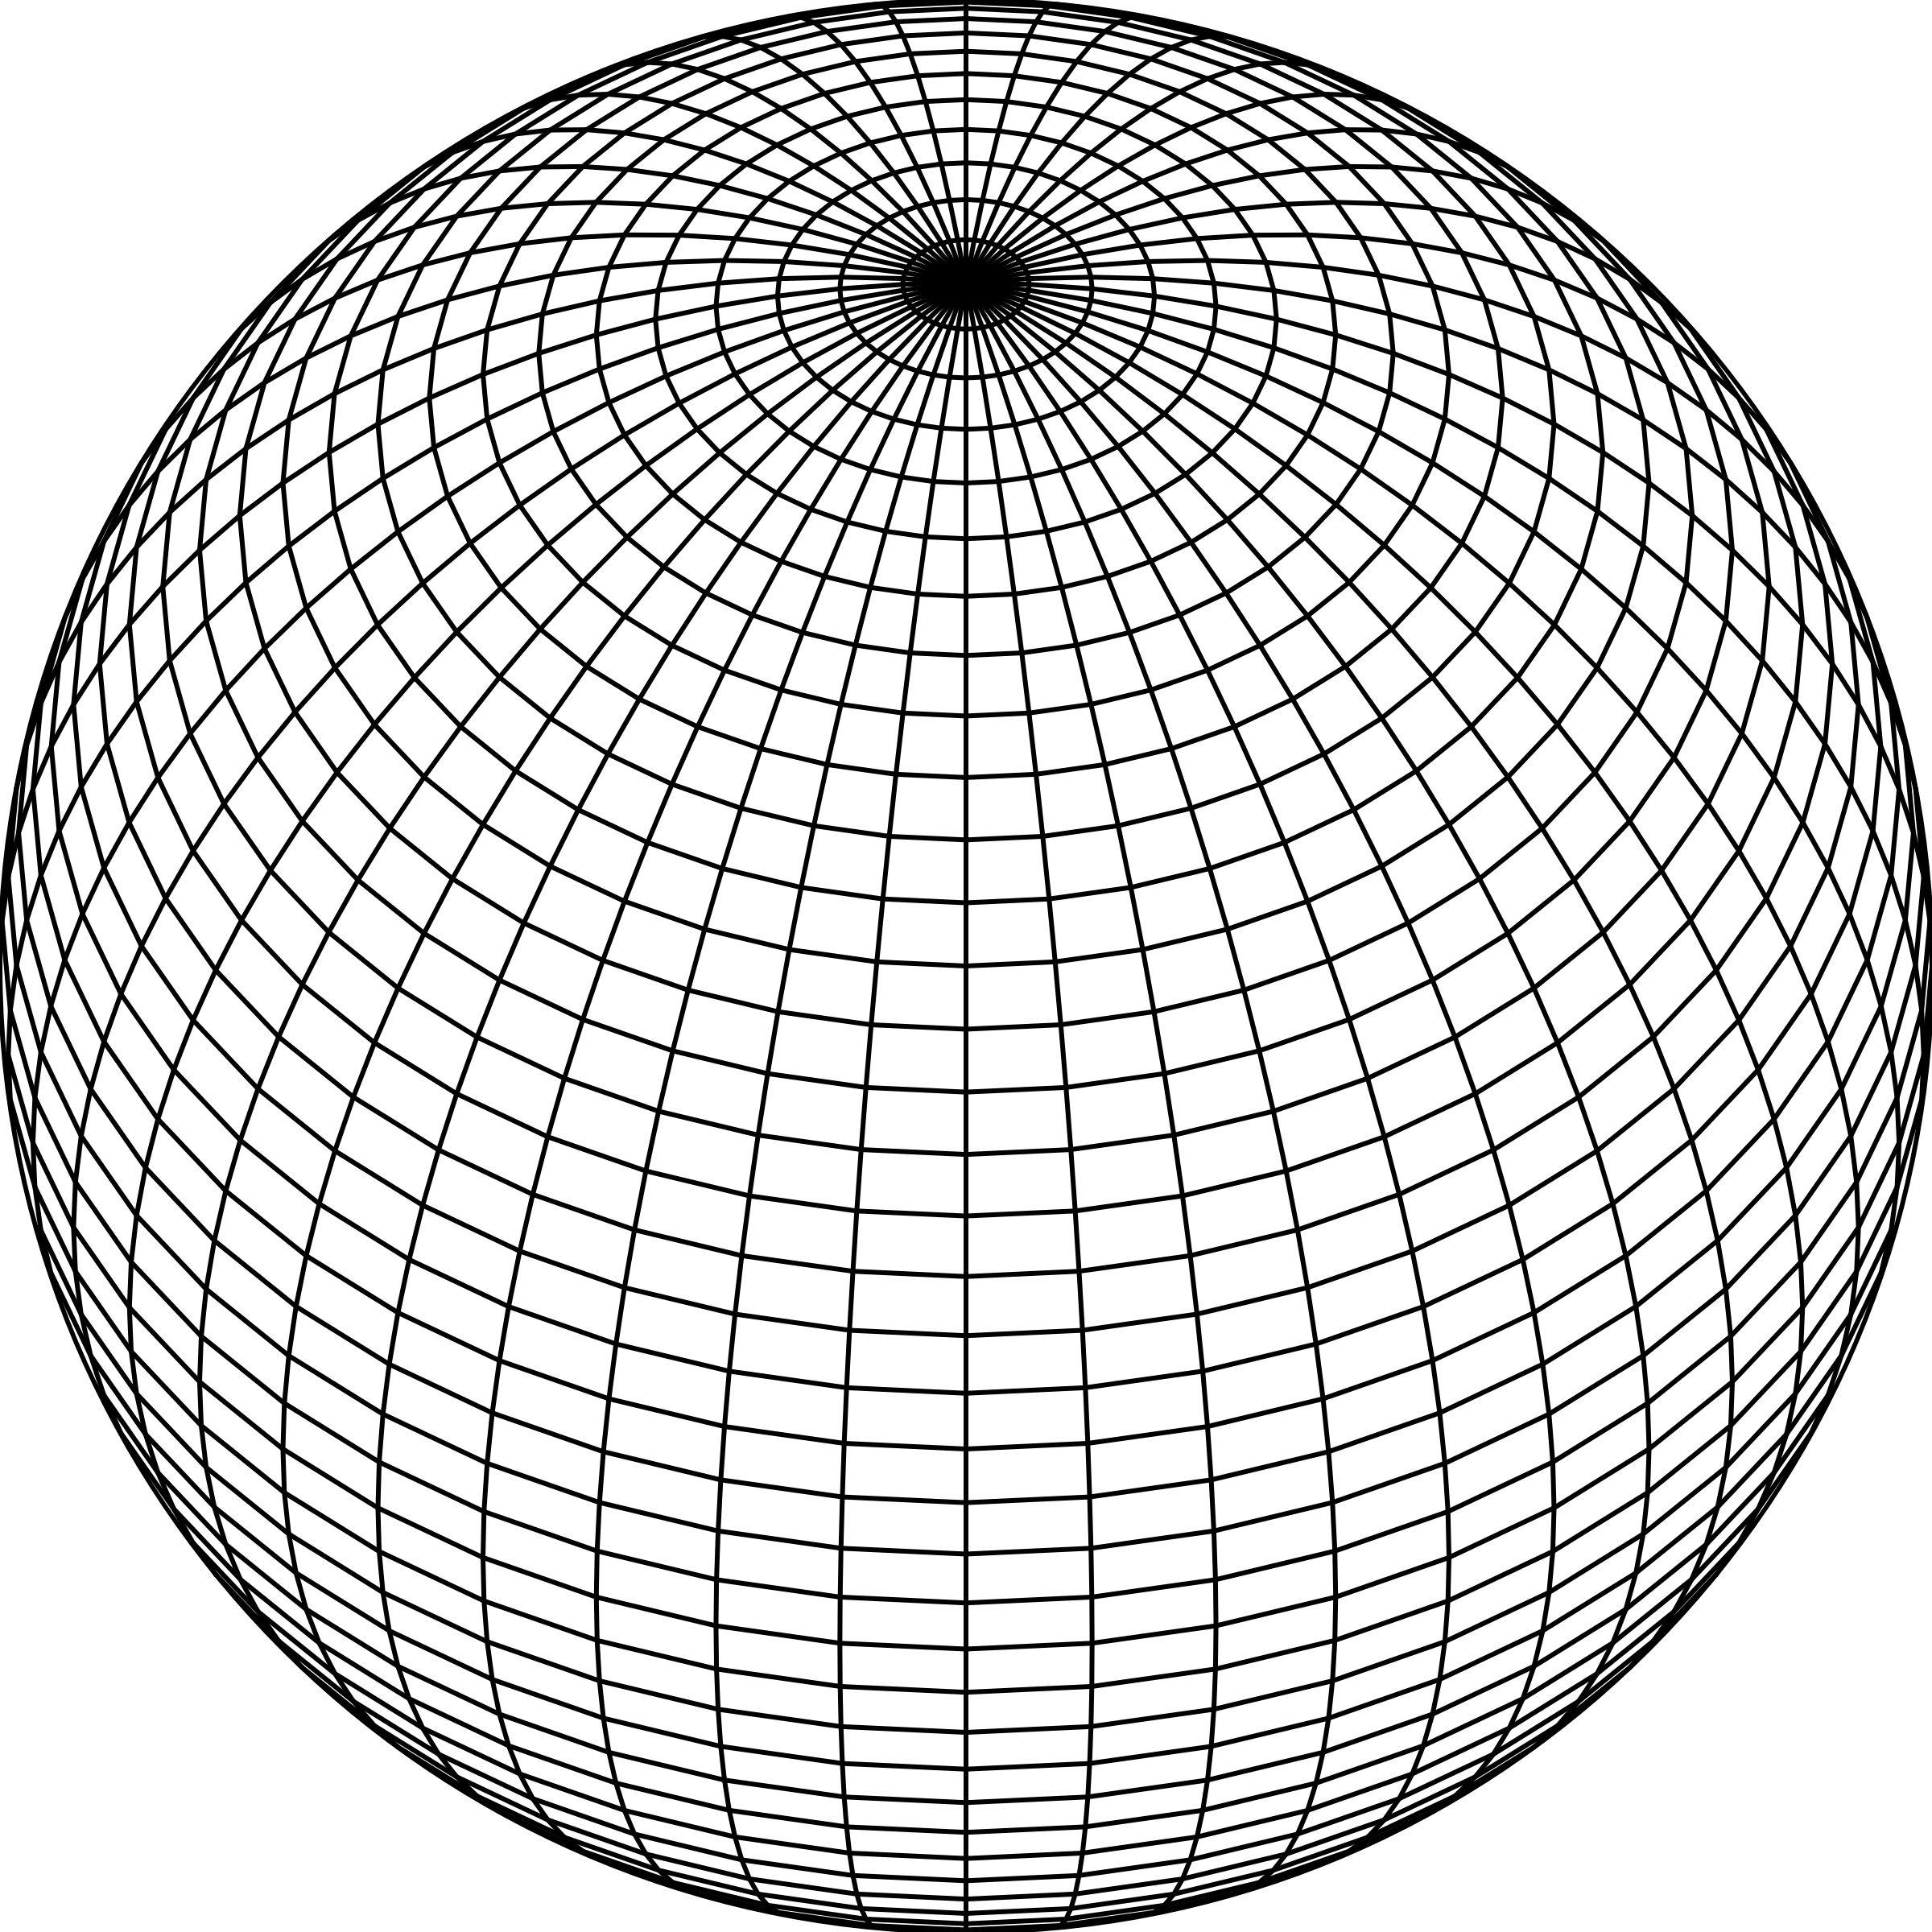
Sphere
1 face
0 edges
0 vertices

Slide 7
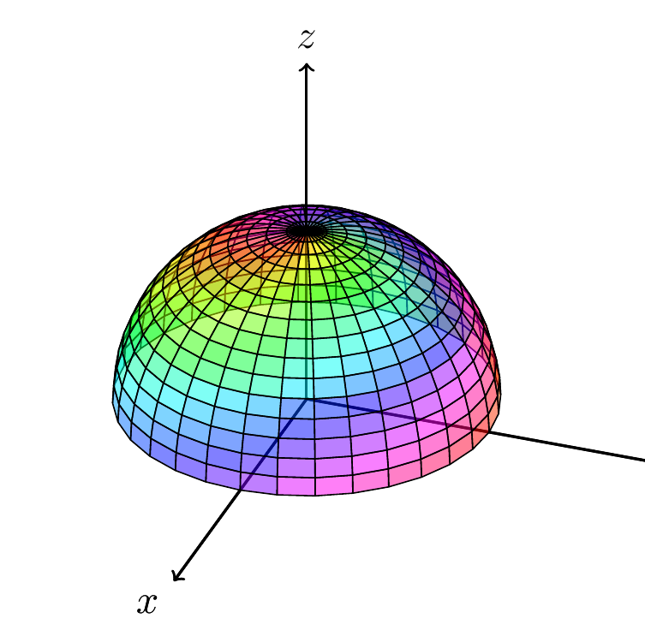
Hemisphere
2 faces
1 edges
0 vertices
This Photo by Unknown author is licensed under CC BY-SA.

Slide 8
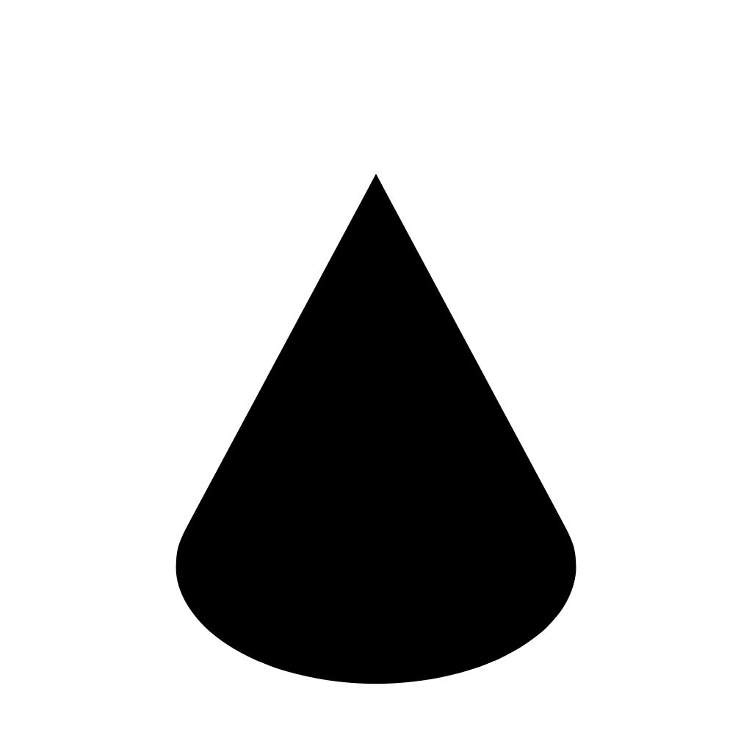
Cone
2 faces
1 edge
1 vertex

Slide 9
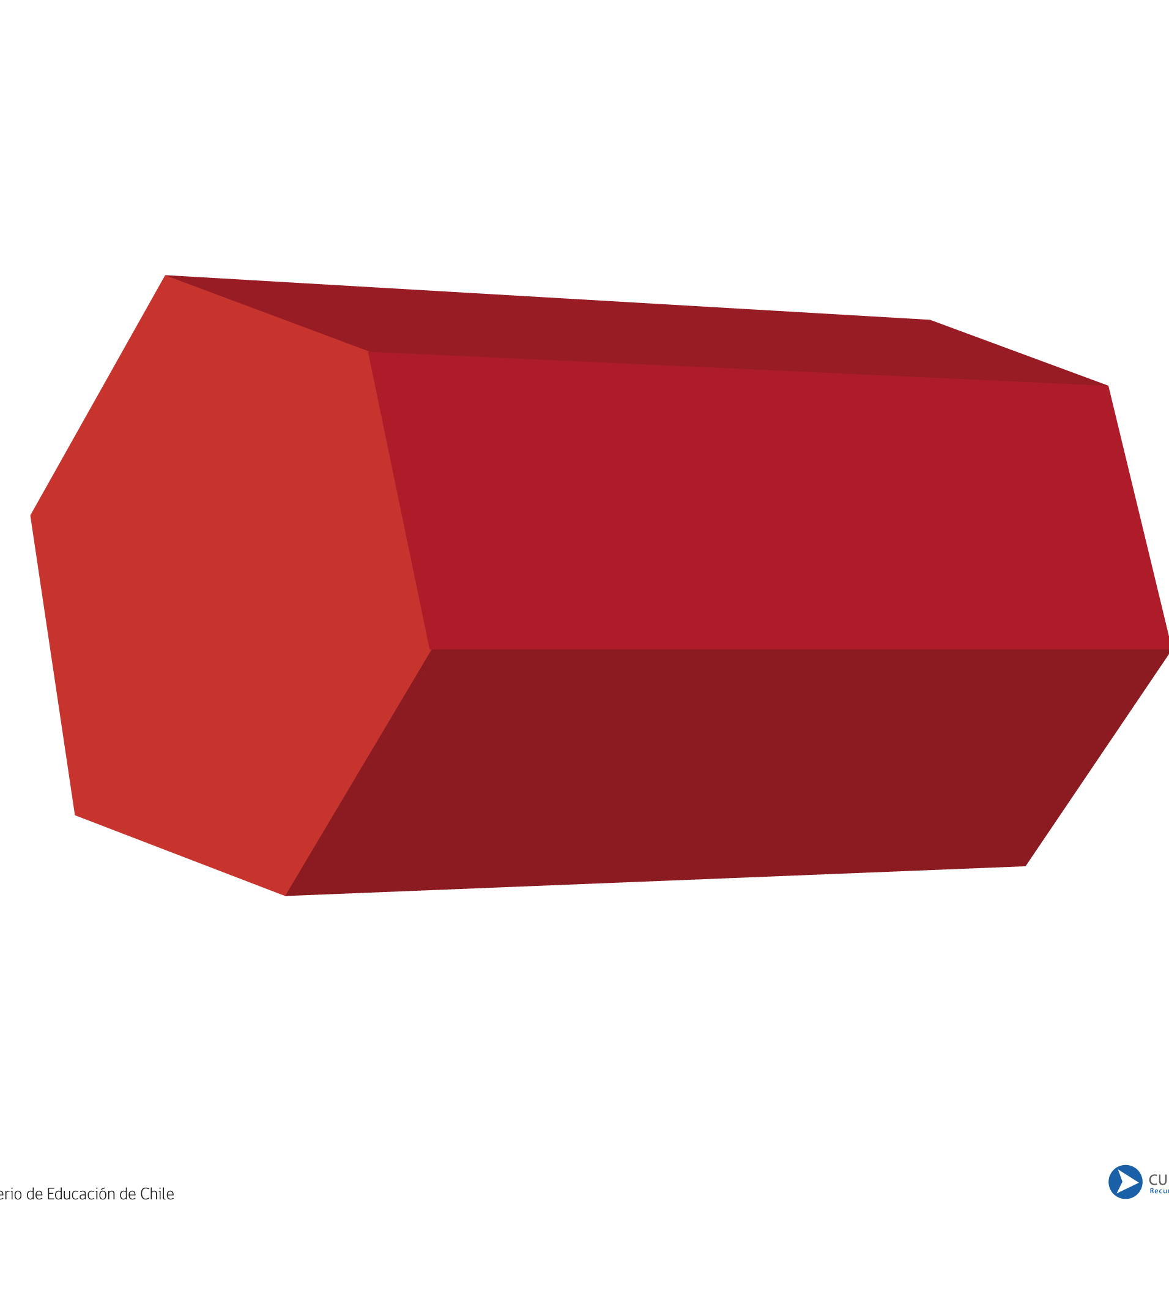
Hexagonal Prism
8 faces
18 edges
12 vertices
This Photo by Unknown author is licensed under CC BY-NC.

