Slide 1

LPS Personal Learning Journey
Financial & business skills
Personal Effectiveness

Slide 2
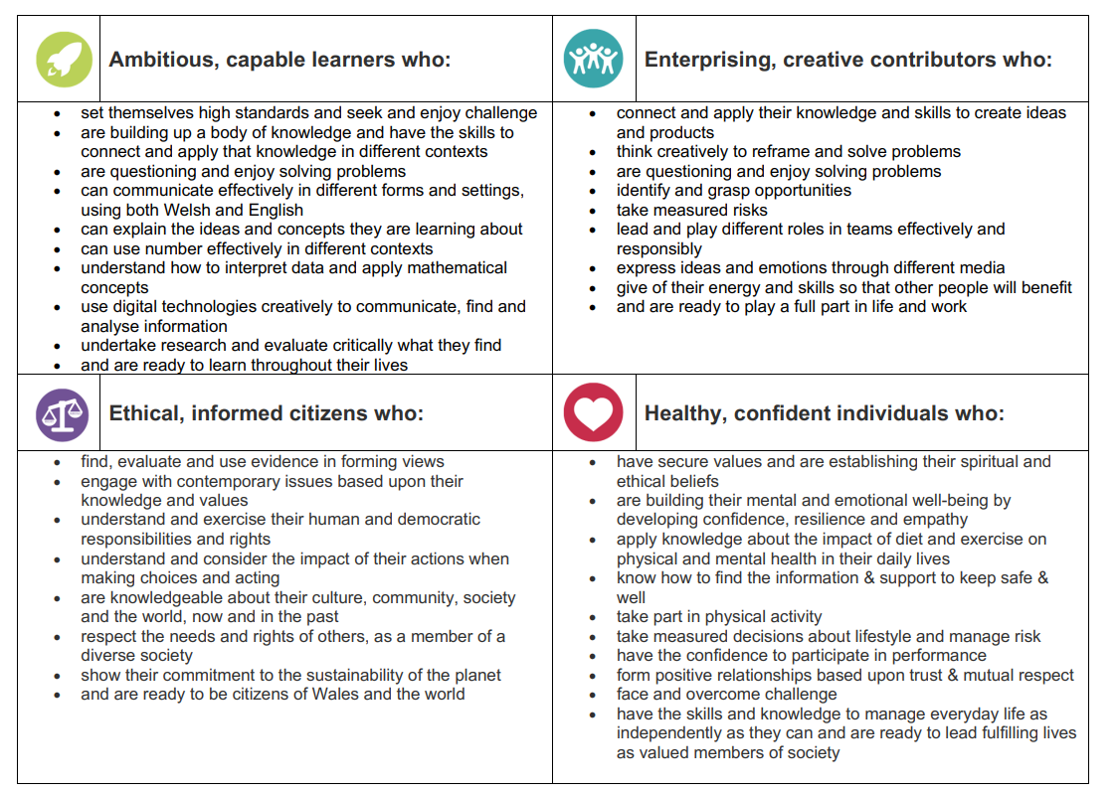
Financial & business skills
Personal Effectiveness

Slide 3
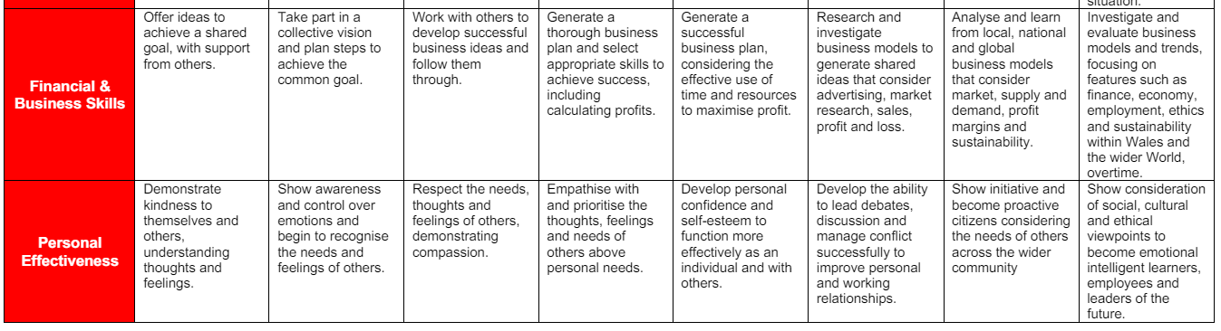
Financial & business skills
Personal Effectiveness

Slide 4
Business plans?
https://www.bbc.co.uk/bitesize/articles/z4q4bdm

