Slide 1

LPS Personal Learning Journey
Teamwork & Leadership

Slide 2
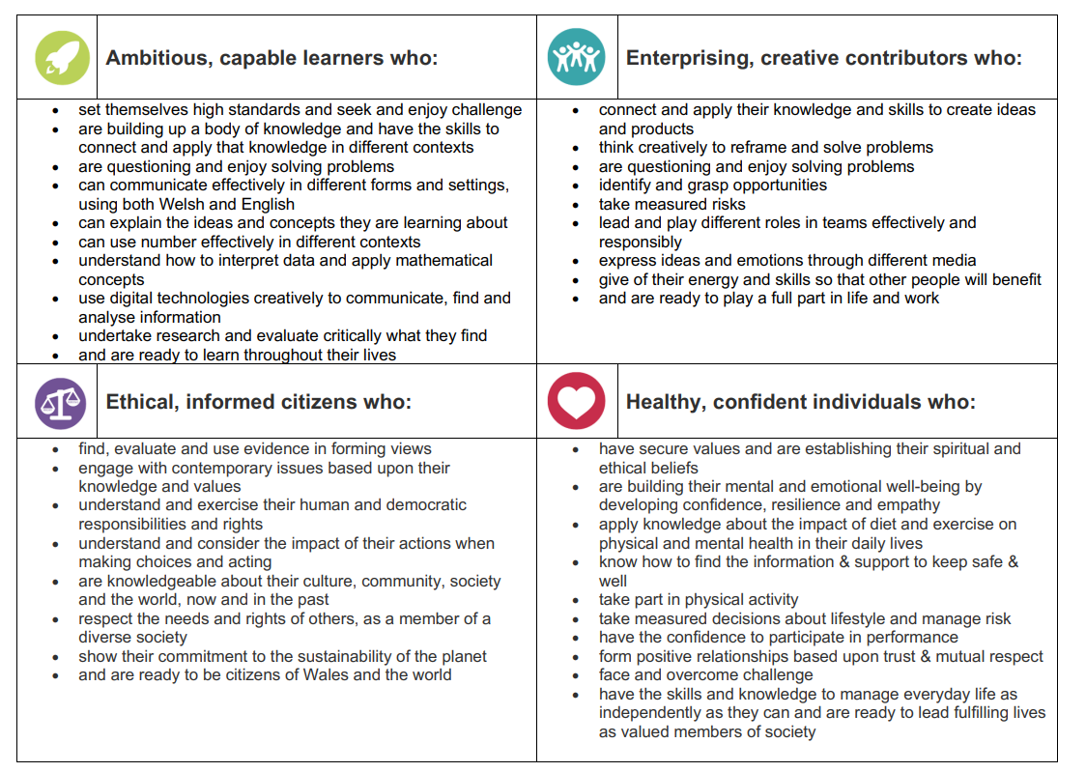
Teamwork & Leadership

Slide 3
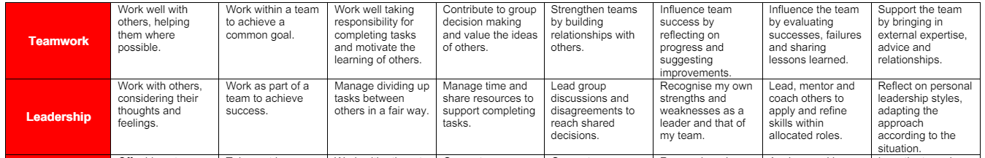
Teamwork & Leadership

Slide 4
Teamwork and Leadership
https://www.bbc.co.uk/bitesize/clips/zv3b87h
https://www.bbc.co.uk/bitesize/articles/zmcq382

Slide 5
Teamwork & Leadership
- Enterprise projects

