Slide 1
WHAT ROLE DOES FOOD PLAY IN RELIGIOUS CELEBRATIONS?
By AMIRAH

Slide 2
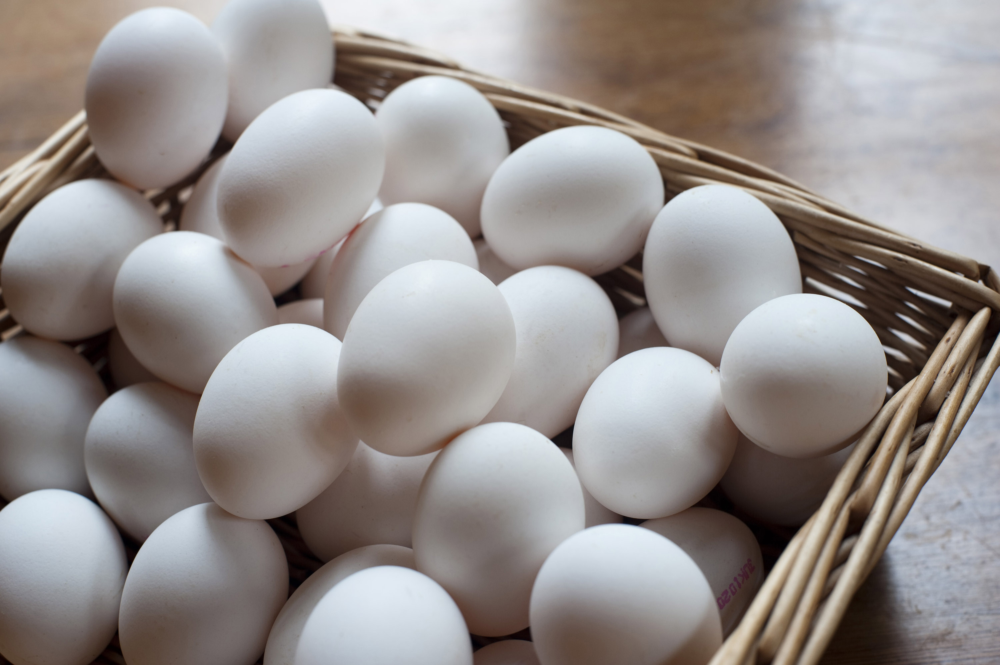
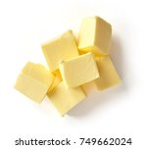
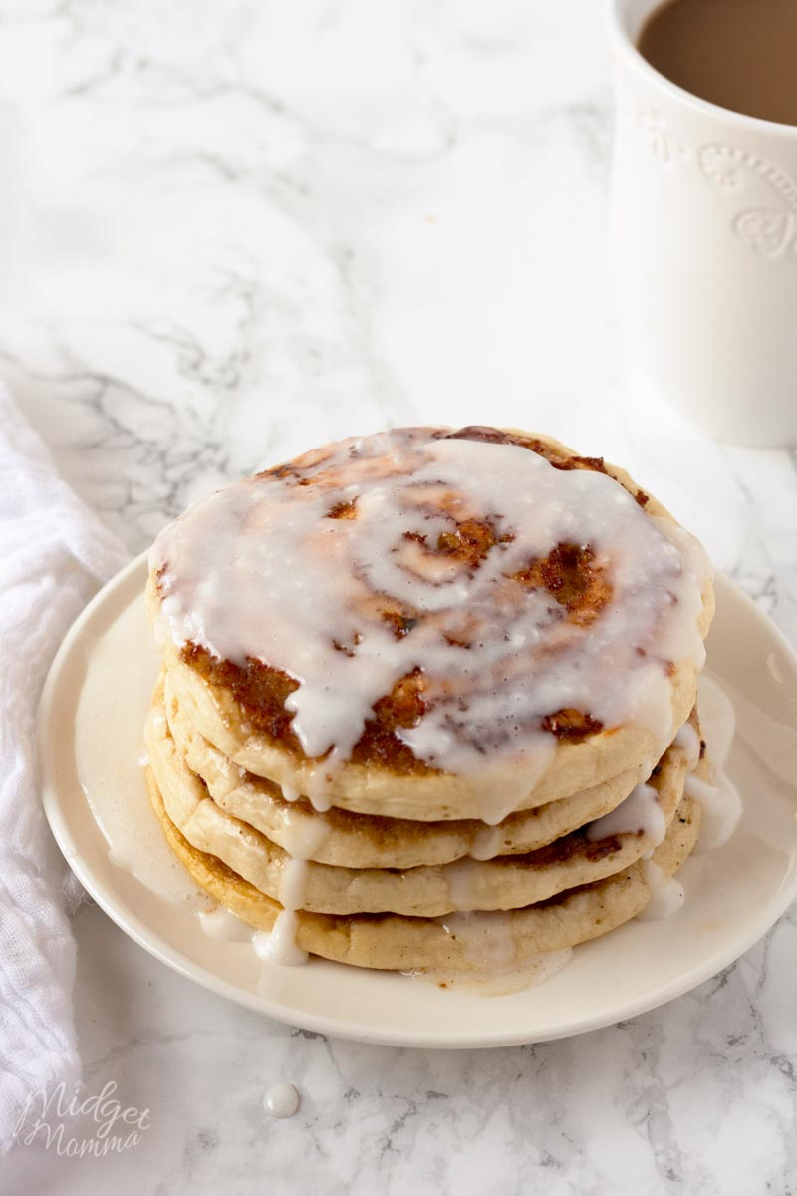
CHRISTIANITY Pancake day - On Pancake Day Christians eat pancakes made from sugar, fat, butter and eggs.

Slide 3
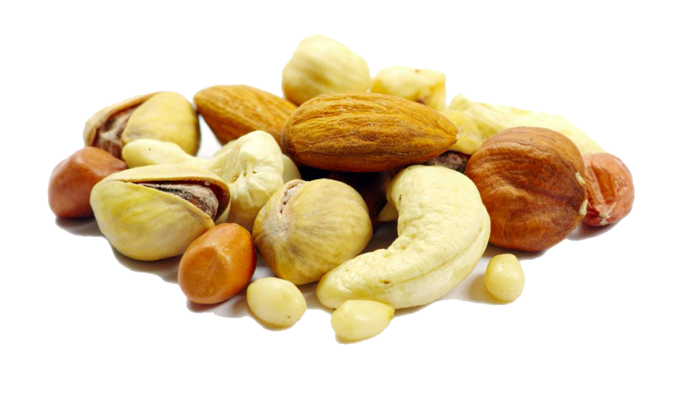
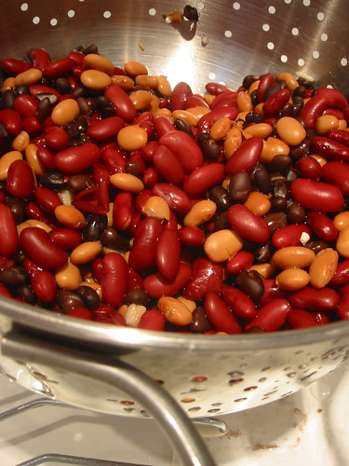
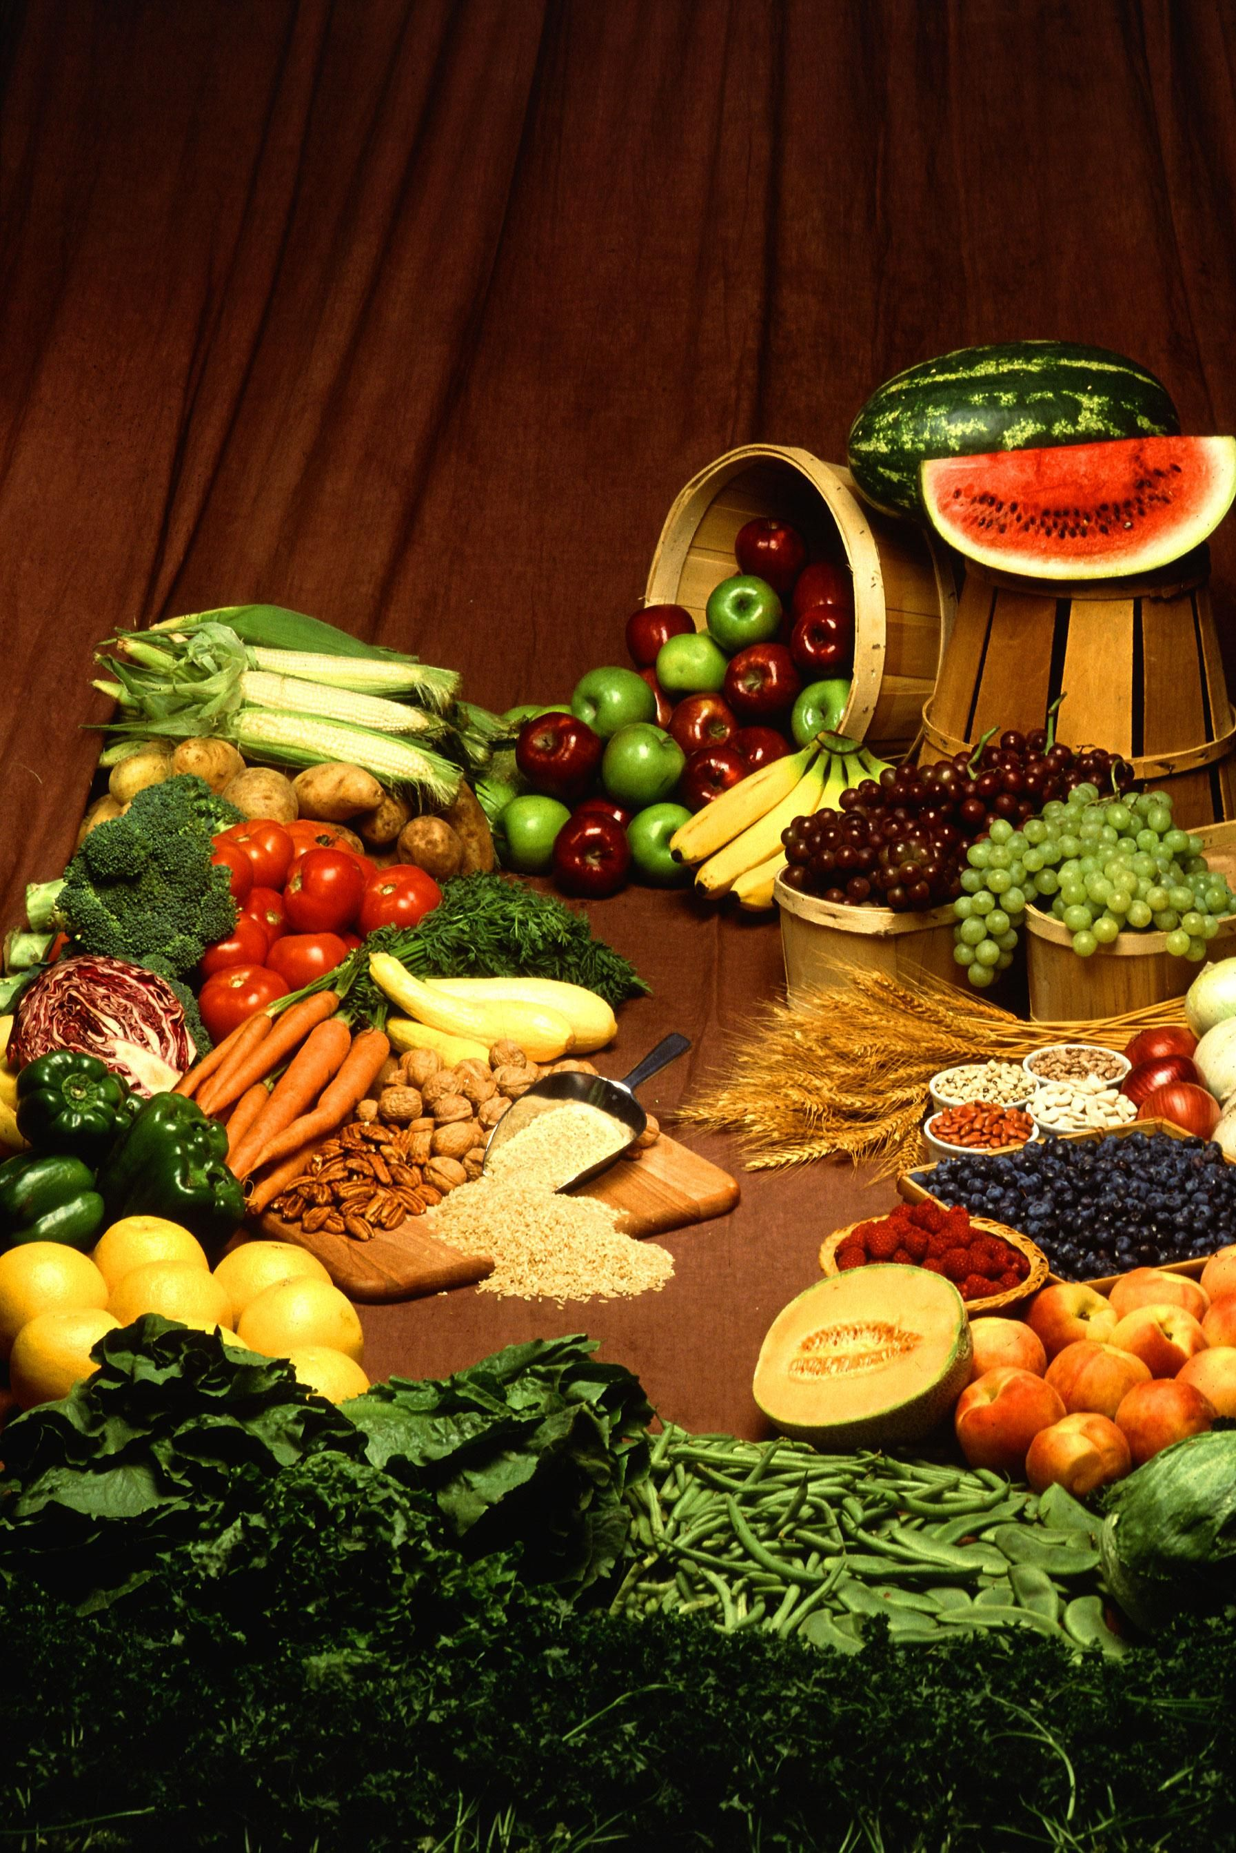
BUDDHISM Puja Day - On Puja Day Buddhists eat fruit and veg with nuts, seeds and beans because they don’t eat animal products.

Slide 4
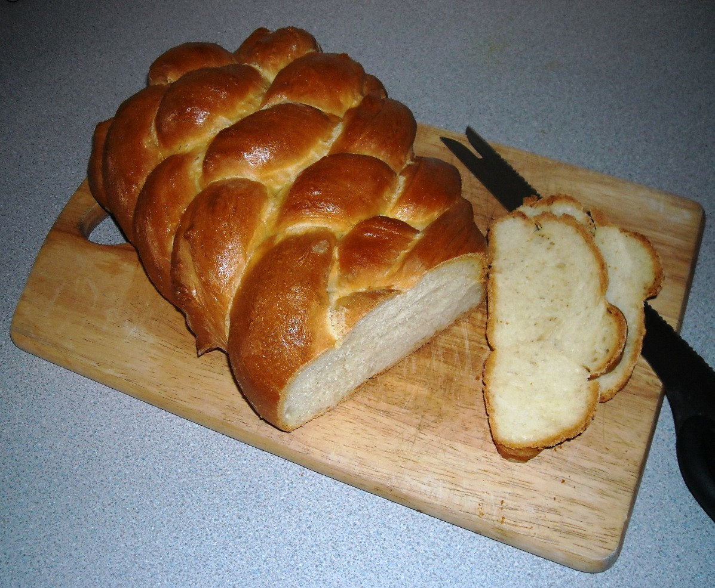
Judaism
On Shabbat Jews eat bread called Halla to symbolise the circle of life at the end of the year .

Slide 5
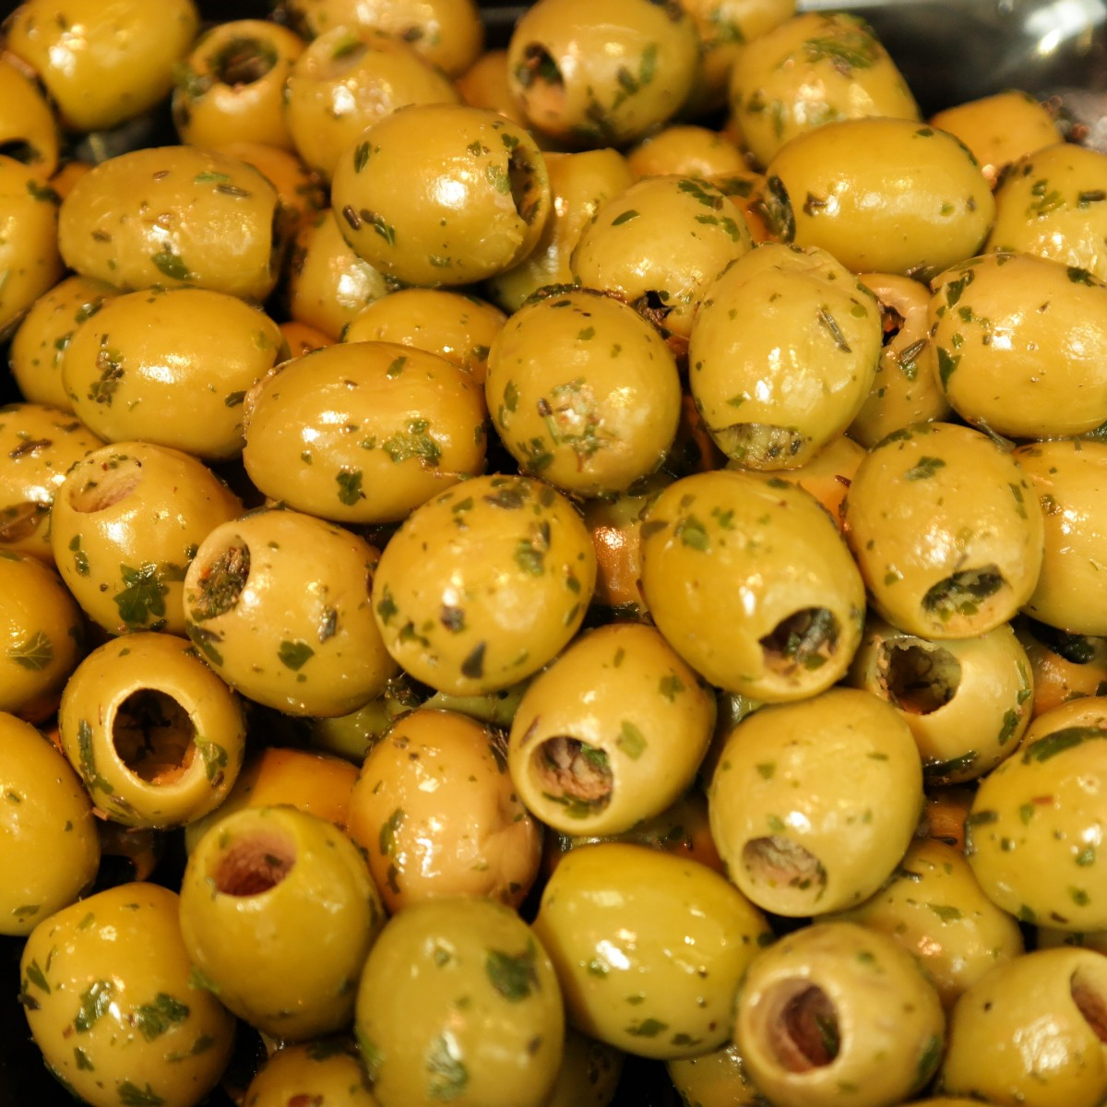
Islam
People who are Muslims eat olives, grapes and honey at the celebration of Eid-al-Adha.

Slide 6
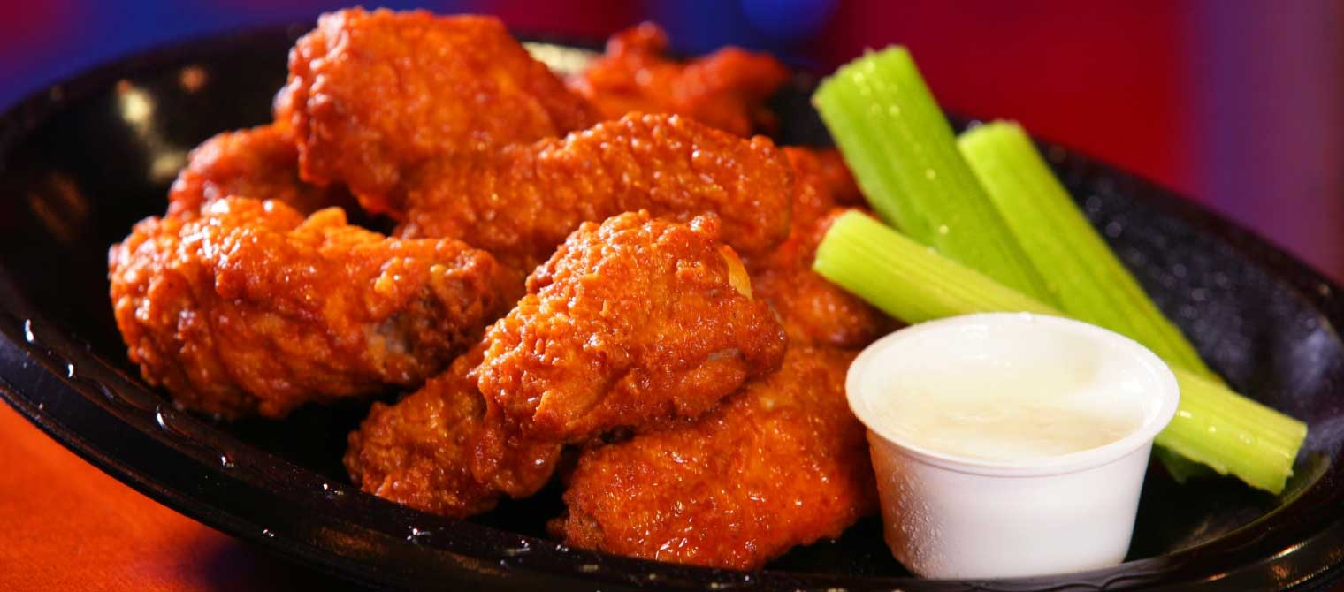
Sikhism
Sikh people eat chicken on the celebration of Vaisakhi.

Slide 7
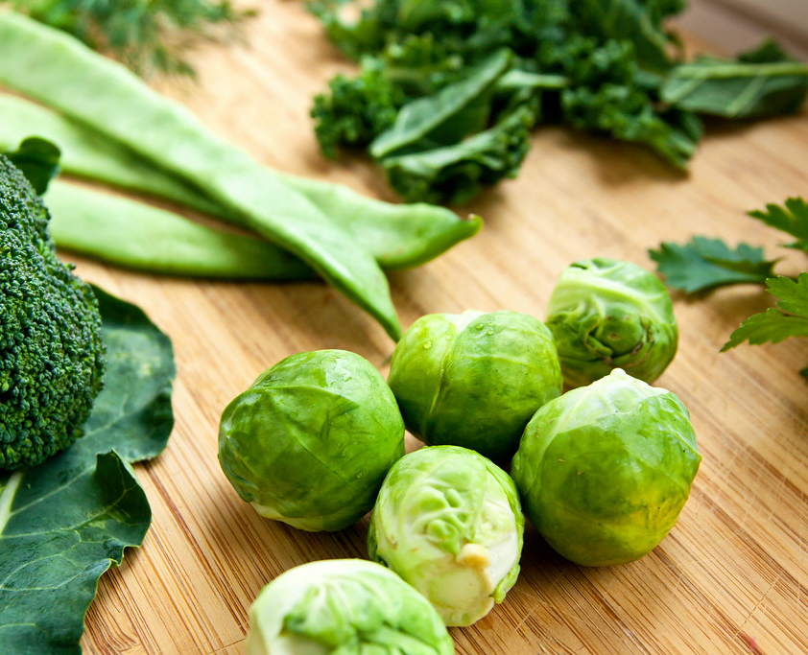
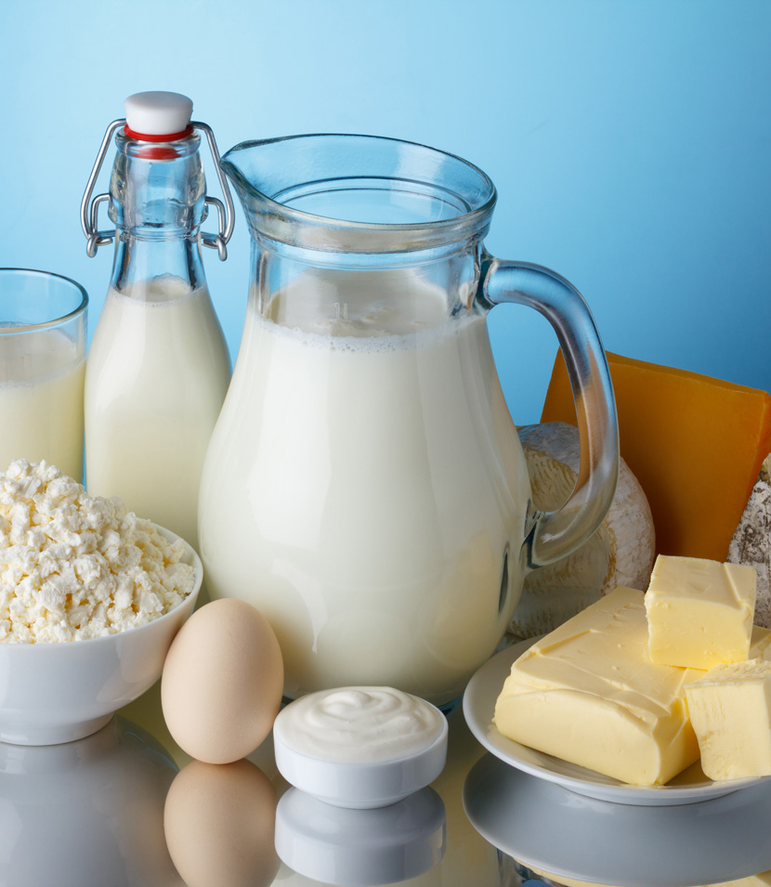
Hinduism - Hindus people eat green vegetables and dairy products when celebrating Navaratri

Slide 8
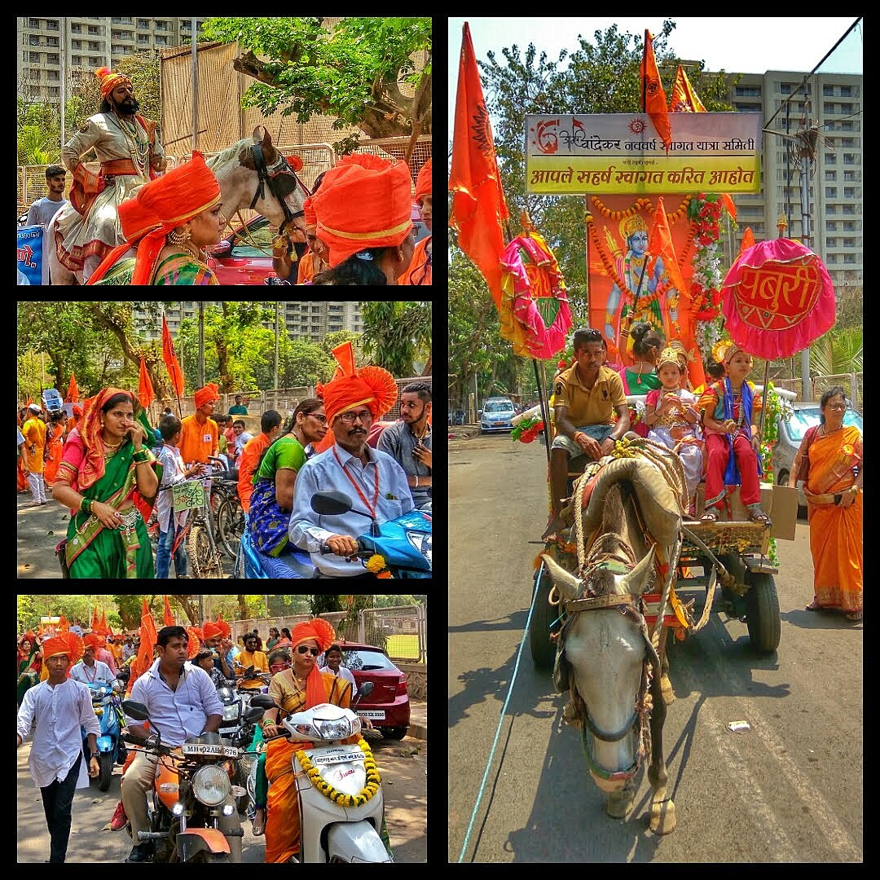
THE END

