Slide 1





What Role Does Food Play In Religious Celebrations?
We researched that the main religions worshipped in Swansea are Christianity, Judaism, Islam, Buddhism, Sikhism and Hinduism.

Slide 2

Christianity
Lamb is referenced in several Christian stories and is eaten at Easter as lamb symbolises Jesus being the sacrificial lamb of God.
Traditionally during Lent, Christians would give up rich, tasty foods such as butter, eggs, sugar and fat (some Christians continue to do so).
Christmas dinners are also an important part of the Christmas celebrations. Families and friends will share food together at Christmas time, eating traditional foods such as turkey, mince pies and Christmas puddings.

Slide 3

Buddhism
Many Buddhist temples serve vegetarian food, as many Buddhists avoid eating meat. Buddhists usually eat vegetarian food during Vesak or Magha Puja Day to show kindness and generosity to all living things.

Slide 4
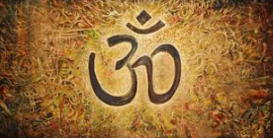
Hinduism
Foods eaten at Diwali and Holi are:
Samosas
Barfi
Kaju katli
Halva
Gulab jamun
Kheer
Aloo tikki
Paneer makhani
Chiroti

Slide 5
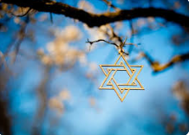
Judaism
Chanukah - This celebration includes plenty of food, wine, songs and conversations with loved ones. Jews eat Challah, matzo ball soup, and roasted chicken.
During Passover, Jews are forbidden to eat leavened foods, and instead eat matzo - an unleavened flatbread.

Slide 6
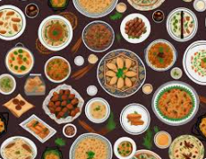
Islam
Sweet snacks may include sheer Kurma, halwa, handesh, carrot halwa and Gujiya.
If you have any space left after snacking and lunching, then you may consider finishing off with some homemade Gulab jamun, Rasmalai, kheer, firni or soan papdi for afters.

Slide 7
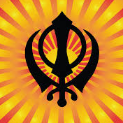
Sikhism
Savoury snacks will often include samosas , nunor bora (salty rice flour puffs).

