Slide 1
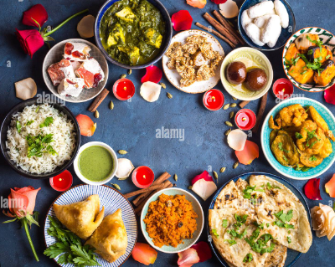
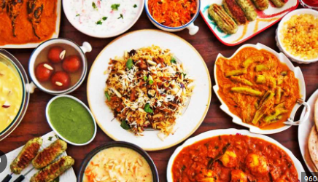
What role does food play in Religious Celebrations?
The main religions worshipped in Swansea are Christianity, Islam, Judaism, Hinduism, Budhism and Sikhism.

Slide 2
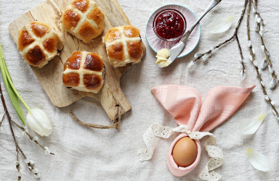
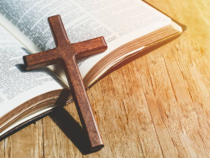
Christianity
Some Christian celebrations are Easter, Christmas, Pancake day and Harvest.
At Easter some people eat eggs to show new life and they also eat hot cross buns to symbolise the cross that Jesus died on.
At Christmas they eat roast chicken, roast beef or ham with stuffing, mashed potatoes, gravy, cranberry sauce and fruit cake or Christmas pudding.
On Pancake Day Christians eat eggs, butter, sugar and fat .
At Harvest give food to the church or to food banks.

Slide 3
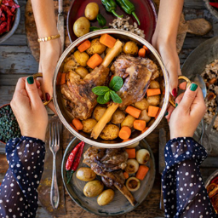
Islam
Islamic celebrations are Eid al – Fitr and Eid al – Adha.
On Eid al – Fitr, Muslims eat beef curry, kheer, manti, halva, cake, bolani and stuffed dates.
On Eid al – Adha, Muslims eat savoury meals like meat and rice dishes, rice, carrots and spices, sometimes eggs and potatoes and meat cooked in yogurt served on top of rice and nuts.

Slide 4
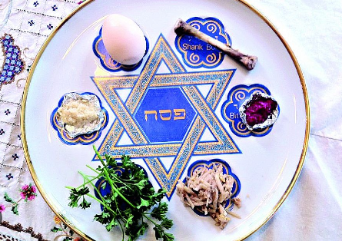
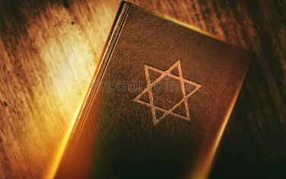
Judaism
On Sukkot, Jews eat challah, fish, salad, chicken and meat .

Slide 5
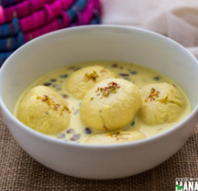
Hinduism
On Holi, Hindus eat a dish called rasmali. It’s made of
milk, sugar, nuts, saffron
and cardamoms.

Slide 6
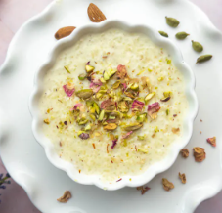
Sikhism
On Maghi, Sikhs eat a dish called kheer which is made out of rice cooked in sugarcane juice.

Slide 7
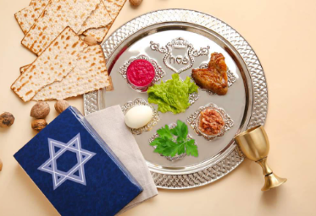
Judaism
Jewish celebrations are Shabbat, Pesach and Hanukkah.
On Hanukkah the Jews eat roasted chicken, brisket, eggs, sugar, sour cream, matzo ball soup and challah.
On Shabbat Jews eat bread, fish, soup, side dishes and desserts.
On Pesach the Jews eat potatoes, kugel, carrots and prunes.

