Slide 1
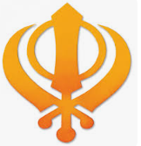

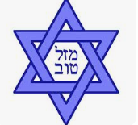

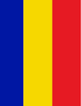
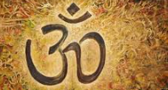
What role does food play in religious celebrations?
By Dottie

Slide 2
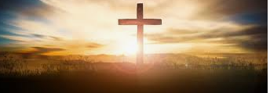
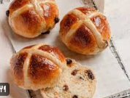
Easter
Christianity
We Christians eat hot cross buns at Easter because it is to remember Jesus on the cross.

Slide 3
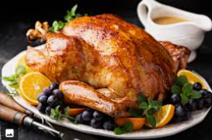
Christmas
Christianity
At Christmas, Christians eat chicken or turkey dinner to celebrate Jesus's birthday.

Slide 4
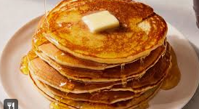
Pancake Day
Christianity
Christians celebrate pancake day because on pancake day you use up all of your butter, sugar, milk and eggs before the forty days of lent.

Slide 5
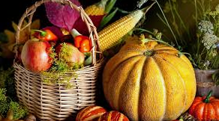
Harvest
Christianity
Harvest is a food celebration for Christians. You eat things like pumpkins, corn, radish and fresh vegetables. Christians also give to the poor and elderly at Harvest.

Slide 6
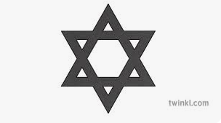
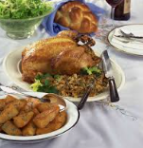
Shabbat
Judaism
Shabbat is a Jewish day of rest but it is also a food celebration where Jews eat bread, fish, soup, meat, side dishes and dessert.

Slide 7
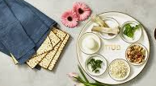
Pesach
Judaism
Pesach is a Jewish food celebration it is where they eat brisket, roasted chicken and potato kugel.

Slide 8
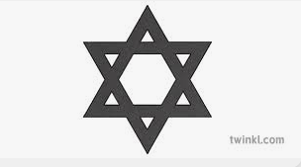
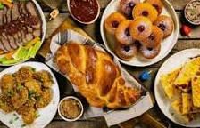
Chanukah
Judaism
Chanukah is a Jewish food festival where Jews eat fried potato pancakes, sufganiyot and fried jelly donuts.

Slide 9
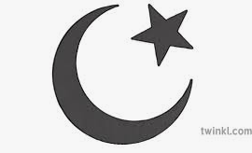
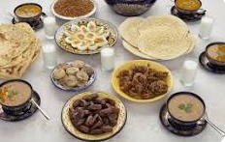
Eid al-Fitr
Islam
Eid al-Fitr is a food festival for Islams it is where you eat meat, currys, kibbey haleem and many other dishes.

Slide 10
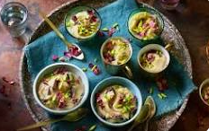
Eid al-Adha
Islam
Eid al-Adha is a food festival for Muslims. They eat curries, tagines, dals, with sides and sweets.

Slide 11
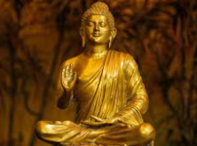
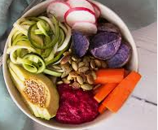
Vesak
Buddhism
Vesak is a food festival for Buddhists . Most Buddhists try to avoid meat on Vesak.

Slide 12
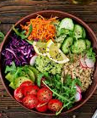
Magha Puja Day
Buddhism
Magha Puja Day is a food festival for Buddhists but like Vesak they eat vegetarian food.

Slide 13
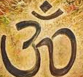
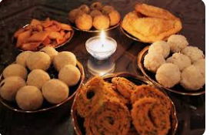
Diwali
Hinduism
Diwali is a food festival for Hindus. It is where they eat samosas, kheer and Bombay mix.

Slide 14
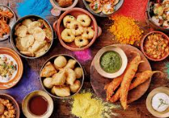
Holi
Hinduism
Holi is a food festival for Hindus. It is where they eat lassi barfi and thandai.

Slide 15
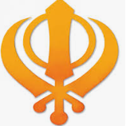
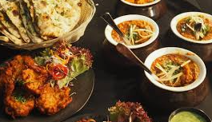
Vaisakhi
Sikhism
Vaisakhi is a food festival for sikh people. It is where they eat mango lassi, kadhi and meethe chawal.

