Slide 1
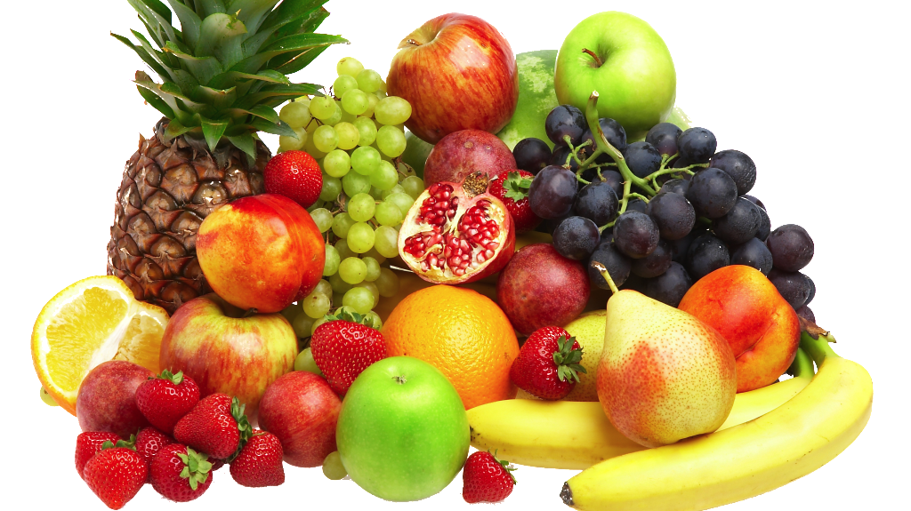
Food is your Mood
By Khloe Hassell

Slide 2
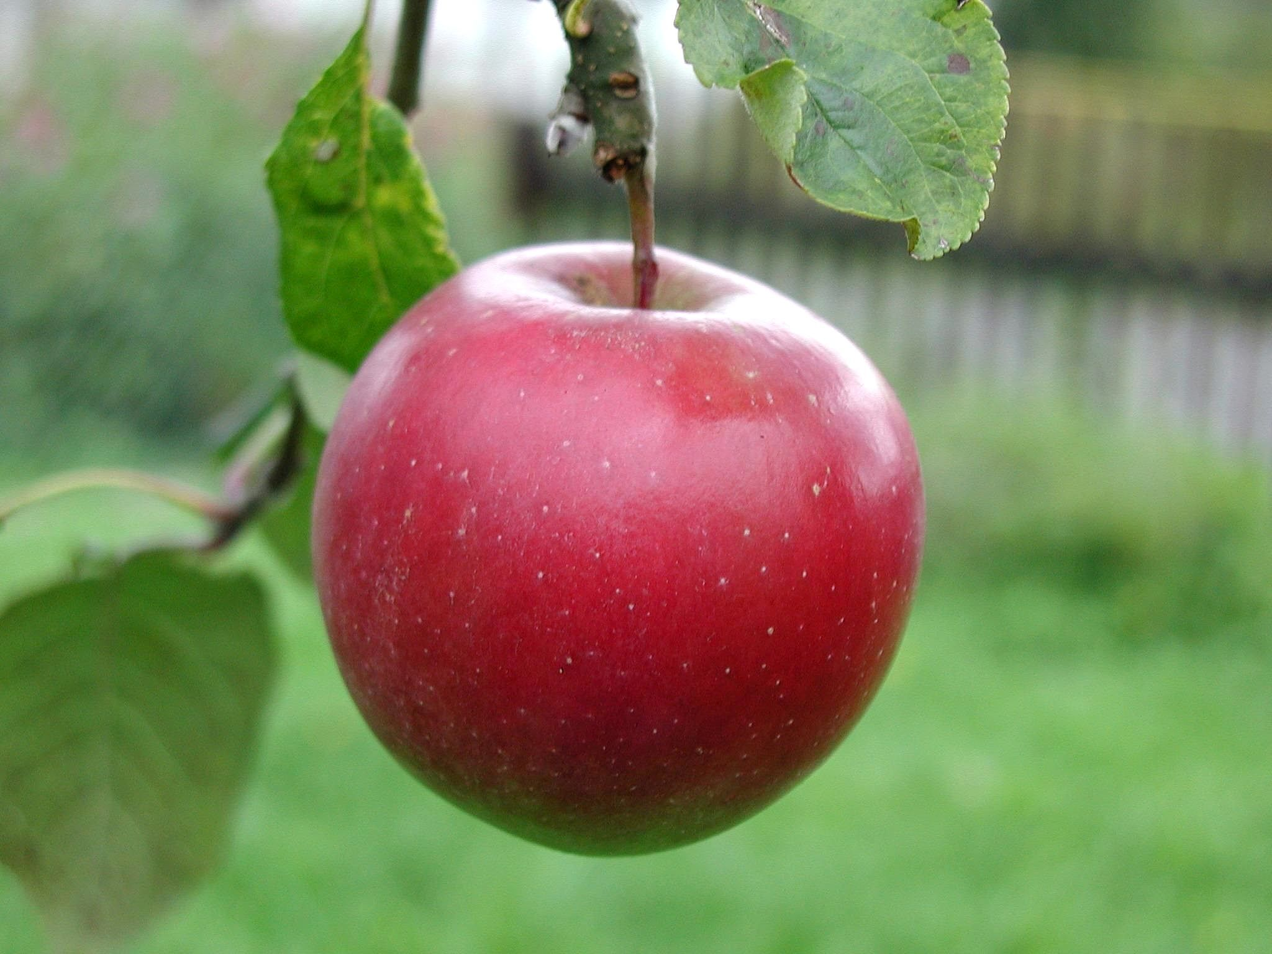
A Healthy Snack
An apple can be a healthy snack every day and with a crunch of a bite you will feel good because they have vitamins in them.
ThePhoto by PhotoAuthor is licensed under CCYYSA.

Slide 3
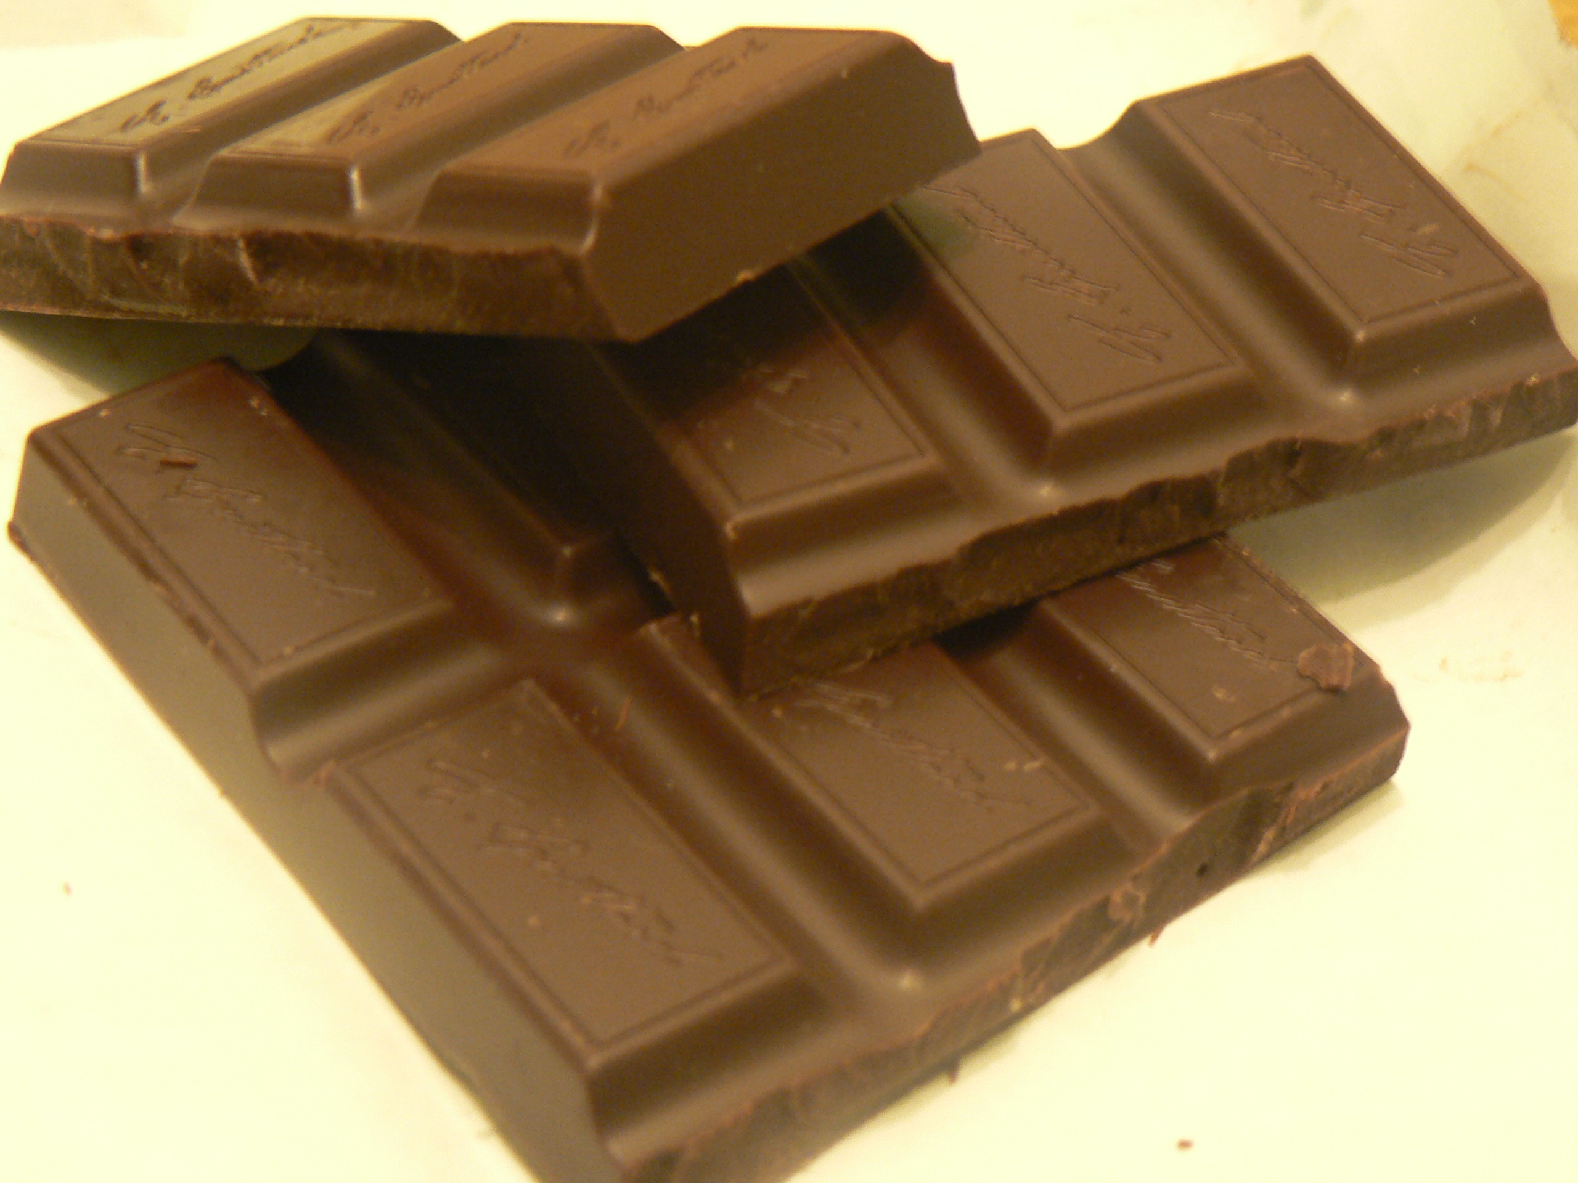
Unhealthy Snacks
Chocolate is a snack that we all love but it is unhealthy. You feel nice when you first eat it but then you might eat too much and feel sick and full of sugar.

Slide 4
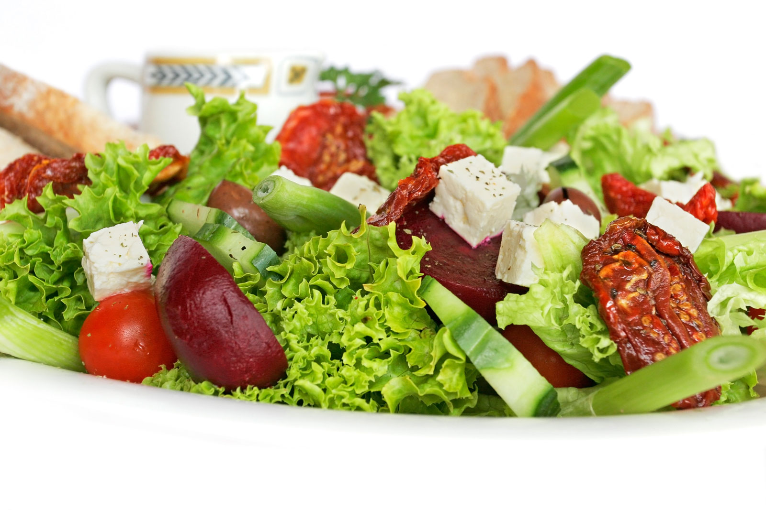
A Healthy Salad
A healthy salad is so nice and so good for you. Salads contain vitamins and minerals which are all good for you and your mood.

Slide 5
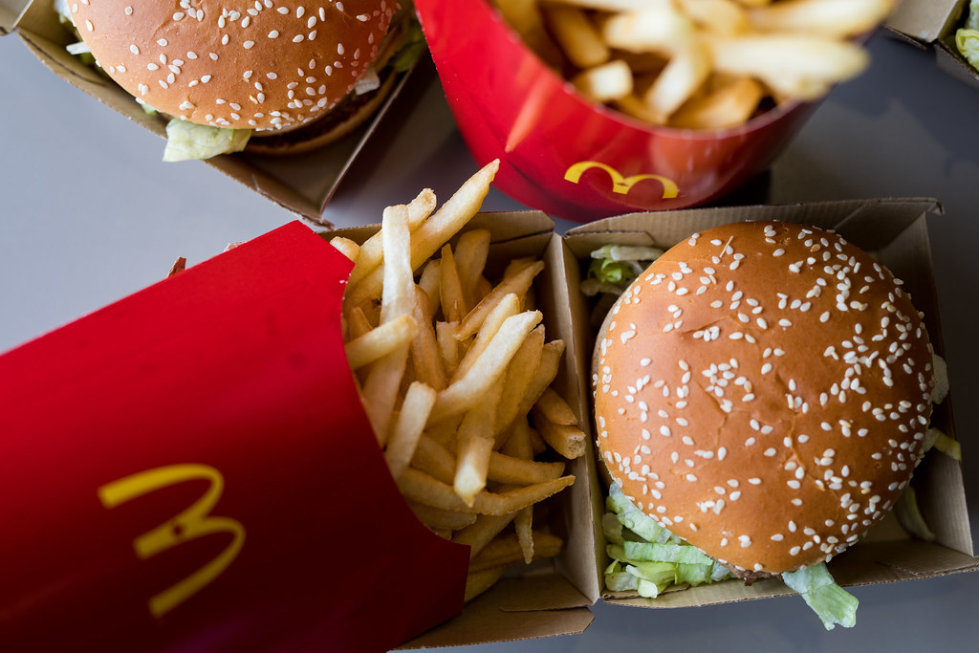
An Unhealthy Dinner
McDonalds is an unhealthy dinner because if you eat too much of it, it can make you have a bad belly.

Slide 6


