Slide 1
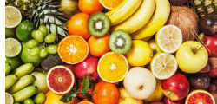
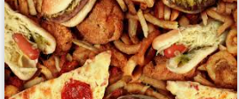
Food Is Your Mood
By Toby.J
.

Slide 2
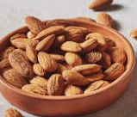
Nuts
Nuts are great for your health and mood because they contain essential fatty acids and other vitamins and minerals that help support a healthy nervous system.

Slide 3
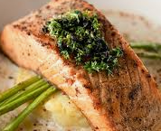
Fish
Fish is great for your health because it contains Omega-3 fatty acids and vitamins.

Slide 4
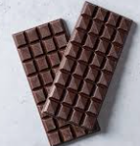
Dark chocolate
Dark chocolate is good for you in small amounts because it helps lower your blood pressure, helps improve your cholesterol levels and brain function, and helps your body deal with insulin.

Slide 5
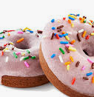
Donut
Donuts are not good for your health because they contain lots of fat and sugar.

Slide 6
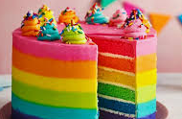
Cake
It is absolutely possible to make cake healthy if you use vegetables and substitutes for sugar. But most of the time it is not healthy.

