Slide 1
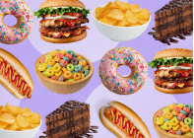
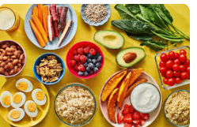
Food Is Your Mood
By William

Slide 2
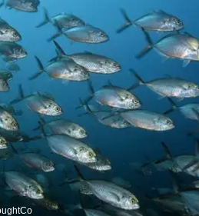
FISH
Fish is good for you because it provides a good source of protein and vitamins. Eating fish provides you with better health and wellbeing.

Slide 3
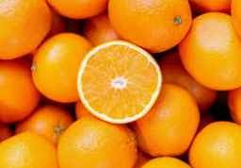
Oranges
.
Oranges are a type of healthy, Oranges are low calorie, highly nutritious fruits. If they are eaten as part of a healthy and varied diet, oranges can help lower a person’s risk of many health conditions. Oranges contain lots of vitamin c.

Slide 4
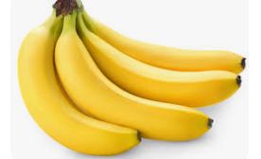
Bananas
Bananas are good for your health because they give you vitamin c, fibre, potassium and folate.
Eating bananas have a positive impact on your health and wellbeing.

Slide 5
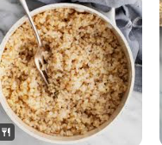
Brown Rice
Brown rice is good because it has folate and protein and low calories. It has a good impact on your health and wellbeing

Slide 6
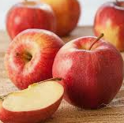
Apples
Apples have a positive impact on your health and wellbeing because they contain fibre and they can promote good heart health.

Slide 7
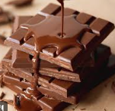
Milk Chocolate
Milk chocolate has a bad impact on your health and wellbeing. It gives you a sugar rush but then you suddenly get really tired when you have a sugar crash. It contains loads of fat, sugar and calories.

Slide 8
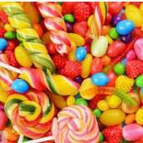
Sweets
Sweets have a bad impact on your health and wellbeing because you have a sugar rush then you get really tired. Also too many sweets can cause type 2 diabetes and they can cause some cancers.

Slide 9
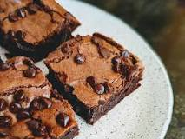
Chocolate Brownie
#
Since brownies don’t contain any nutrients, they are not usually regarded as a healthy food. However, brownies do have some health benefits that might be surprising due to their chocolate content.

Slide 10
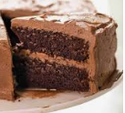
Chocolate Cake
Chocolate cake has a bad impact on your health and wellbeing, because it has lots of sugar and you can go overweight if you eat to much chocolate cake. It gives you a sugar rush then all of a sudden you get really tired.

Slide 11
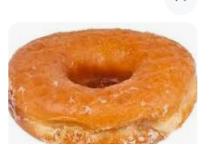
Donuts
Donuts have a bad impact on your health and wellbeing because they have lots of sugar and salt in them and if you eat too many donuts you might get overweight.

