Slide 1
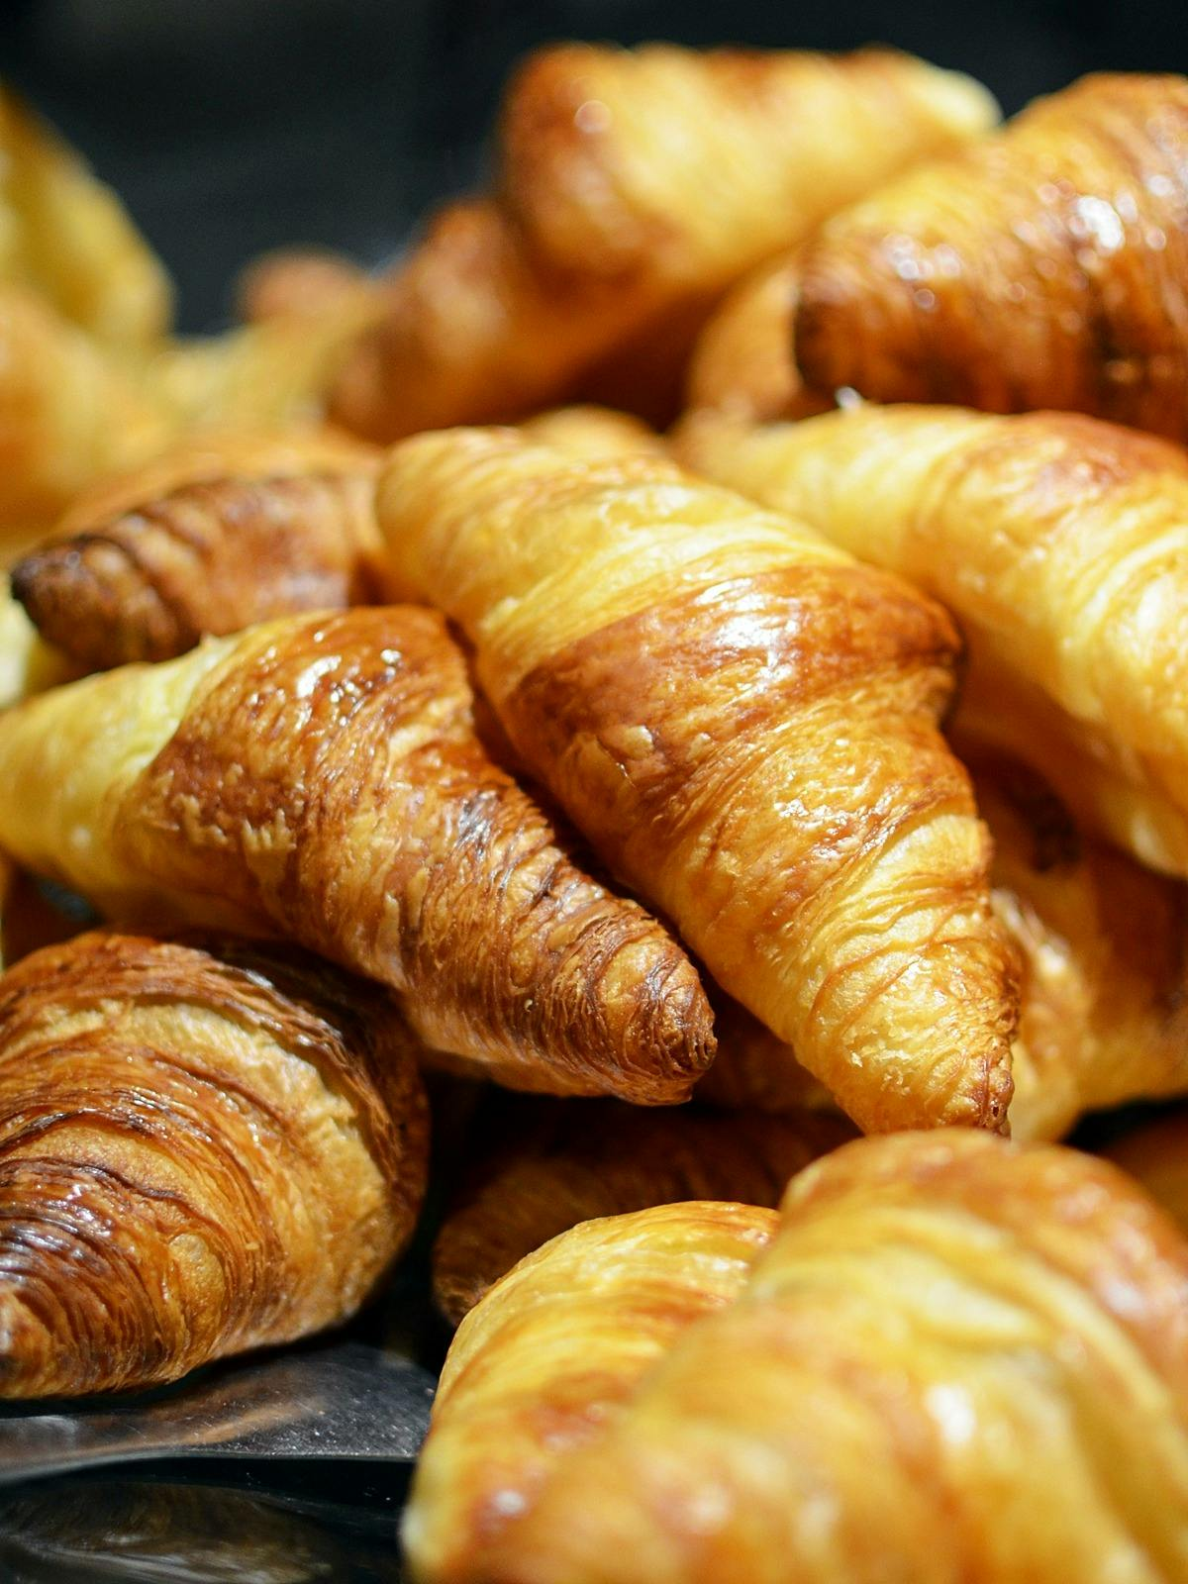

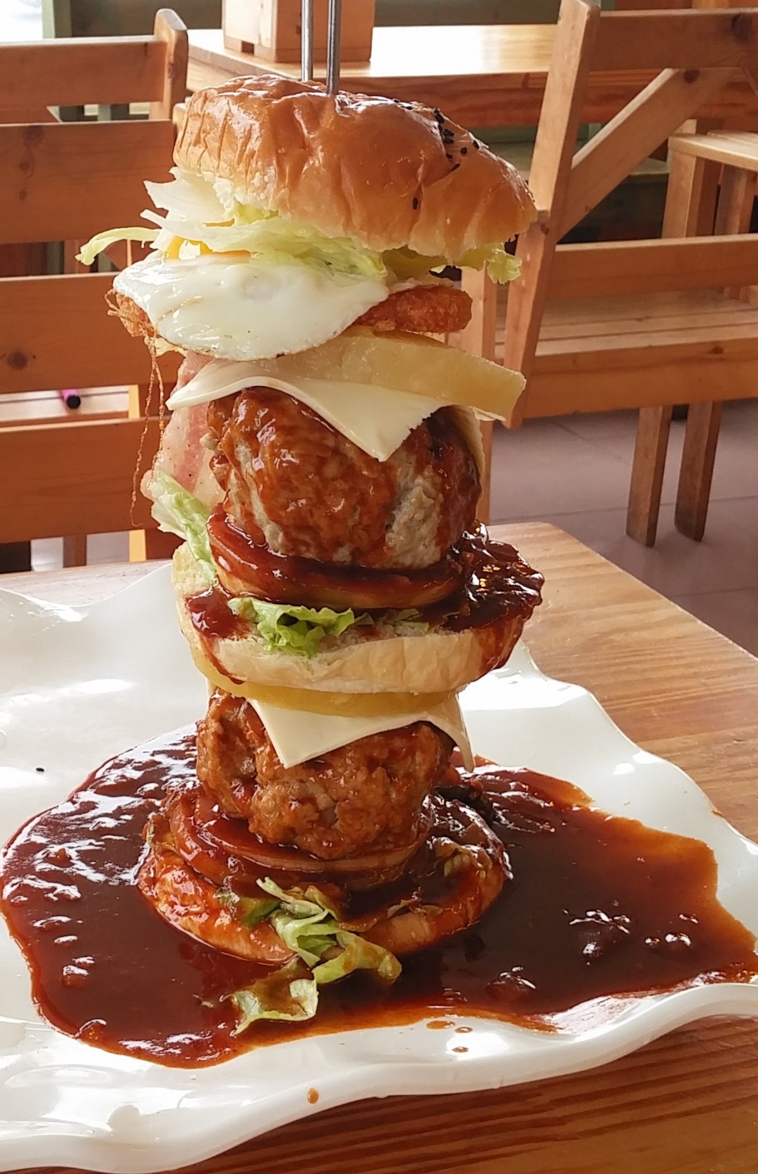
FOOD IS YOUR MOOD
by Ryan

Slide 2
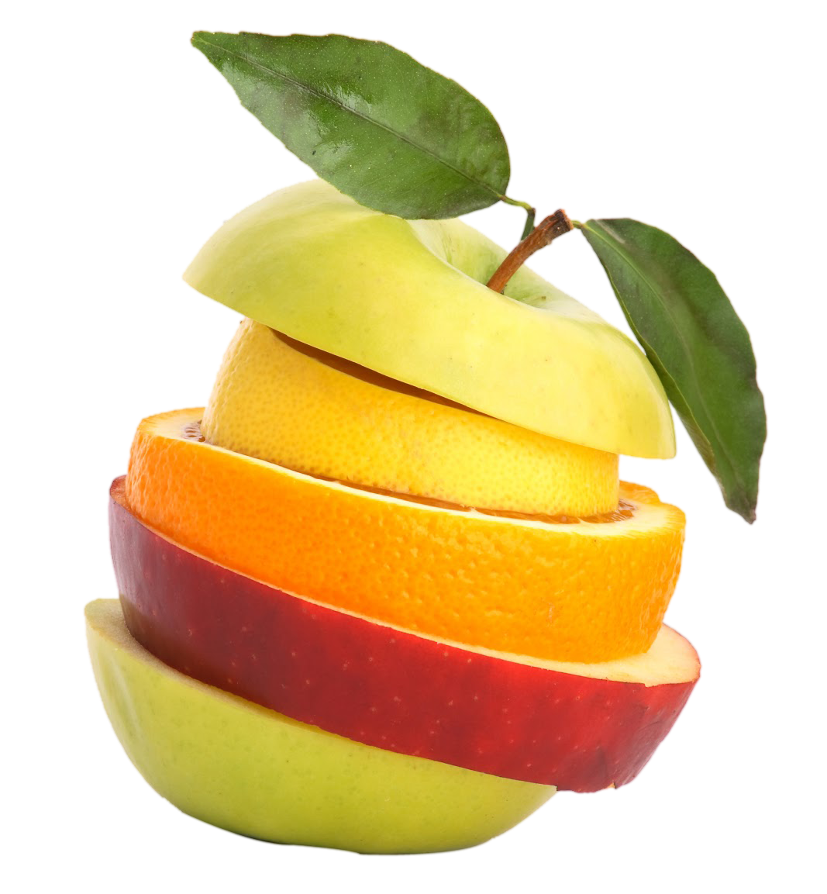
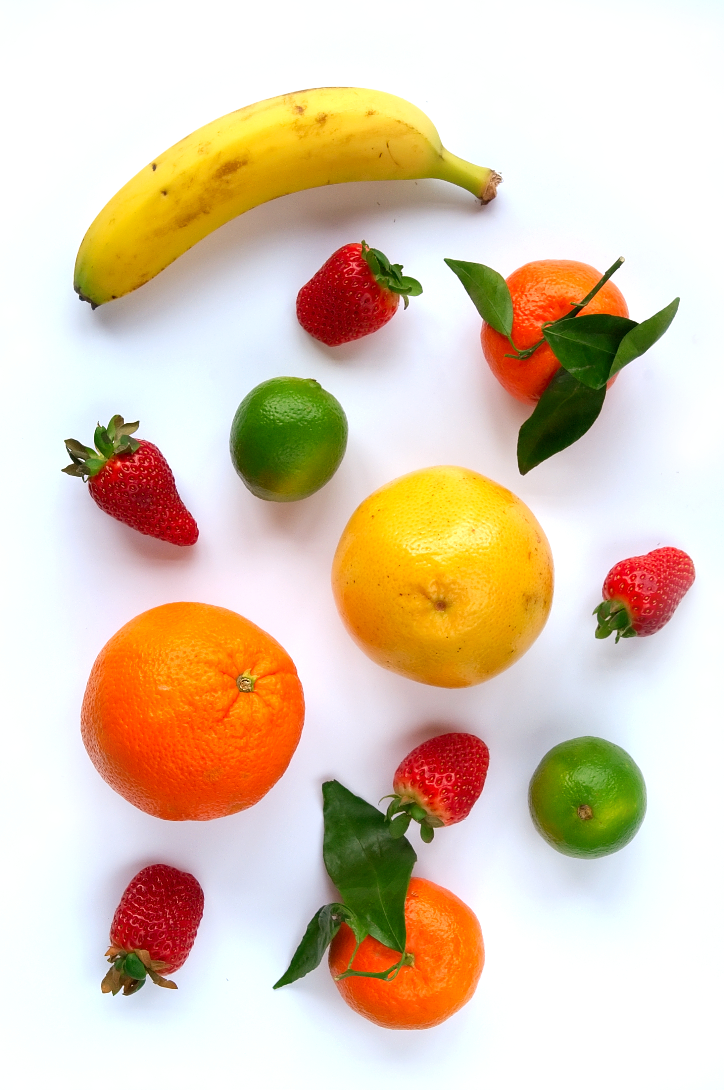
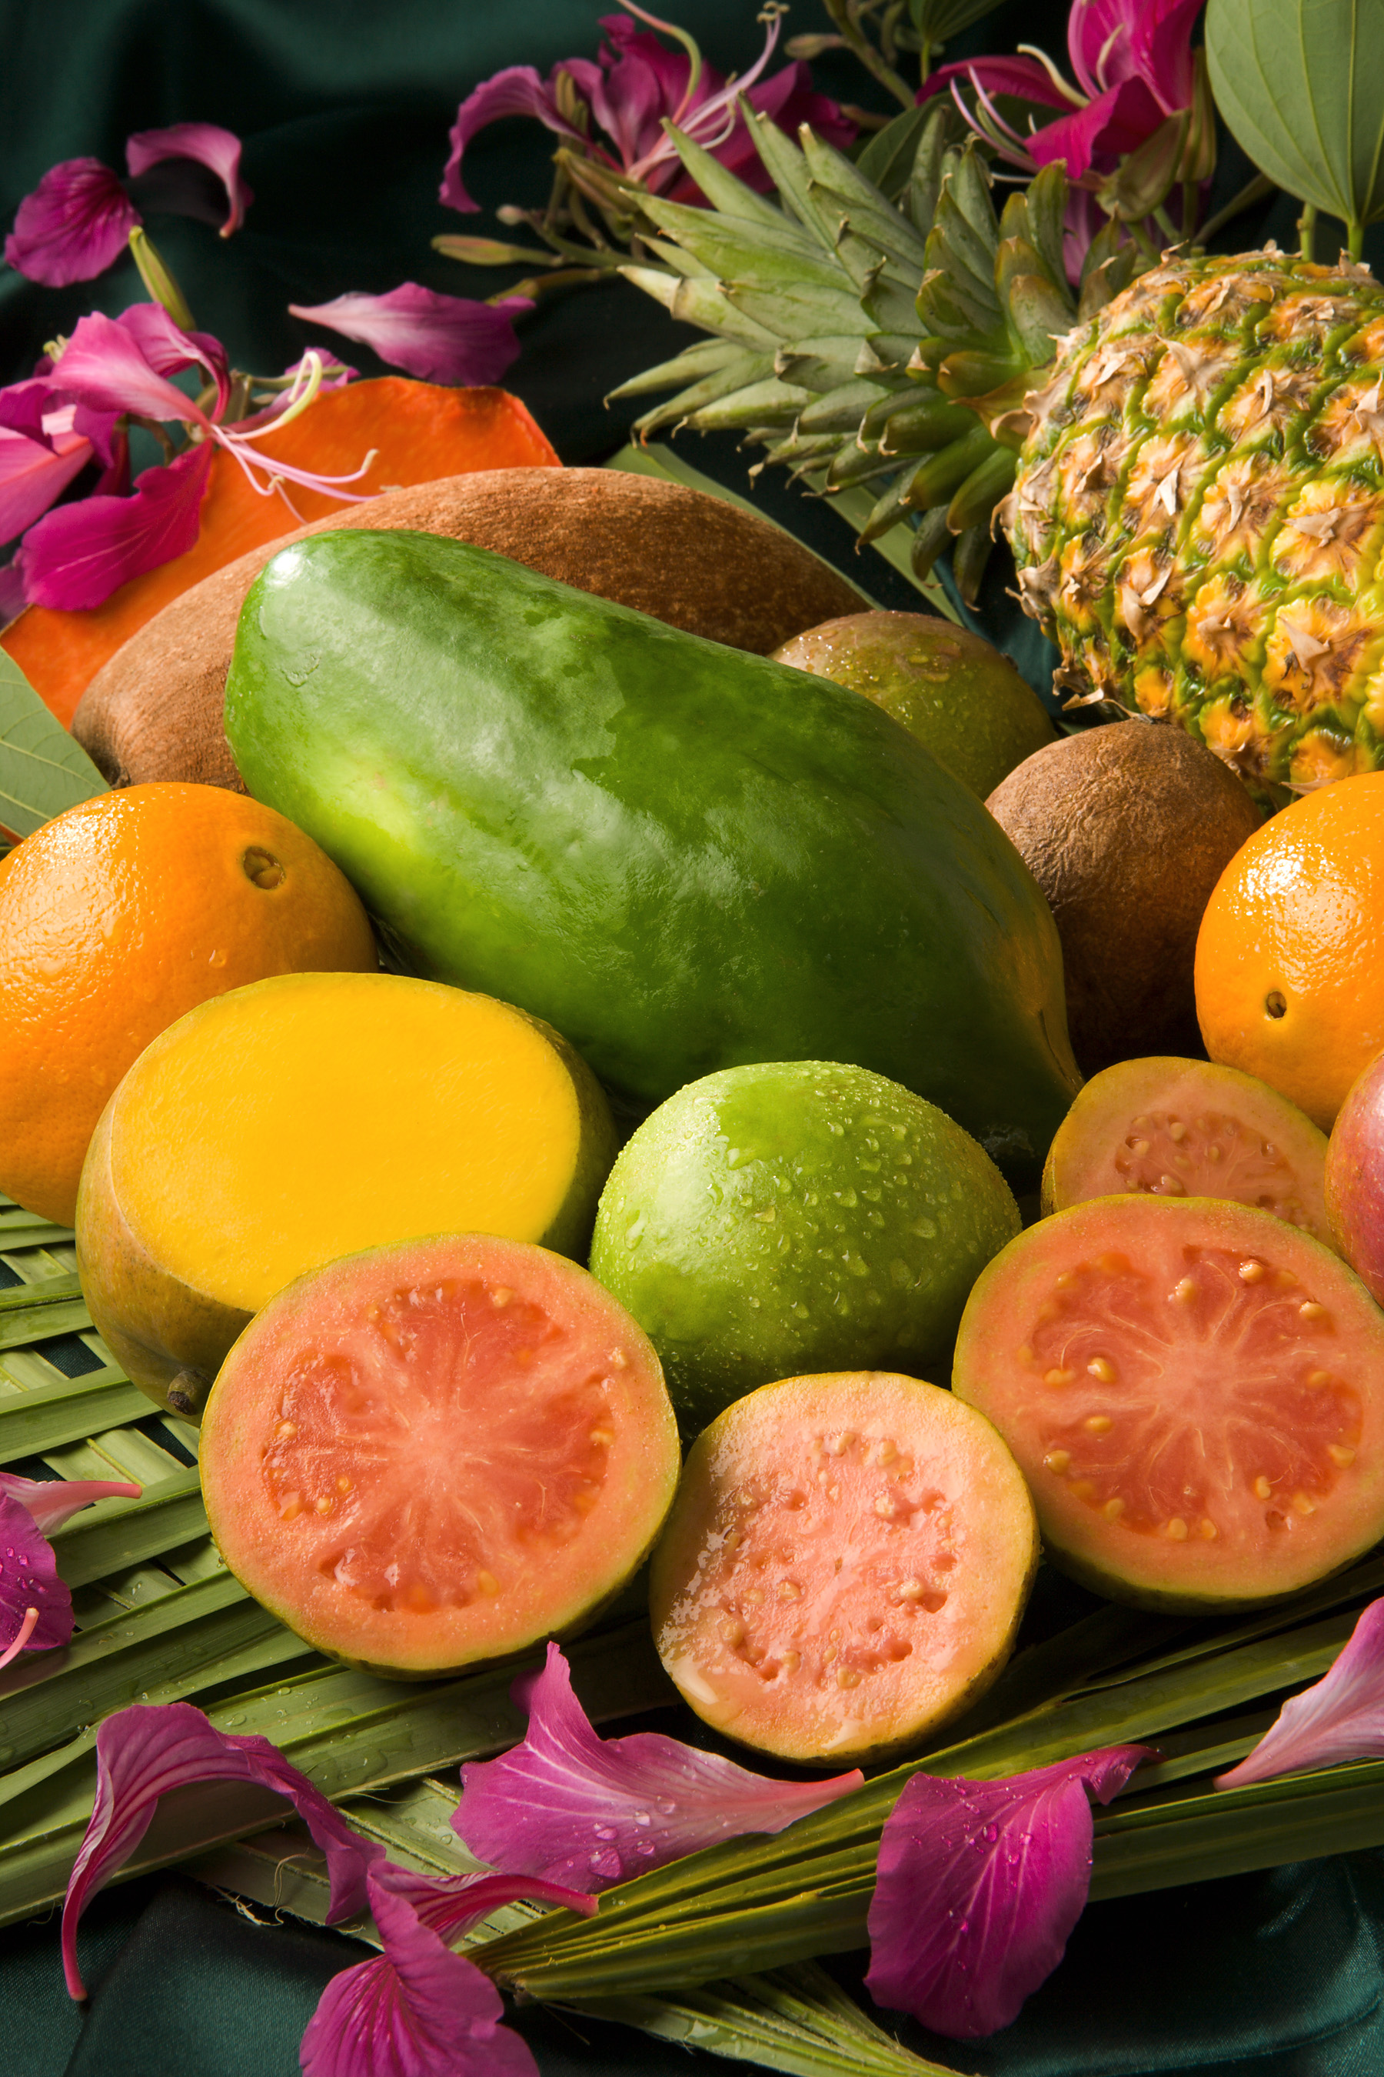
Fruits
100 billion bananas are eaten every year, they are very good for you.
Fruits contain lots of vitamins.
Strawberries are highly nutritious and low in both carbs and calories so that is good.

Slide 3
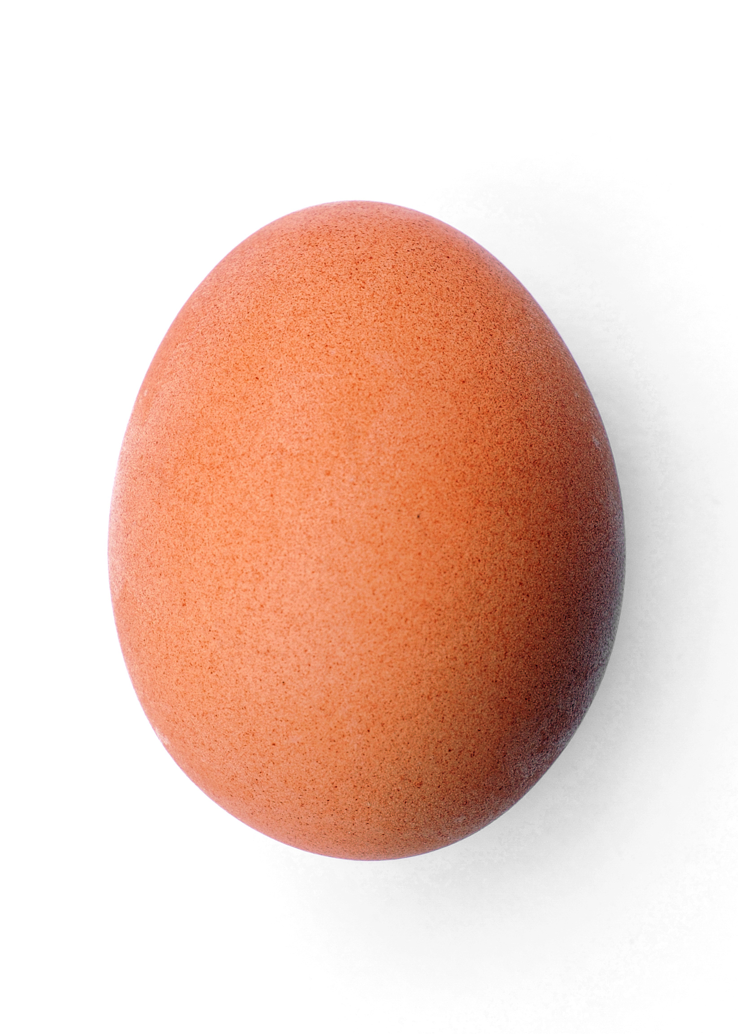
Eggs
Eggs are good for your eyes
Egg yolks are one of the few foods that naturally contain vitamin D
Egg shell and yolk colour can vary but have no effect on taste or quality
Eggs are very good for your mood.
ThePhoto by PhotoAuthor is licensed under CCYYSA.

Slide 4
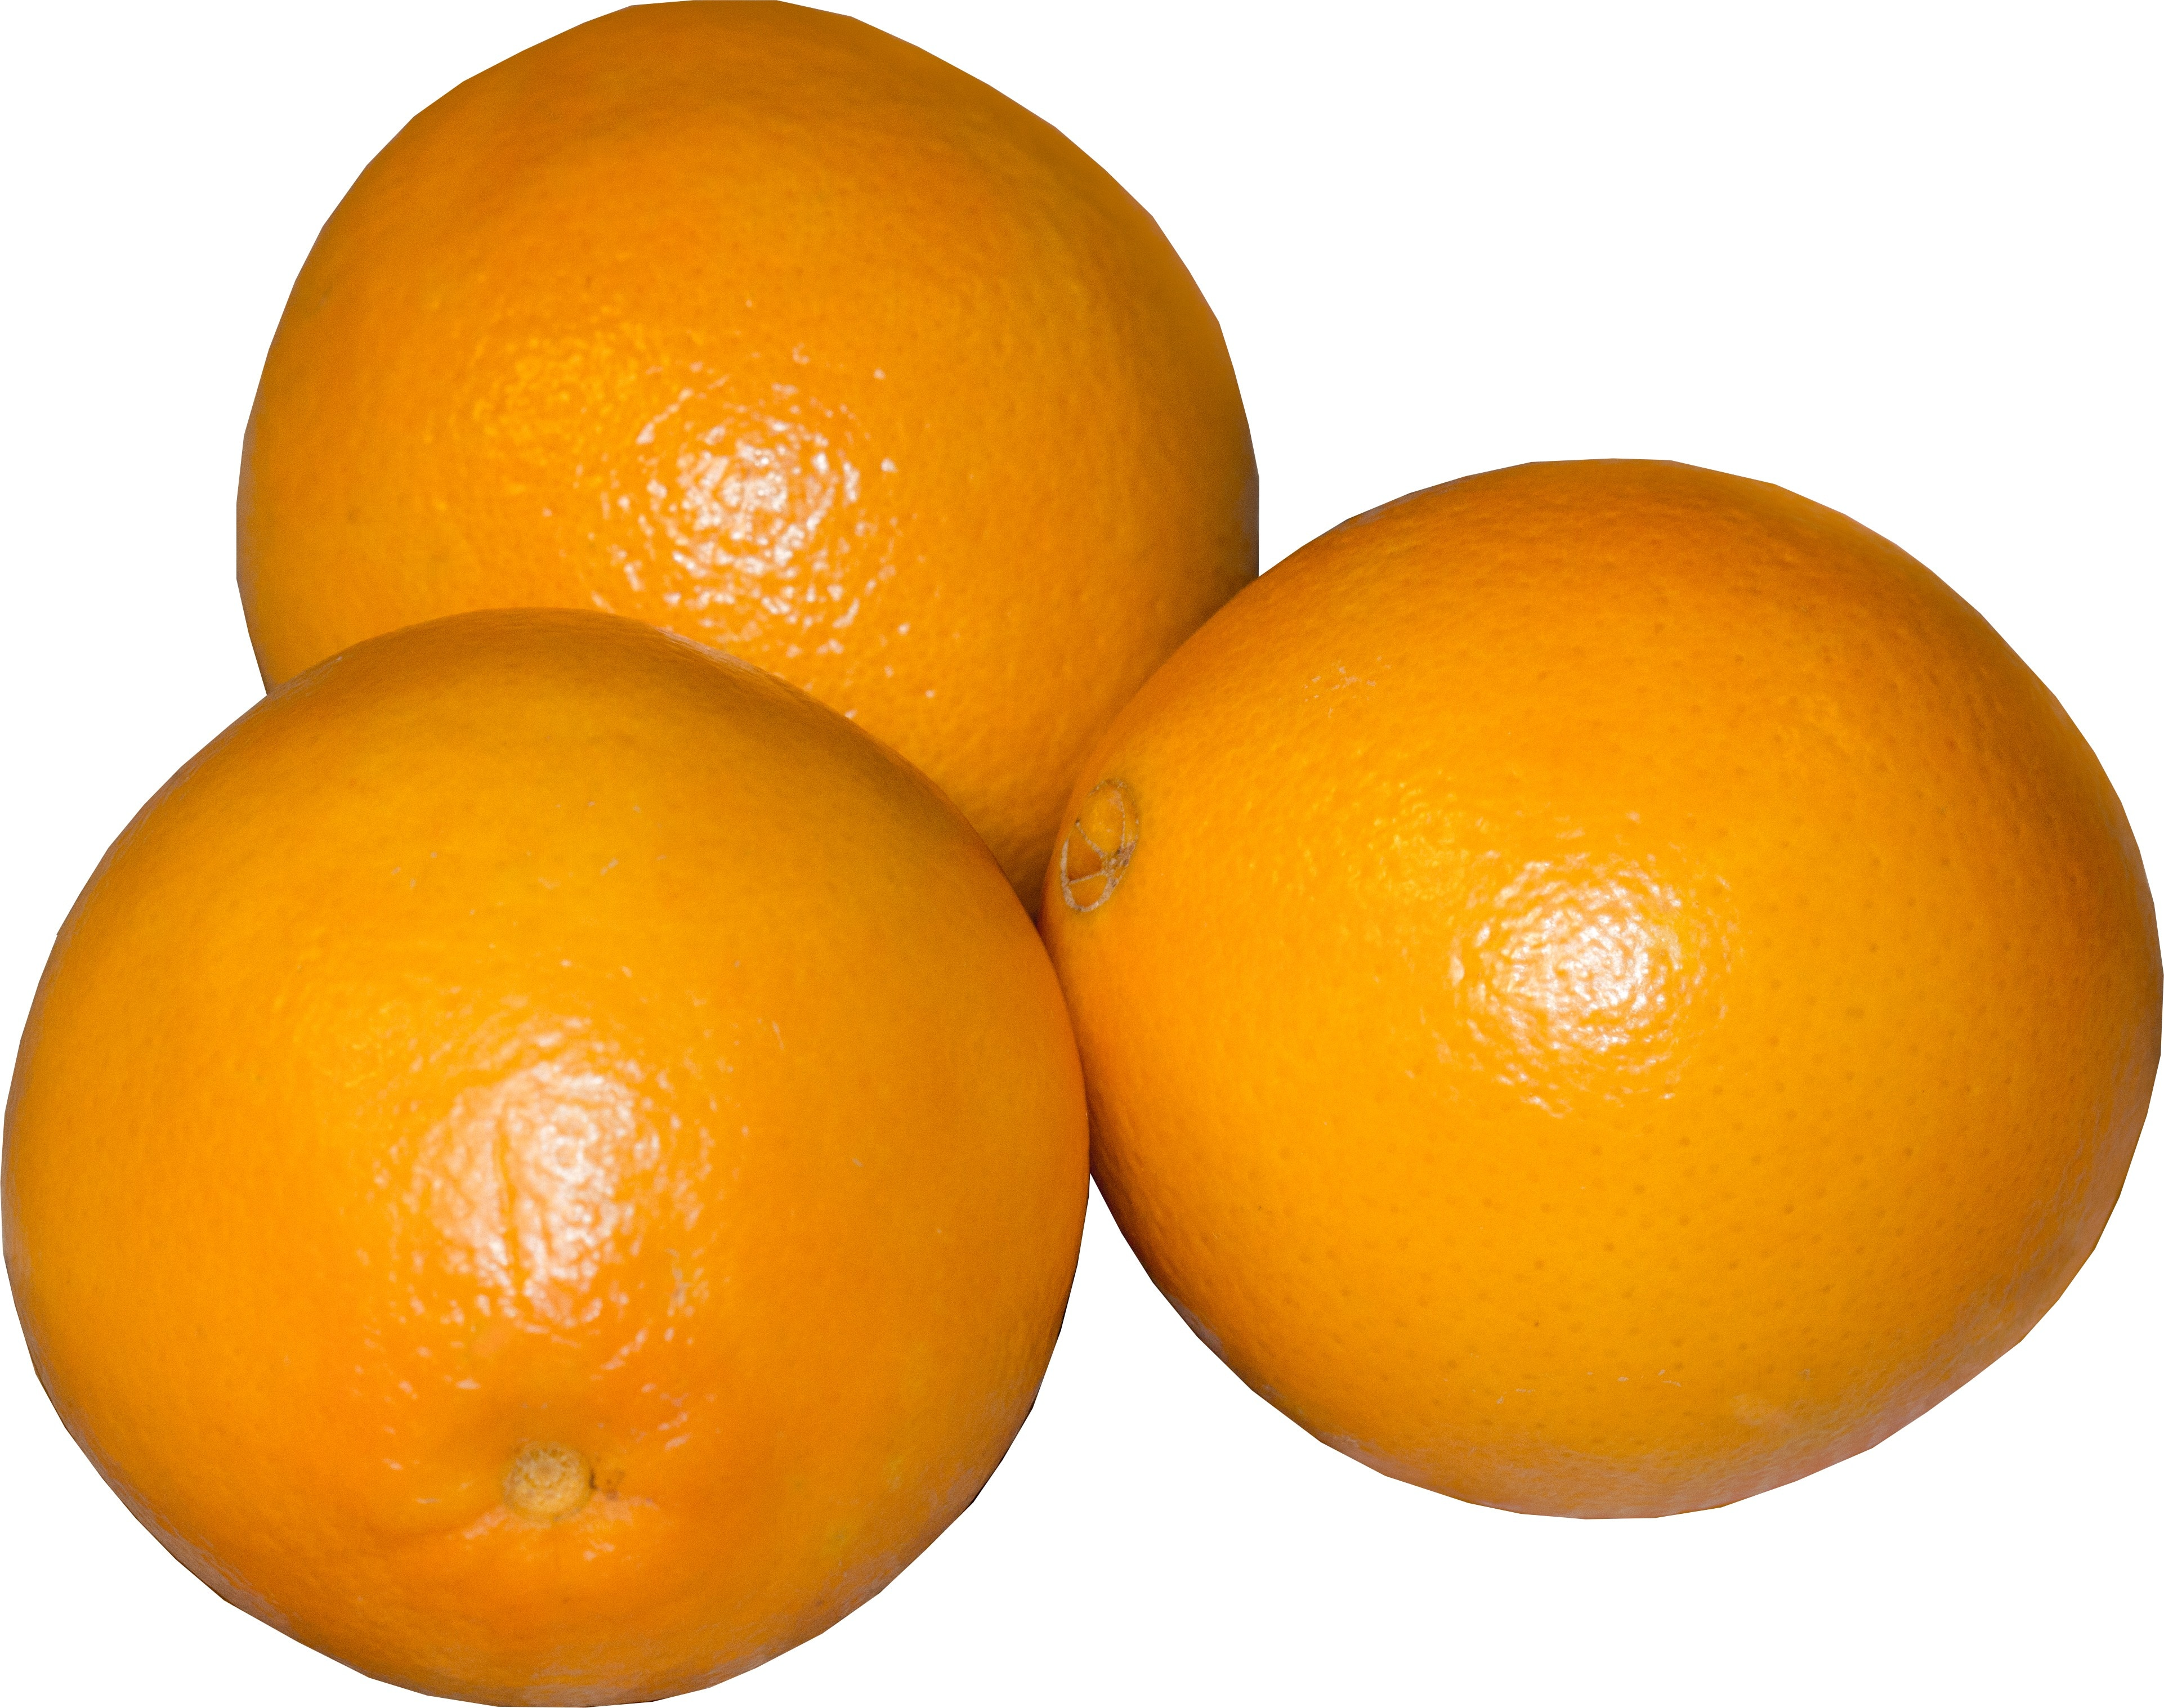
Oranges
Oranges provide vitamins which are very good for our bodies.

Slide 5
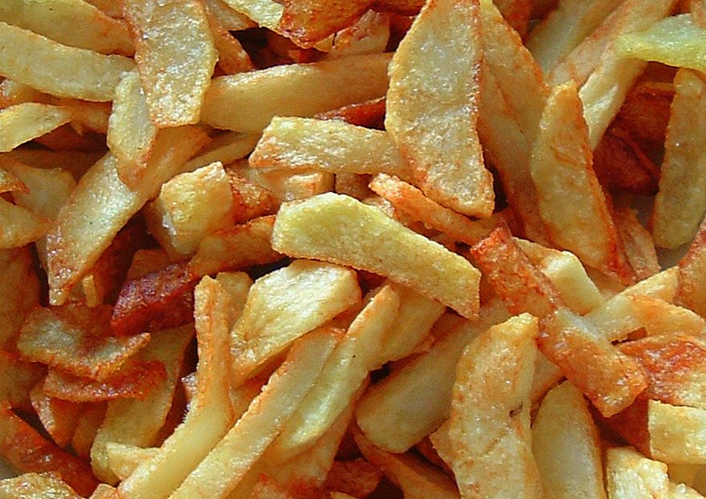
Chips
Chips are bad for your health if they are fried and you eat too many of them.
They sometimes have salt on them and too much salt is bad for your liver.
ThePhoto by PhotoAuthor is licensed under CCYYSA.

