Slide 1

LPS Personal Learning Journey
Communication & collaboration

Slide 2
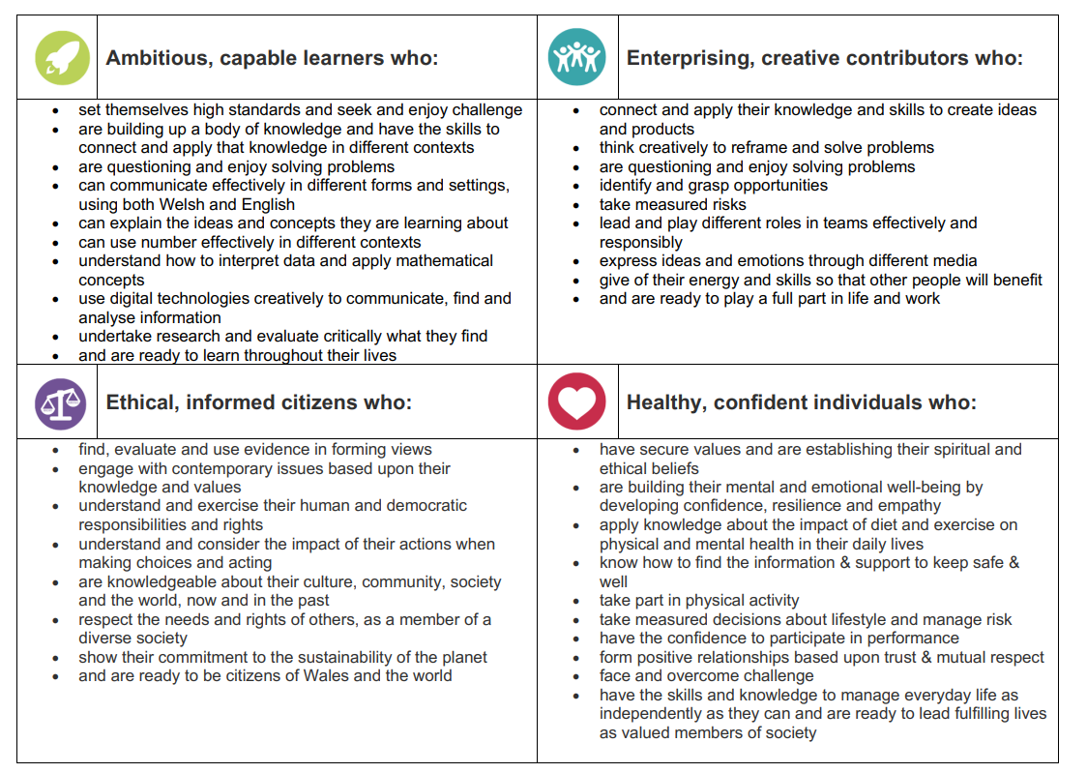
Communication & Collaboration

Slide 3
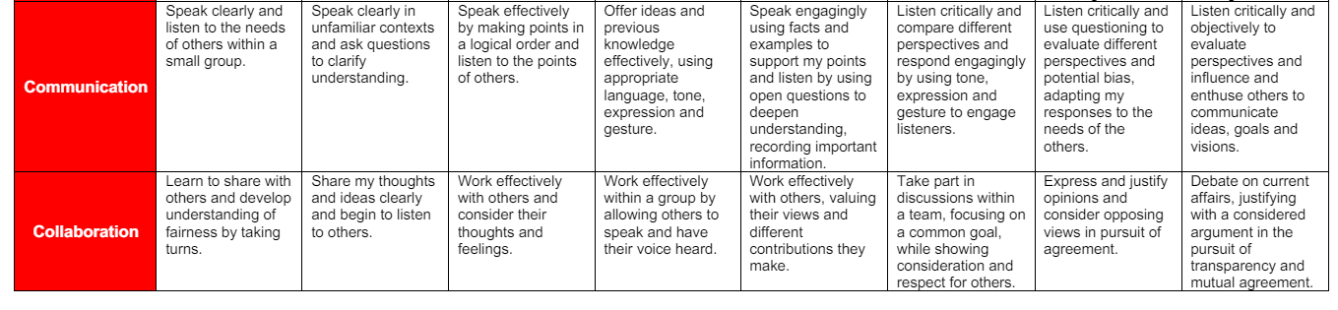
Communication & Collaboration

Slide 4
Communication & Collaboration
https://www.youtube.com/watch?v=KGZSu7RXMH4

Slide 5

Mental Health week

