Slide 1
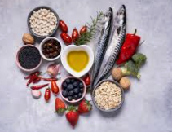
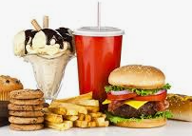
Food Is Your Mood
By Dottie

Slide 2
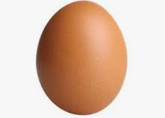
Eggs
Eggs have a very good impact on your health because they have lots of protein in them .You can have eggs cooked in lots of different ways such as scrambled, poached boiled and sunny side up.

Slide 3
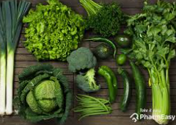
Greens
There are lots of green vegetables such as broccoli, avocado and lots more. They have a good impact in your mood and health because they have vitamins and fibre in them.

Slide 4
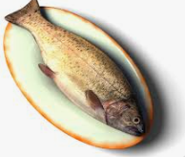
Fish
Fish is good at improving your mood because it has calcium in it. I love fish and chips but I also have tuna which is also a type of fish.

Slide 5
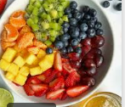
Fruit
Fruit has a very good impact on your mood and health because it has vitamin c and potassium in it. I love fruit but my favourite is pineapple.

Slide 6

Lollipops
Lollipops are one of those foods that is not very good for you. They have lots of sugar, corn syrup, water and citric acid in them. Too much sugar can raise your risk of heart disease.

Slide 7
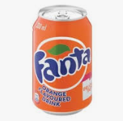
Fanta and other Fizzy Drinks
Fanta is not good for you because it has sweeteners, citric acid and potassium. Drinking too many fizzy drinks can make you gain weight and have heart problems.

