Slide 1


Food is Your Mood

Slide 2
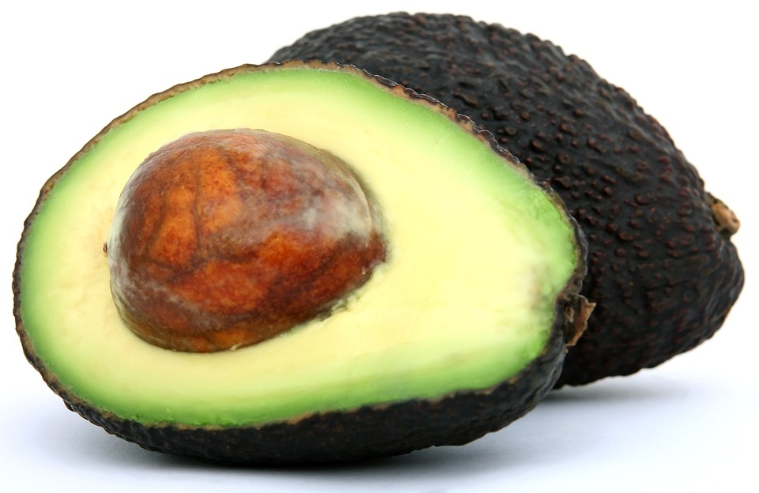
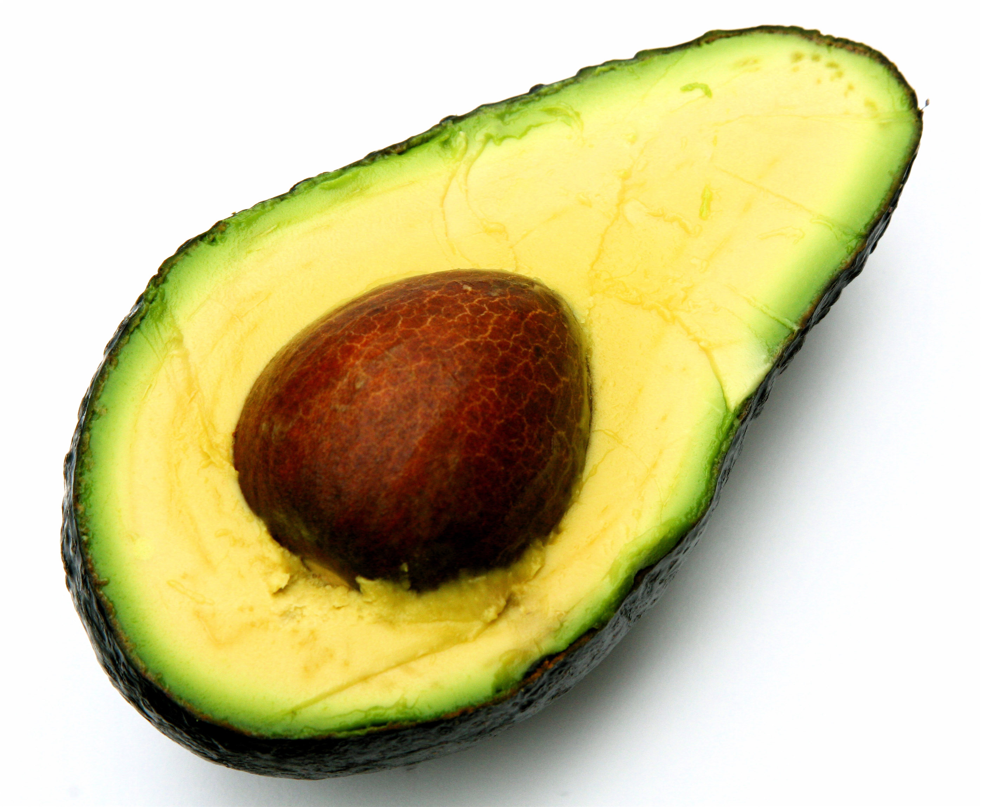
nutrients
Certain foods, like avocados, contain nutrients that can get rid of stress and improve your mood.
ThePhoto by PhotoAuthor is licensed under CCYYSA.

Slide 3
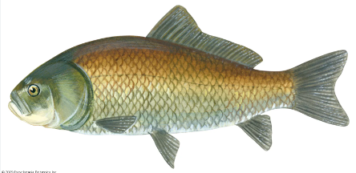
fish
Fish is very good for you. Fish helps with anxiety and it improves your mood. Eating fish gives you a healthy brain.

Slide 4

caffeine
Caffeine is in drinks like coffee, coke and energy drinks.
Too much caffeine actually causes anxiety which is not good for your mood or mental health.

Slide 5
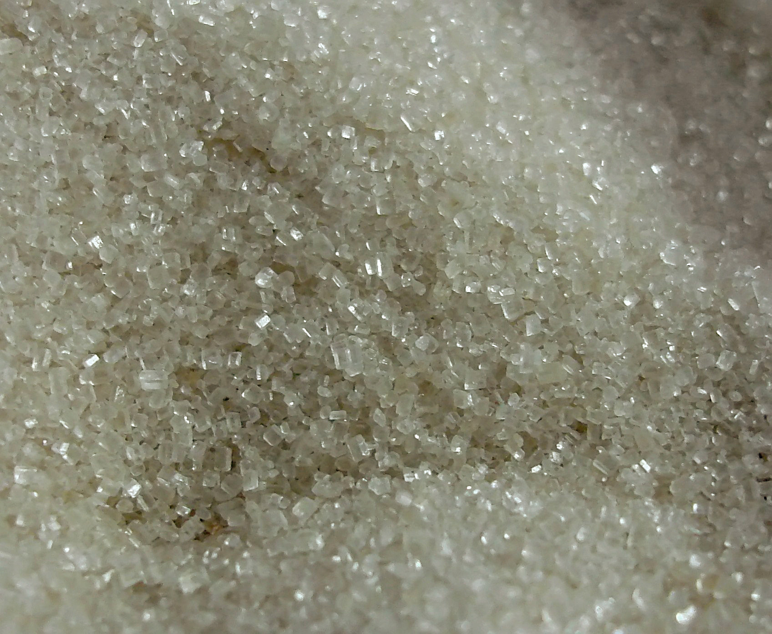
Sugary drinks and food
Sugary drinks and sugary food can lead to aggression.

Slide 6

alcohol
Alcohol affects the chemistry of the brain and too much alcohol can lead to depression.

