Slide 1

Welcome to Reception

Slide 2
Daily Organisation
Pupils are to make their way down to the Reception class between 8.40 and 9am.
We will help the children to put their coats and bags onto their pegs.
Please provide your child with a healthy snack and drink.
Please make sure your child’s belongings are clearly labelled with their name- jumpers, PE kit, snack, water bottles etc.

Slide 3
What happens in a typical day?
Meet and greet the children
Focused numeracy/ literacy session
Assembly
Break time/ Snack
Focused numeracy/ literacy session
Lunch
Reading time
Focused topic session
Rotate through range of learning activities indoors and outdoors
Boost groups- Wellcomm, Speech & Language Link, Attention Autism, DCD, Sensory circuit, Pastoral, Popat

Slide 4
Phonics
Jolly Phonics is a fun approach to teach your child their sounds. There is a combination of stories, decodable reading books, pictures and rhymes for each sound.
We learn the sounds rather than letter names.
One new sound each week- ‘Sound of the Week’.

Slide 5
Numeracy
Maths is taught indoors and outdoors.
Heavy focus on numbers – forming, ordering, sequencing, more and less.
Maths activities within the role play area – opportunities to use their skills in the areas within the classroom.

Slide 6
Reading
Learn to recognise series of High Frequency words.
Group Reading/ Reading Eggs.
Reading Day- letter will be attached to their reading record.
Will not have a reading book straight away as we will take time to get to know your child.
Reading record- please feel free to comment how your child is getting along.

Slide 7
What you can do to help
Learn letter sounds
Read bedtime stories/ decodable reading books.
Check website every week! https://www.llangyfelachprimaryschool.co.uk/reception/
Encourage children to draw, paint, cut, fasten zips, practise opening lunch box etc.
Homework online every Friday.

Slide 8
In the Class
Children will work in groups.
Will have opportunity through day to take part in teacher and child led activities- pupil voice.
Children will work in small focus tasks and in the enhanced provision/ challenges- in the different areas- sand, water etc.
Indoor and outdoor activities.
Suitable outdoor footwear- Welly Wednesday.
Good to be Green: behaviour system.
Dojo points- reward system.

Slide 9
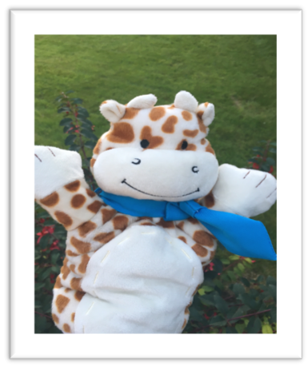
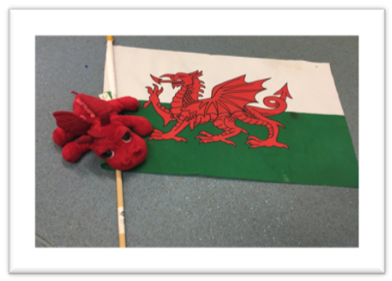
Geoff and Dewi
Geoff: to support sound of the
week each week.
Dewi: to support Welsh
sentence patterns, new words.
To be sent home on Friday and
returned on Monday.

Slide 10
Things to remember:
Please inform the office or myself of any medical needs/ dietary requirements.
Packed lunches in named lunch box.
Spare change of clothes in their bag- labelled.
Check the website regularly- homework will be on here, photos of our learning, new topics.
Children to bring in a healthy snack for snack time. This can be a piece of fruit, crackers, yoghurt.

Slide 11
Timetable of the week
Monday- Geoff and Dewi to be returned.
Wednesday- Welly Wednesday- waterproof overalls provided, wellys to be brought in bag and appropriate clothing to be worn. Homework due in.
Friday- Geoff and Dewi to be given out. Homework on the webiste
PE days to be confirmed: check the website/letter.

Slide 12
Free School Meals For All
As part of the Co-operation Agreement with Plaid Cymru, the Welsh Government is working closely with local authorities to meet the commitment for every primary school pupil to receive a free school meal by 2024.
This will mean that all children in the school will start receiving universal primary free school meals from this September.

Slide 13
School uniform grant – please sign up.

Slide 14
Admin
School uniform
School app
iPay
English_Help+with+School+Costs_web.pdf (hwb-team-storage.s3.eu-west-1.amazonaws.com)

Slide 15
Any questions?

