Slide 1

LPS Personal Learning Journey
Problem solving

Slide 2
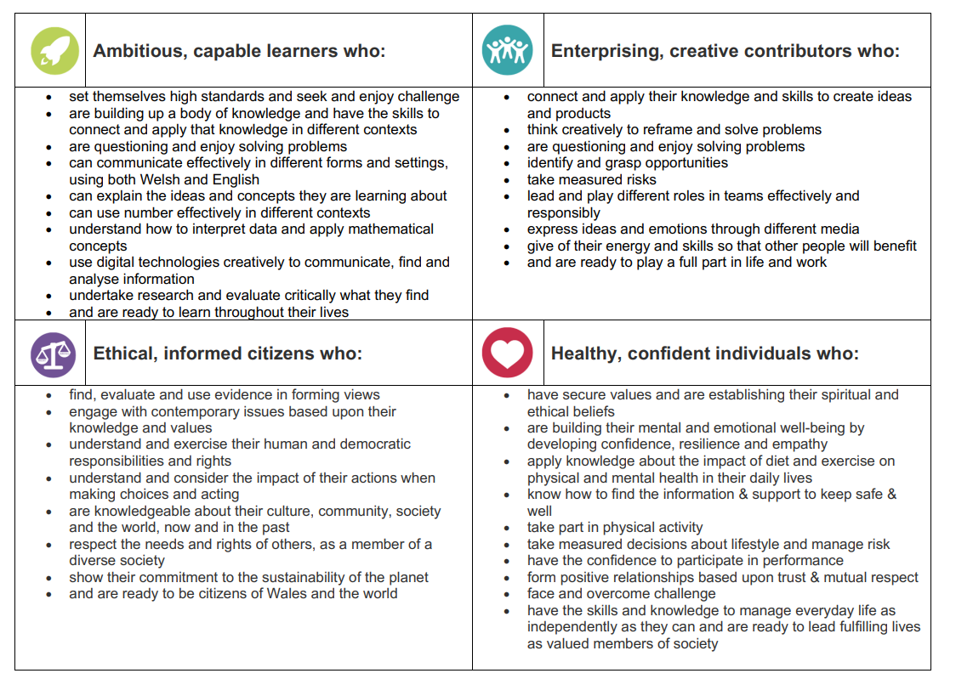
Creativity

Slide 3
Problem solving

Slide 4
Problem solving
https://ideas.classdojo.com/b/conundrums
Solving Problems - Building Resilience with Hunter and Eve (youtube.com)

Slide 5

Problem solving
Rights of the child: what rights can we link to our discussions today?
https://www.unicef.org.uk/wp-content/uploads/2019/10/UNCRC_summary-1_1.pdf

