Slide 1

LPS Personal Learning Journey
Creativity

Slide 2
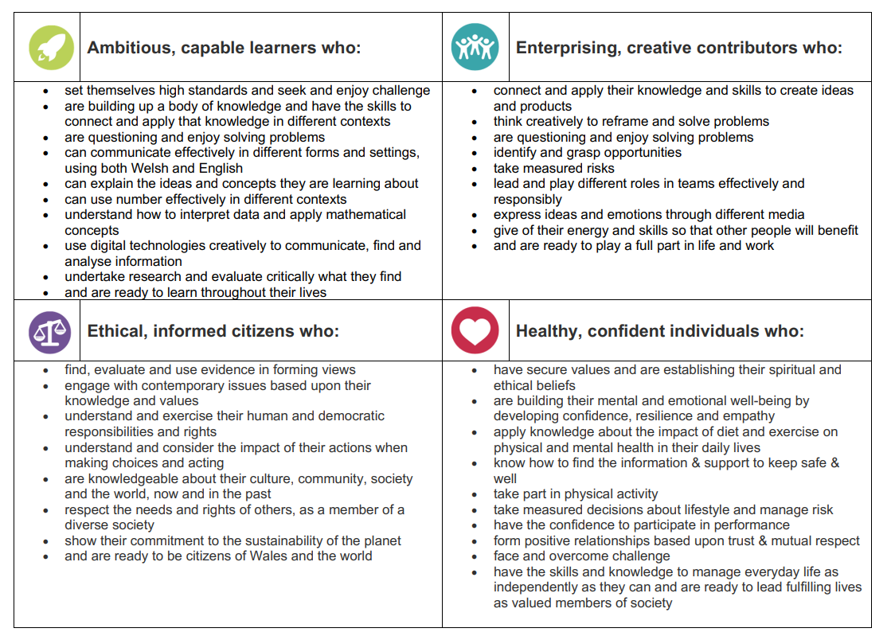
Creativity

Slide 3
Creativity

Slide 4
Creativity
https://www.youtube.com/watch?v=lbPqZ-HmISM

Slide 5
How are we creative at LPS?
  Projects- https://www.llangyfelachprimaryschool.co.uk/lps-learning-projects/
  Creative crew
  LPS Matrix
  Through play in Early Years
  How can we improve?

Slide 6
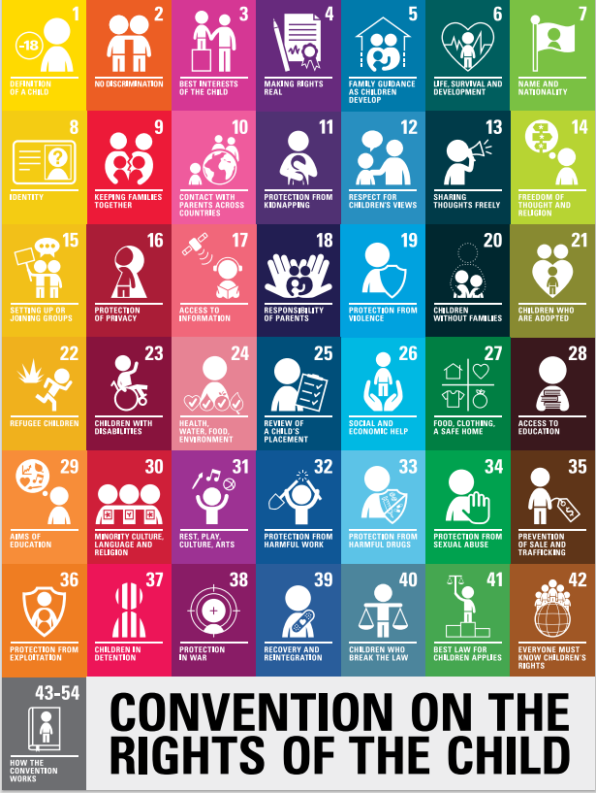
Planning to aim high
Rights of the child: what rights can we link to our discussions today?
https://www.unicef.org.uk/wp-content/uploads/2019/10/UNCRC_summary-1_1.pdf

Slide 7
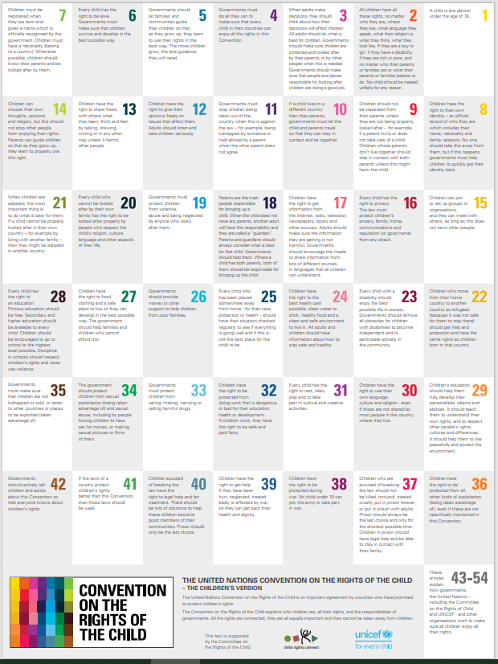
Article 12- (respect for the views of the child) Every child has the right to express their views, feelings and wishes in all matters affecting them, and to have their views considered and taken seriously. This right applies at all times, for example during immigration proceedings, housing decisions or the child’s day-to-day home life.
Article 13- (freedom of expression) Every child must be free to express their thoughts and opinions and to access all kinds of information, as long as it is within the law.
Article 31- Right to play- ‘Every child has the right to rest and leisure, to engage in play and recreational activities appropriate to the age of the child and to participate freely in cultural life and the arts.

