Slide 1

LPS Personal Learning Journey
Planning to aim high

Slide 2
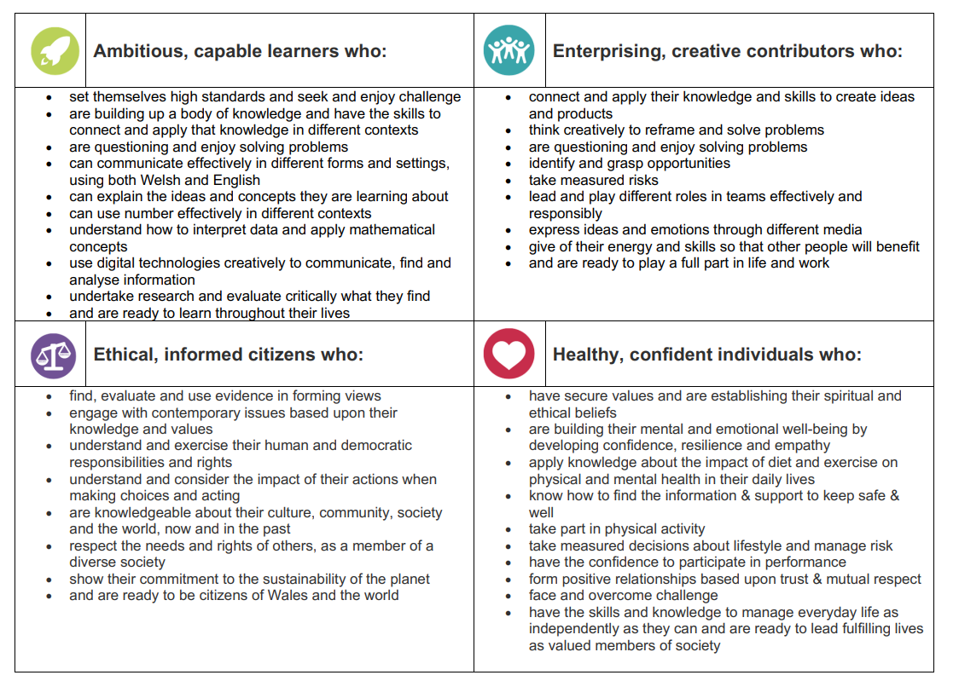
Planning to aim high

Slide 3
Planning to aim high

Slide 4
Planning to aim high
Achievements - BBC Bitesize

Slide 5
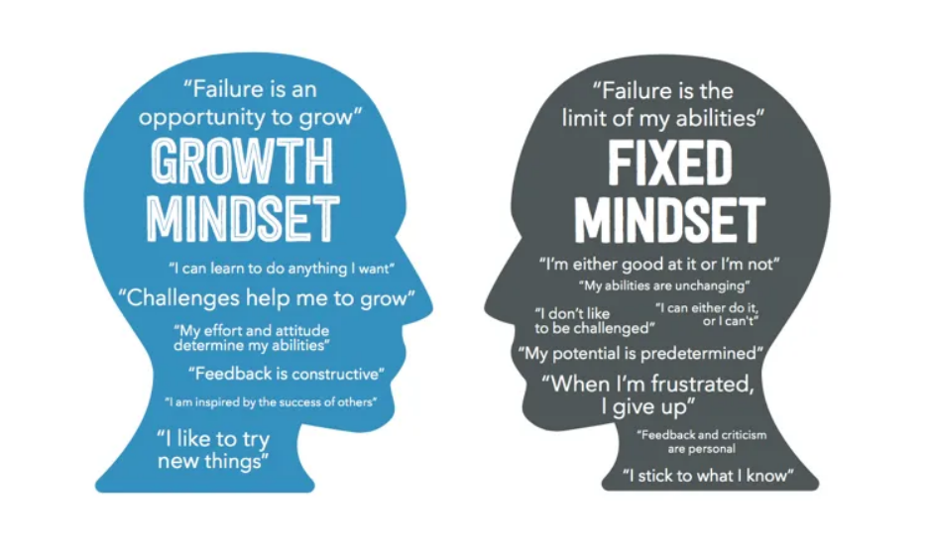

Slide 6
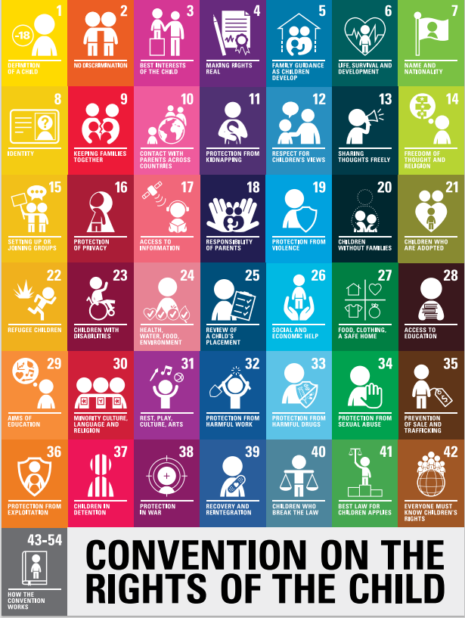
Planning to aim high
Rights of the child: what rights can we link to our discussions today?
https://www.unicef.org.uk/wp-content/uploads/2019/10/UNCRC_summary-1_1.pdf

Slide 7
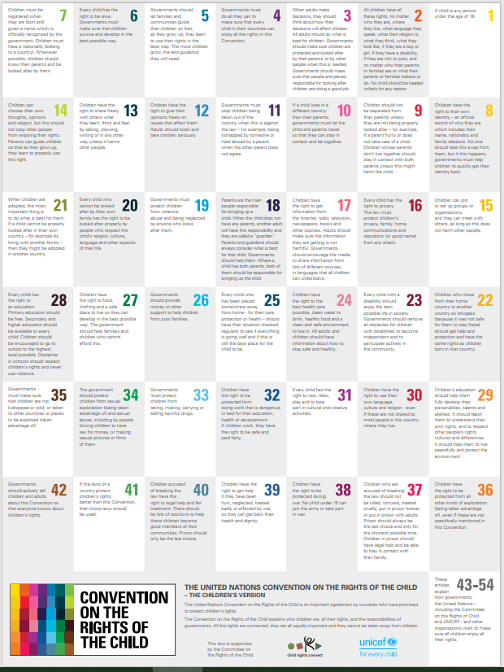
Article 12- (respect for the views of the child) Every child has the right to express their views, feelings and wishes in all matters affecting them, and to have their views considered and taken seriously. This right applies at all times, for example during immigration proceedings, housing decisions or the child’s day-to-day home life.
Article 13- (freedom of expression) Every child must be free to express their thoughts and opinions and to access all kinds of information, as long as it is within the law.
Article 28-(right to education) Every child has the right to an education. Primary education must be free and different forms of secondary education must be available to every child. Discipline in schools must respect children’s dignity and their rights. Richer countries must help poorer countries achieve this.
Article 29- goals of education) Education must develop every child’s personality, talents and abilities to the full. It must encourage the child’s respect for human rights, as well as respect for their parents, their own and other cultures, and the environment.

