Slide 1

LPS Personal Learning Journey
Self-direction

Slide 2
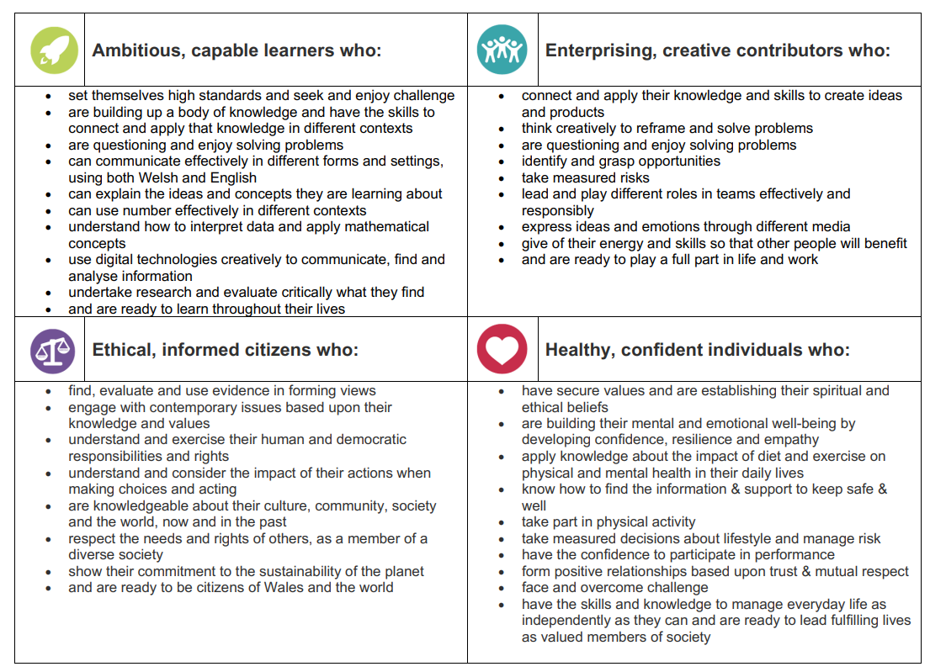
Self -Direction

Slide 3
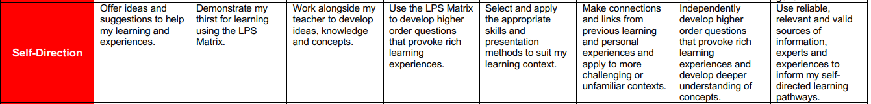
Self -Direction

Slide 4
Self- Direction
  Resourcefulness – YouTube
  https://ideas.classdojo.com/f/growth-mindset-5/0

Slide 5
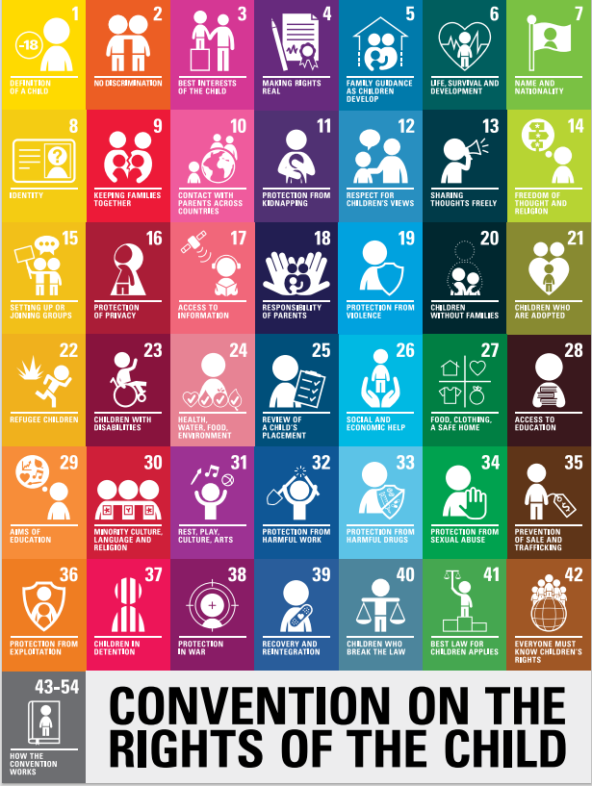
Citizenship
Rights of the child: what rights can we link to our discussions today?
https://www.unicef.org.uk/wp-content/uploads/2019/10/UNCRC_summary-1_1.pdf

Slide 6
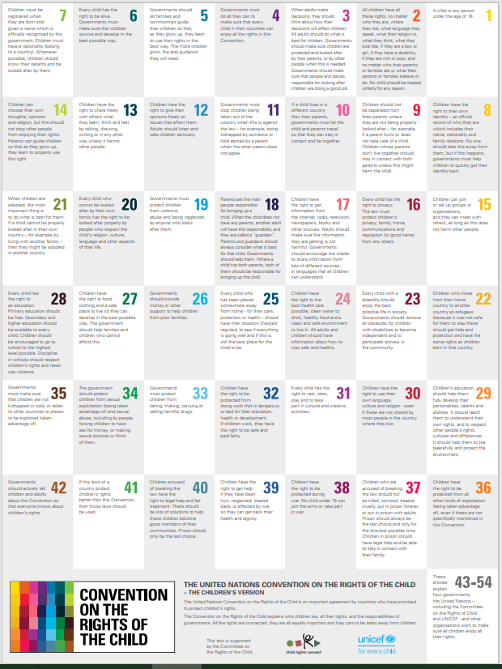
Citizenship
Rights of the child

