Slide 1

LPS Personal Learning Journey
Citizenship

Slide 2
PLJ
https://primarysite-prod-sorted.s3.amazonaws.com/llangyfelach-primary-school/UploadedDocument/1e53849c-ee93-4bac-86be-07bf6f80fa3e/lps-plj-2024.pdf

Slide 3
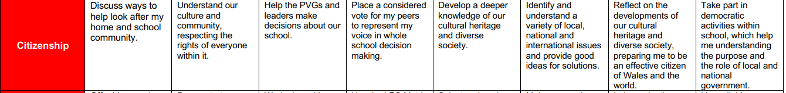
Citizenship

Slide 4
Citizenship
  What is a citizen?

Slide 5
Citizenship
https://www.bbc.co.uk/bitesize/topics/zhfdjsg/articles/zryjdp3

Slide 6
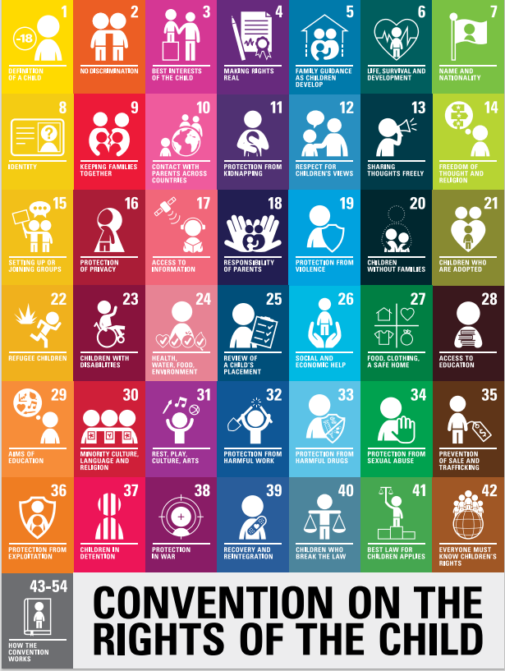
Citizenship
Rights of the child: what rights can we link to our discussions today?

Slide 7
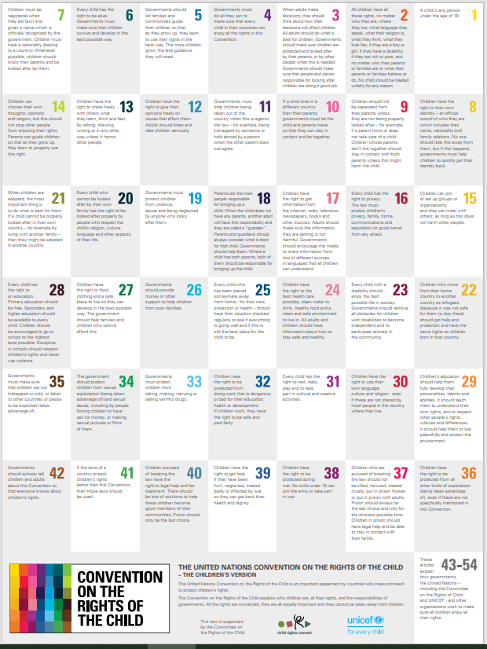
Citizenship
Rights of the child

