Slide 1

LPS Personal Learning Journey
Values

Slide 2
PLJ
https://primarysite-prod-sorted.s3.amazonaws.com/llangyfelach-primary-school/UploadedDocument/1e53849c-ee93-4bac-86be-07bf6f80fa3e/lps-plj-2024.pdf

Slide 3
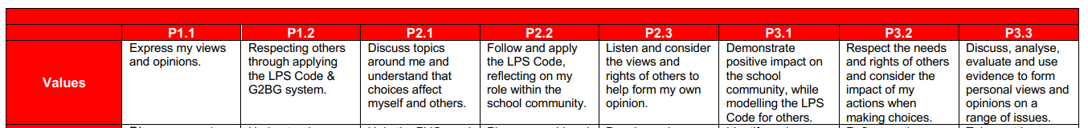
Values

Slide 4
Values
  What are values?

Slide 5
Values
https://www.youtube.com/watch?v=om3INBWfoxY#:~:text=values%20are%20a%20group%20of,creativity%20leadership%20kindness%20or%20loyalty.

Slide 6
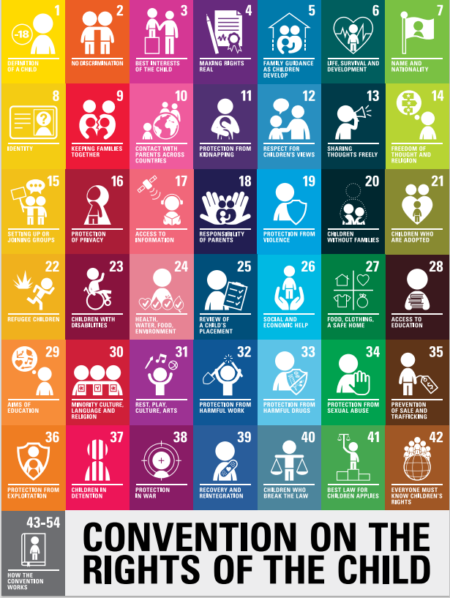
Values
Rights of the child: what rights can we link to our discussions today?

Slide 7
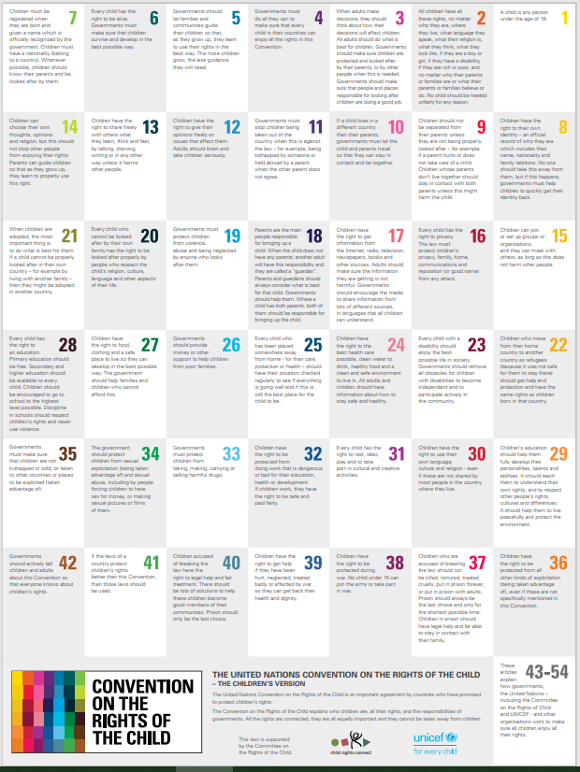
Values
Rights of the child

