Slide 1

Welcome to
© Jigsaw PSHE Ltd
Notes:
This slide is for Wales and/or Scotland – Please delete if not appropriate to your region.

Slide 2
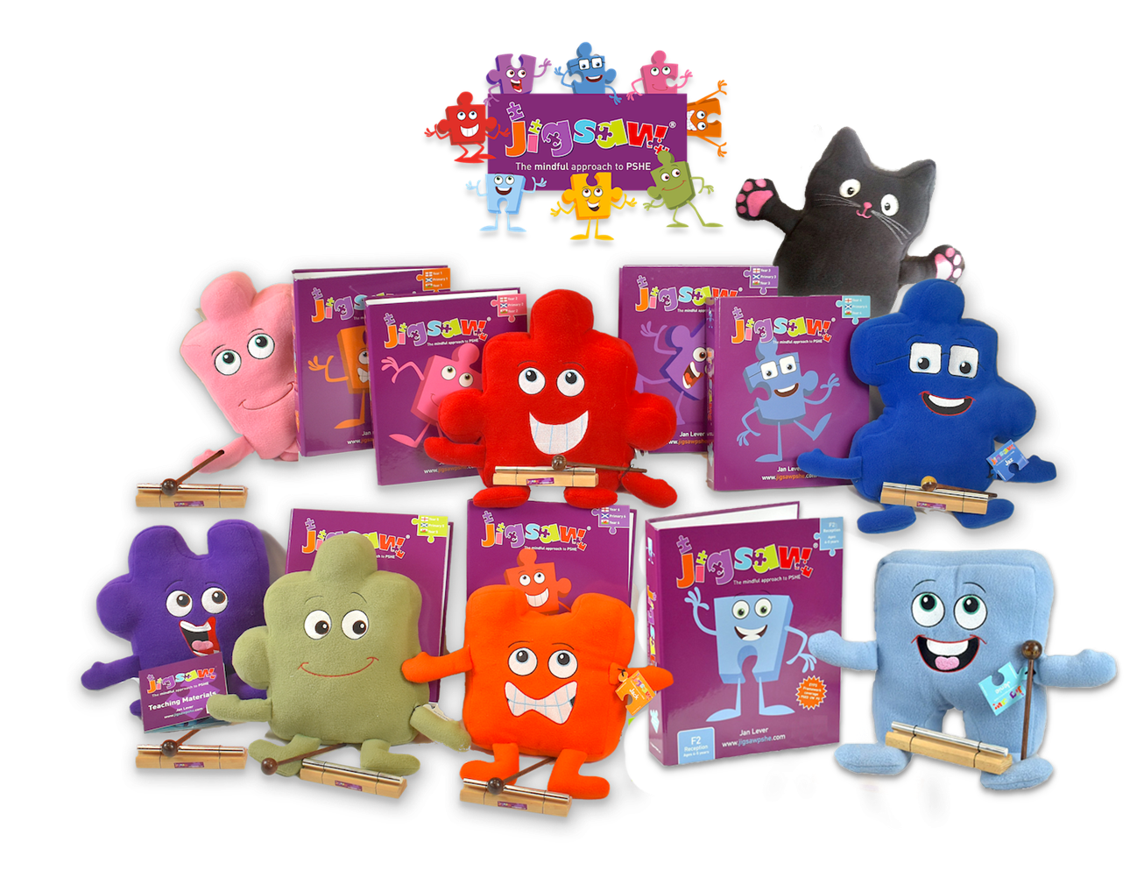
We are your new
Jigsaw Friends
© Jigsaw PSHE Ltd
Notes:
Notes: England and Wales schools can delete the yellow Jigsaw Jello Friend (if you wish) who is the Friend for Scotland Primary 7 (ages 11-12).

Slide 3
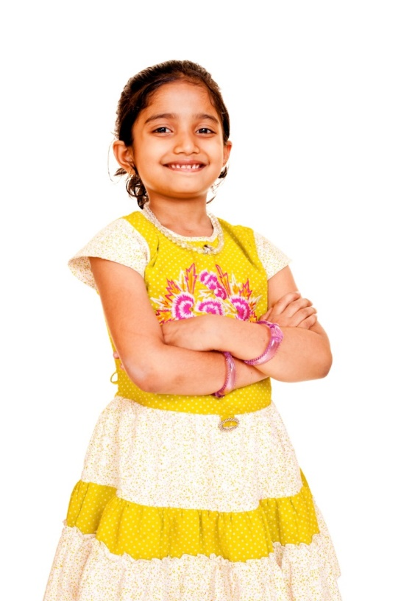
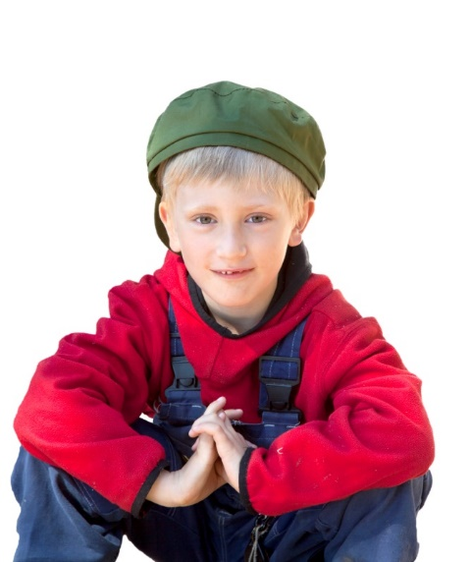
We are going to have lots of fun together!
We are going to help you learn about Health and Well-being
That’s about you as a person,
how you get on with other people,
how to stay healthy,
and lots more to keep you safe
and help you learn.
© Jigsaw PSHE Ltd
Notes:
For Wales and/or Scotland: Health and Well-being – Delete is not applicable to your region.

Slide 4
Together we are going to work on 6 Jigsaw Puzzles
Being Me in My World
Celebrating Difference
Dreams and Goals
Healthy Me
Relationships
Changing Me
We will explore one each half term.
© Jigsaw PSHE Ltd
Notes:
Notes:

Slide 5
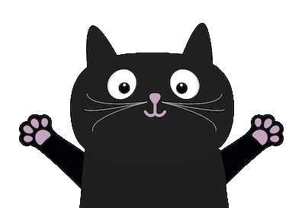
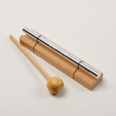
We are also going to teach you how to feel calm
and think about things
more mindfully.
© Jigsaw PSHE Ltd
Notes:
Notes:

Slide 6
Allow us to introduce ourselves
I’m Jigsaw Jenie,
and I live in
Nursery and Reception.
I hope we can help each other settle into school!
© Jigsaw PSHE Ltd
Notes:
You are free to adjust the text in the following few slides to suit your children, and accommodate how your school refers to each year-group.

Slide 7
Year 1
I’m Jigsaw Jack
and I’m a bit nervous about moving
to Year 1. I hope you and I will be friends!
© Jigsaw PSHE Ltd
Notes:
Notes:

Slide 8
Year 2
I’m Jigsaw Jo and
I like learning new things. I’m looking forward to meeting everyone in Year 2.
© Jigsaw PSHE Ltd
Notes:
Notes:

Slide 9
Year 3
I’m JIgsaw Jino,
I can’t wait to meet you and have
some fun
in Year 3.
© Jigsaw PSHE Ltd
Notes:
Notes:

Slide 10
Year 4
I’m Jigsaw Jaz, we’ll be tackling some tricky topics together in Year 4.
© Jigsaw PSHE Ltd
Notes:
Notes:

Slide 11
Year 5
I’m Jigsaw Jez. We’re going to learn a lot together in Year 5. I can’t wait to meet you all!
© Jigsaw PSHE Ltd
Notes:
Notes:

Slide 12
Year 6
I’m Jigsaw Jem.
I’m going to help you enjoy Year 6 and prepare for your future!
© Jigsaw PSHE Ltd
Notes:
Notes:

Slide 13
Don’t forget about me! I’m Jigsaw Jerrie Cat and I’ll help you to learn mindfulness.
© Jigsaw PSHE Ltd
Notes:
Notes:

Slide 14
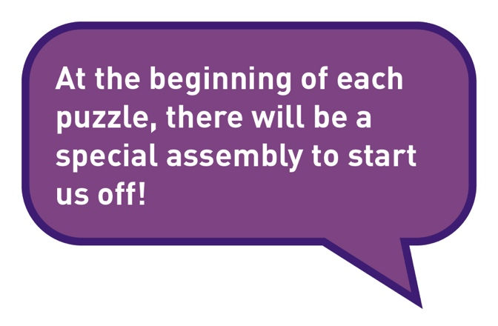
What else?
© Jigsaw PSHE Ltd
Notes:
Notes:

Slide 15
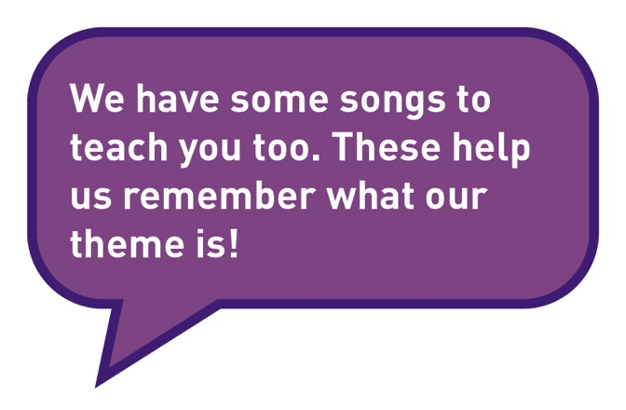


What else?
© Jigsaw PSHE Ltd
Notes:
Notes:

Slide 16
Your lessons will have different parts!
The Jigsaw Charter will help you feel safe and respected.
Connect Us is when you will play some games.
Calm Me time will help you relax and manage your feelings.
© Jigsaw PSHE Ltd
Notes:
Notes:

Slide 17
Your lessons will have different parts!
Open My Mind will focus your thoughts on the lesson topic.
Tell Me or Show Me is when you will be taught new skills and information.
Let Me Learn is where you will have a chance to put these into practice.
Help Me Reflect is when you will be able to think about how you feel about your learning and your progress.
© Jigsaw PSHE Ltd
Notes:
Notes:

Slide 18
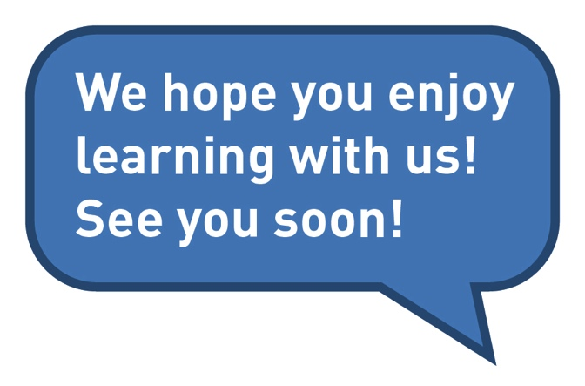
© Jigsaw PSHE Ltd
Notes:
Notes:

