Slide 1
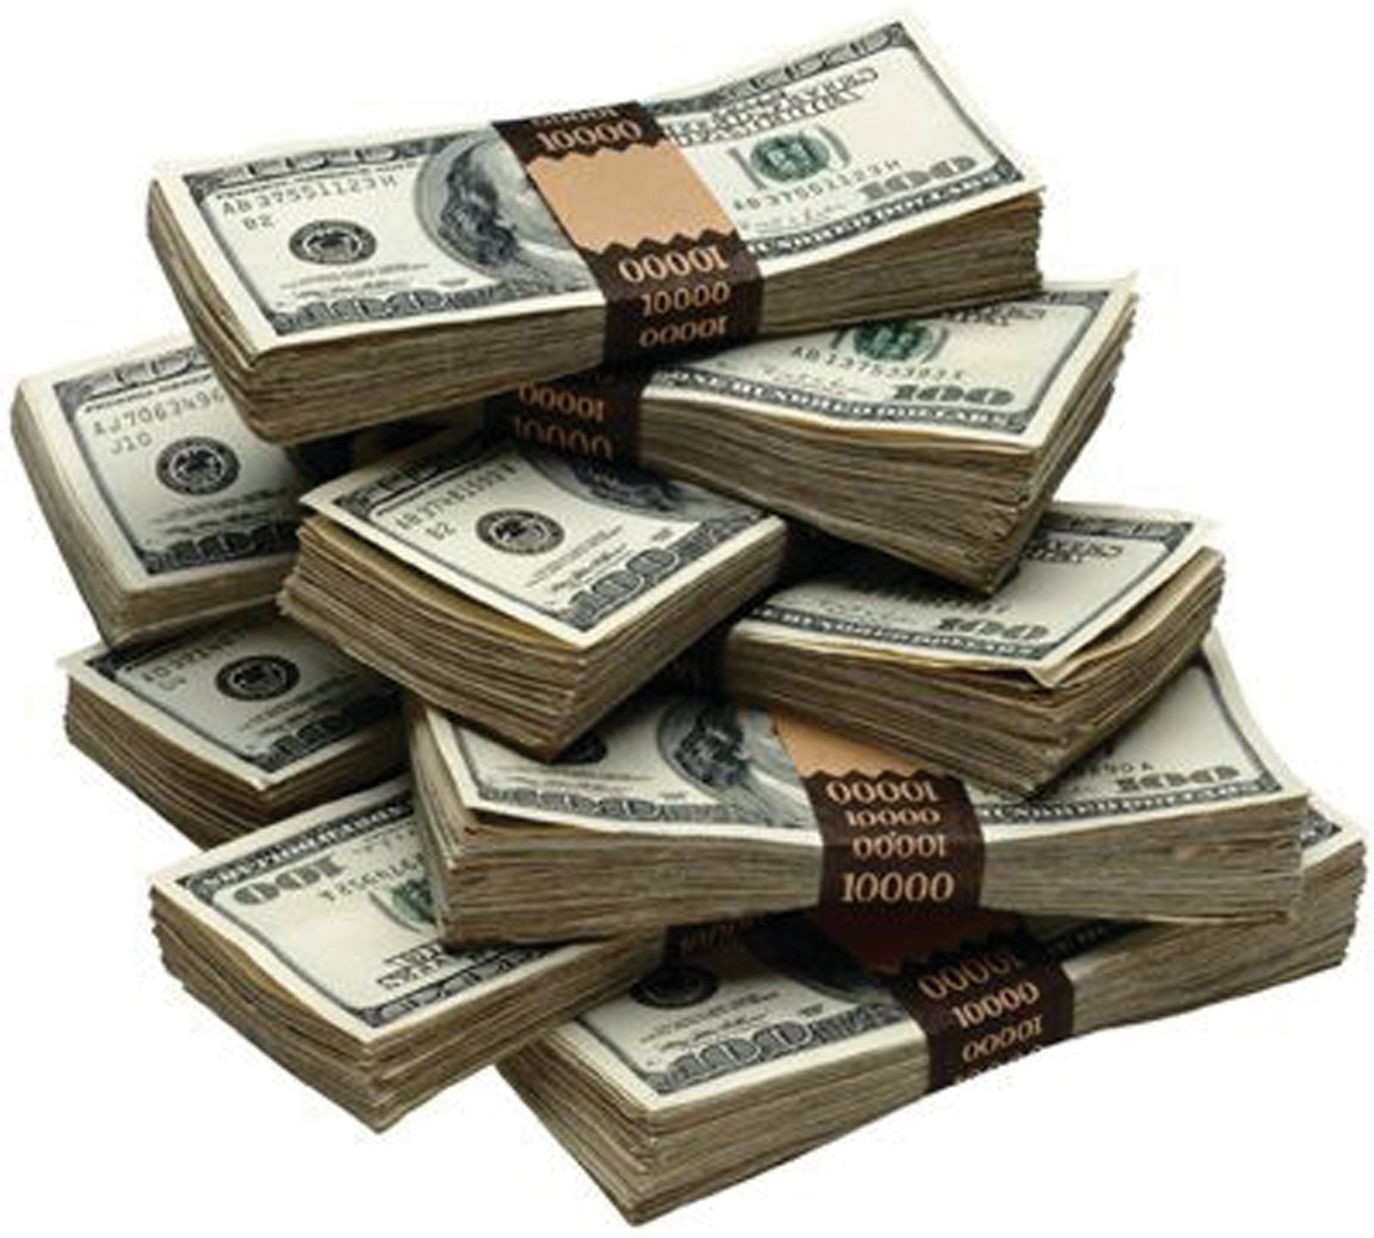
LPS Enterprise Challenge
Year 2
This Photo by Unknown author is licensed under CC BY-SA-NC.
This Photo by Unknown author is licensed under CC BY-SA-NC.

Slide 2
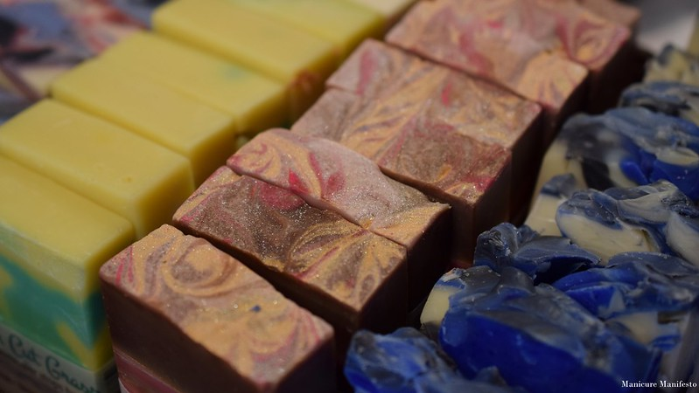
SUPER SOAPS
By Year 2
This Photo by Unknown author is licensed under CC BY-NC-ND.

Slide 3
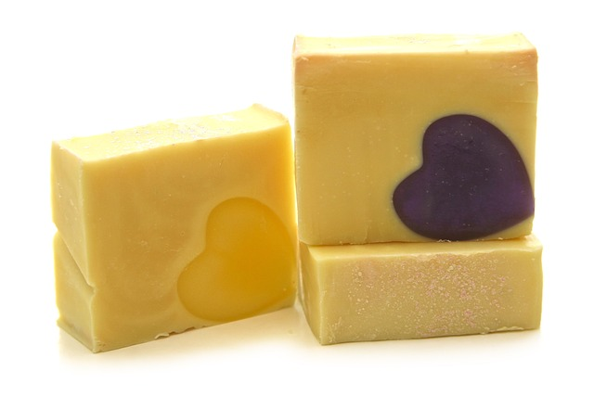
Everyone has been put into groups that have different jobs.
Group 1 – Pitchers
Group 2 – Market researchers and buyers
Group 3 – Designers
Group 4 - Makers
Group 5 – Advertisers
Group 6– sellers

Slide 4
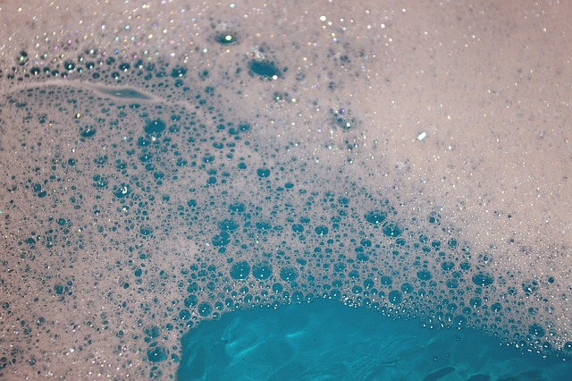
We plan to make fun, colourful and themed shaped soaps aimed towards kids.
Most of us kids don’t like having a wash, so we hope that our fun soaps will make kids want to get clean.
We want to promote hygiene and having fun.

Slide 5
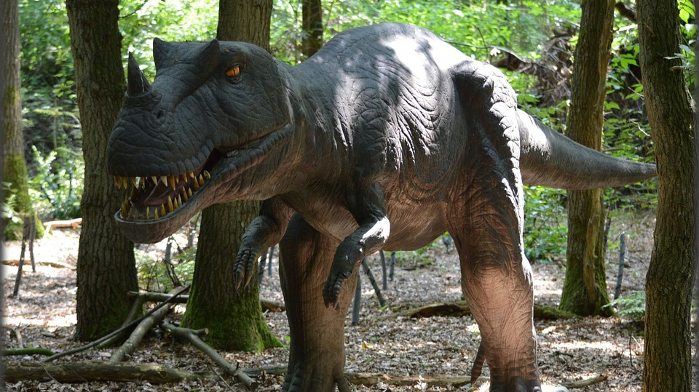
Market Research.
We have already asked children in our class about what types of soaps they would like and we found out that they liked -
Flowers
Football
Dinosaurs

Slide 6

We need to buy -
Soap moulds
Bars of sensitive white soap
Soap dye

