Slide 1
The Roman Invasion
My Super Evaluation

Slide 2
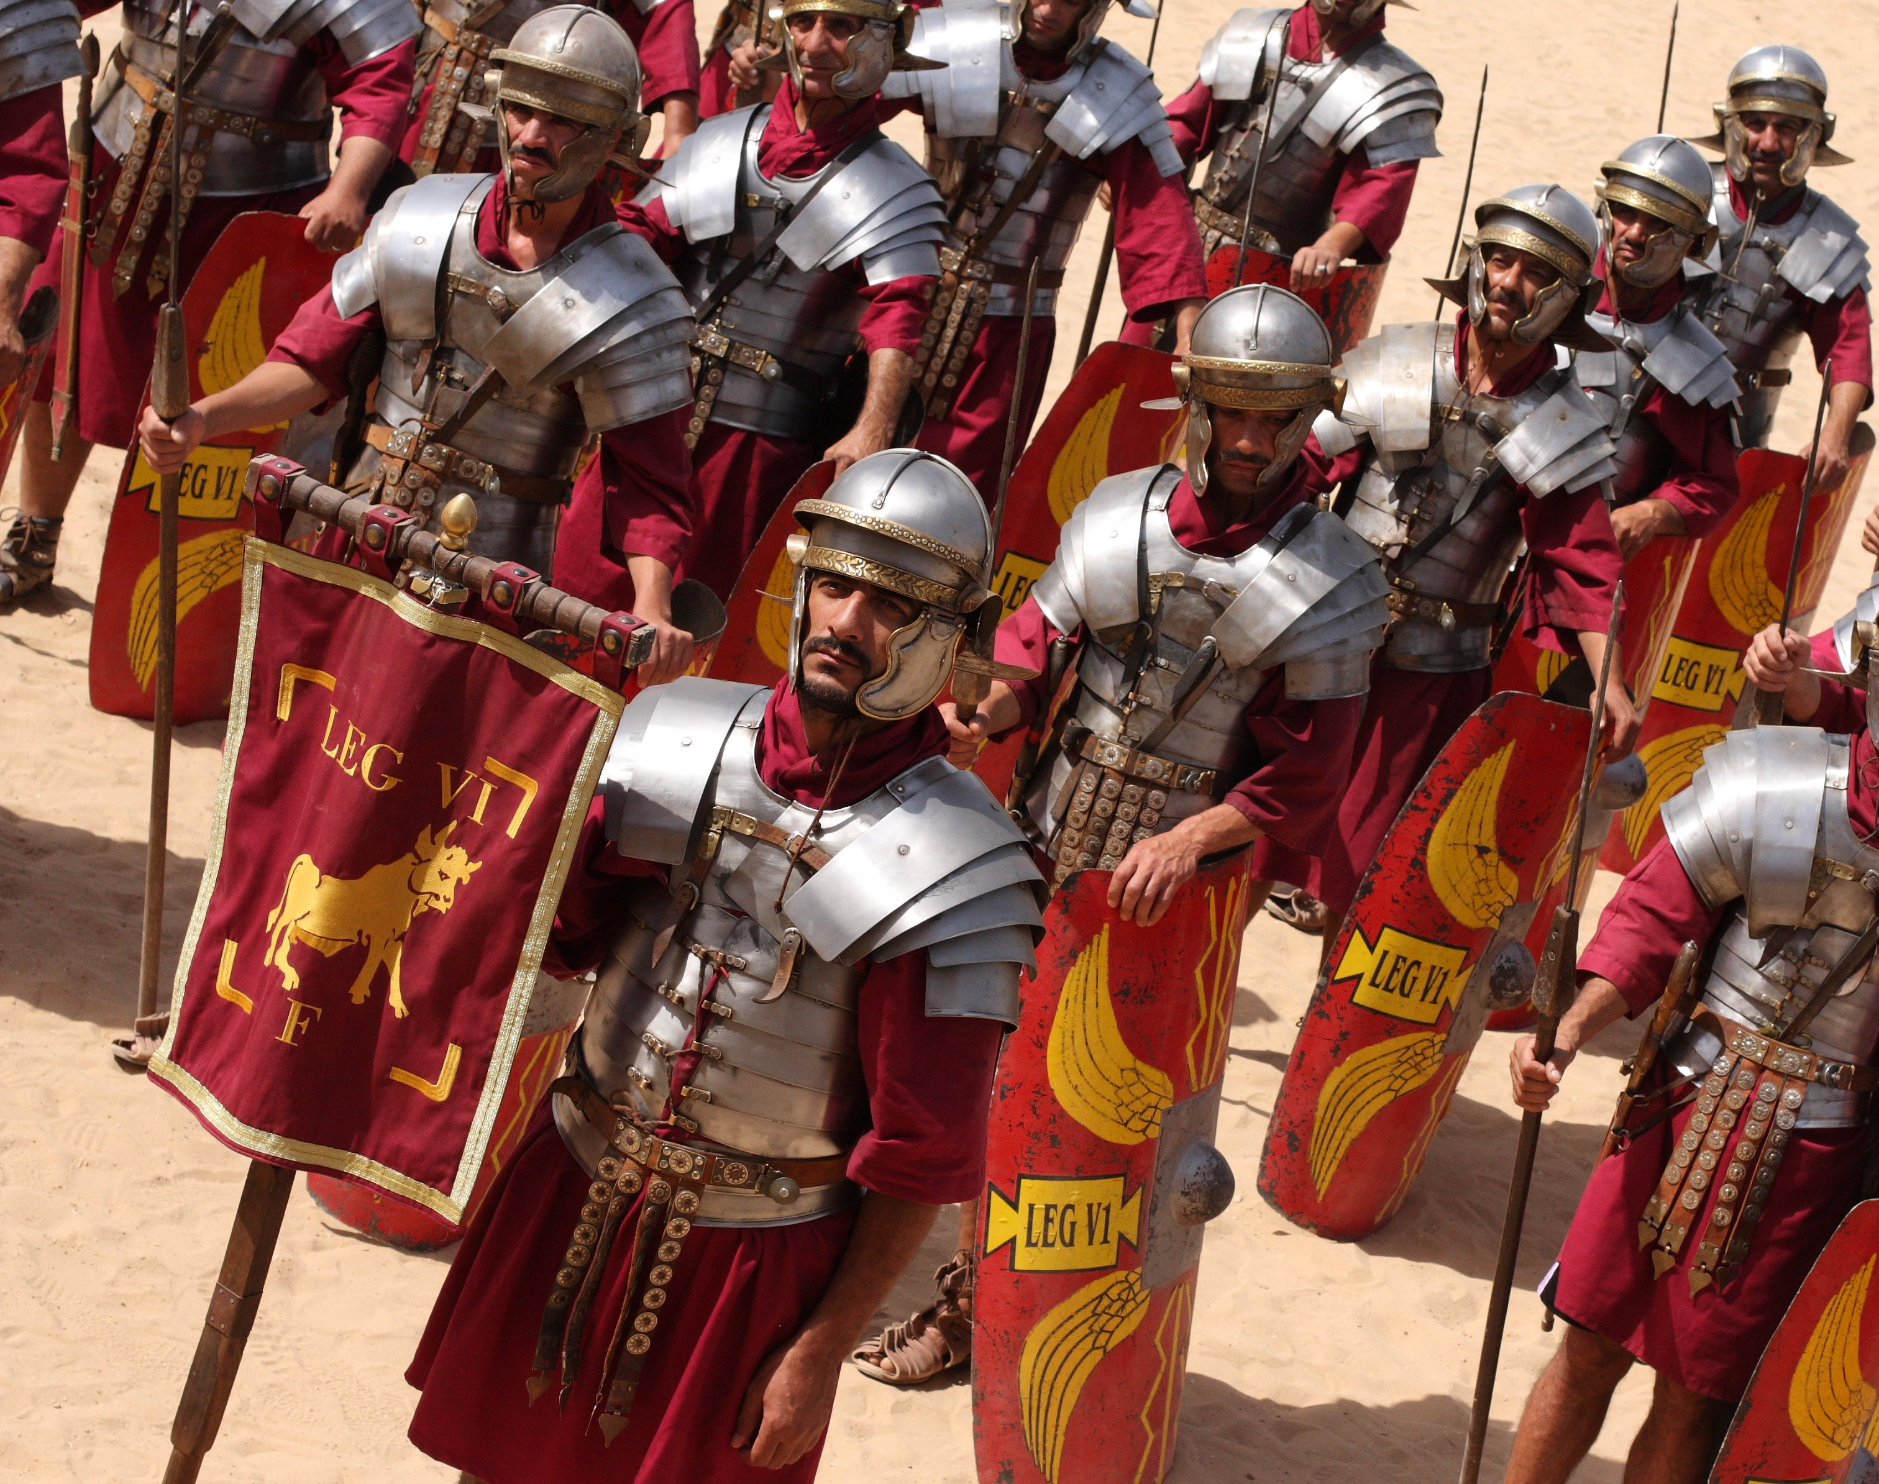
Our topic was about the Roman Invasion in Wales.It was about the Romans taking over the celts land.
This Photo by Unknown author is licensed under CC BY-SA.

Slide 3
We went to castell Henllys and we learnt how the Romans survived and the celts survived.We went inside round houses and saw how they lived. The round houses were very dark and they had a fire inside, so it was smoky. We learnt how to be a Roman soldier and we uesd shields to go into formations.

Slide 4
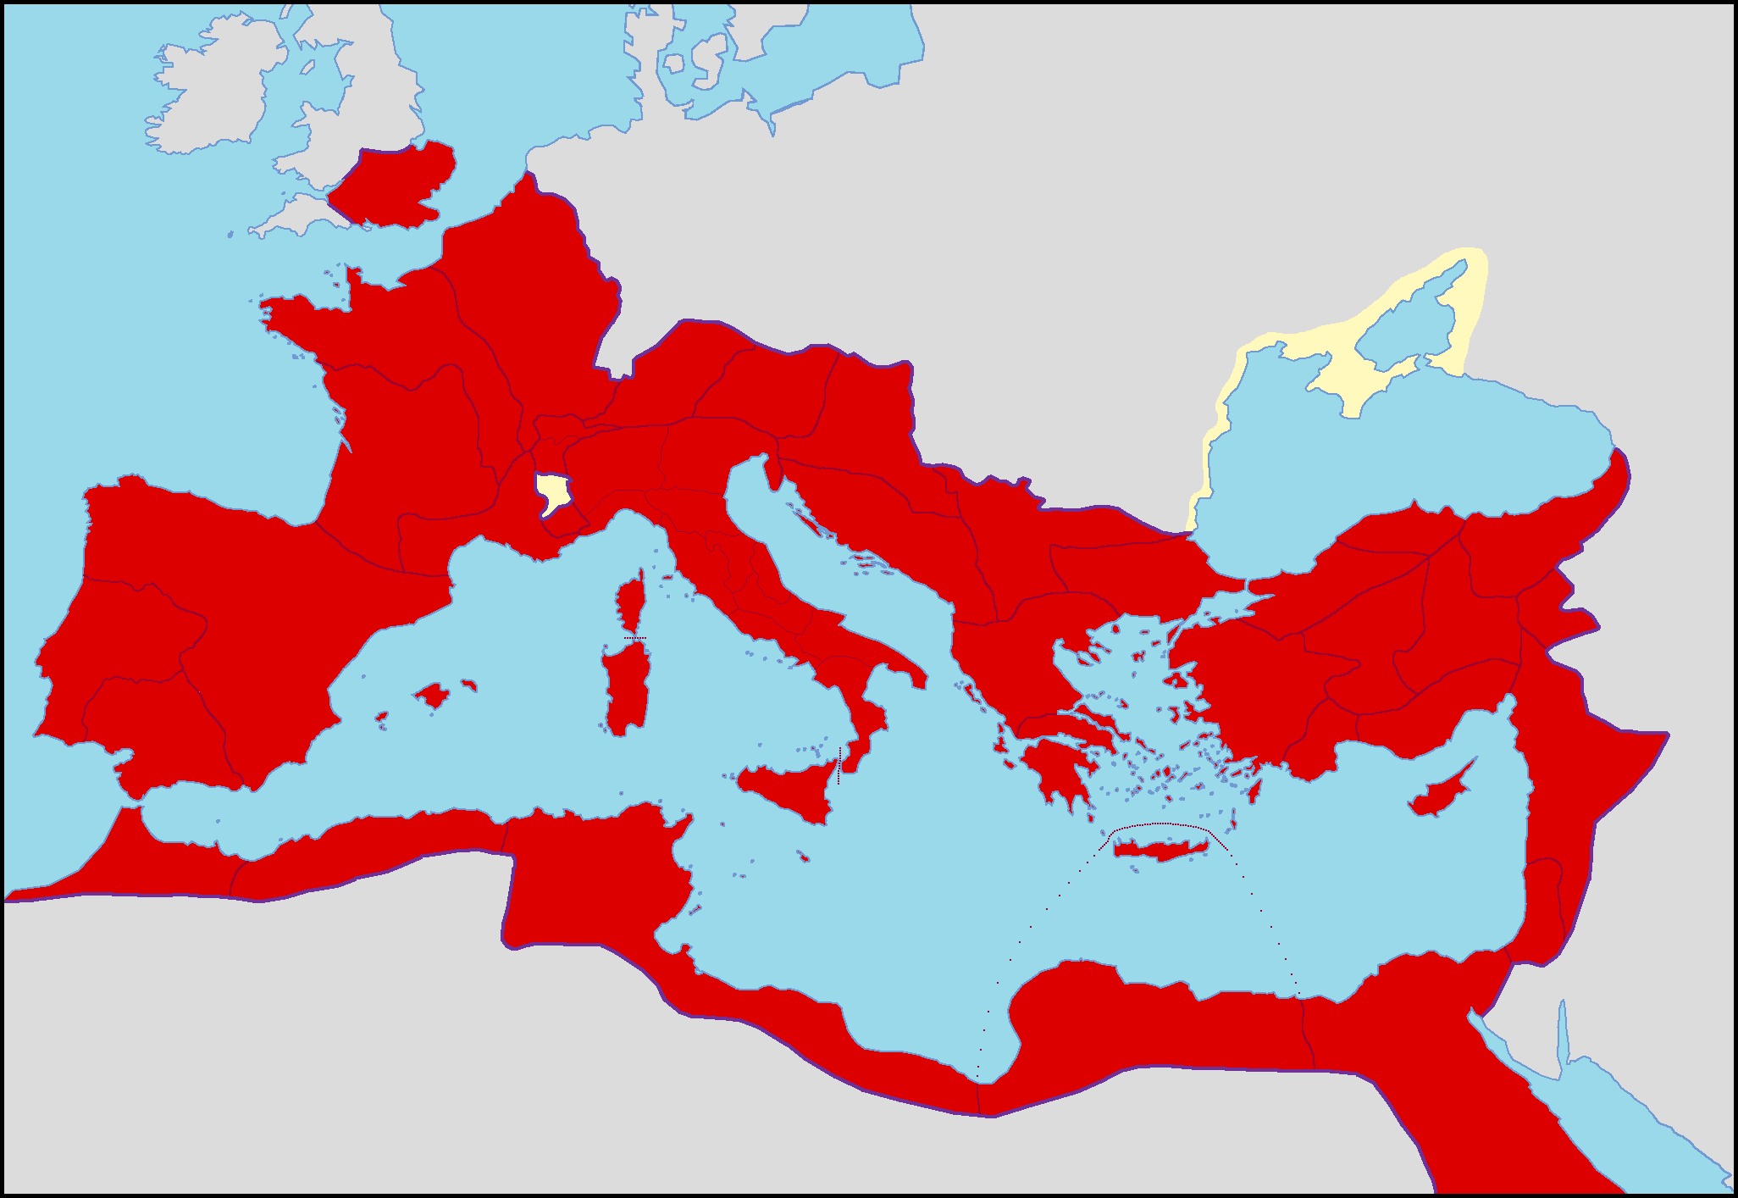
The Roman invaded lots of places like France, Italy and Spain
This Photo by Unknown author is licensed under CC BY-NC.

