Slide 1
The Roman Invasion
My Super Evaluation

Slide 2
This topic was about the Roman Invasion. It was about the Romans and Celts.

Slide 3
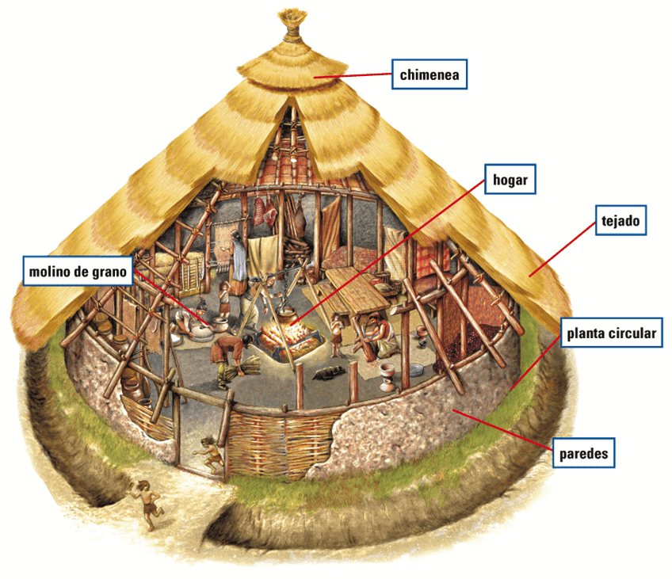
We went to castell Henllys and we found out about celtic homes and there weaponds. We went in a round house to see what it was like.
This Photo by Unknown author is licensed under CC BY-NC-ND.

Slide 4
We lernd about the celltic hill forts and the features they had. They where built on a hill and they had ramparts to keep them safe. We chosd a goodplace for a hillfort on a map of Wales.

Slide 5
We pretended to be Romans and peple askt us questions about awer life.

Slide 6
I liked the teopik because it is fun and I can tell evry won about the Romans and celts.

