Slide 1
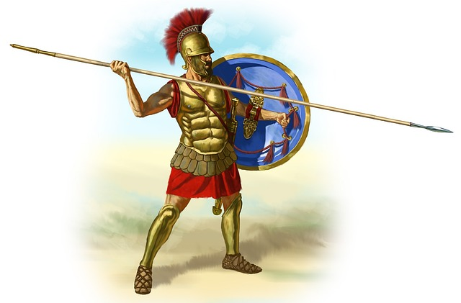
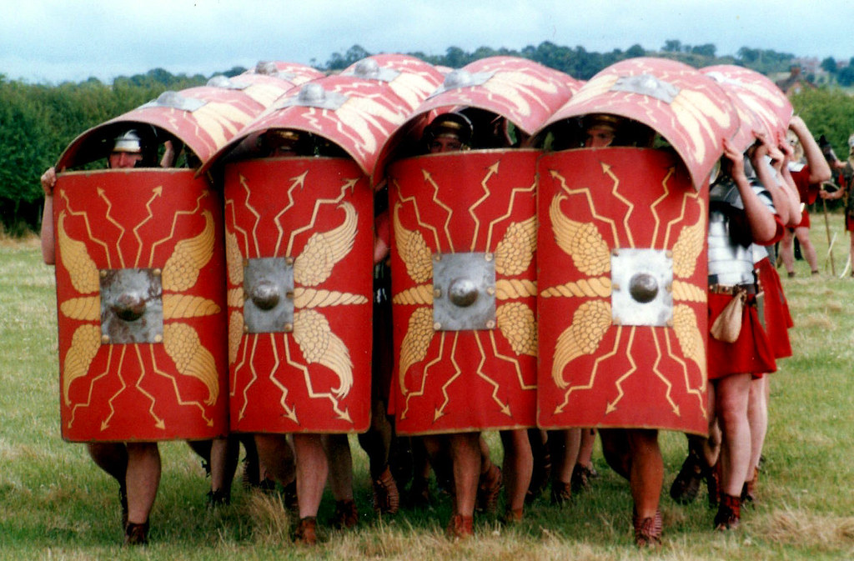
The Roman Invasionn
My Super Evaluation
This Photo by Unknown author is licensed under CC BY.

Slide 2


This topic was about the Roman Invasion.The Romans conquered the Celts and made lots of changeds. We learnt what weapons they had and where they came from.
This Photo by Unknown author is licensed under CC BY-NC.
This Photo by Unknown author is licensed under CC BY-NC.

Slide 3
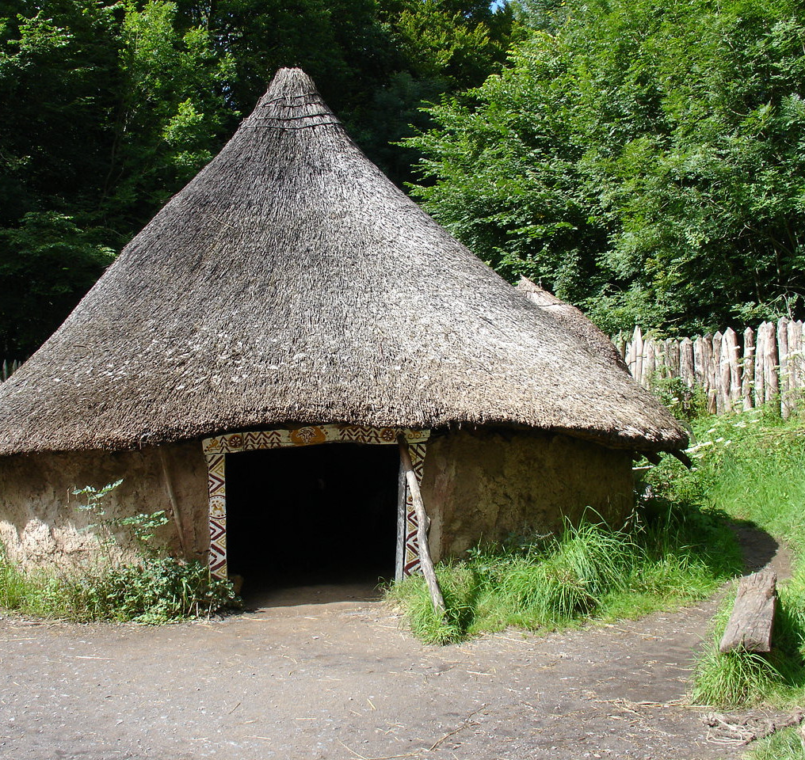
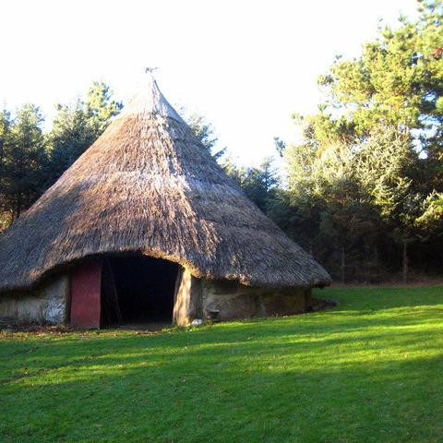
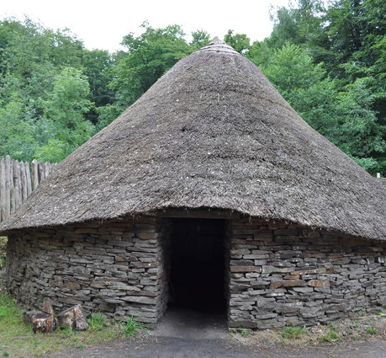
We went on a trip to Castell Henllys and we learnt what life was like for the Celts. We also learnt warrior skills using shields. We practised different formations that the Roman soldiers did in battle. We went in Celtic round houses to see what they were like.
This Photo by Unknown author is licensed under CC BY-SA.
This Photo by Unknown author is licensed under CC BY-SA.
This Photo by Unknown author is licensed under CC BY-SA.

Slide 4
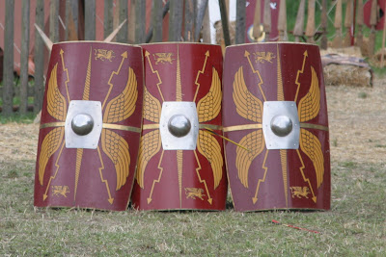
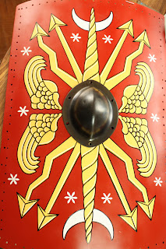
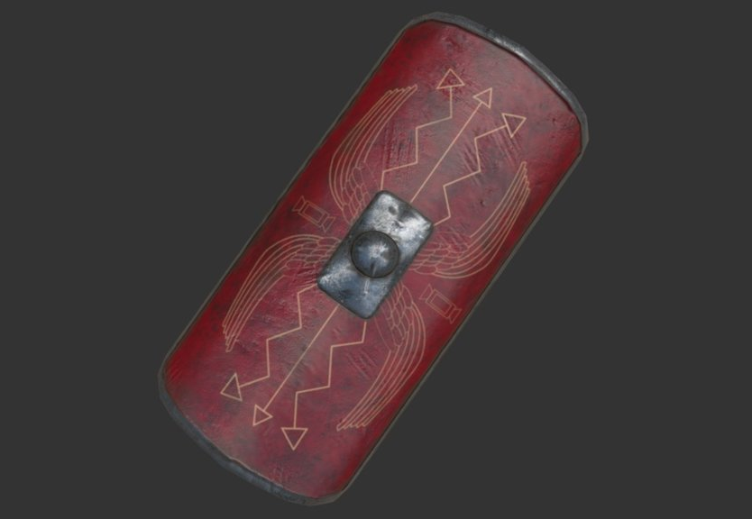
We learnt about the Roman gods and using information about them we designed a shield on them. I put Roman money on my shield to represent the Roman god Pluto.
This Photo by Unknown author is licensed under CC BY.
This Photo by Unknown author is licensed under CC BY-NC-ND.
This Photo by Unknown author is licensed under CC BY-NC-ND.

Slide 5
We learnt about hillforts they had a gate so the enemies could not get in. They had ramparts and fences.To keep them safe.We chose the best place to build a hillforts in wales.

Slide 6
I liked this topic because it was really fun we went to Castell Henllys on a school trip we went into battle with shields.

