Slide 1
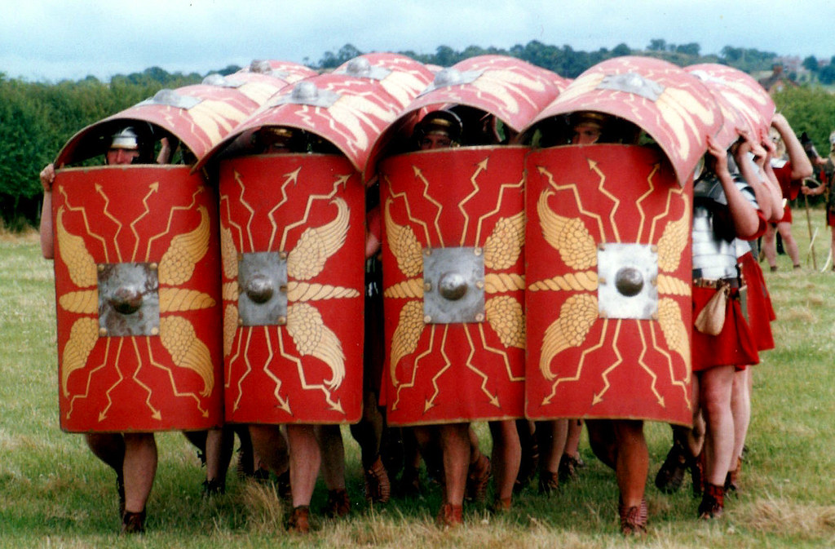
The Roman Invasion
My Super Evaluation
This Photo by Unknown author is licensed under CC BY.

Slide 2
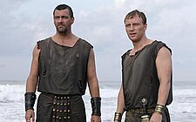
This topic was about the Roman Invasion in Wales.It was about the Iron age and the Celts and the Romans.We learnt about what they did, there weapons and were they came from.
This Photo by Unknown author is licensed under CC BY-SA.

Slide 3
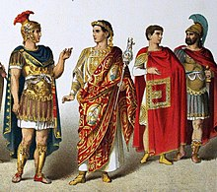
We went to Castell Henllys on a trip .We learnt about Celtic and Romans Warrior Skills and their weapons.We practised Roman Soldier marching and different formations that they used when they went to war.
This Photo by Unknown author is licensed under CC BY-SA.

Slide 4
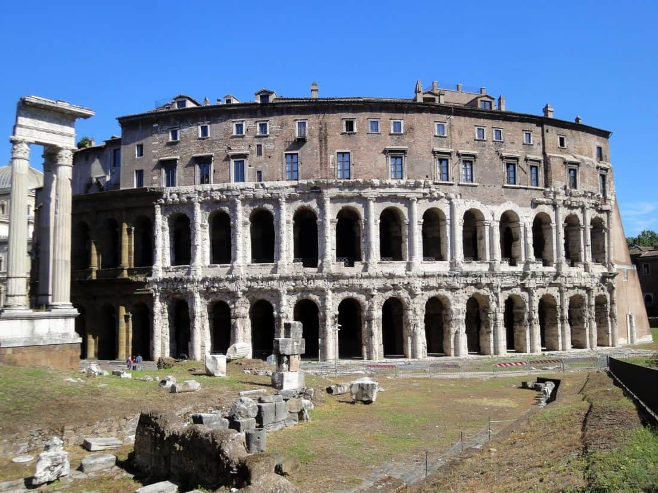
We learnt about all the difforant Countries that the Romans Invaded.The Romans Invaded Italy,Spain,France and Portugal. We used an atlas to find them. We found where Italy was on the atlas and that is where the Romans came from.

Slide 5
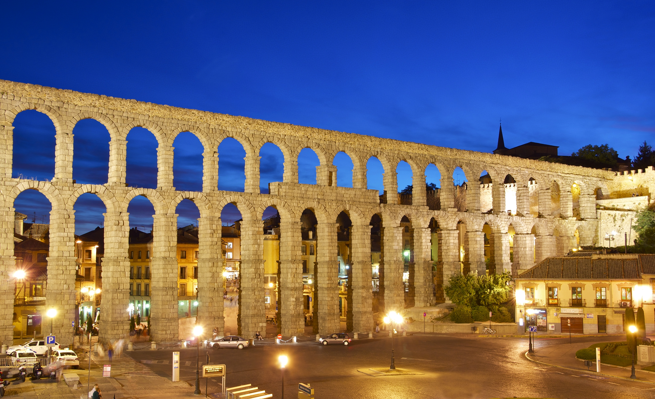
We learnt a Roman rap song and we learnt all the things that they changed when they came here and all the things that affect us.They brought hospitals and aquaducts they did it all.They brought better food and houses for us and we use them today still.
This Photo by Unknown author is licensed under CC BY-SA.

Slide 6
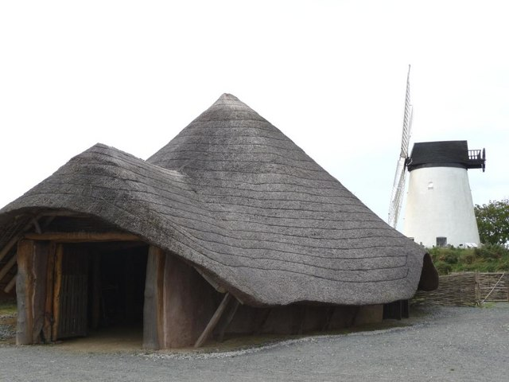
I really liked the topic it was so fun it was the best,because we got to know about the Stone age the Bronze age and the Iron age.
This Photo by Unknown author is licensed under CC BY-SA.

