Slide 1
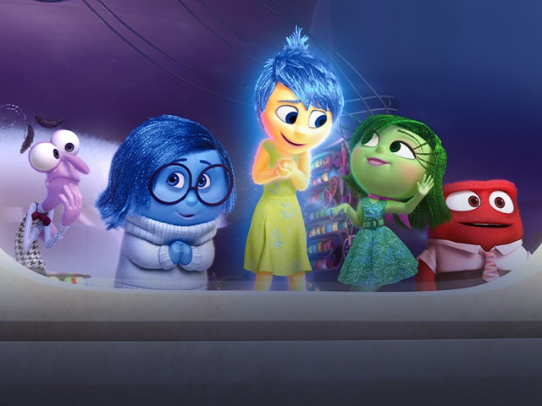
Health and Wellbeing: The Triple H & Fitness Fanatics

Slide 2

The Triple H & Fitness Fanatics: Year 2s?
Who’s interested?
What would make you a good Triple H member? What would make you a good Fitness Fanatics member
PVGs- over to you…

Slide 3
The Triple H are….
Emotion Coaches!

Slide 4
What is Emotion coaching?
1. Becoming aware of your own and others emotions
2. Recognising the emotion as an opportunity to communicate
3. Listening and validating the child's
feelings
4. Helping the child find words to label the
emotion
5. Setting limits and explore strategies to solve the
problem at hand.

Slide 5
Turn your frown upside down….
First drop in session will be on Monday at the bottom of the stairs near the lift.
Triple H will be running the drop in.
Games, social stories, check in and out, breathing activities.
Any suggestions?

Slide 6
Turn your frown upside down….
Who can attend?
  Year 4-6 initially….
  Triple H and teachers will remind you.
  If you are feeling sad, anxious, nervous, angry or just want a chat.
  Bring a friend!

Slide 7
Healthy snack & Lunchtimes.
Triple H:
Ride your bike/ scooter to school
Rights of the child.
Food and plastic waste.

Slide 8
Fitness Fanatics
Playtime games
Competitions
Sports club suggestions and activities with Miss Galvin

