Slide 2
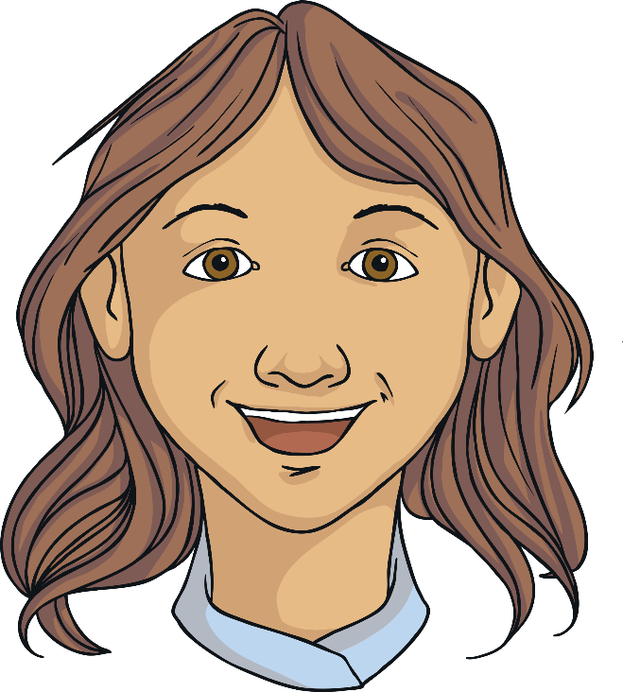
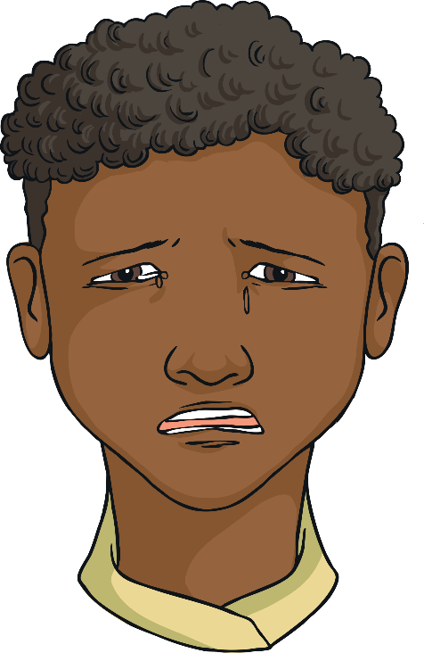
During your life, there will be times when you will experience change.

Slide 3
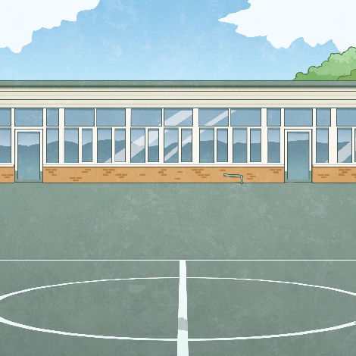
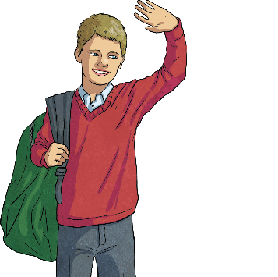
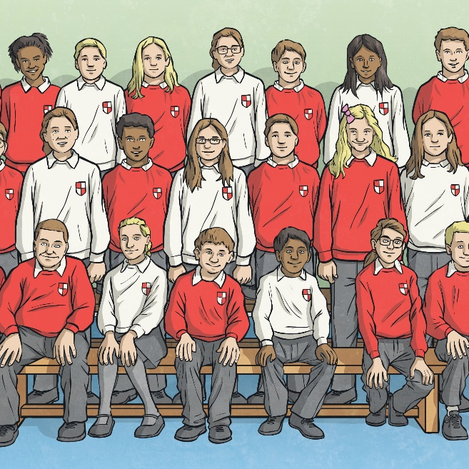
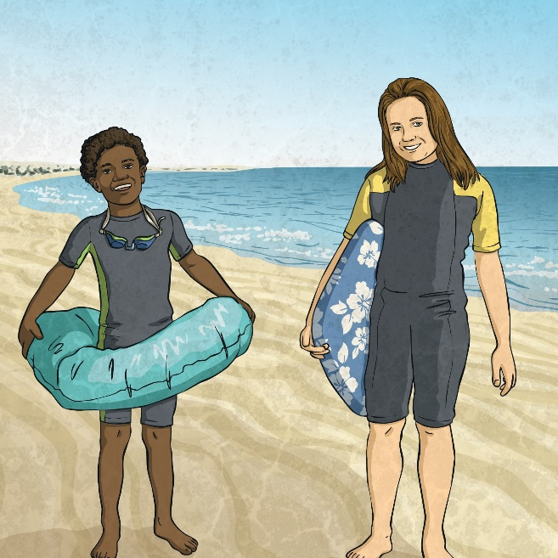

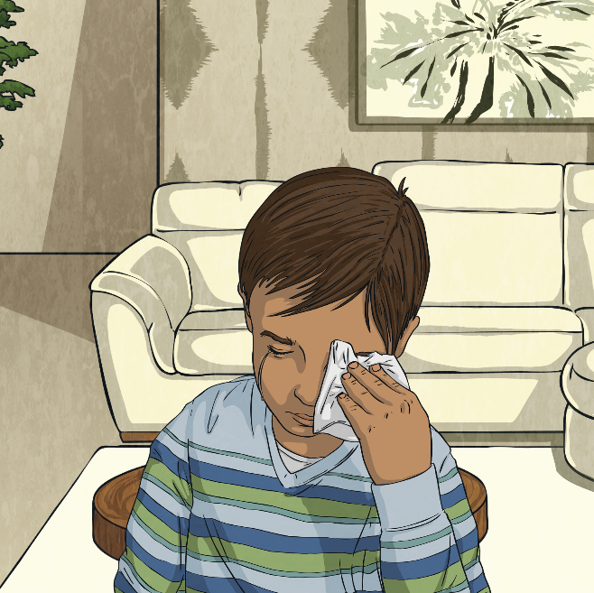
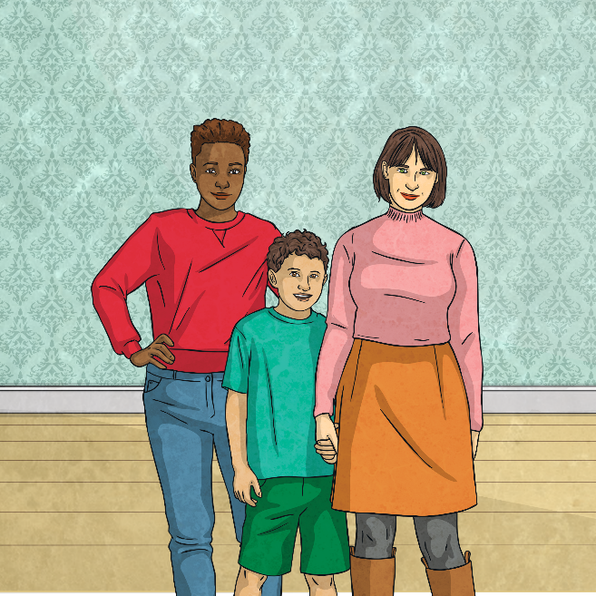
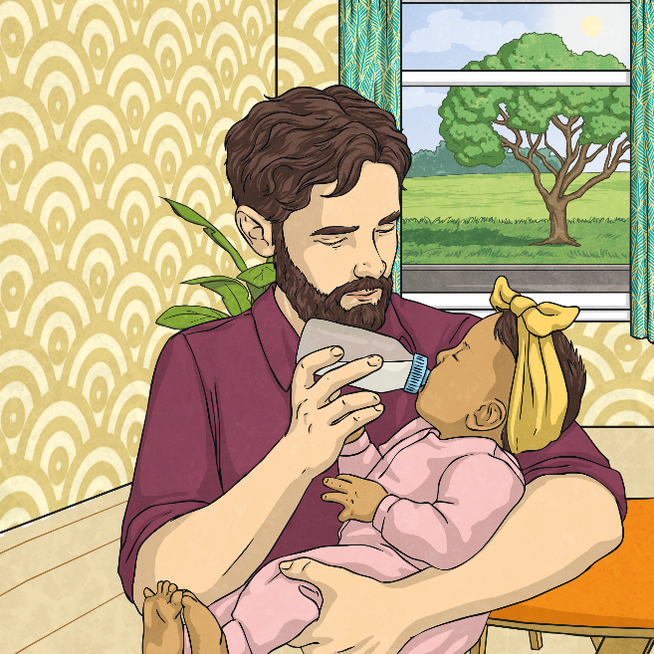
Examples of Times of Change
On other days, you may experience both good and bad change.
Moving from primary to secondary school
Moving to a new class
School holidays – a change in routine
Moving house
A sibling being born
Death of a loved one
Changes to family structure

Slide 4


When things change, how might this feel?

Slide 5
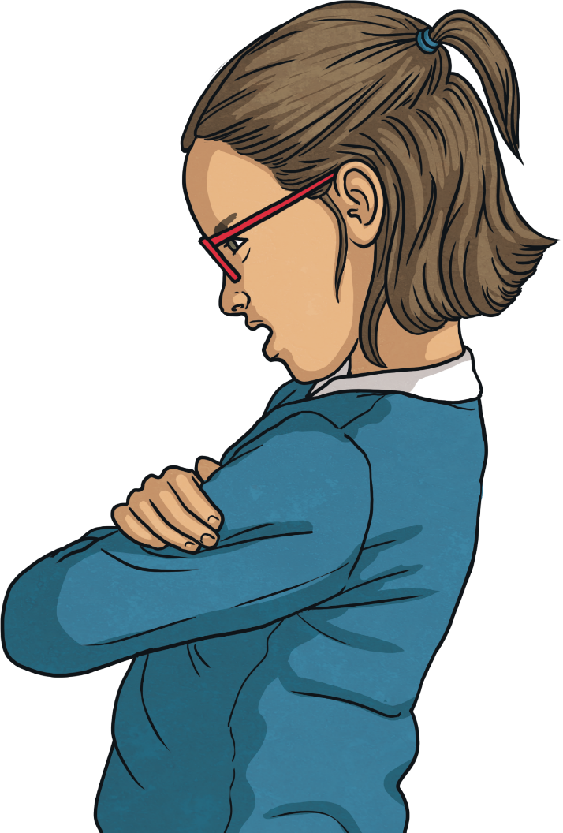
Changes can be good and can make you feel excited or that things are going to get better.
This assembly is going to focus on
those times when you find changes difficult and might need some
support. Dealing with change can be difficult for many reasons and can produce uncomfortable feelings.
There are lots of things you can do to look after yourself during these times.

Slide 6
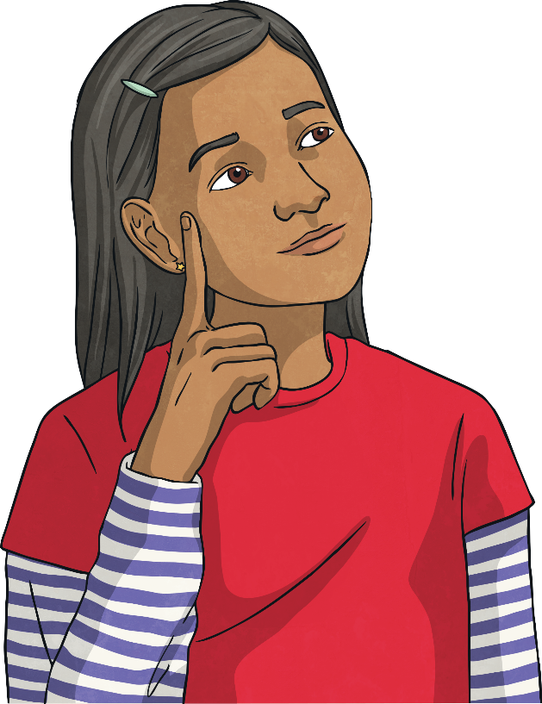
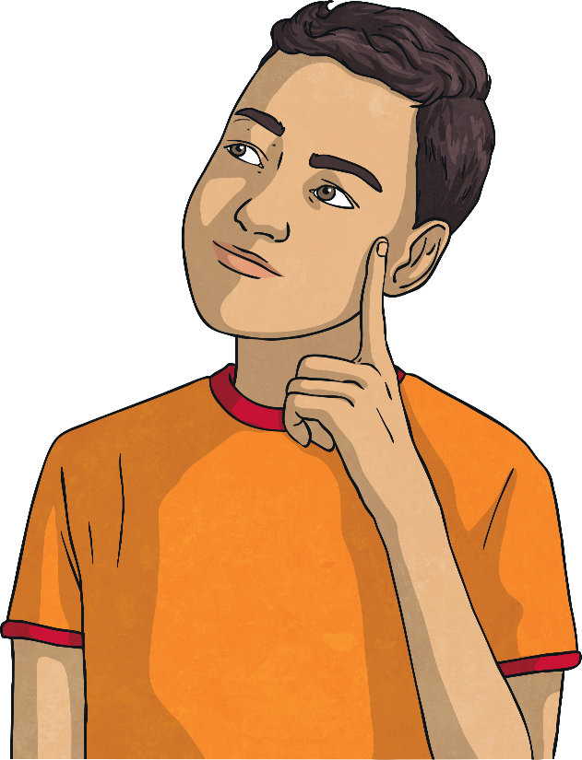
What can you do to help cope with change?

Slide 7
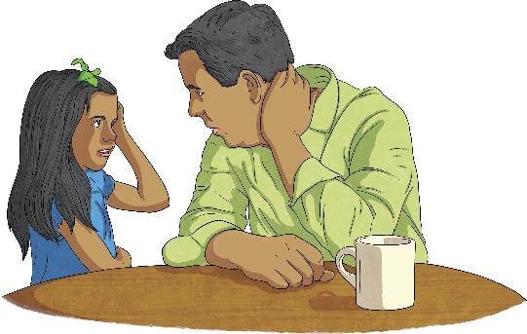
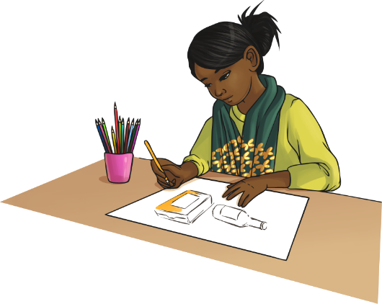
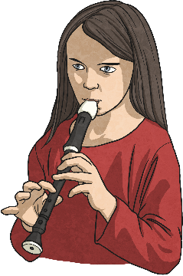
Top Tips to Manage Change
Talk to an adult you trust.
Focus on a simple task, such as mindful colouring or tidying up.
Do something that makes
you happy.

Slide 8





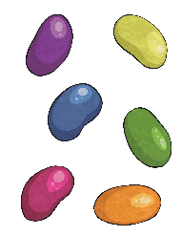




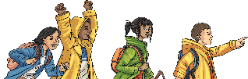






Wellbeing Bingo
Help someone. | Do some exercise. | Read a book. | Get a good night sleep.
Treat yourself. | Manage the time spent online. | Spend time with friends. | Listen to music.
Eat a healthy and balanced diet. | Practise mindfulness. | Spend time in nature. | Watch a film or TV show.

Slide 9

What if I feel like I need help now?
If you want to talk to someone about your mental health today, Childline offers free, confidential counselling, currently from 9am until midnight.
You can call them on 0800 1111 or go online to chat one-to-one with a counsellor at Childline.
https://www.youtube.com/watch?v=zMuudnwOdeo

