Slide 1
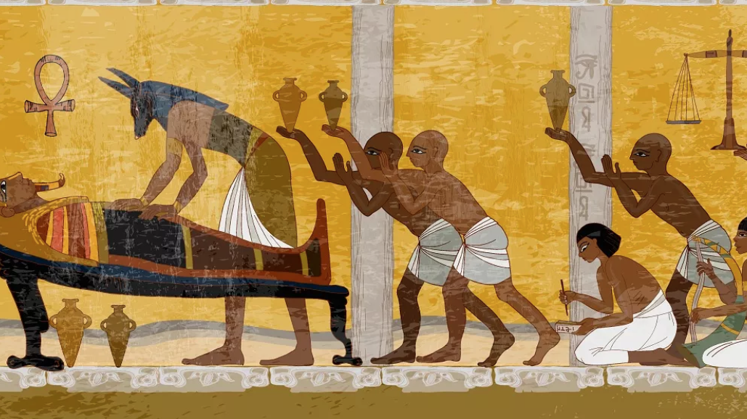
Mummification

Slide 2
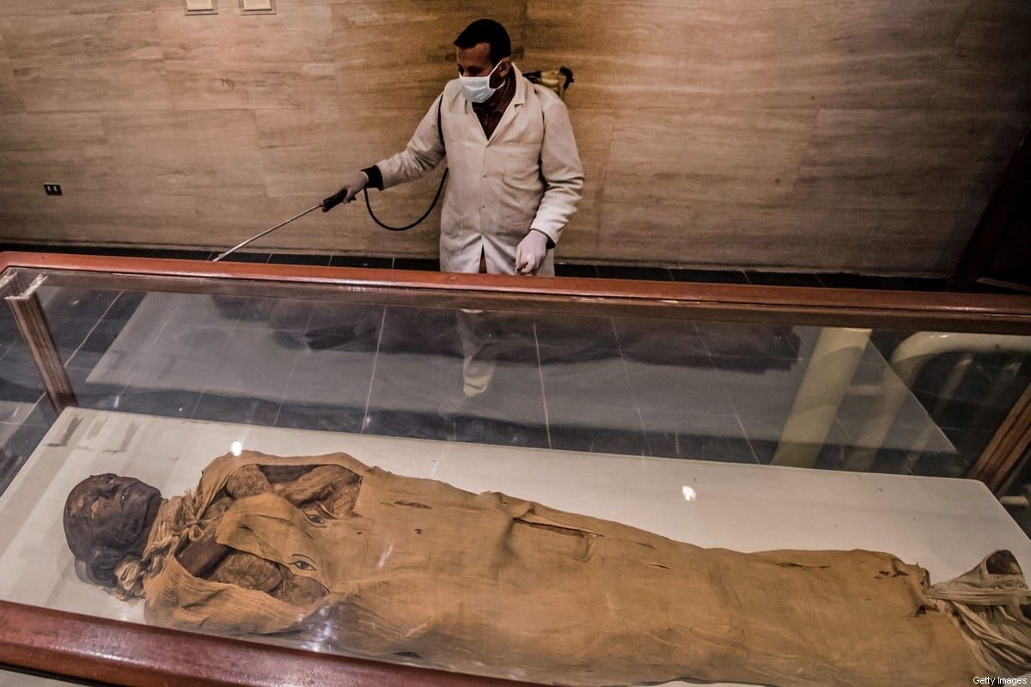
What is mummification?
Mummification is the process where bodies of the deceased were embalmed and preserved. The purpose of mummification was to keep the body intact so it could be transported to a spiritual afterlife. The methods of embalming, or treating the dead body, that the ancient Egyptians used is called mummification. Using special processes, the Egyptians removed all moisture from the body, leaving only a dried form that would not easily decay.
This Photo by Unknown Author is licensed under CC BY-SA-NC

Slide 3
Questions:
What is mummification?
What do you think the word ‘preserved’ means?
What did the Ancient Egyptians remove from the body? Why?
This Photo by Unknown Author is licensed under CC BY-SA-NC

Slide 4
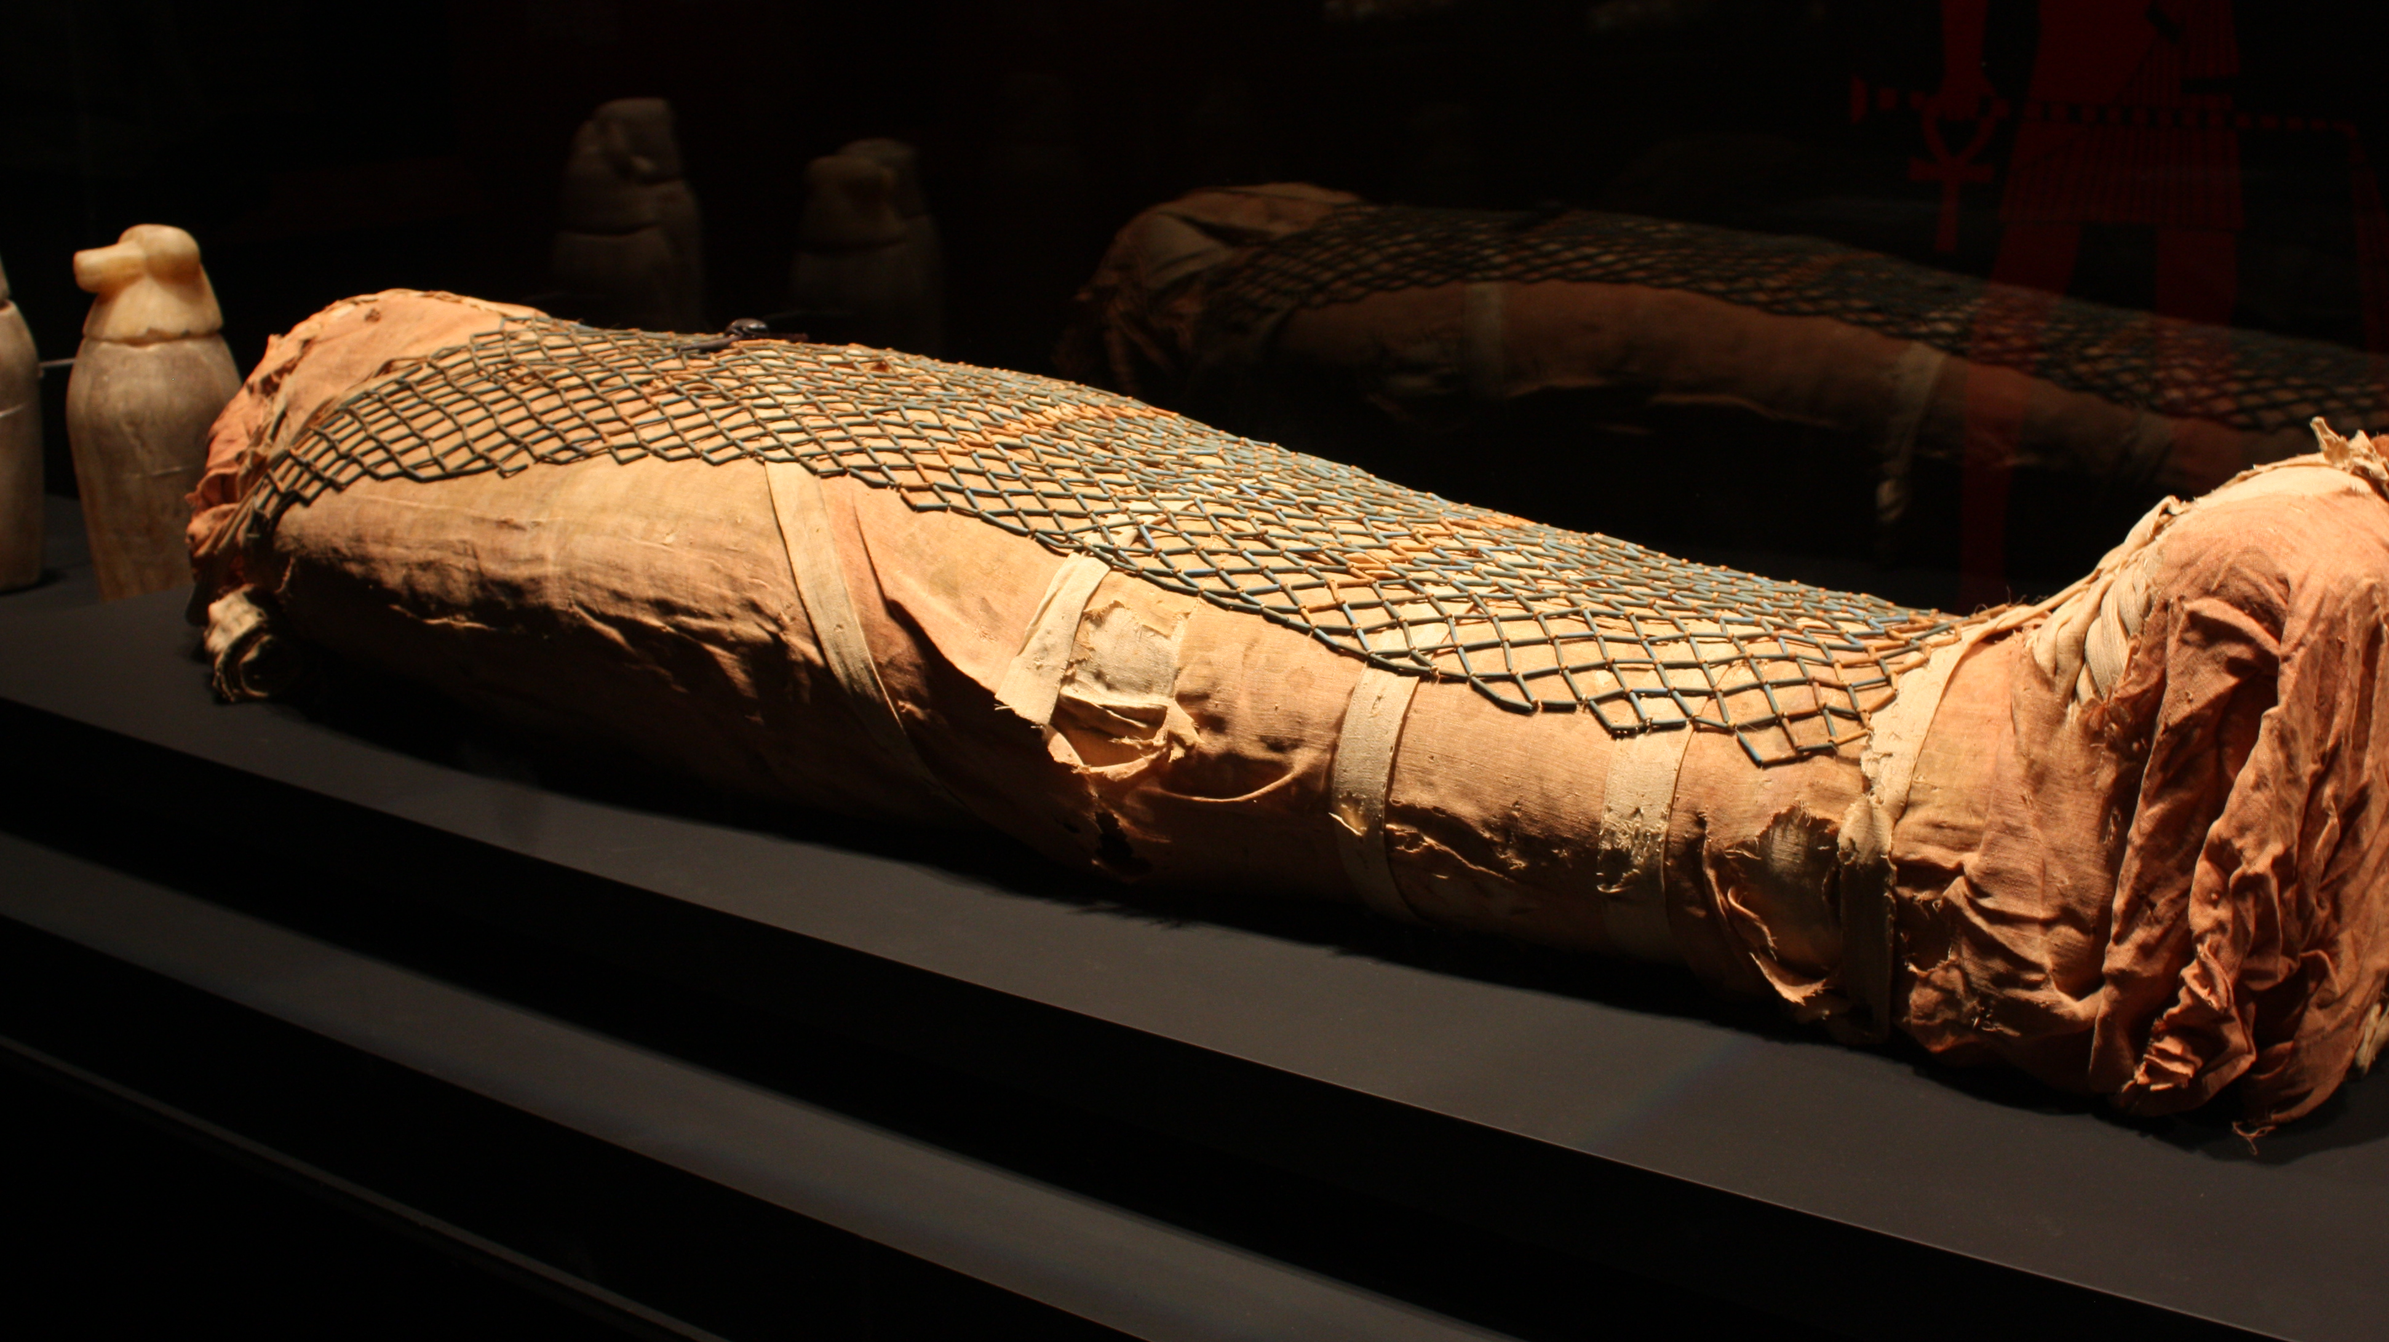
Why were people mummified?
To understand Egyptian mummies you have to first know about their religious beliefs. Ancient Egyptians believed in many gods and that when a person died they passed into an ‘afterlife’. They thought that the individual would have a life that was very close to the one that they lived in with everyone else. In order to have that kind of life, their body needed to be preserved and they needed to be buried with all of the possessions that they would take with them on their journey into the afterlife. So successful were they that today we can view the mummified body of an Egyptian and have a good idea of what he or she looked like in life, 3,000 years ago.
This Photo by Unknown Author is licensed under CC BY-NC

Slide 5
Questions:
4) What did Ancient Egyptians believe happened when a person died?
5) Why were people buried with their possessions?
6) What phrase in the text tells you that Ancient Egyptians were good at preserving bodies.
This Photo by Unknown Author is licensed under CC BY-NC

Slide 6
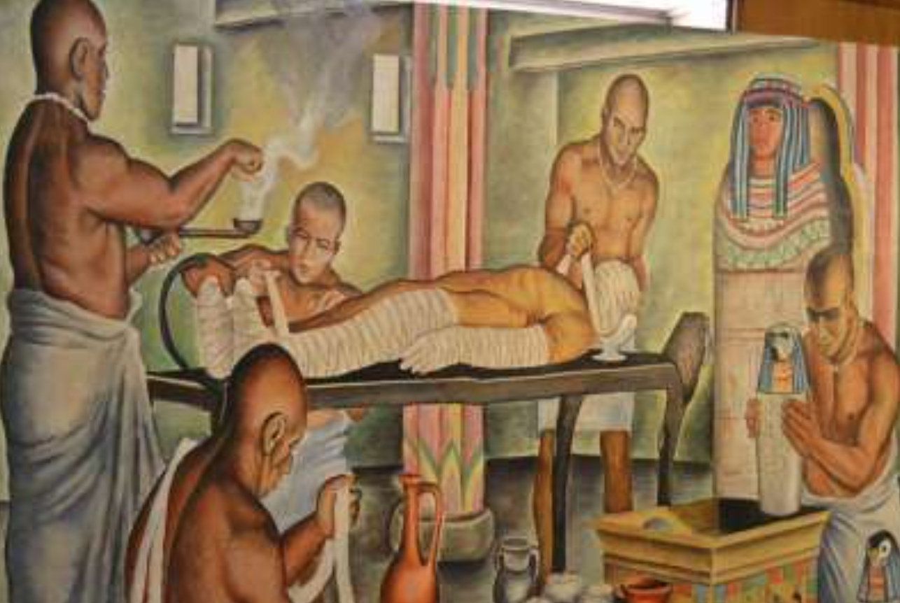
How were people mummified?
The mummification process took seventy days. Special priests worked as embalmers, treating and wrapping the body. Beyond knowing the correct rituals and prayers to be performed at various stages, the priests also needed a detailed knowledge of human anatomy.

Slide 7
Questions:
7) How long did the mummification process take to complete?
8) Who treated and wrapped the body?
9) What did priests need to have a good understanding of before they could perform mummification?

Slide 8
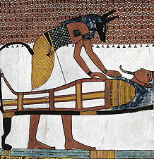
Mummification process
1. The body must be purified and washed.
2. All internal organs were removed; however, they left the heart in place. The brain was removed by carefully inserting special hooked instruments up through the nostrils in order to pull out bits of brain tissue. It was a delicate operation, one which could easily disfigure the face. The embalmers then removed the organs of the abdomen and chest through a cut usually made on the left side of the abdomen. They left only the heart in place, believing it to be the centre of a person's being and intelligence. The other organs were preserved separately, with the stomach, liver, lungs, and intestines placed in special boxes or jars today called canopic jars. These were buried with the mummy.
3. They had to ‘dry’ the body out, so they placed it in a naturally found substance called ‘natron’. This was almost like salt and it drew out all of the moisture in the body. The result was a very dried-out but recognisable human form. To make the mummy seem even more life-like, sunken areas of the body were filled out with linen and other materials and false eyes were added.
4. They filled in the body with a kind of stuffing so that it would look normal.
5. In about 40-50 days, they removed the body from natron and then replaced the original stuffing with new stuffing made out of sawdust or linen.
6. The body was then carefully wrapped in layers of linen that covered every area of the body. In order to protect the dead from misfortune, amulets were placed among the wrappings and prayers and magical words written on some of the linen strips.
7. Some special oils were placed on the body to help in the preservation. A final covering was placed on it called a ‘shroud’.
8. The finished mummy was placed in a stone or wooden container called a ‘sarcophagus’ The mummy was placed in his coffin, or coffins, in the burial chamber and the entrance sealed up.

Slide 9
Questions:
10) Write the statements out and say whether they are true or false:
All internal organs were removed from the body.
The brain was removed via the nostrils.
The organs removed from the body were placed in canopic jars.
Natron was used to dry out the body.
The body was removed from the natron after 50-60 days.
11) Why were amulets and magical words used?
12) What was the final covering called?
13) What is a sarcophagus?

Slide 10
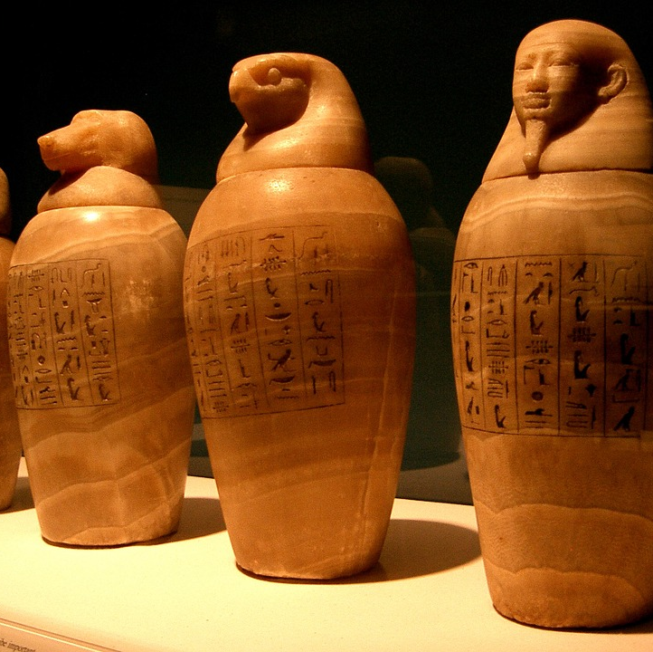
The organs:
The organs of the body that had been taken out were also mummified and placed in special containers, called canopic jars, that would be placed in the burial tomb with the body.
Both the sarcophagus and the jars containing the body parts were sealed with a black resin.
They left the heart in the body as they thought this was required for part of the test needed to enter the afterlife.
They believed the heart was the centre of all intelligence and emotion, but they removed the brain, thinking it wasn’t important.
Canopic Jars

Slide 11
Questions:
14) How were the sarcophagus and canopic jars sealed?
15) Why did they leave the heart in the body?
16) Did the Egyptians think the brain was important? Explain your answer.
Canopic Jars

Slide 12
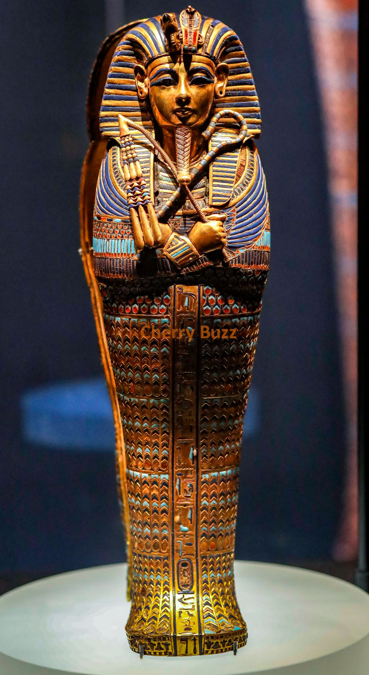
Who were mummified?
Mummification was a very expensive process, so only the wealthiest of Egyptian people were able to afford to be mummified.
Pharaohs had the most expensive mummification of all people. Since the pharaoh was considered a God, they included many gems and amulets in between the layers of linen wrapping. They would also use a special sarcophagus for the pharaoh that was carved and painted in his likeness. Some were decorated with gold. Others, had solid gold decorative masks placed on the head and face that looked like the pharaoh.
The pharaoh mummies were placed in special burial places along with many of the expensive items that they would take with them in the afterlife.
In addition to the wealthy people, animals such as bulls, crocodiles and cats have also been found to have been mummified.

Slide 13
?Questions:
17) What type of people would be able to get mummified? Why?
18) Why would the Pharaohs get gems and amulets put between their linen?
19) Based on their sarcophagus, what tells you that the Pharaohs were the most important people in Egypt?
20) ‘In addition to the wealthy people, animals such as bulls, crocodiles and cats have also been found to have been mummified.’ What does this tell you about the relationship between these animals and the Ancient Egyptian people?

