Slide 1
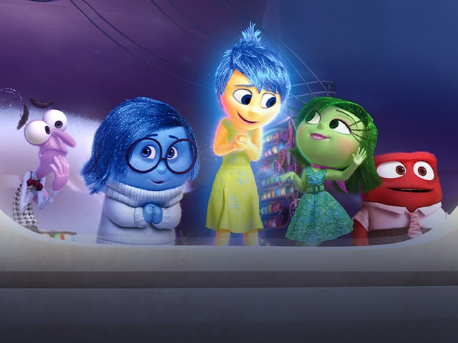
Health and Wellbeing: The Triple H

Slide 2

The Triple H: Year 2s?
Who’s interested?
If you would like to be part of this exciting team, please see Mrs Gaffney- Jones.
What would make you a good Triple H member?
Triple H- over to you…

Slide 3
The Triple H are….
Emotion Coaches!

Slide 4
What is Emotion coaching?
1. Becoming aware of your own and others emotions
2. Recognising the emotion as an opportunity to communicate
3. Listening and validating the child's
feelings
4. Helping the child find words to label the
emotion
5. Setting limits and explore strategies to solve the
problem at hand.

Slide 5
Turn your frown upside down….
First drop in session will today at the bottom of the stairs near the lift.
Triple H will be running the drop in.
Games, social stories, check in and out, breathing activities.
Any suggestions?

Slide 6
Turn your frown upside down….
Who can attend?
  Everyone!
  Triple H and teachers will remind you.
  If you are feeling sad, anxious, nervous, angry or just want a chat.
  Bring a friend!

Slide 7
Healthy snack & Lunchtimes:
What can we do to make it better?
Incentive to bring in a healthy snack?
What would you like to change?
Keeping my body healthy - BBC Teach
Ride your bike/ scooter to school:
Incentive?
Why should we encourage this?

Slide 8
Let’s unwind together…
GoNoodle | Let's Unwind

