Slide 1

Welcome to the Creative Crew!
censCC BY.

Slide 2


Hello Year 2!
This Photo by Unknown author is licensed under CC BY-SA-NC.

Slide 3

We need two more members!!
This Photo by Unknown author is licensed under CC BY.

Slide 4


We are looking for two amazing children to join the Creative Crew!
We would like…

Slide 5

Children with lots of ideas!
We want children with plenty of ideas for things like events, redecorating the school, and ways we can promote the Expressive Arts in LPS. ​

Slide 6
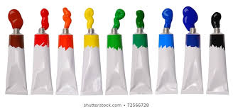


Children who like the Expressive Arts!
We want children to join us who are passionate about art, music, drama, dance and media.

Slide 7

Children who are confident speakers!
We would like children who are confident speakers to join us, so talking won’t be a problem when presenting a powerpoint or speaking to adults or children. ​

Slide 8


Children who are creative!

Slide 9

Children who are outgoing, energetic and active!

Slide 10




We can’t wait to welcome our new members into our Pupil Voice Group!
rArtCC BY-SA.
music
This Photo by Unknown author is licensed under CC BY-SA.

