Slide 1
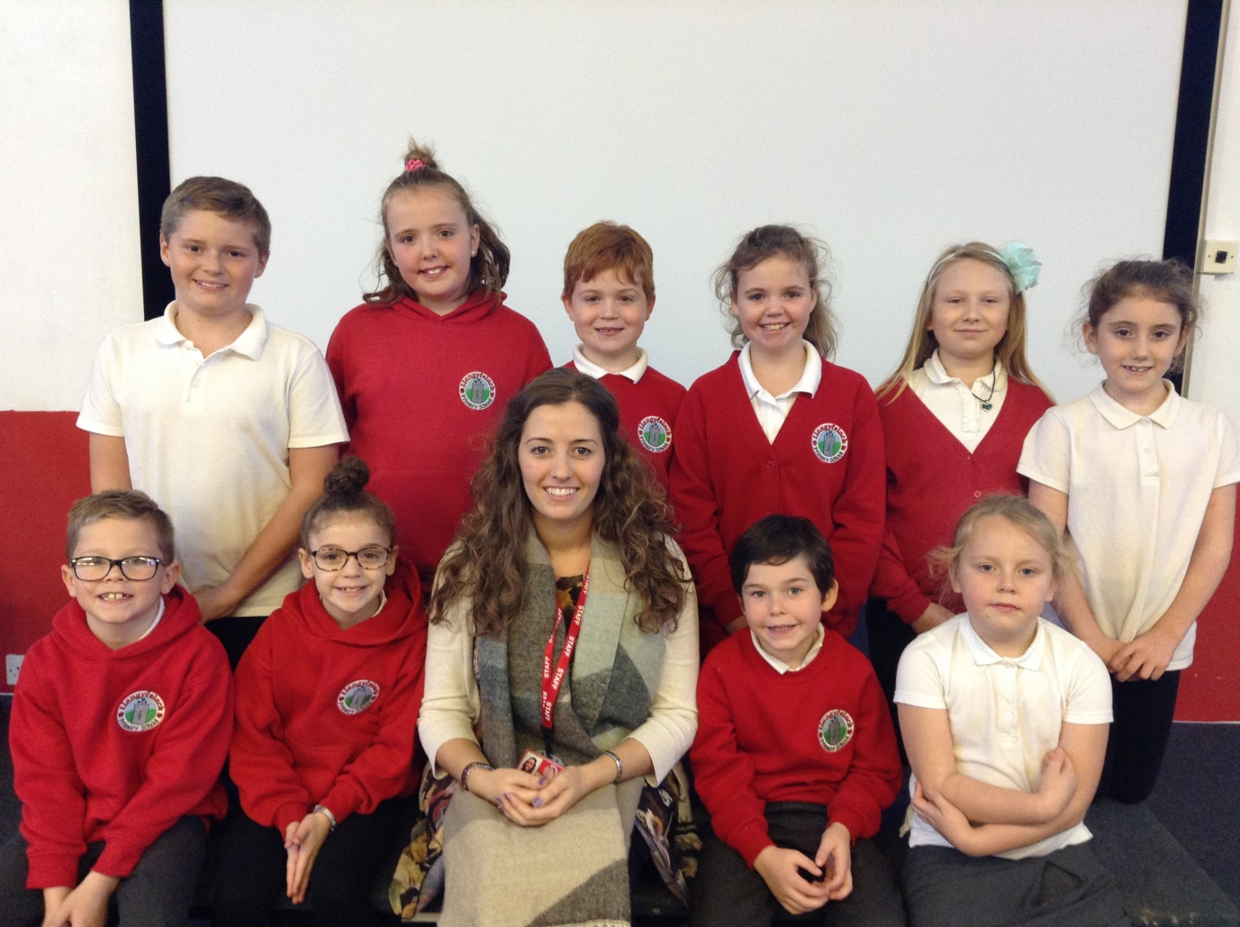
We are the Creative Crew
Y2

Slide 2




Our Job
Y3
We are in charge of making our school more creative.
We try and make our school do more, Art, Music and Drama.
We will be coming around the classes to check what you have done.

Slide 3
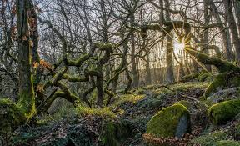

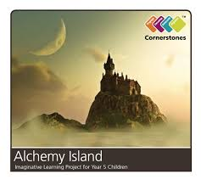
Competition
Y4
We are asking all children in each class to create a poster for your topic.
Year 2 – Topic is ‘Enchanted Woodland’
Year 3 & 4 – ‘Mighty Metals’
Year 5 & 6 ‘Alchemy Island’
You are advertising your topic.

Slide 4



Things to include
Y5
Pictures
Information about your topic
Colours
Good detail
Fill the whole page
Bold title

Slide 5
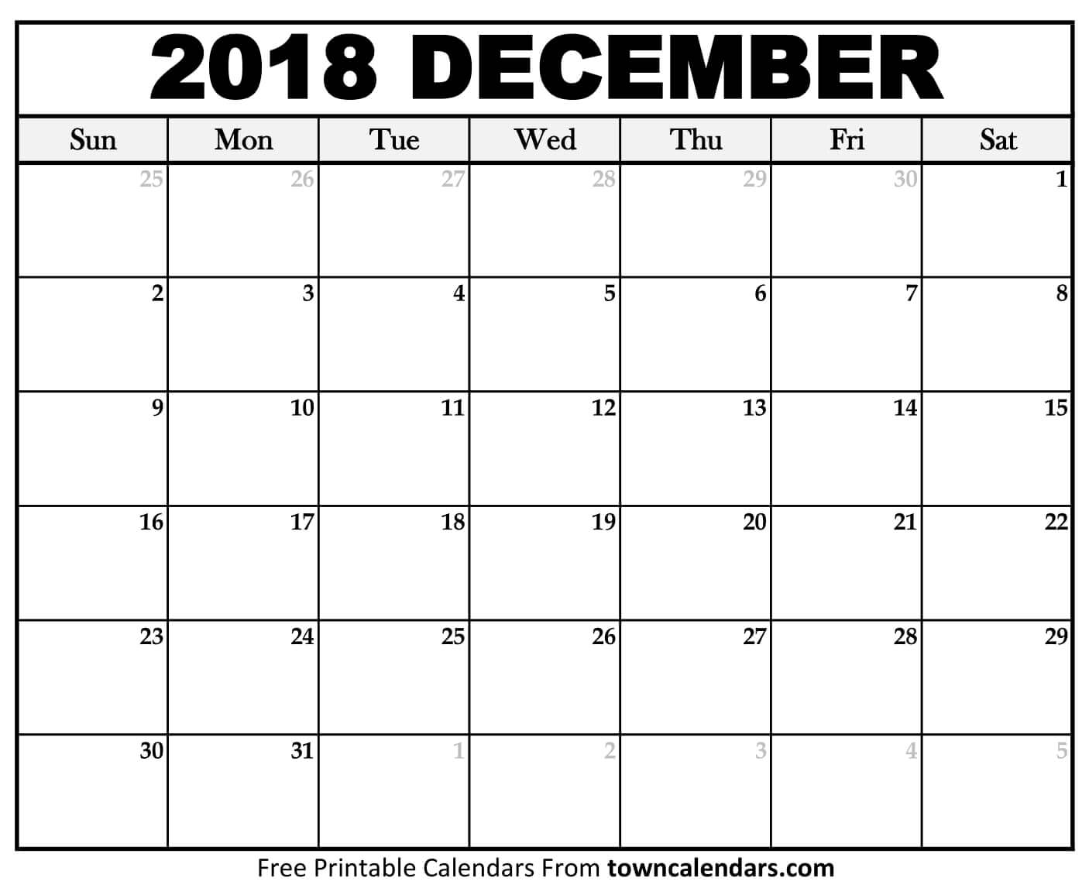


Dates
Y6
You have until the Friday 30th November to complete the poster and hand it to Miss Jones or one of us.
We are judging the winners on the Monday 3rd of December during our meeting .
And we will announce the winners in our next assembly.
The winner from each class will get 10 dojo points and a prize from Miss Jones.
The winning poster will be displayed around the school.

Slide 6

We hope you enjoyed our first assembly.

