Slide 1


Creative crew
Easter competition
@LPS

Slide 2
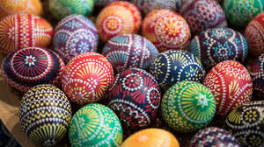

CREATIVE CREW EASTER COMPETITION
Creative Crew are inviting you to take part in an Easter art competition.

Slide 3
CREATIVE CREW EASTER COMPETITION
You have to design an Easter egg!
There will be 3 winners; first, second and third places!

Slide 4


CREATIVE CREW EASTER COMPETITION
Your entries have to be returned to Miss Evans or a member of the Creative Crew by
TUESDAY 9th APRIL!

Slide 5
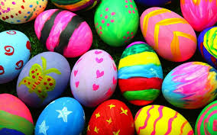


CREATIVE CREW EASTER COMPETITION
The winners will be announced on the last day of term which is Friday 12th April!

Slide 6



CREATIVE CREW EASTER COMPETITION
Your designs need to be bright and colourful!

Slide 7

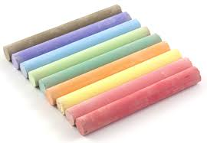
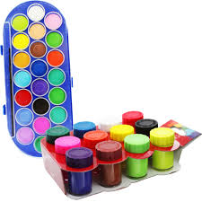

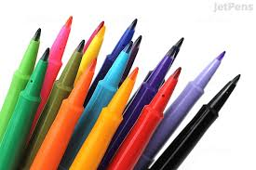
CREATIVE CREW EASTER COMPETITION
You can use any art material you like!

Slide 8
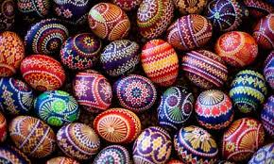

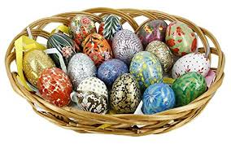
CREATIVE CREW EASTER COMPETITION
Your design must be 2D, not 3D!

Slide 9



CREATIVE CREW EASTER COMPETITION
Your design must be no bigger than A4!

Slide 10
CREATIVE CREW EASTER COMPETITION
You must remember to put your name and class on the back of your design!
We won’t be able to tell you you’ve won if you don’t!

Slide 11
CREATIVE CREW EASTER COMPETITION
Just to recap:
Your designs need to be bright and colourful!
You can use any art material!
Your design must be 2D!
It must be no bigger than A4!
Put your name and class on the back!
Please hand your entry to Miss Evans or a member of the Creative Crew by Tuesday 9th April!

Slide 12



CREATIVE CREW EASTER COMPETITION
Good Luck!

